Slide 1
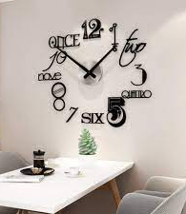
Present tense☺
present
Ind
cont.
fut.
fut. cont.
Topic from english grammer.
By: Amna

Slide 2
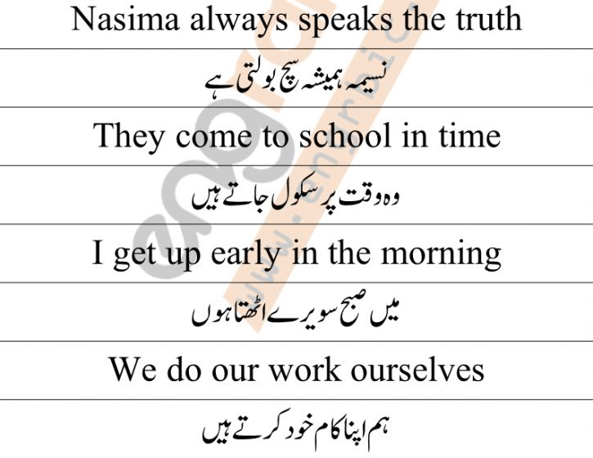
Present Indefinite Tense
Simple tense
Universal truths
Daily routine
Helping verb: do/does
s/es in case of singular noun

