Slide 1


Provide Insights to Management in Consumer Goods Domain
Presented By
AMNA KHURSHID

Slide 2




Agenda
Company Overview
Objective
The Data
Ad-Hoc Requests and Insights

Slide 3
Atliq Hardwares (imaginary company) is one of the leading computer hardware producers in India and well expanded in other countries too.
It has 74 customers in 27 countries along with Asia Pacific(APAC), Europe(EU),North America(NA) and Latin America(LA).
The company manufactures products in three major divisions namely personal computer(PC), peripherals and accessories(P&A), networking and storage(N&S).
They run their business on two platforms E-commerce and Brick & Mortar. They reach out the customer world through three channels Direct, Distributor and Retailer.
Company Overview

Slide 4
Objective
Assist the management team to get actionable insights about the business by solving ad-hoc requests.

Slide 5

The input data consists of sales data for fiscal year 2020-2021 along with other dimension table. Company’s fiscal year starts from 1st September and ends on 31st August.
The data set has 4 fact tables and 2 dimension tables :-
dim_customer: Contains customer related data.
dim_product: Contains product related data.
fact_gross_table: Contains gross price information for each product.
fact_manufacturing_cost: Contains data for cost incurred in production of each product.
fact_pre_invoice_deductions: Contains pre-invoice deductions information for each product.
fact_sales_monthly: Contains monthly sales data for each product.
The Data

Slide 6
Request 1
Request 2
Request 3
Request 4
Request 5
Request 6
Request 7
Request 8
Request 9
Request 10
Ad-hoc requests, results and insights

Slide 7
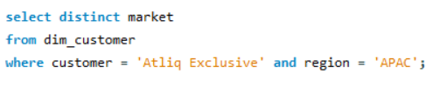
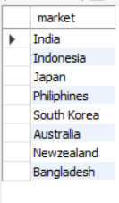
Request 1 :
Query:
Output:
Provide the list of markets in which customer "Atliq Exclusive" operates its
business in the APAC region.

Slide 8
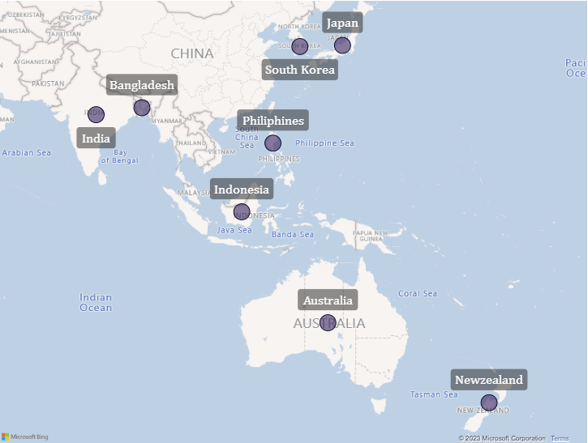
Insights:
Atliq exclusive operates it’s business in 8 markets(countries) across APAC region.
Atliq exclusive has max no. of markets in APAC region followed by EU(6), NA(2).
LATAM has no market share.

Slide 9
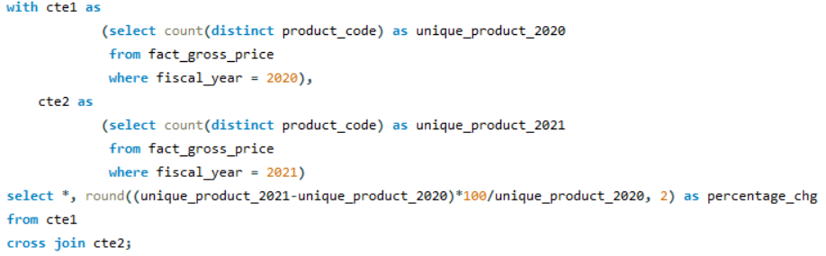

Query:
Output:
Request 2 :
What is the percentage of unique product increase in 2021 vs. 2020?
The final output contains these fields :
unique_products_2020
unique_products_2021
percentage_chg

Slide 10
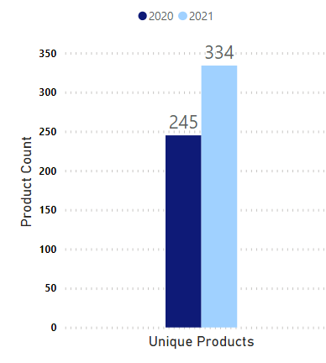
Insights:
There is a unique product increase of 36.33% in fiscal year 2020 to 2021.
This is a considerable increase and it can help Atliq to increase its customer base.
Being a covid affected time period it is a appreciated performance.

Slide 11
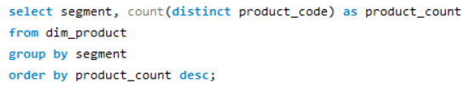
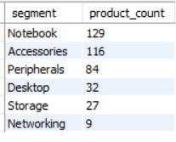
Query:
Request 3 :
Provide a report with all the unique product counts for each segment and
sort them in descending order of product counts.
The final output contains :
segment
product_count
Output:

Slide 12
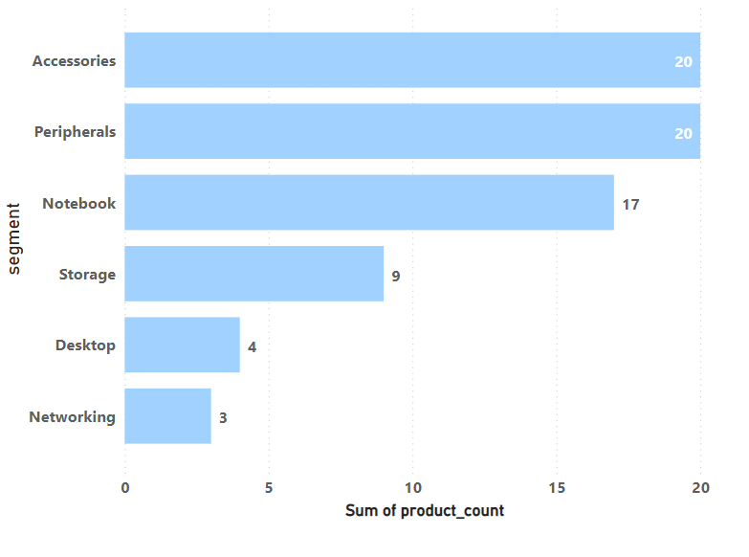
Insights:
Accessories and Peripheral segments have best unique product count. These segments may help in getting more sales as more products are there to choose from for customers.
Storage, Networking and Desktop segments need to increase their unique product counts.

Slide 13
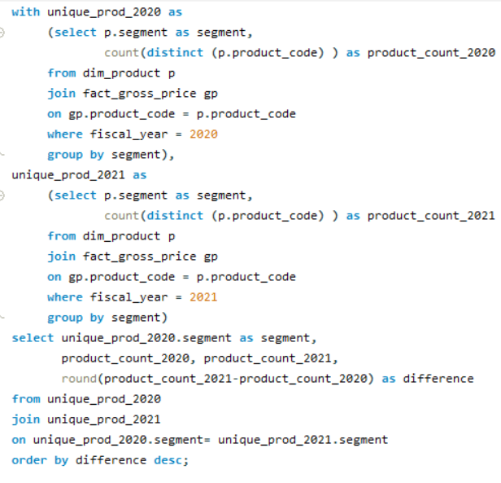
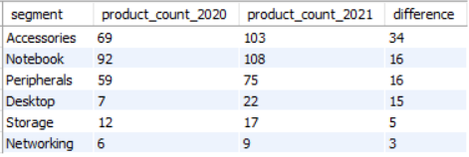
Query :
Request 4 :
Follow-up: Which segment had the most increase in unique products in
2021 vs 2020?
The final output contains these fields :
segment
product_count_2020
product_count_2021
difference
Output :

Slide 14
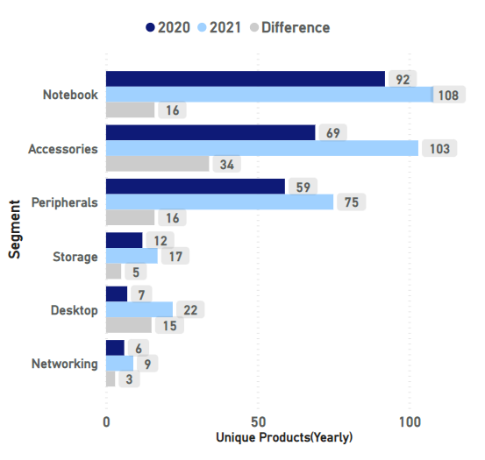
Insights :
Accessories segment topped in increasing the number of unique products from 2020 to 2021. A survey or questionnaire for end users could be organised to find the reason for this successful movement.
Storage and Networking segment were much below par in increasing number of unique products going to 2021. A survey or questionnaire for end users could be organised to find the reason for this decline.

Slide 15
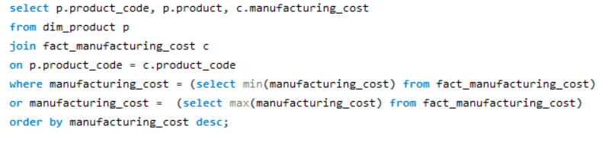

Request 5:
Query :
Get the products that have the highest and lowest manufacturing costs.
The final output should contain :
product_code
product
manufacturing_cost
Output :

Slide 16


Insights :
Highest Manufacturing cost
($240.5364)
Product : AQ HOME allin 1 Gen 2
Category : PC
Analysing deeper, the total manufacturing cost(for all quantities) incurred by Atliq is near about same, i.e. 5,99,231(single quantity cost * total quantity manufactured) and 5,51,054 for lowest manufacturing cost product and
highest manufacturing cost product
respectively.
Further analysing the sale data for both products. The AQ Master Wired x1 Ms (low manufacturing cost product) has given more profit to Atliq.
Lowest Manufacturing cost
($0.8920)
Product : AQ Master Wired x1 Ms
Category : Mouse

Slide 17
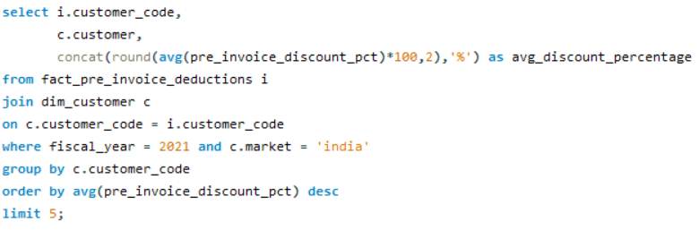
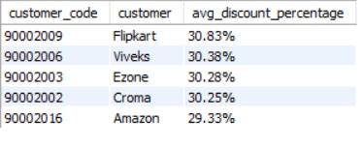
Query :
Request 6:
Generate a report which contains the top 5 customers who received an
average high pre_invoice_discount_pct for the fiscal year 2021 and in the
Indian market.
The final output contains :
customer_code
customer
average_discount_percentage
Output :

Slide 18
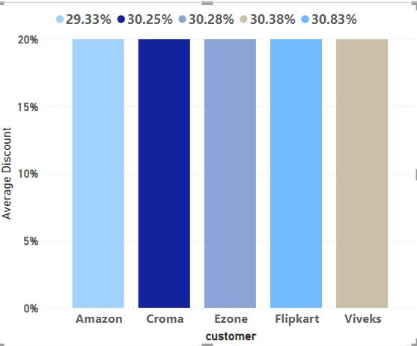
Insights :
All top 5 performers in pre_invoice_discounting belong to retail channel.
Analysing further, there is no pre_invoice_discounting data for customers belonging to distributor channel.
In direct channel, Atliq exclusive has very low pre_invoice discounting.
In conclusion, major business was done with retail channel. Atliq should take measures to increase business in other channels.

Slide 19
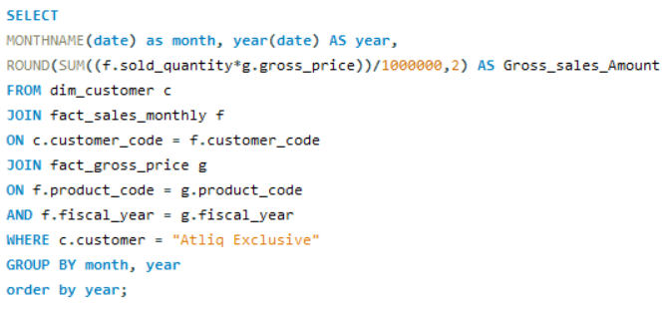
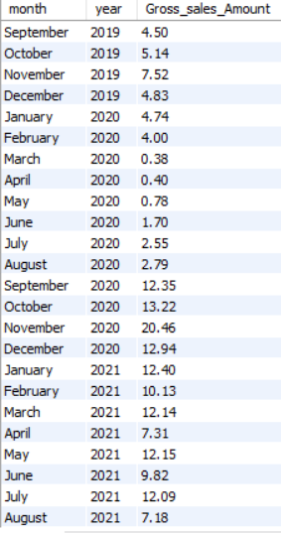
Query :
Request 7:
Get the complete report of the Gross sales amount for the customer “Atliq Exclusive” for each month . This analysis helps to get an idea of low and high-performing months and take strategic decisions.
The final report contains these columns :
Month
Year
Gross sales Amount
Output :

Slide 20
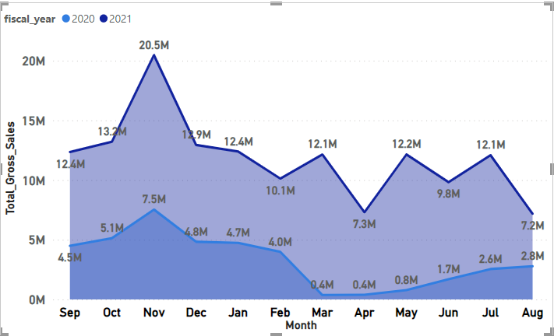
Insights :
We can break the sales graph for each year into 2 parts i.e. Sep-Jan and Feb-Aug.
Sep-Jan period is similar for both years. The important point here is shooting up of sales in Nov and then dropping. The reason cannot be festive season(Diwali, etc.) alone as the business operates in foreign countries also. Atliq needs to further gather data to analyse this key period.
Feb-Aug period for both years show sales struggling to get back on track.

Slide 21
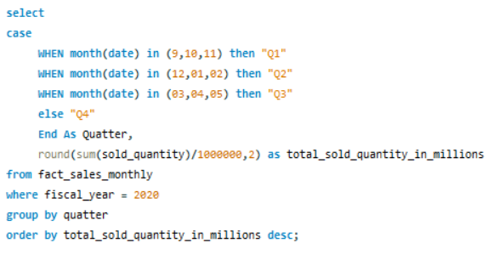
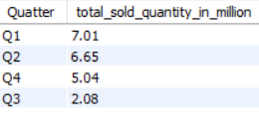
Request 8:
Query :
In which quarter of 2020, got the maximum total_sold_quantity?
The final output contains these fields sorted by the total_sold_quantity:
Quarter
total_sold_quantity
Output :

Slide 22
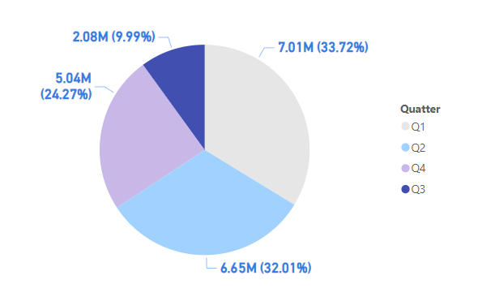
Insights :
Q1 showed the highest total sales and then it decline till Q3. Finally, the total sales showed some recovery in Q4.
The decline in total sales for Q2, Q3 is probably due Covid pandemic outbreak

Slide 23
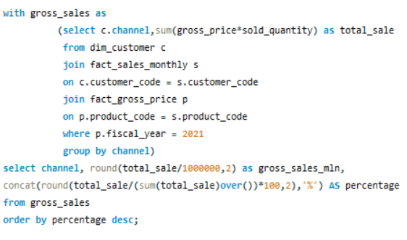
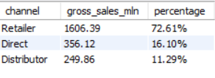
Request 9:
Query :
Which channel helped to bring more gross sales in the fiscal year 2021
and the percentage of contribution?
The final output contains :
channel
gross_sales_mln
percentage
Output :

Slide 24
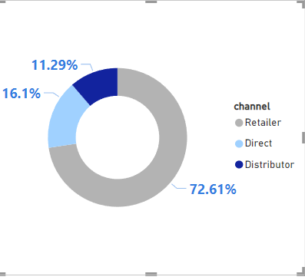
Insights :
Retail channel topped among getting most gross sales. So, more products have to be promoted and sold through this channel.
The performance of distributor channel was very poor. So, the company has to rethink about the distributor channel.
After further analysis, the distributor channel have less customer and market capture. While direct channel has better market capture even though their customer capture is less.
Covid has also affected distributor and sales got higher on ecommerce.

Slide 25
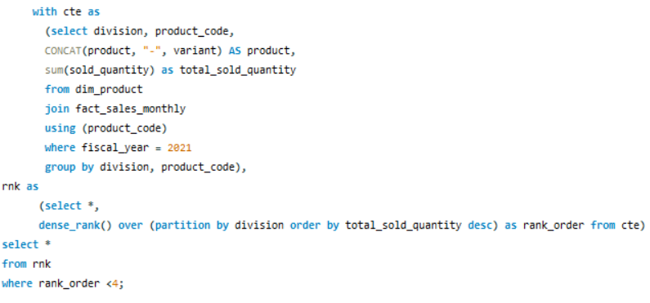
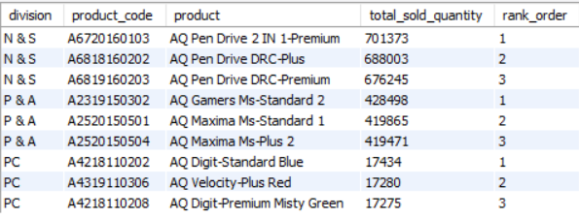
Query :
Request 10:
Get the Top 3 products in each division that have a high
total_sold_quantity in the fiscal_year 2021?
The final output contains :
division
product_code
Output :

Slide 26
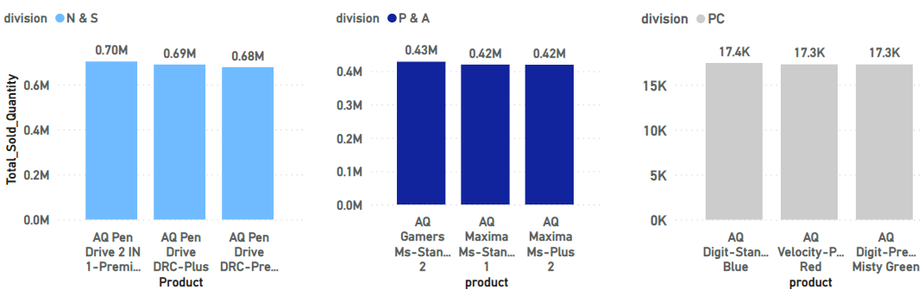
Insights :
All the products are performing neck to neck in their respective divisions.
The three divisions have products with different price ranges and hence the different sold quantities can be expected.

Slide 27
Thank You !

