Slide 1
eXD
NokriExtenddd
A Fake Job Detector for LinkedIn
Chrome Extension · Node.js / Express · PostgreSQL · Python / scikit-learn · Flask
Amna Mahboob (SP25-BED-015) · SEAL Lab Project Under Sir Bilal Khalid Dar
NokriExtenddd
01 / 10
Notes:
Good morning, everyone. My name is Amna Mahboob, and today I'll be presenting my project, NokriExtenddd, a fake job detector for LinkedIn.
It's a Chrome extension that automatically checks LinkedIn job postings for signs of fraud, right where you're already browsing.

Slide 2
eXD
WHY THIS EXISTS
Job seekers are the target of a growing scam economy
1
2
3
Students & early-career applicants are disproportionately targeted
Verifying a posting takes real effort
No at-a-glance trust signal exists today
Fake internship and entry-level job postings prey on people with the least experience spotting red flags.
Checking a company's legitimacy means leaving LinkedIn, searching separately, and cross-referencing — most people simply don't.
LinkedIn itself doesn't score postings for fraud risk — users are on their own.
The objective: give every job seeker an automatic, real-time trust signal on the LinkedIn posting they're already viewing — combining a trained ML model, a human-reviewed blacklist, and quick rule-based checks into one 0–100% score, with no extra research required.
NokriExtenddd
02 / 10
Notes:
Let me start with why this project matters and honestly, it started from something personal. When I was applying for jobs and internships myself, I had to do a lot of my own manual research just to check whether a posting was legitimate — and at one point, I very nearly applied to one that turned out to be a scam. That experience is really what pushed me to build this.
More broadly, fake job postings and internship scams are a real, growing problem — and the people most likely to fall for them are students and early-career job seekers, because they have the least experience spotting red flags.
Right now, if you want to check whether a company is legitimate, you have to leave LinkedIn, search separately, and cross-reference information yourself. Most people don't bother — they just apply, or worse, they get scammed, the same way I almost did.
And LinkedIn itself doesn't give you any kind of fraud score. There's no trust signal at all. So the objective of this project was simple: give every job seeker an automatic, real-time trust signal on the exact posting they're viewing — no extra research required.

Slide 3
eXD
SYSTEM CONFIGURATION
Seven small programs, working as one system
Chrome Extension (Manifest V3)
In-browser client — scrapes postings, injects the badge, provides popup & dashboard
Node.js + Express
Backend API — auth, scoring, quota, preferences, blacklist, saved jobs
PostgreSQL
Primary database for all persistent data
node-cron
Scheduled daily job — checks saved jobs for deadlines due tomorrow
Python + scikit-learn
Trains the fraud-detection logistic regression model
Flask
Small Python service — loads the trained model, serves predictions over HTTP
Google Colab
Environment where the model was originally trained
NokriExtenddd
03 / 10
Notes:
Before I get into how it works, let me quickly explain what the system is actually built from because it's not one program, it's seven small pieces working together, like a small team.
"There's the Chrome Extension — that's the part the user actually sees and interacts with in their browser. It reads the job posting and shows the result."
"Behind that is a backend server, built with Node.js — think of this as the 'brain' that receives information, makes decisions, and stores it. It talks to a database, PostgreSQL, which is just where all the information is permanently saved — user accounts, scores, saved jobs, and so on."
"For the actual fraud-detection intelligence, I trained a machine learning model in Python, and that model runs inside a small separate service called Flask, which the main backend talks to whenever it needs a prediction."
"One more thing worth saying directly: you won't see any hardware or hosting specifications on this slide, and that's on purpose, not something I forgot. This is a working prototype that runs entirely on my own laptop right now — none of it is deployed to a live server. Before something like this could go up on the Chrome Web Store, it still needs further refinement and a proper hosting setup, which is actually one of the next steps I'll come back to later."

Slide 4
eXD
HOW A SCREENING HAPPENS
Scrape → score → badge, in under two seconds
1
2
3
4
5
Content script scrapes 9 fields from the job posting
→
Node API checks the user's monthly quota first
→
Three checks run: ML model · blacklist · rule checks
→
Signals combine into one 0–100 fraud score + flags
→
Extension shows a color-coded Trust Score badge
Fraud Score = 0.6 × ML probability + 0.3 × blacklist match + 0.1 × rule-check score
Displayed to the user as a Trust Score (100 − fraud score), color-banded:
≥ 70% Likely Real
40–69% Use Caution
< 40% Likely Fake
NokriExtenddd
04 / 10
Notes:
"So how does this actually work end-to-end? When you open a job posting on LinkedIn, five things happen in under two seconds."
"First, the extension scrapes — meaning it reads — nine pieces of information off the page: job title, company, description, and so on."
"That information is sent to the backend, which first checks whether you've used up your monthly quota. If you're within your limit, it runs three checks at the same time: the machine learning model gives a fraud probability, a blacklist check sees if the company has already been flagged by other users, and a set of simple rule checks look for obvious red flags — like a missing job description."
"These three signals are combined using a weighted formula — you can see it here: sixty percent machine learning, thirty percent blacklist, ten percent rule checks."
[Point to the formula on screen]
"I weighted the machine learning model highest because it's the most sophisticated signal, but I didn't want to rely on it completely, since it was trained on a relatively small dataset — so the blacklist and rule checks act as a safety net."
"I also deliberately chose a traffic-light color scheme for the result — green, amber, red — because it's something everyone already reads instinctively. The amber 'use caution' band isn't just a middle option for looks — I put it there on purpose, to represent genuine uncertainty, so a borderline posting doesn't get forced into a falsely confident 'safe' or 'unsafe' label."
"That combined score becomes what the user sees as a Trust Score — a percentage from zero to a hundred, color-coded green, amber, or red, so it reads intuitively, like a battery indicator. I chose to show a Trust Score rather than the internal Fraud Score specifically because a higher number meaning better reads far more naturally to users than a higher number meaning worse."

Slide 5
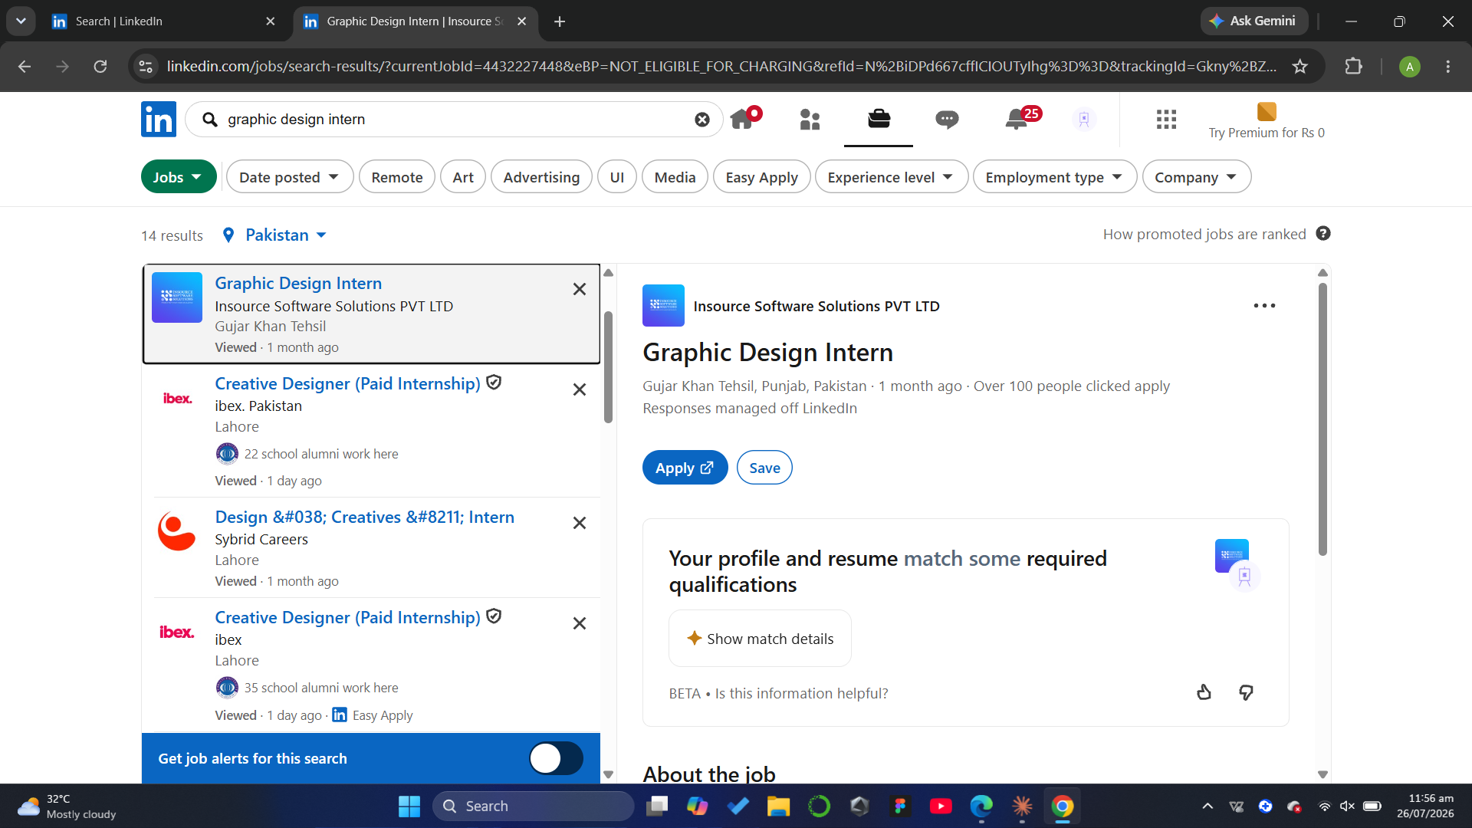
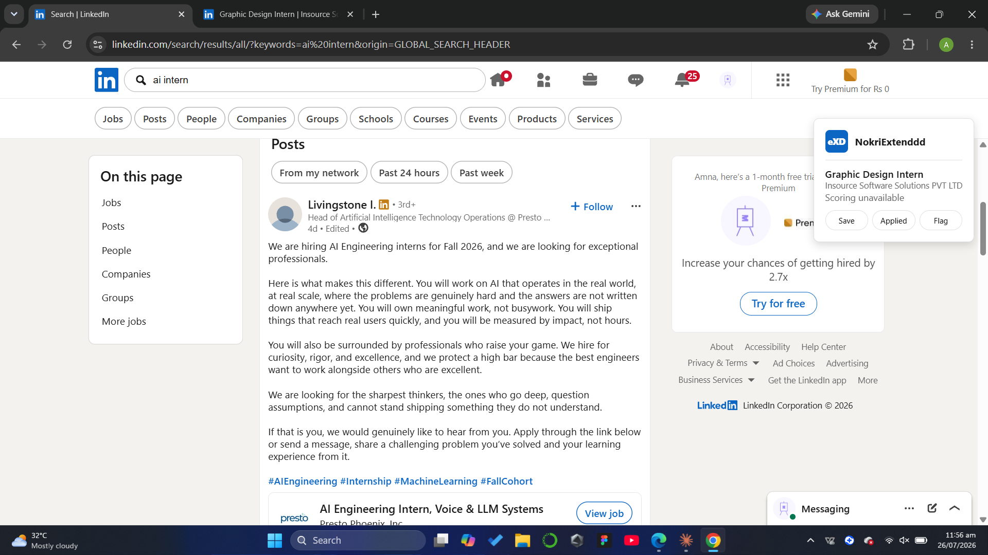
eXD
A HARD CONSTRAINT
The scraper works on structured job postings only
The extension reads named, structured DOM fields (title, company, description, location...) that only exist on LinkedIn's dedicated job posting pages. It cannot currently screen free-text hiring posts shared in the main feed — those have no structured fields to extract, and would require a fundamentally different technique (natural-language extraction, not DOM scraping).
SUPPORTED
NOT SUPPORTED
Structured job posting (/jobs/view/)
Free-text hiring post in the main feed
NokriExtenddd
05 / 10
Notes:
"One honest limitation I want to flag myself, rather than have it be found: this only works on structured job posting pages — the ones with a dedicated title, company, and description field, like this one on the left."
[Point to the green "SUPPORTED" screenshot]
"It can't yet screen free-text hiring posts people share in the main LinkedIn feed, like this one on the right. The reason comes down to how the page itself is built: LinkedIn's dedicated job pages have named, structured fields — a specific field for the title, one for the company, one for the description — so the extension can reliably reach in and grab exactly what it needs. A free-text feed post is just one big, unstructured block of text with no such labeled fields, so there's nothing consistent for it to grab onto."
"Extracting information from free-flowing text like that is a fundamentally different, harder technique than reading a structured page, and it's something I've listed as a next step."

Slide 6
eXD
THE FRAUD-DETECTION MODEL
Trained in Google Colab, ahead of the backend build
Dataset: 202 labeled postings · 10 columns · no missing values
Results on the 41-row test set
Feature engineering: 9 text fields joined → TF-IDF (max 500 features, English stop words removed)
0.758
F2 SCORE
Model: scikit-learn LogisticRegression (max_iter=1000), sklearn v1.6.1
Real postings (27)
Split: 80% / 20%, stratified, random_state=42 — 41 rows held out for testing
100% recall · 87% precision
Fake postings (14)
Evaluation: Confusion matrix + F2 score — weights recall higher, since missing a fake listing is worse than over-flagging a real one
71% recall (10/14 caught) · 100% precision
Overall accuracy
90%
Caveat: only 202 total rows — these numbers carry real statistical noise, which is why the ML signal is blended with the blacklist and rule checks rather than trusted alone.
NokriExtenddd
06 / 10
Notes:
"I trained it on 202 labeled job postings — meaning 202 real examples where I already knew which were real and which were fake. I combined the text fields from each posting and converted them into numbers the model could actually process, using a technique called TF-IDF."
"It's a way of turning words into numbers based on how important and how unusual they are in a piece of text — so words that show up in almost every posting, like 'the' or 'and,' get ignored, while distinctive words that might signal a scam get more weight."
"The model itself is a Logistic Regression — a well-established, simple algorithm that's good at yes/no style predictions, in this case, 'is this fake or not.' I didn't use deep learning because with only 202 examples, a more complex model would have just memorized the data rather than learned general patterns — that's called overfitting."
"I split the data eighty-twenty — eighty percent to train the model, twenty percent, or 41 postings, held back to test it fairly, on data it had never seen."
"To evaluate it fairly, I used something called a confusion matrix — basically a table comparing what the model predicted against what actually was true, so I could see exactly where it got things right or wrong, not just one overall percentage."
[Point to the results panel]
"On that held-out test set, it scored 0.758 on something called the F2 score. I specifically chose F2 instead of the more common F1 score, because in fraud detection, missing an actual fake posting is worse than occasionally over-flagging a real one — F2 puts more weight on catching fakes, even at the cost of some false alarms."
"It correctly caught 10 out of 14 fake postings, and correctly identified all 27 real postings, for 90% overall accuracy. But I want to be upfront: 202 rows is a small dataset, so these numbers carry real statistical noise — which is exactly why I didn't let the model act alone in the final scoring formula."

Slide 7
eXD
WHAT'S BUILT
All 11 spec requirements, plus four add add-ons
Scrape + score every posting (ML + blacklist + rules)
Centralized, human-reviewed company blacklist
Custom preference matching ( multiple saved profiles)
Tiered dashboard — aggregate stats vs. full history
200/month quota, enforced server-side
Behavior logging (apply / save)
On-page badge for every screened posting
Public blacklist page (scoped to logged-in users)
Real-time flags + Pro-only deadline reminders
Add-ons: Contact Us form · editable saved-job deadlines · about us page · basic tutorial on what the extension does
FREE
PRO
200 screenings/mo · 1 preference · aggregate dashboard
Unlimited screenings · 10 preferences · full history · deadline reminders
NokriExtenddd
07 / 10
Notes:
"Stepping back from the technical details — here's everything that actually got built. All eleven functional requirements from the original spec were completed, plus two extra features I added along the way: a Contact Us form, and an editable saved-jobs list with deadlines."
"The product also has a simple business model built in — a free tier with 200 screenings a month and one saved preference, and a Pro tier with unlimited screenings, ten saved preferences, and deadline reminders."
"Let me actually show you this live for a moment rather than just describe it."

Slide 8
eXD
DESIGN EVOLUTION
From a retro pixel-art badge to a LinkedIn-native look
BEFORE
AFTER
NOKRIEXTENDDD
eXD
NokriExtenddd
87%
87%
LIKELY REAL
Likely Real
Hard pixel borders · monospace type · stair-step shadows · dark navy “game UI” frame
Soft rounded cards · LinkedIn blue · percentage-based Trust Score · subtle shadows, no harsh borders
NokriExtenddd
08 / 10
Notes:
"Just briefly — the visual design went through a real evolution. It started as this retro, pixel-art, dark 'game UI' style badge on the left, and ended up here, on the right, matching LinkedIn's own blue, rounded, professional look — because the goal was for it to feel like it belongs on the page, not like a separate gadget bolted on."

Slide 9
eXD
WHAT WENT WRONG — AND WHY IT MATTERS
Three real bugs worth understanding
1
2
3
Brittle web scraping
Incomplete salary scraping
Silent timezone bug
LinkedIn's auto-generated CSS class names (e.g. “f18eb30d”) change on every deploy — sometimes between page loads of the same listing. The first scraper broke almost immediately. Fixed by matching on page structure and stable attributes instead of exact class names.
The salary field is pulled with a regex over free-text description content, so it only succeeds when a posting states pay in an anticipated format. Unusual phrasing or omitted salary correctly returns null — but this means salary is genuinely under-reported. Still unresolved.
PostgreSQL stored deadline dates correctly, but the Node driver's timezone conversion — and the return trip back to text — silently shifted saved deadlines back by a day. Invisible until specifically tested, and would have made reminders quietly never fire.
NokriExtenddd
09 / 10
Notes:
"First, brittle web scraping. LinkedIn auto-generates its CSS styling class names, and they change constantly — sometimes even between two loads of the exact same page in the exact same session, because they're generated fresh at build time rather than deliberately named. My first scraper broke almost immediately because it depended on one of those exact names, and hard-coding any specific class name was doomed to break sooner or later. I fixed it by matching on the structure of the page instead — for example, 'find the link that points to a job view URL' rather than 'find the element with this specific class name.' That's far more stable, because that structural pattern stays the same across LinkedIn's redesigns even when the styling underneath keeps changing."
"Second, salary scraping is still incomplete. I use a pattern-matching technique to pull salary numbers out of free text, and it only works when the posting states salary in a format I anticipated. This is a genuine, unresolved limitation I'm carrying forward as a next step, not something I'm hiding."
"Third — and this one taught me the most — a silent timezone bug. Saved deadlines were quietly shifting back by one day. To explain a bit more: PostgreSQL was storing the date correctly, but the problem was in the middle layer — the Node.js database driver automatically converts date values based on a timezone when it reads them out of the database, and again when it sends them back out as text, and those two conversions together quietly pushed the date back by a full day. There was no crash and no error message anywhere — the data always looked technically valid on the surface — so this could easily have shipped exactly like that, and I'd have had no idea until a reminder simply failed to fire on the wrong day."

Slide 10
Next Steps
What moves this from prototype to product
Build a 1M+ row labeled dataset
Detect “is this a job post at all” first
Manually label a far larger set of real and fake postings to retrain the model well past today's 202-row prototype scale.
Add a classification step ahead of fraud scoring so the system can eventually screen general feed content, not just structured job pages.
Refine the formula against research literature
Fix the known scraping gaps
Review published job-fraud-detection research to validate or adjust the current 0.6 / 0.3 / 0.1 weighting, rather than relying on an educated guess.
Resolve salary under-reporting and continue hardening the scraper against LinkedIn layout changes.
Move off localhost
Wire up real email delivery
Choose a hosting provider, enable HTTPS, and prepare the Chrome Web Store submission + privacy policy.
Integrate Nodemailer or SendGrid so deadline reminders and Contact Us messages actually reach people.
NokriExtenddd
10 / 10
Notes:
"Looking ahead, the clearest next steps are: building a much larger labeled dataset — well beyond 202 rows — retraining the model on it, extending the system to eventually handle free-text feed posts, fixing the salary-scraping gap, and — as I mentioned earlier — finally moving this off my laptop onto real hosting with HTTPS and a proper email service, so reminders and contact messages actually reach people and it's ready for something like the Chrome Web Store."
"That's NokriExtenddd — thank you. I'm happy to answer any questions."

