Slide 1


Slide 2
CHAPTER 22
Database Recovery Techniques

Slide 3
22.1 Recovery Concepts
Recovery process restores database to most recent consistent state before time of failure
Information kept in system log
Typical recovery strategies
Restore backed-up copy of database
Best in cases of extensive damage
Identify any changes that may cause inconsistency
Best in cases of noncatastrophic failure
Some operations may require redo

Slide 4
The log is kept on disk start_transaction(T): This log entry records that transaction T starts the execution.
read_item(T, X): This log entry records that transaction T reads the value of database item X.
write_item(T, X, old_value, new_value): This log entry records that transaction T changes the value of the database item X from old_value to new_value. The old value is sometimes known as a before an image of X, and the new value is known as an afterimage of X.
commit(T): This log entry records that transaction T has completed all accesses to the database successfully and its effect can be committed (recorded permanently) to the database.
abort(T): This records that transaction T has been aborted.

Slide 5
Recovery Concepts (cont’d.)
Deferred update techniques
Do not physically update the database until after transaction commits
Undo is not needed; redo may be needed
Immediate update techniques
Database may be updated by some operations of a transaction before it reaches commit point
Operations also recorded in log
Recovery still possible

Slide 6
Recovery Concepts (cont’d.)
Undo and redo operations required to be idempotent
Executing operations multiple times equivalent to executing just once
Entire recovery process should be idempotent
Caching (buffering) of disk blocks
DBMS cache: a collection of in-memory buffers
Cache directory keeps track of which database items are in the buffers
Notes:
The UNDO and REDO operations are required to be idempotent—that is, executing an operation multiple times is equivalent to executing it just once. In fact, the whole recovery process should be idempotent because if the system were to fail during the recovery process, the next recovery attempt might UNDO and REDO certain write_item operations that had already been executed during the first recovery process. The result of recovery from a system crash during recovery should be the same as the result of recovering when there is no crash during recovery!

Slide 7
Recovery Concepts (cont’d.)
Cache buffers replaced (flushed) to make space for new items
Dirty bit associated with each buffer in the cache
Indicates whether the buffer has been modified
Contents written back to disk before flush if dirty bit equals one
Pin-unpin bit
Page is pinned if it cannot be written back to disk yet
Notes:
Another bit, called the pin-unpin bit, is also needed—a page in the cache is pinned (bit value 1 (one)) if it cannot be written back to disk as yet. For example, the recovery protocol may restrict certain buffer pages from being written back to the disk until the transactions that changed this buffer have committed.

Slide 8
Recovery Concepts (cont’d.)
Main strategies
In-place updating
Writes the buffer to the same original disk location
Overwrites old values of any changed data items
Shadowing
Writes an updated buffer at a different disk location, to maintain multiple versions of data items
Not typically used in practice
Before-image: old value of data item
After-image: new value of data item
Notes:
Two main strategies can be employed when flushing a modified buffer back to disk. The first strategy, known as in-place updating, writes the buffer to the same original disk location, thus overwriting the old value of any changed data items on disk. Hence, a single copy of each database disk block is maintained. The second strategy, known as shadowing, writes an updated buffer at a different disk location, so multiple versions of data items can be maintained, but this approach is not typically used in practice.

Slide 9
Recovery Concepts (cont’d.)
Write-ahead logging
Ensure the before-image (BFIM) is recorded
Appropriate log entry flushed to disk
Necessary for UNDO operation if needed
UNDO-type log entries
REDO-type log entries
Notes:
When in-place updating is used, it is necessary to use a log for recovery. In this case, the recovery mechanism must ensure that the BFIM of the data item is recorded in the appropriate log entry and that the log entry is flushed to disk before the BFIM is overwritten with the AFIM in the database on disk. This process is generally known as write-ahead logging.
A REDO-type log entry includes the new value (AFIM) of the item written by the operation since this is needed to redo the effect of the operation from the log (by setting the item value in the database on disk to its AFIM).
The UNDO-type log entries include the old value (BFIM) of the item since this is needed to undo the effect of the operation from the log (by setting the item value in the database back to its BFIM).
In an UNDO/REDO algorithm, both BFIM and AFIM are recorded into a single log entry.

Slide 10
Recovery Concepts (cont’d.)
Steal/no-steal and force/no-force
Specify rules that govern when a page from the database cache can be written to disk
No-steal approach
Cache buffer page updated by a transaction cannot be written to disk before the transaction commits
Steal approach
Recovery protocol allows writing an updated buffer before the transaction commits
Notes:
If a cache buffer page updated by a transaction cannot be written to disk before the transaction commits, the recovery method is called a no-steal approach. The pin-unpin bit will be set to 1 (pin) to indicate that a cache buffer cannot be written back to disk.
On the other hand, if the recovery protocol allows writing an updated buffer before the transaction commits, it is called steal.
Steal is used when the DBMS cache (buffer) manager needs a buffer frame for another transaction and the buffer manager replaces an existing page that had been updated but whose transaction has not committed.
The no-steal rule means that UNDO will never be needed during recovery, since a committed transaction will not have any of its updates on disk before it commits

Slide 11
Recovery Concepts (cont’d.)
Force approach
All pages updated by a transaction are immediately written to disk before the transaction commits
Otherwise, no-force
Typical database systems employ a steal/no-force strategy
Avoids need for very large buffer space
Reduces disk I/O operations for heavily updated pages

Slide 12
Recovery Concepts (cont’d.)
Write-ahead logging protocol for recovery algorithm requiring both UNDO and REDO
BFIM of an item cannot be overwritten by its after image until all UNDO-type log entries have been force-written to disk
Commit operation of a transaction cannot be completed until all REDO-type and UNDO-type log records for that transaction have been force-written to disk

Slide 13
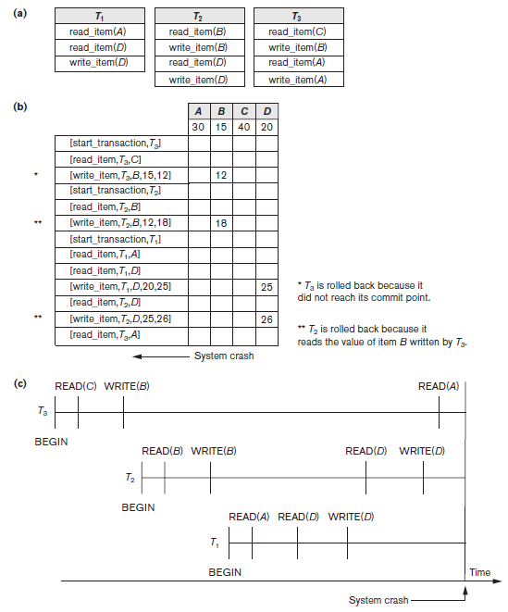
Figure 22.1 Illustrating cascading rollback (a process that never occurs
in strict or cascadeless
schedules) (a) The read and write operations of three transactions (b) System log at point of crash (c) Operations before the crash

Slide 14
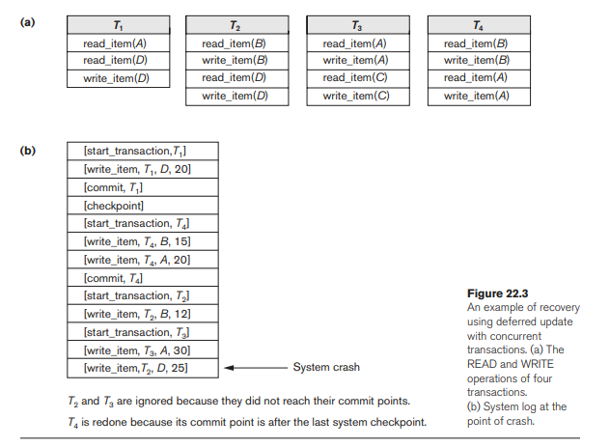

Slide 15
Checkpoints in the System Log and Fuzzy Checkpointing
Taking a checkpoint
Suspend execution of all transactions temporarily
Force-write all main memory buffers that have been modified to disk
Write a checkpoint record to the log, and force-write the log to the disk
Resume executing transactions
DBMS recovery manager decides on checkpoint interval

Slide 16
Checkpoints in the System Log and Fuzzy Checkpointing (cont’d.)
Fuzzy checkpointing
System can resume transaction processing after a begin_checkpoint record is written to the log
Previous checkpoint record maintained until end_checkpoint record is written

Slide 17
Transaction Rollback
Transaction failure after update but before commit
Necessary to roll back the transaction
Old data values restored using undo-type log entries
Cascading rollback
If transaction T is rolled back, any transaction S that has read value of item written by T must also be rolled back
Almost all recovery mechanisms designed to avoid this

Slide 18
Transactions that Do Not Affect the Database
Example actions: generating and printing messages and reports
If transaction fails before completion, may not want user to get these reports
Reports should be generated only after transaction reaches commit point
Commands that generate reports issued as batch jobs executed only after transaction reaches commit point
Batch jobs canceled if transaction fails

