Slide 1


Cover Page
Role of Different Organizations in STEM Education For Kids
Presented By
Subhana Shoukat

Slide 2
Technobots53
SPIKE Prime Kit=>Lego bricks & elements
LEGO WeDo 2.0 kits
Drone Dreybots=>Program Drones through block coding

Slide 3

SPIKE Prime Kit
STM32F413 microcontroller.
Sensors: Color Sensor, Distance Sensor, and Force Sensor.
Motors: Two Large Angular Motors and one Medium Angular Motor.
Building Elements: LEGO Technic™ beams, connectors, gears, axles, and wheels.
Cables: For connecting components.
Storage Box: With sorting trays for organization.

Slide 4
AceLabs
Dexter Smart Programmable Robot
Electric Explorers Activity Box (20+ Projects)
FUNKAAR Creative Tinkerer Kit (35 projects)
Magnet Lab STEM Kit (12 Experiments)
Young Inventors Kit (40+ Projects)

Slide 5

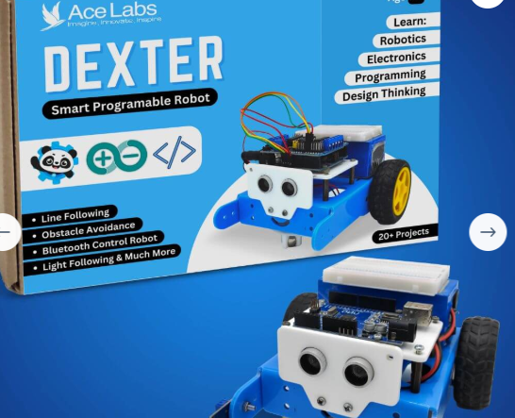
DEXTER

Slide 6
ComPONENTS LIST (DEXTER)
Arduino
Motor Driver
Ultrasonic Sensor HC-SR04. Motors & Wheels
Power SourceBattery
Chassis & FrameAcrylic
Connecting WiresJumper Wires
Additional Components IR Sensor, Buzzer / LEDs

Slide 7
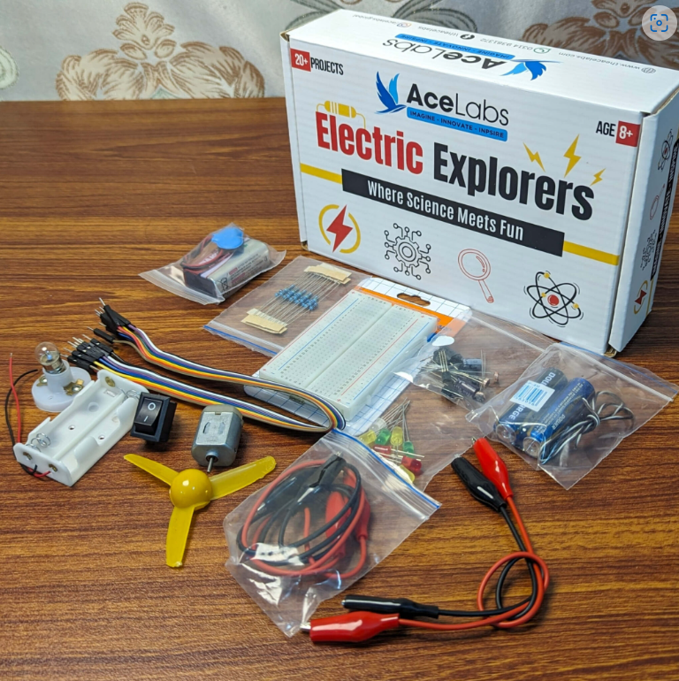
Electric Explorers

Slide 8
Project LIST (Electric Explorer)
Light Tracker
Smart Night Lights
Salt-Water Experiment
Gates
Fan Circuits
Sun Rise Alarms

Slide 9
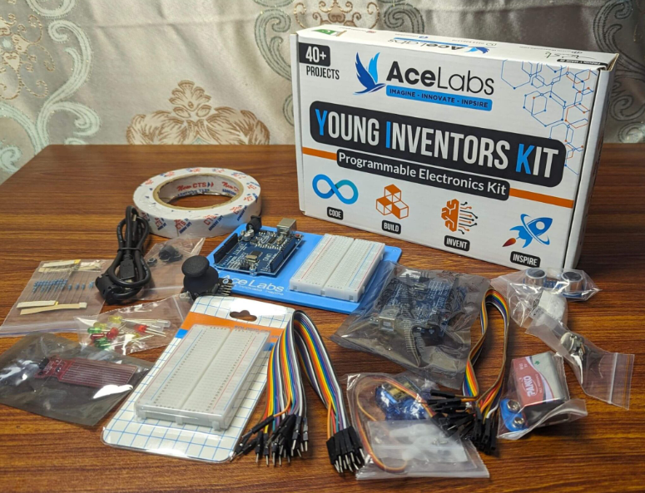
Young Inventors Kit

Slide 10
ProjecT List
Twilight Tune Box
Traffic Light
Distance Sensor
Sunrise Alarm
Water Level Alarm
Arduino Joy-Stick
Smart Night Light
Light Tracker

Slide 11
TheSTEMpedia
Evive Starter Kit
Quarky Kit

Slide 12
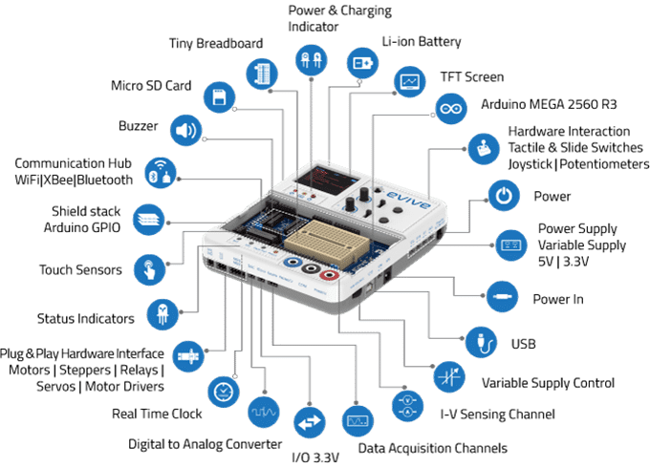
ROBOTS COLORING BOOK - PICTURE 2
Evive

Slide 13
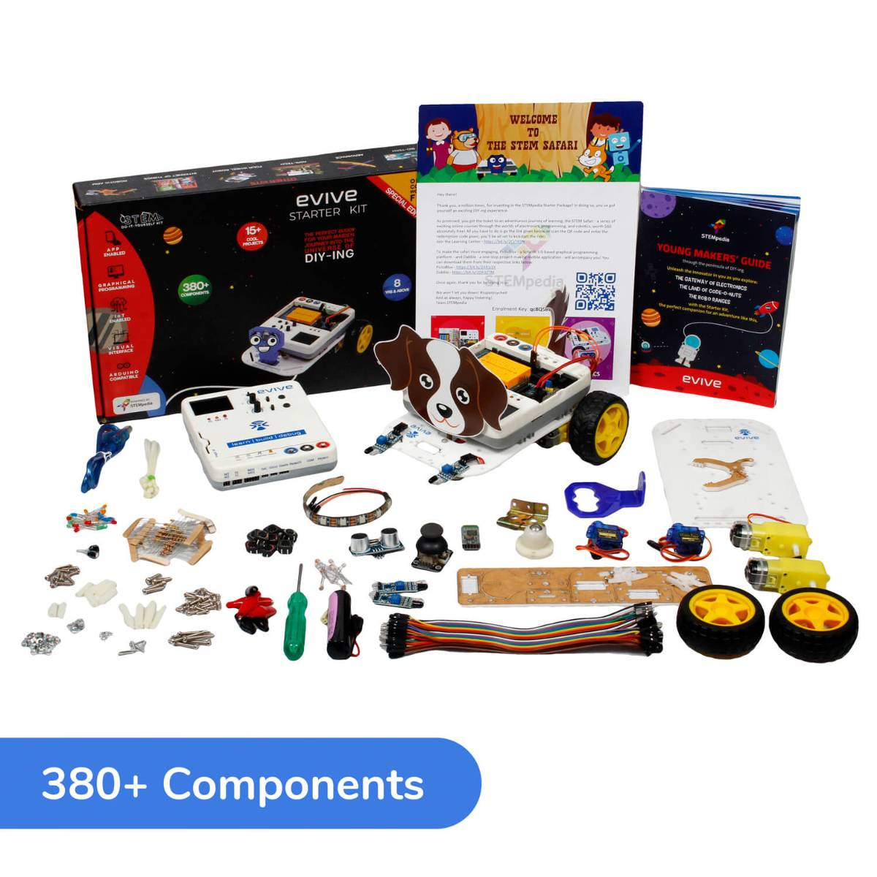
COMPONENTS OF Evive KIT

Slide 14
ProJECTS LIST (evive starter kit)
Games on Scratch using Buttons on Evive
Capacitive Touch Input
Mobile Robot with JoyStick Control
Bluetooth Controlled Mobile Robot
Auto-Railway Crossing Using Ultrasonic Sensor
Line Following

Slide 15
ProjectS LIST CONT…
Time Period of a Pendulum
Visualizing EMF Generation
Obstacle Avoidance / Robot Balloon Pop battle
Programmable Timer

Slide 16
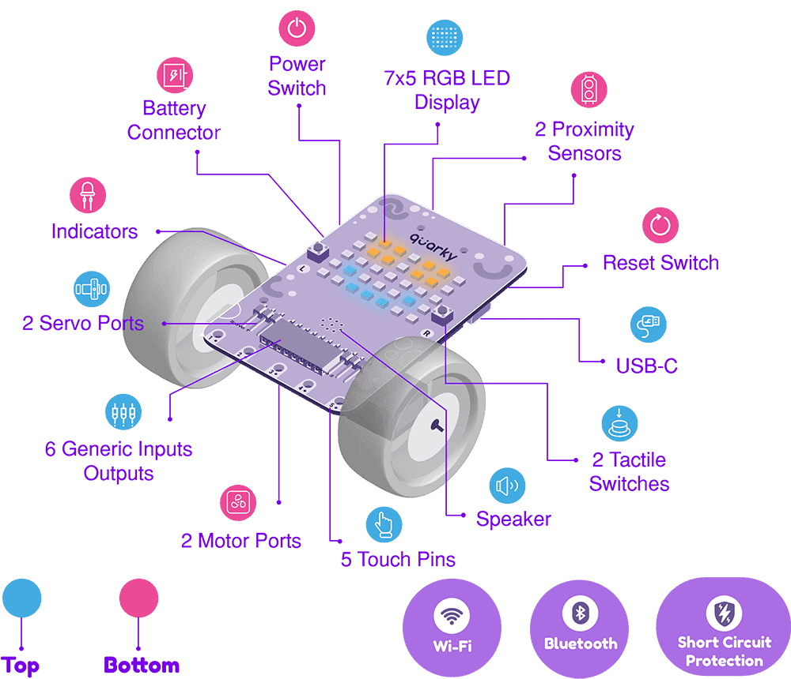
ROBOTS COLORING BOOK - PICTURE 2
QUARKY

Slide 17
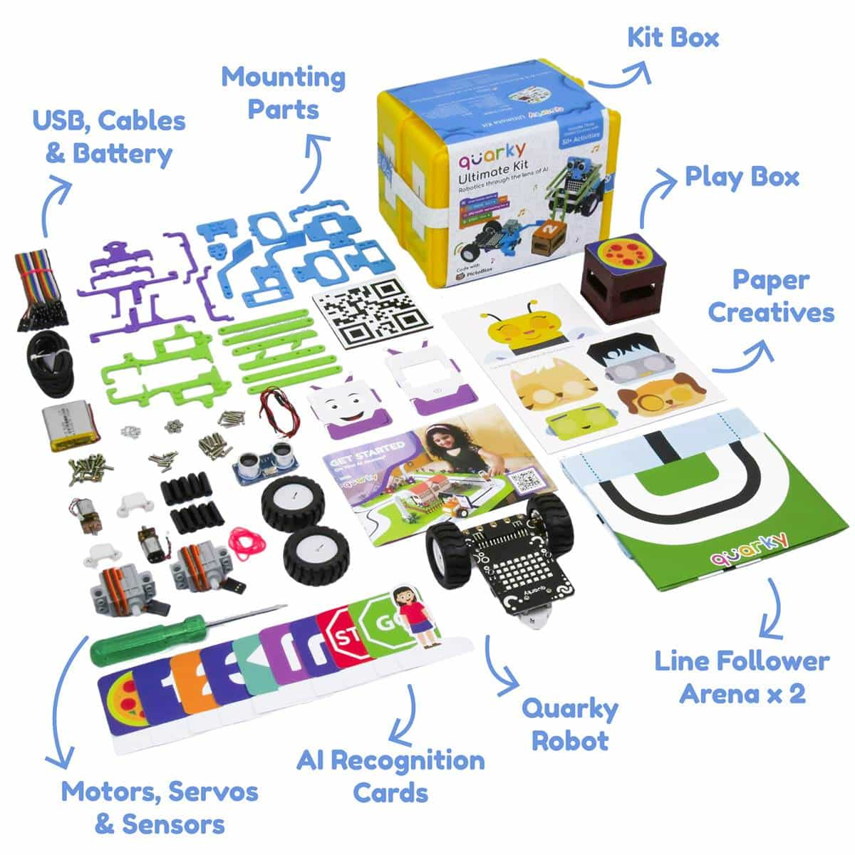
COMPONENTS OF QUARKY KIT

Slide 18
Makeblock
mBot Series
Codey Rocky
Makeblock Neuron
Cyber Pi

Slide 19
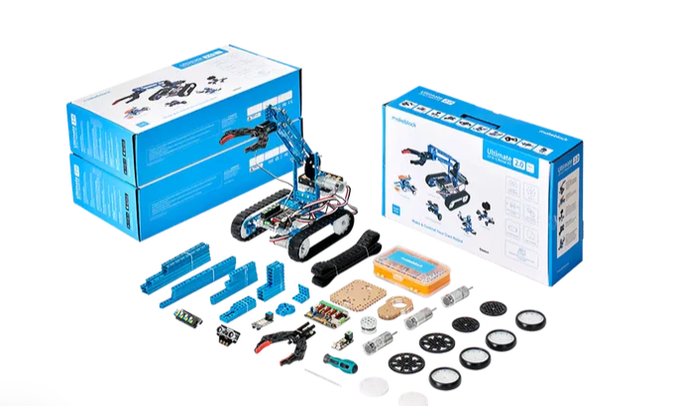
mBot Ultimate

Slide 20
ProjecT List
Rolling tank
Detecting robot
Robotic arm
Tech robotic ant
Self balancing robot
Camera dolly
3D capture

Slide 21
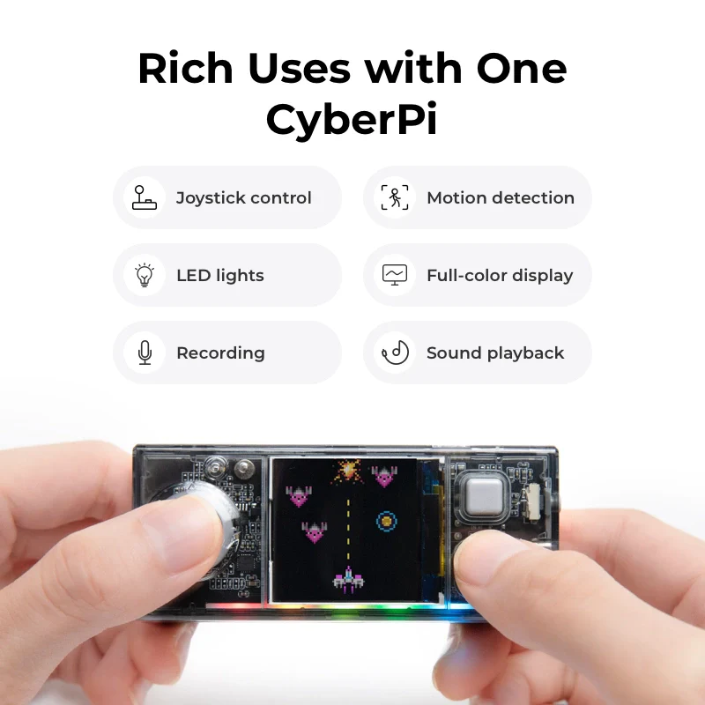
Cyber Pi
Notes:
(10+ Sensors)
ESP32-WROVER-B

Slide 22
ProjecT List
Steps Counter
Smart Trash bin
Scratch Games
Oscilating Fan
Auto Driving Car

