Slide 1
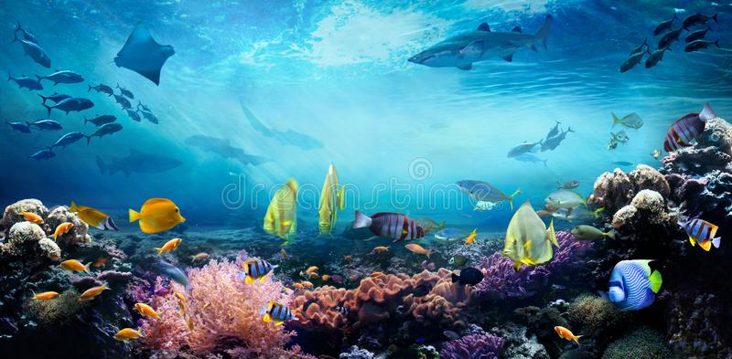
Color Balance and Fusion for Underwater Image Enhancement
Presented By
AMNA SHAKEEL

Slide 2
Introduction
We introduce an effective technique to enhance the images captured underwater that are degraded due to the medium scattering and absorption.
It does not require specialized hardware or knowledge about the underwater conditions.
Enhance a wide range of underwater images (e.g. different cameras, depths, light conditions) with high accuracy
Recover important faded features and edges.
Our enhanced images and videos are characterized by better exposedness of the dark regions, improved global contrast, and edges sharpness.

Slide 3
Related work:
Using Specialized Hardware
The divergent-beam underwater Lidar imaging (UWLI) system [10] uses an optical/laser-sensing technique to capture turbid underwater images. Unfortunately, these complex acquisition systems are very expensive, and power consuming.
Polarization-based Methods
These approaches use several images of the same scene captured with different degrees of polarization, as obtained by rotating a polarizing filter fixed to the camera. polarization techniques are not applicable to video acquisition.
Dark Channel Prior (DCP)
Recently, several algorithms that specifically restore underwater images based on Dark Channel Prior (DCP) have been introduced. The DCP has initially been proposed for outdoor scenes dehazing.

Slide 4
Applications:
Inspection of underwater infrastructures
Detection of man made objects
Control of underwater vehicles
Marine biology research
Marine cables
Archeology

Slide 5
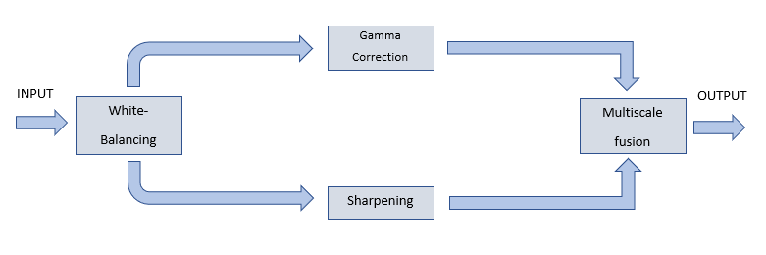
Workflow

Slide 6
White Balancing :
White balance (WB) is the process of removing unrealistic color casts, so that objects which appear white in person are rendered white in our photo.
important problem is the green-bluish appearance that needs to be rectified.
Gray world algorithm
To compensate for the loss of red channel, we build on the four following observations/principles:
The green channel is relatively well preserved under water, compared to the red and blue ones.
we compensate the red attenuation by adding a fraction of the green channel to red.
All the channels have same mean value.
Avoid the reddish introduced by the Gray-World algorithm in the over-exposed regions appearance .

Slide 7
Steps:
1: Converting RGB image into grey scale image.
2: Extract the individual red, green, and blue color channels.
3: Taking mean of R,G,B and Grey channel
4: Make all channels have the same mean
5: Red Channel and Blue Channel Correction
6: Recombine separate color channels into a single, true color RGB image :

Slide 8
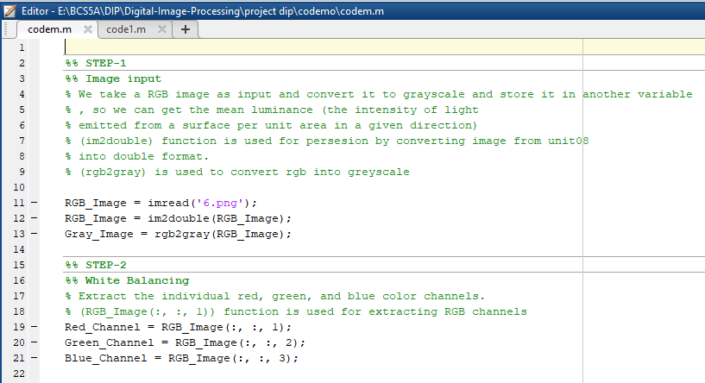
Code:

Slide 9
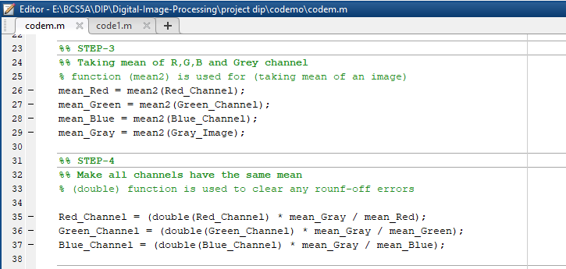
Code:

Slide 10
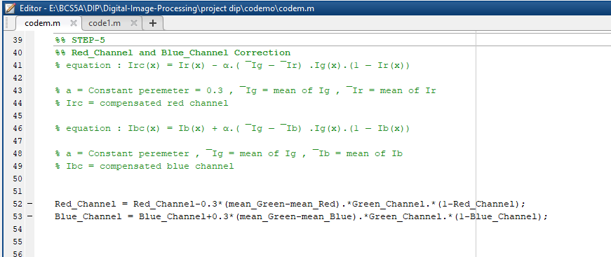
Code:

Slide 11
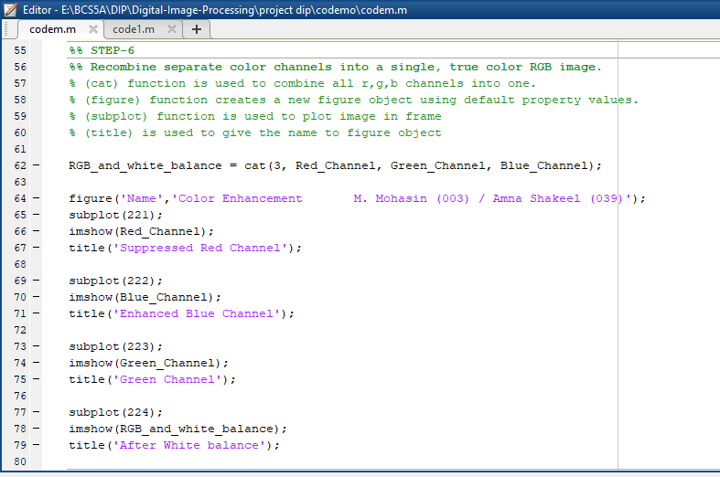
Code:

Slide 12
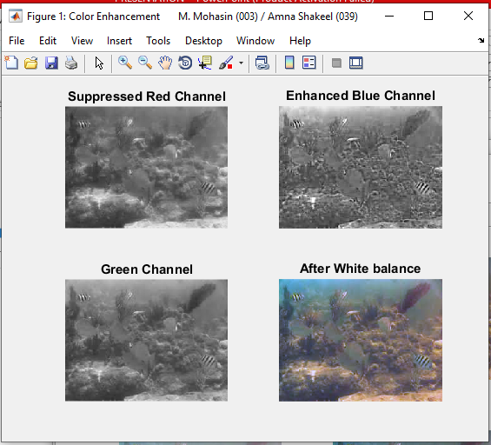
Output:

Slide 13
Gamma Correction :
Gamma correction controls the overall brightness of an image. Images which are not properly corrected can look either bleached out, or too dark.
Gamma correction aims at correcting the global contrast and is relevant since, in general, white balanced underwater images tend to appear too bright. This correction increases the difference between darker/lighter regions at the cost of a loss of details in the under-/over-exposed regions.
function:-
I = imadjust(rgbImage_white_balance,[],[],0.5);

Slide 14
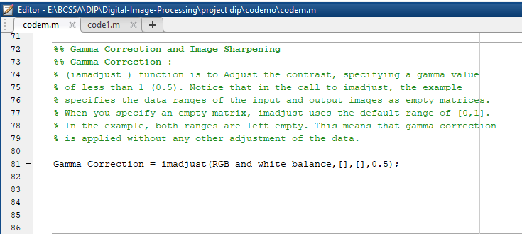
Code:

Slide 15
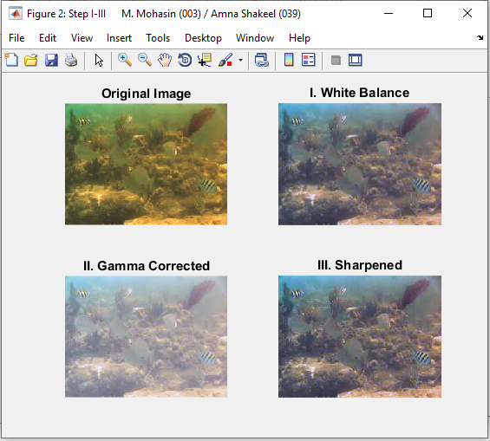
Output:

Slide 16
Sharpening
Image sharpening refers to any enhancement technique that highlights edges and fine details in an image.
Image sharpening is widely used in printing and photographic industries for increasing the local contrast and sharpening the images.
Sharpening images increases the contrast along the edges where different colors meet.
Unsharp masking:
An image is sharpened by subtracting a blurred (unsharp) version of the image from itself. Do not be confused by the name of this filter: an unsharp filter is an operator used to sharpen an image.

Slide 17
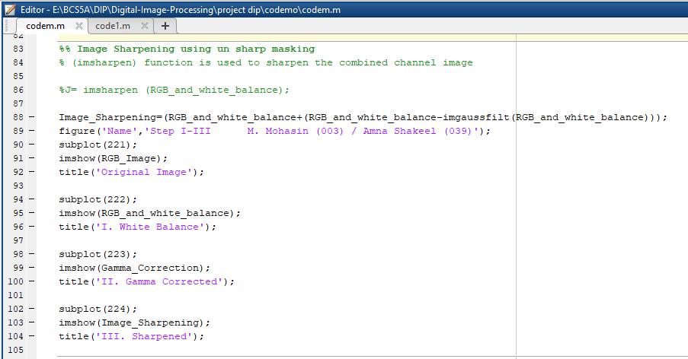
Code:

Slide 18
Output:

Slide 19
Multi-Scale Fusion :
Image fusion is the combination of two or more images.
retaining the important features from each of the original images.
in order to obtain a more accurate, more comprehensive, more reliable image description of the same scene.
Image Fusion using wavelet transform.
In MATLAB we can directly use the function wfusimg () to achieve the image fusion
xfus = wfusimg(x1,x2,wname,level,afusmeth,dfusmeth)

Slide 20
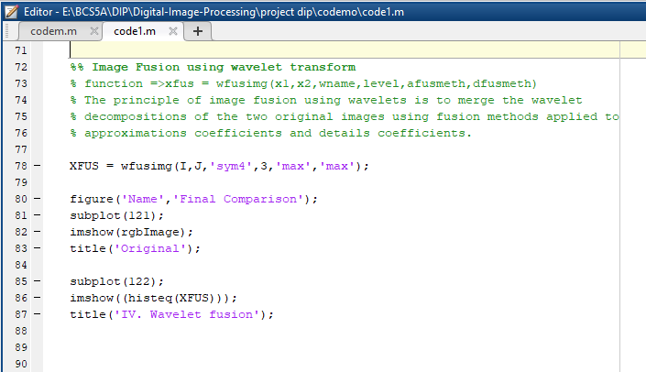
Code:

Slide 21
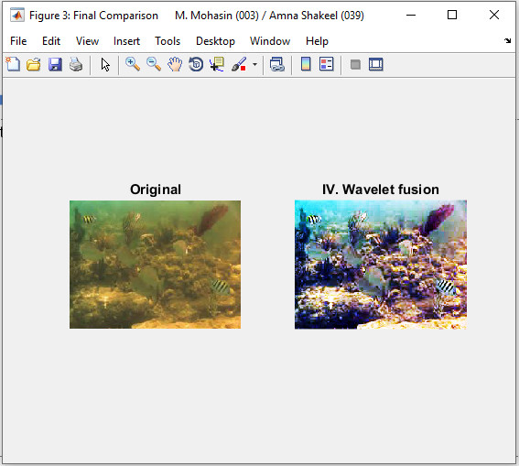
Final Result

Slide 22
Conclusion:
We introduce an effective technique to enhance the images captured underwater that are degraded due to the medium scattering and absorption.
our enhanced images and videos are characterized by better exposedness of the dark regions, improved global contrast, and edges sharpness.

