Slide 1

Number Plate Recognition
AMNA SHAKEEL

Slide 2

Contents
Introduction
WorkFlow
Code
Output
Summary

Slide 3
Introduction
Automatic Number Plate Recognition (ANPR) is one of the technologies employed in Intelligent Transportation Systems.
This system is provided with vehicle images and it would segment the number plate from the image using image processing techniques.
Also it recognises the Alphanumeric characters in that particular number plate.
This type of system is widely used in Traffic control areas, tolling, parking area, Security System etc.

Slide 4
Why Did we select this Project?
To Prevent the smuggling of cars.
For the Identification of stolen cars.
Usage of cars in illegal Activities.
Identification of invalid License plates.

Slide 5
Various Names For this Technique:-
Various names of same this technologies are following Down:-
License plate Recognition(LPR)
Intelligent Transport System(ITS)
Car Registration System(CRS)

Slide 6
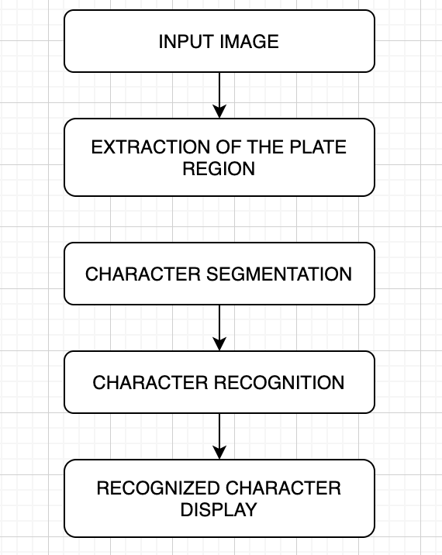
Flow Daigram

Slide 7
Workflow
The ANPR process typically involves three stages:
Plate detection
Plate segmentation
Character recognition
The ability of the algorithm to detect the plate depends on the Plate Detection Stage as a failure at this stage immediately means complete failure of the algorithm.
After the Plate is recognized and detected all the alphanumeric characters are to be extracted from that particular number plate so we segment each character region from our number plate and pass it to our template in order to match that character.

Slide 8
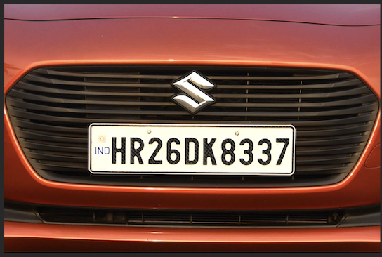
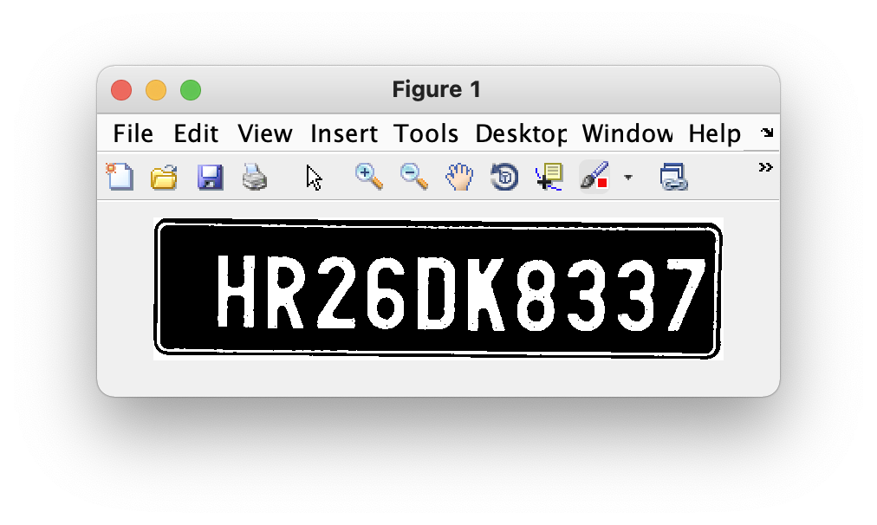
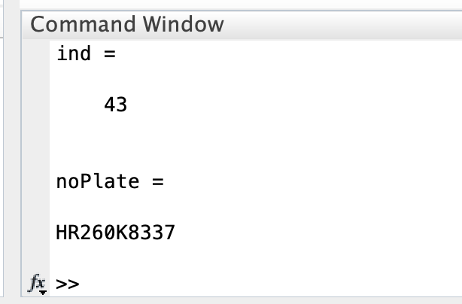
Workflow
Input Image
Extraction of Number Plate Region
Letters Detection

Slide 9
Code
Code for our system is divided into three files
Plate Detection
Letter Detection
Template Creation

Slide 10
Plate Detection
Plate Detection is the main File in which input image is being segmented and plate is detected.
Some Basic Functions used in Plate Detection code are:
imread() – This command is used to open the image into the MATLAB from the target folder.
rgb2gray() –This command is used to convert the RGB image into grayscale format.
subplot(m,n,p) – Divides the current figure into an m-by-n grid and creates axes in the position specified by p.
graythresh() – Computes a global threshold T from grayscale image I.
im2bw(I,level) – Converts the grayscale image I to binary image BW, by replacing all pixels in the input image with luminance greater than level with the value 1 (white) and replacing all other pixels with the value 0 (black).

Slide 11
Plate Detection
edge() – This command is used to detect the edges in the image, by using various methods like Roberts, Sobel, Prewitt and many others.
regionprops() – This command is used to measure properties of image region.
numel() – This command is used to calculate the number of array elements.
imcrop() – This command is used to crop the image in the entered size.
bwareaopen() – This command is used to remove small objects from binary image.
By using the above commands in the code, we are calling the input image and converting it into the grayscale. Then the grayscale is converted into the binary image, and the edge of the binary images is detected by the Prewitt method.

Slide 12
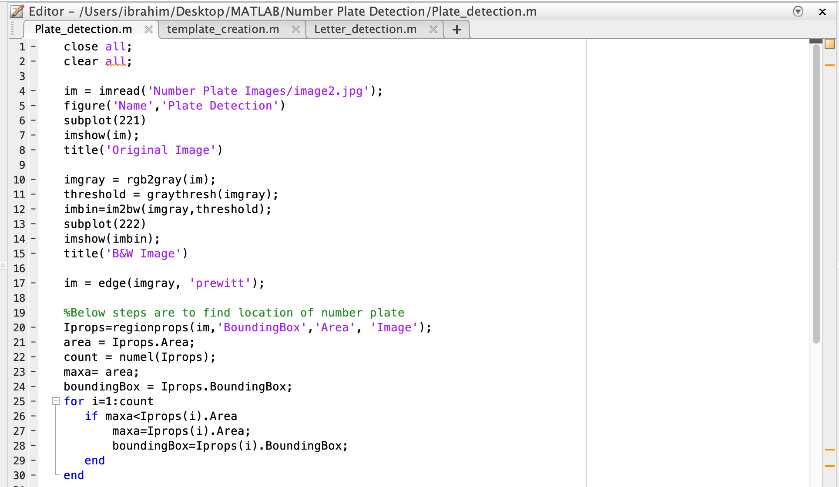
Plate Detection

Slide 13
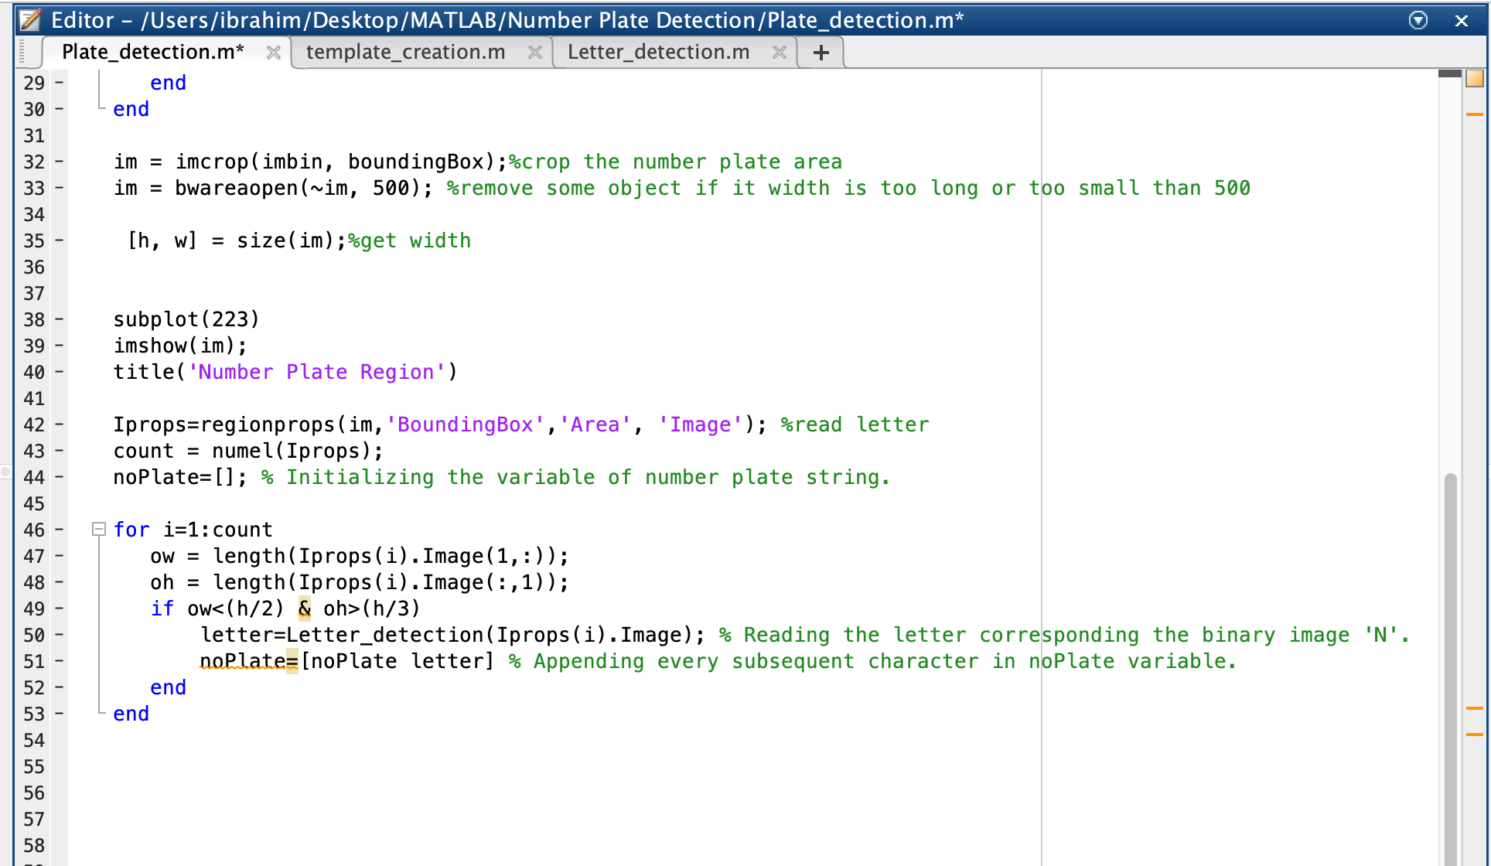
Plate Detection

Slide 14
Letter Detection
In letter detection we have created a function named letter which gives us the alphanumeric output of the input image from class ‘alpha’ by using command ‘readLetter()’.
Then load the saved templates by using command load ‘NewTemplates’.
After that, we have resized the input image so it can be compared with the template’s images by using the command ‘imresize(filename,size)’.
Then for loop is used to correlates the input image with every image in the template to get the best match.

Slide 15
Letter Detection
A matrix ‘rec’ is created to record the value of correlation for each alphanumeric template with the characters template from the input image, as shown in the below code:
cor=corr2(NewTemplates{1,n},snap);
Then ‘find()’ command is used to find the index which corresponds to the highest matched character. Then according to that index, corresponding character is printed using‘if-else’ statement

Slide 16
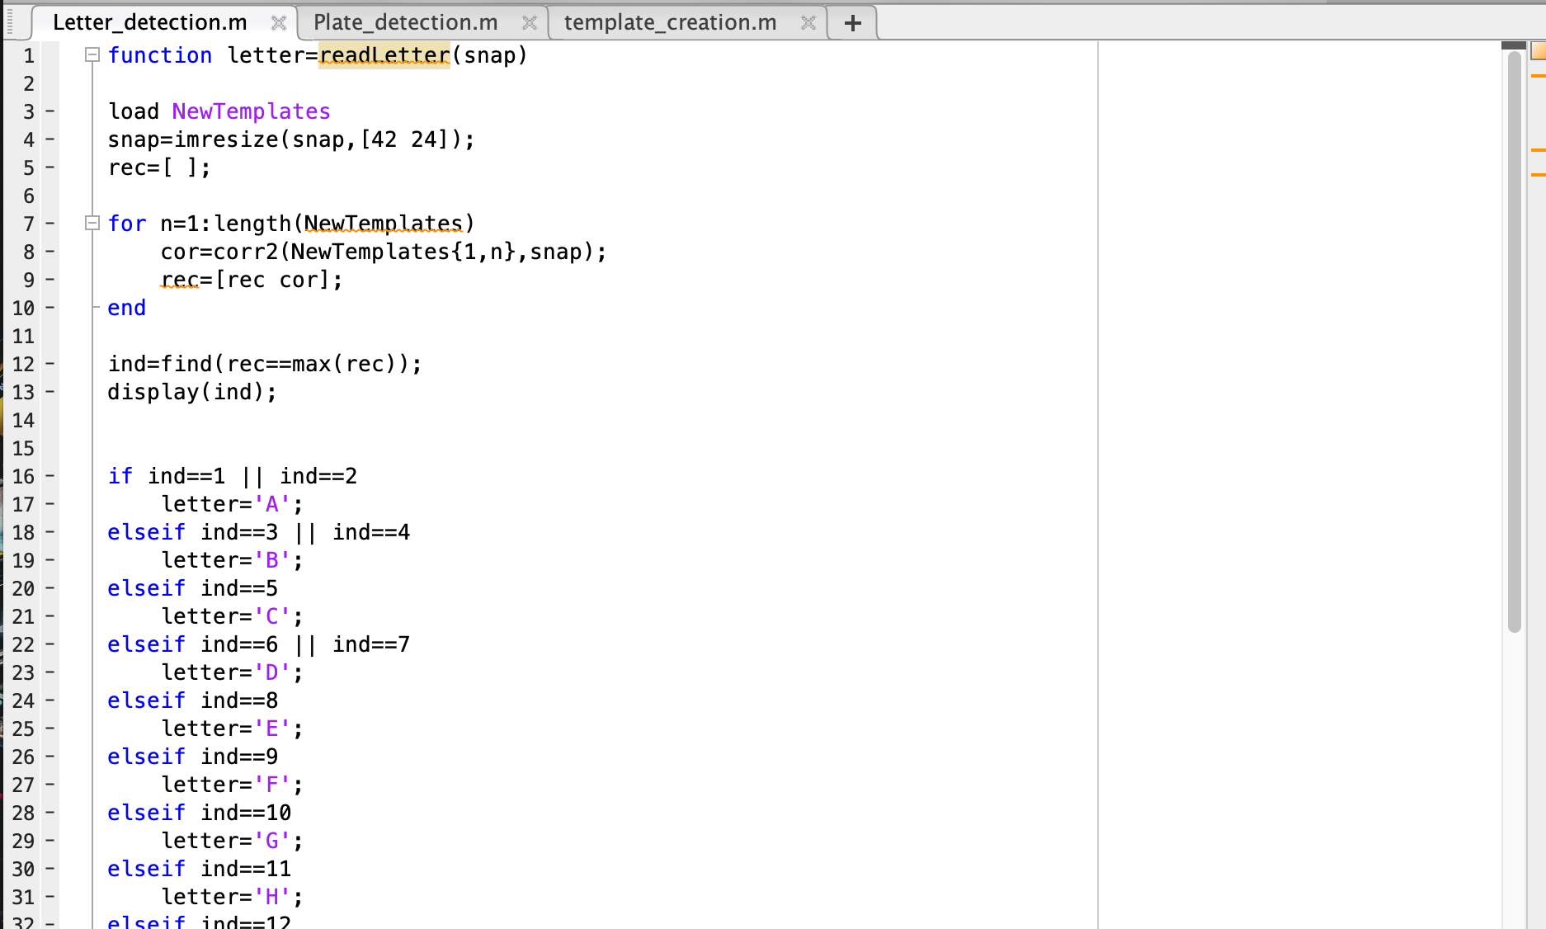
Letter Detection

Slide 17
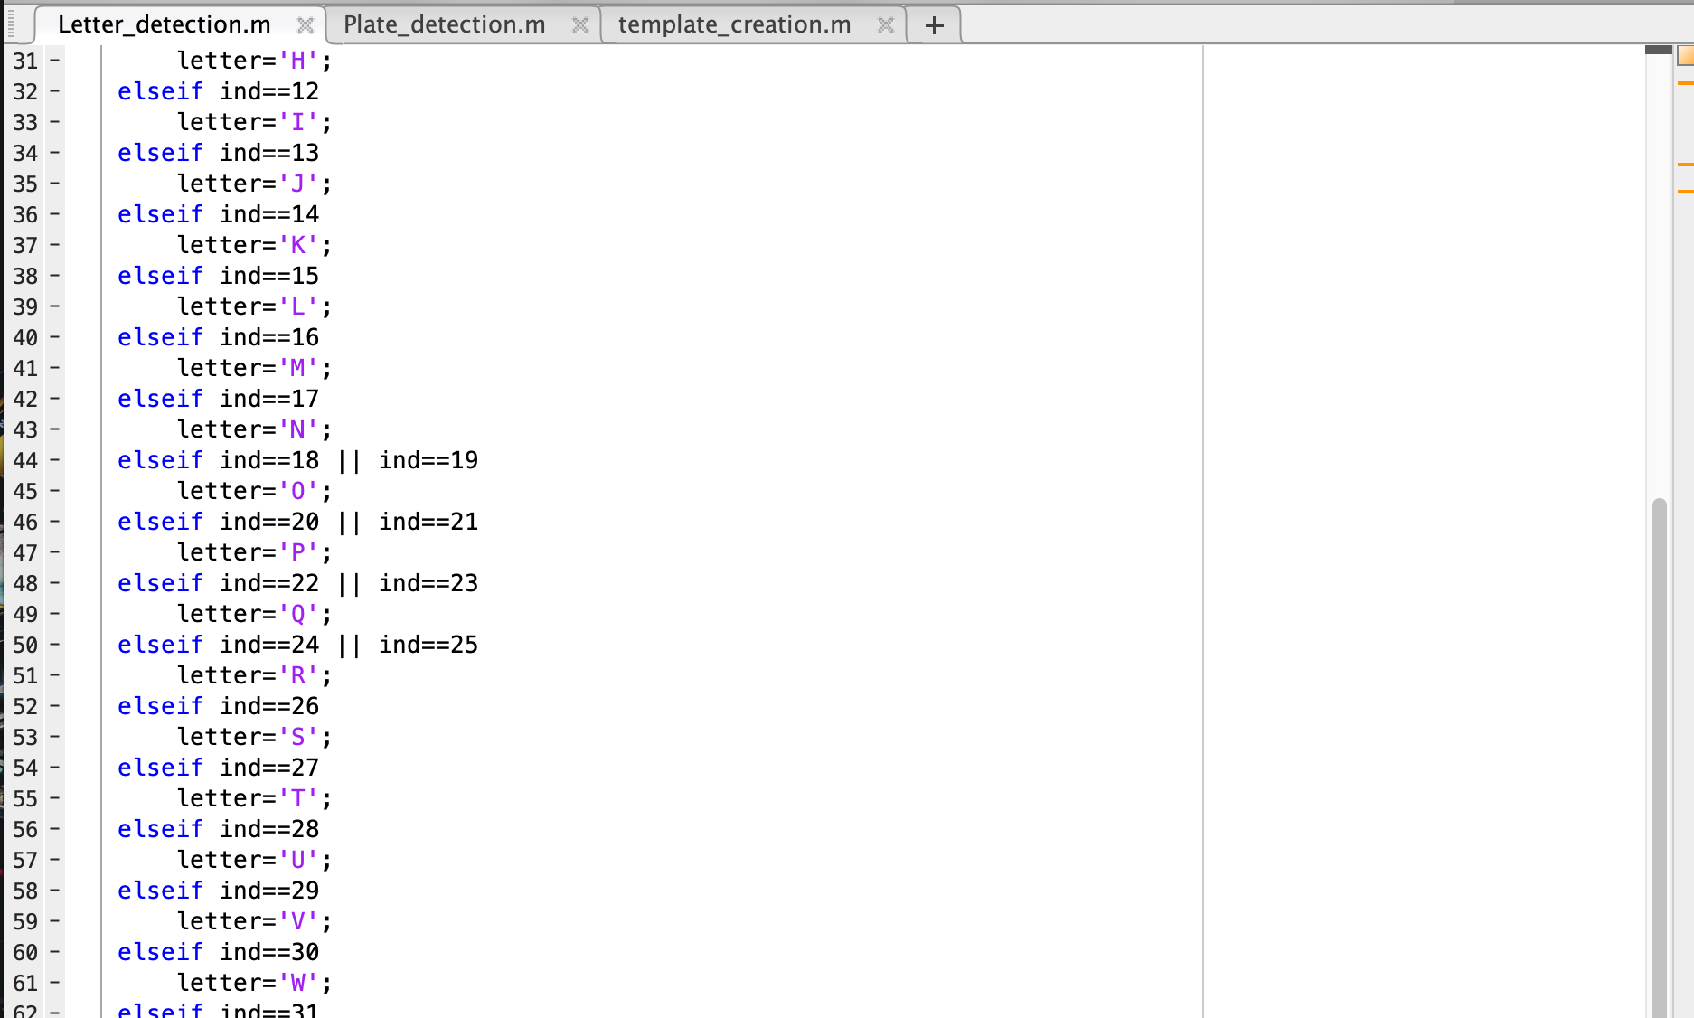
Letter Detection

Slide 18
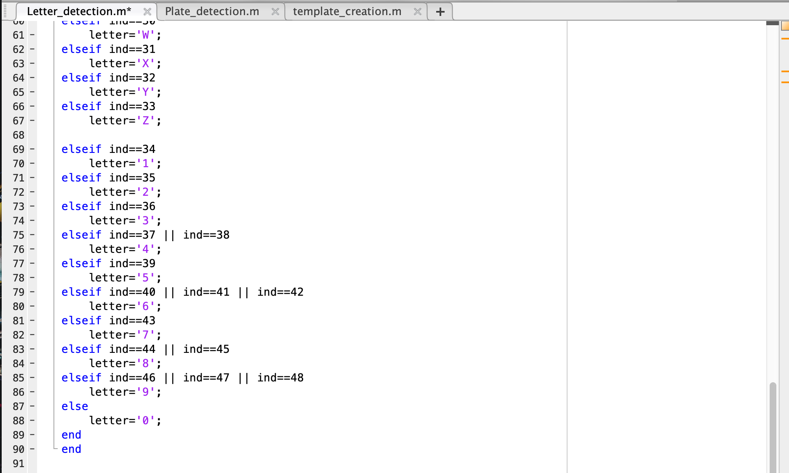
Letter Detection

Slide 19

Template Creation
We have stored the binary images of all the alphabets and numbers in the sub-folder named as ‘alpha’.

Slide 20
Template Creation
In our code we are saving the images into a variable by using command ‘imread()’.
This function is used to call the images from the folder or from any location of the PC into the MATLAB.
A=imread('alpha/A.bmp’); (A is the variable, and in ‘alpha/A.bmp’, ‘alpha’ is the folder name and ‘A.bmp’ is the file name.)
After that create a matrix of ‘letter’ and ‘number’ and save it in variable ‘NewTemplates’ by using command ‘save(filename,variables)’.

Slide 21
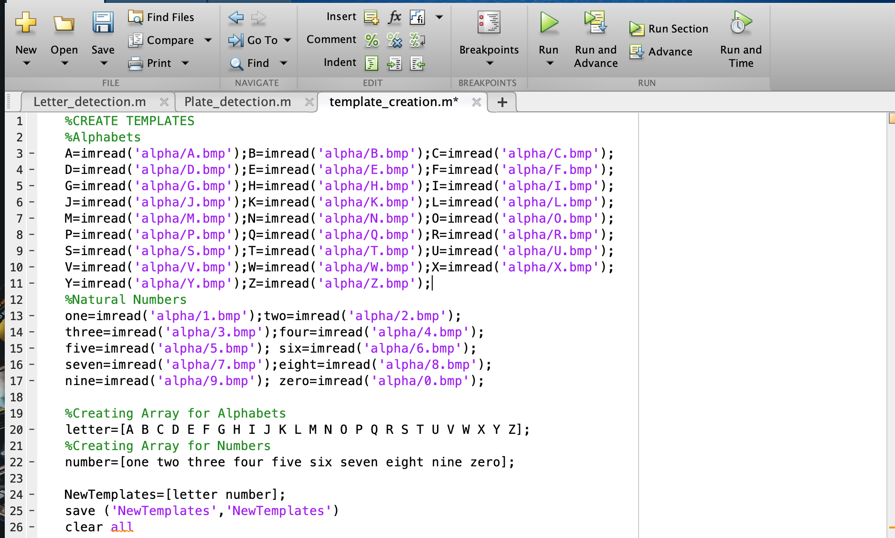
Template Creation

Slide 22
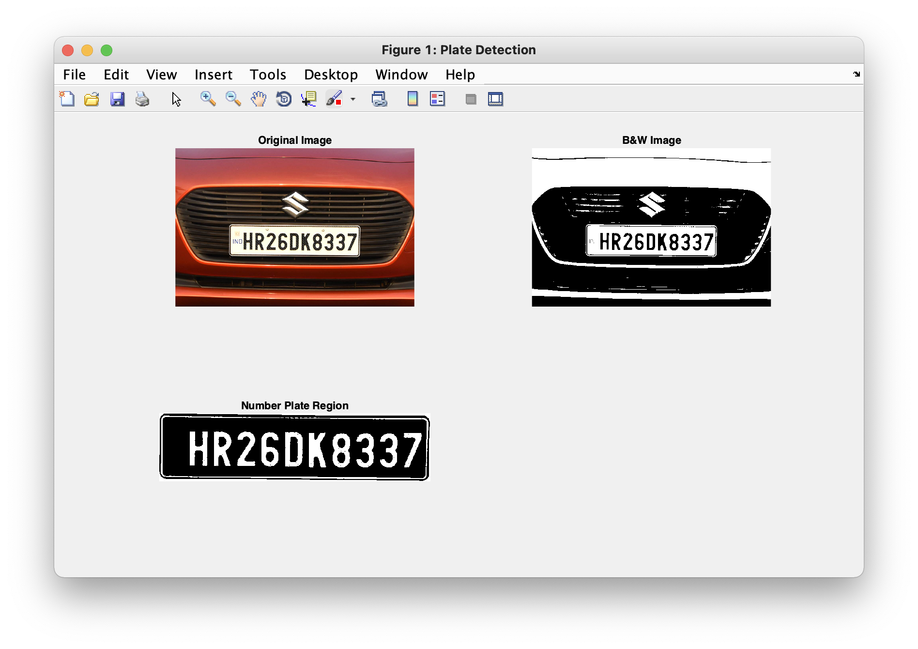
Final Output

Slide 23
Conclusion:-
ANPR is an efficient System with time it will attain more accuracy.
Basically , we intended to develop a system in MATLAB which can perform detection of Car number plate as well as recognition of Car number plate.
It also depends on conditions like lighting, visibility, image skew and camera quality in which the image was captured, and the nature of image itself.
This System can be helpful in many ways for example to increased security, check for stolen cars.
This system is implemented in MATLAB and its performance is tested on Real images.
It is very economical and eco-friendly system If Government should take interest in developing this system.
This change will help in the progress of Country.

Slide 24
Any Questions?

