Slide 1

🎬 Enhanced Movie Hangman Game
A GUI-based game built with Python and Tkinter
Presented by: 23F-BSCS-10
23F-BSCS-22
23F-BSCS-41

Slide 2

Project Overview
Objective:
- Create a fun and interactive Hangman game using movie quotes.
Technology Used:
- Python 3
- Tkinter (GUI library)

Slide 3

Game Concept
How It Works:
- Random movie quote selection
- Player guesses letters to reveal quote
- Max 6 wrong guesses allowed
Movie Categories:
- Avengers: Endgame
- Batman v Superman
- Fast and Furious
- Interstellar
- John Wick

Slide 4
Automata Theory in Hangman
🧠 Automata Theory in Movie Hangman (NFA)
Content:
The game is modeled as a Non-deterministic Finite Automaton (NFA)
States: Start, Choose Category, Guess, Draw Hangman, Win, Lose, End
Transitions:
Correct guess → loop or go to Win
Incorrect guess → Draw Hangman → Lose (if max reached)
ε-transitions: No input required (e.g., Start → Choose)
Accepting states: Win and Lose
Final state: End Game
NFA handles uncertainty of user input and internal game logic

Slide 5
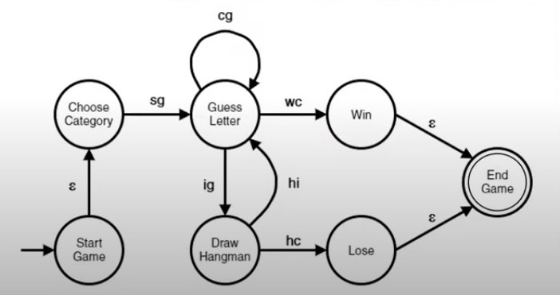
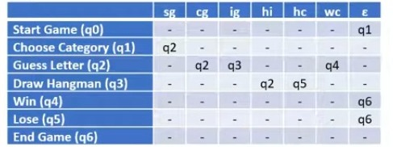
in
comp
wrong
in
comp
Wrong(q3)

Slide 6

Features
✔ GUI interface with Tkinter
✔ Alphabet buttons for input
✔ Live status updates
✔ Wrong guess tracking
✔ Win/Loss detection
✔ Play Again and Exit options

Slide 7

Code Highlights
Key
Key Functions:
Choose
- choose_word(): Random movie & quote
Guess
- guess_letter(): Handles letter input
Update
- update_display(): UI refresh
End
- end_game(): Win/Loss logic
Reset
- reset_game(): Restart logic

Slide 8

THANKYOU

