Slide 1
Risk Stratification for Lung Cancer Screening Using Machine Learning
A Data-Driven Approach to Identifying High-Risk Patients Using Clinical and Demographic Factors

Slide 2
Dataset & Features Overview
Target Variable: Lung Cancer Outcome
Demographic Features: Age, Age Groups
Behavioural Feature: Smoking Exposure (Pack-years)
Clinical Feature: COPD Status
Genetic Factor: Family History
Composite Metric: Risk Score
Purpose: Analyze key risk factors influencing lung cancer and support risk stratification

Slide 3
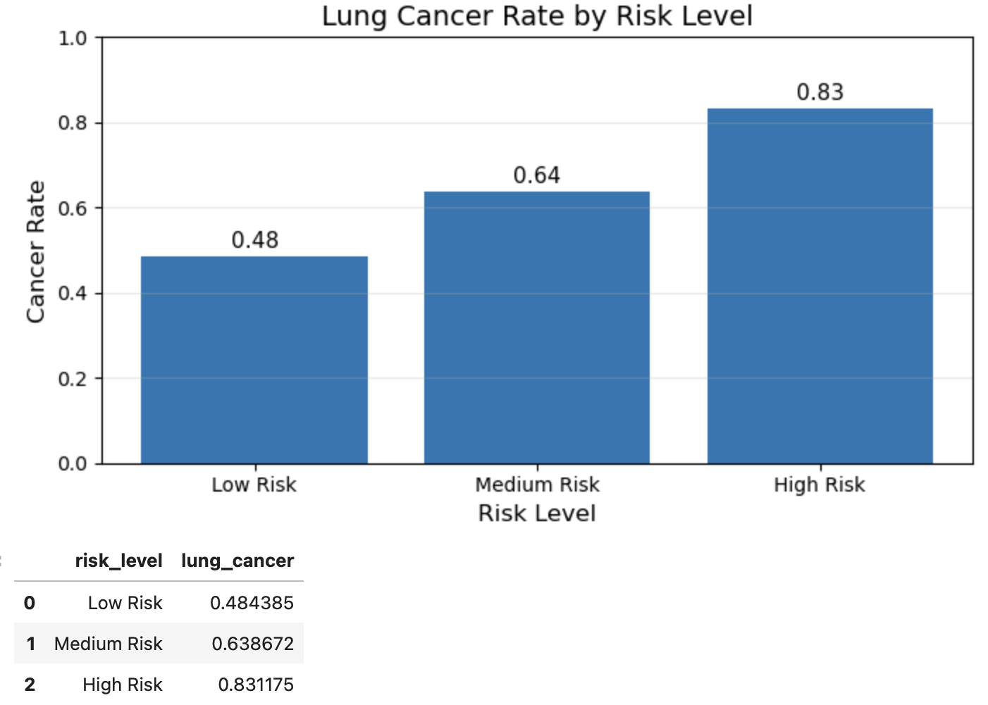
Lung Cancer Risk vs Risk Level
Cancer incidence increases significantly from low to high-risk groups
High-risk groups demonstrate the highest prevalence, supporting targeted screening strategies
Key Insight: Risk stratification enables identification of high-risk patients for efficient screening
Key Values:
Low Risk: 48%
Medium Risk: 64%
High Risk: 83%

Slide 4
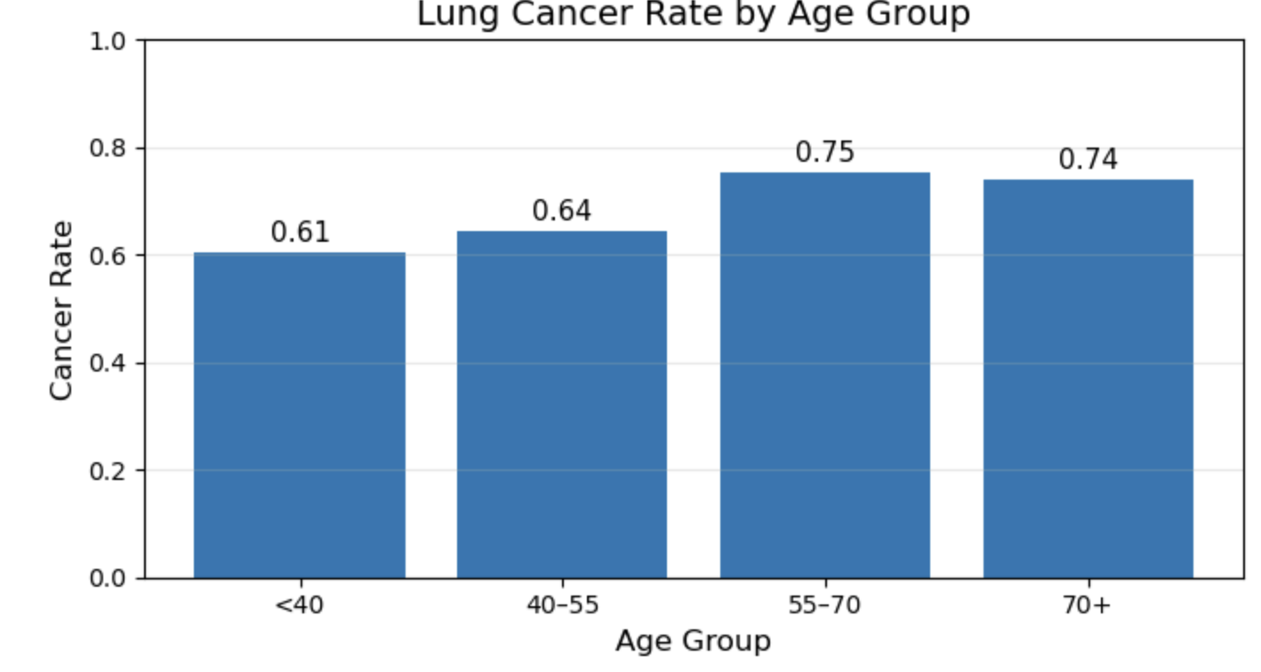
Impact of Age on Lung Cancer Risk
Cancer incidence increases with age, showing a clear upward trend
Older age groups demonstrate significantly higher prevalence
Age is a critical factor in determining screening eligibility
Key Insight: Age is a primary driver of lung cancer risk and a critical factor for targeted screening.
Key Values:
<40: 61%
40–55: 64%
55–70: 75%
70+: 74%

Slide 5
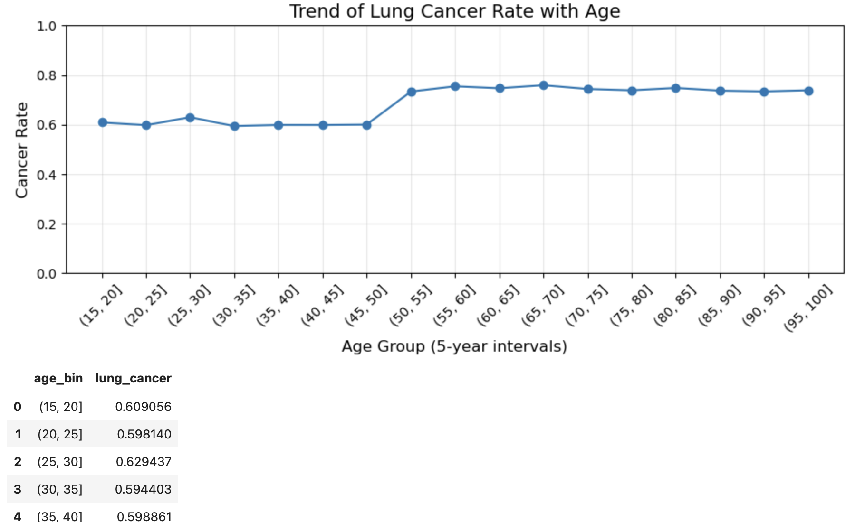
Trend of Lung Cancer Risk with Age
This trend confirms a consistent increase in cancer risk across continuous age groups.
Supports age-based screening strat
Key Insight: Cancer risk increases progressively with age, reinforcing age as a primary factor in screening decisions.

Slide 6
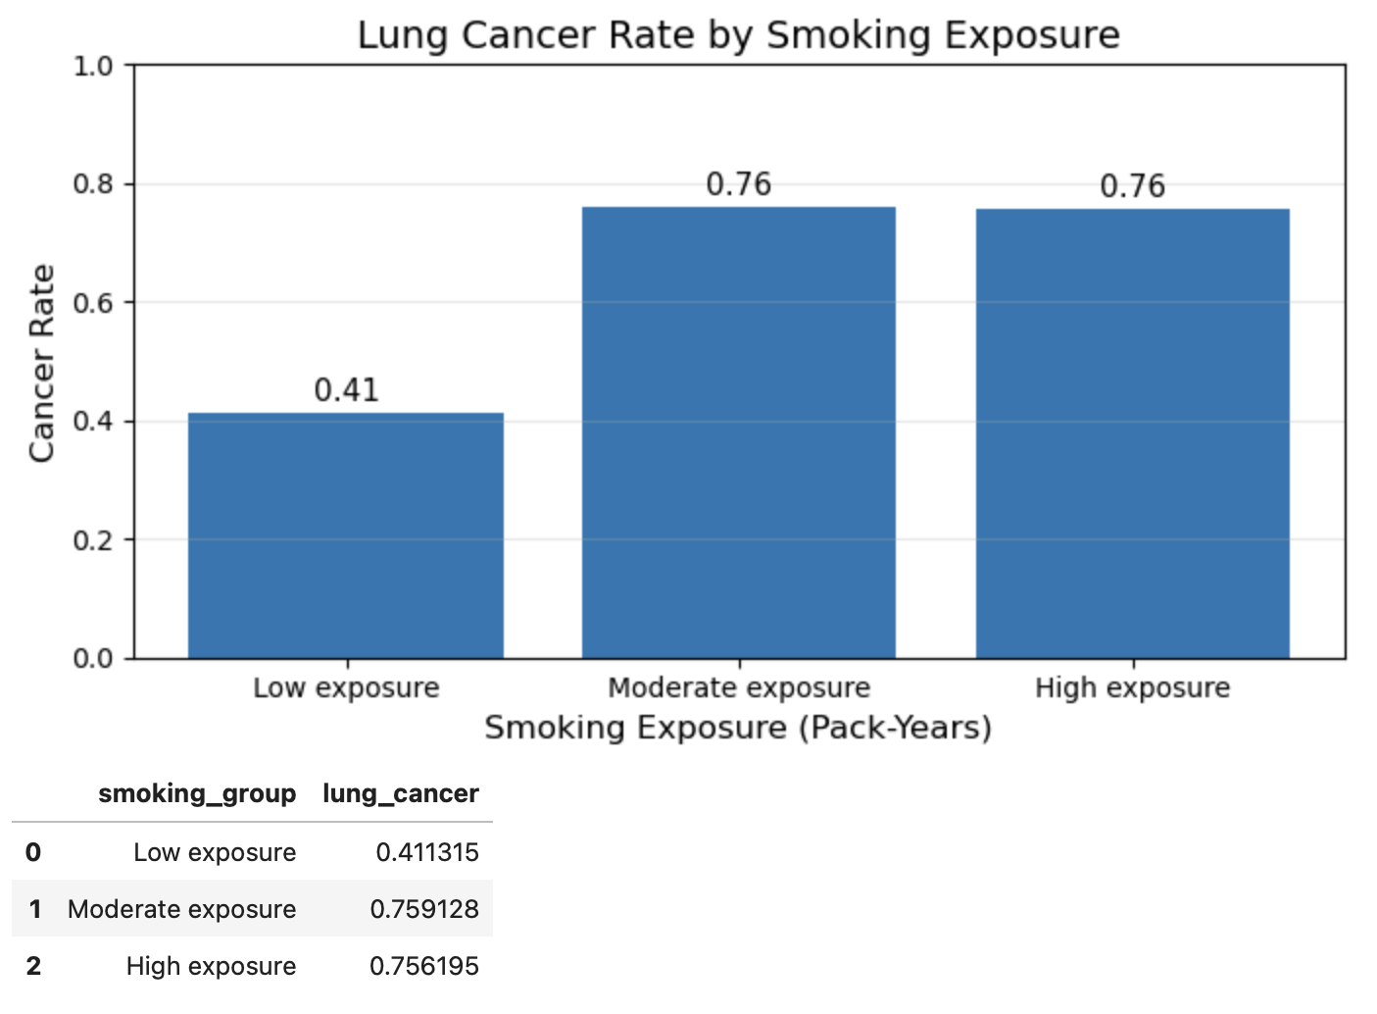
Impact of Smoking Exposure on Lung Cancer Risk
Cancer incidence increases significantly with higher smoking exposure.
Individuals with moderate to high exposure show substantially higher risk.
Smoking exposure (pack-years) is a critical predictor of lung cancer risk
Key Insight: Smoking exposure is one of the strongest predictors of lung cancer risk, highlighting the importance of lifestyle factors in screening decisions.
Key Values:
Low: 41%
Moderate: 76%
High: 76%

Slide 7
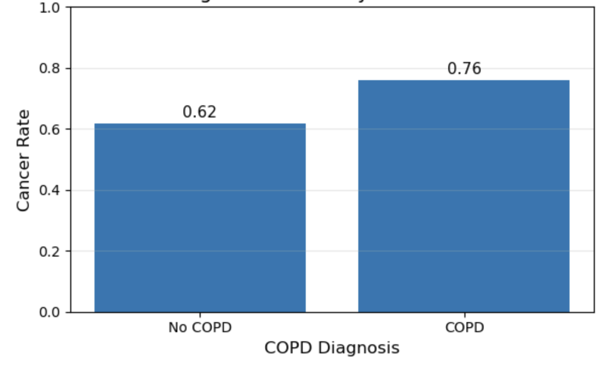
Impact of COPD on Lung Cancer Risk
Cancer incidence is higher in patients with COPD compared to non-COPD individuals
COPD is associated with increased lung cancer risk due to underlying chronic lung damage
Indicates COPD as an important clinical risk factor.
Key Insight: COPD is a significant clinical risk factor and should be incorporated into lung cancer risk stratification models
Key Values:
No COPD: 62%
COPD: 76%

Slide 8
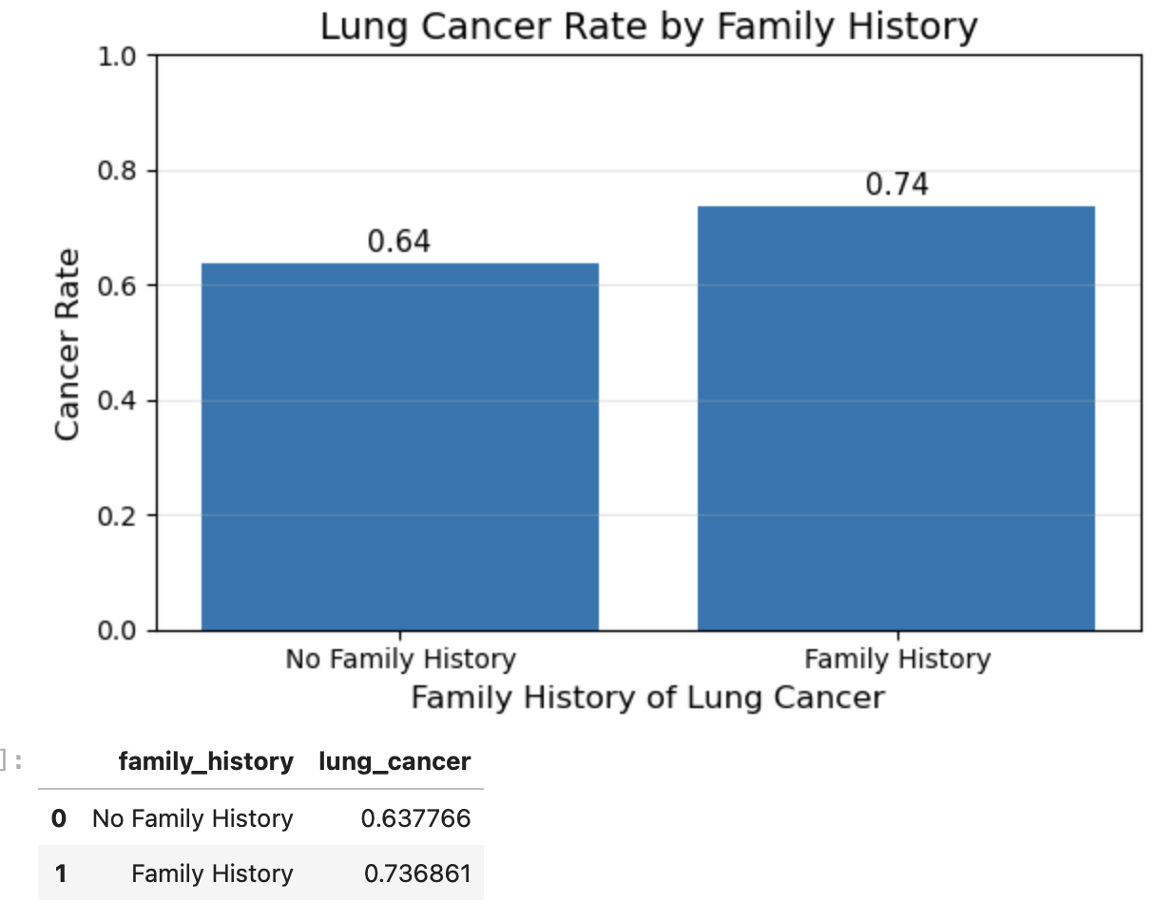
Impact of Family History on Lung Cancer Risk
Individuals with a family history of lung cancer show higher cancer incidence.
Genetic predisposition contributes to increased risk.
Family history acts as an additional but important risk factor
Key Insight: Family history contributes to increased lung cancer risk, but has a smaller impact compared to smoking and COPD.
Key Values:
No Family History: 64%
Family History: 74%

Slide 9
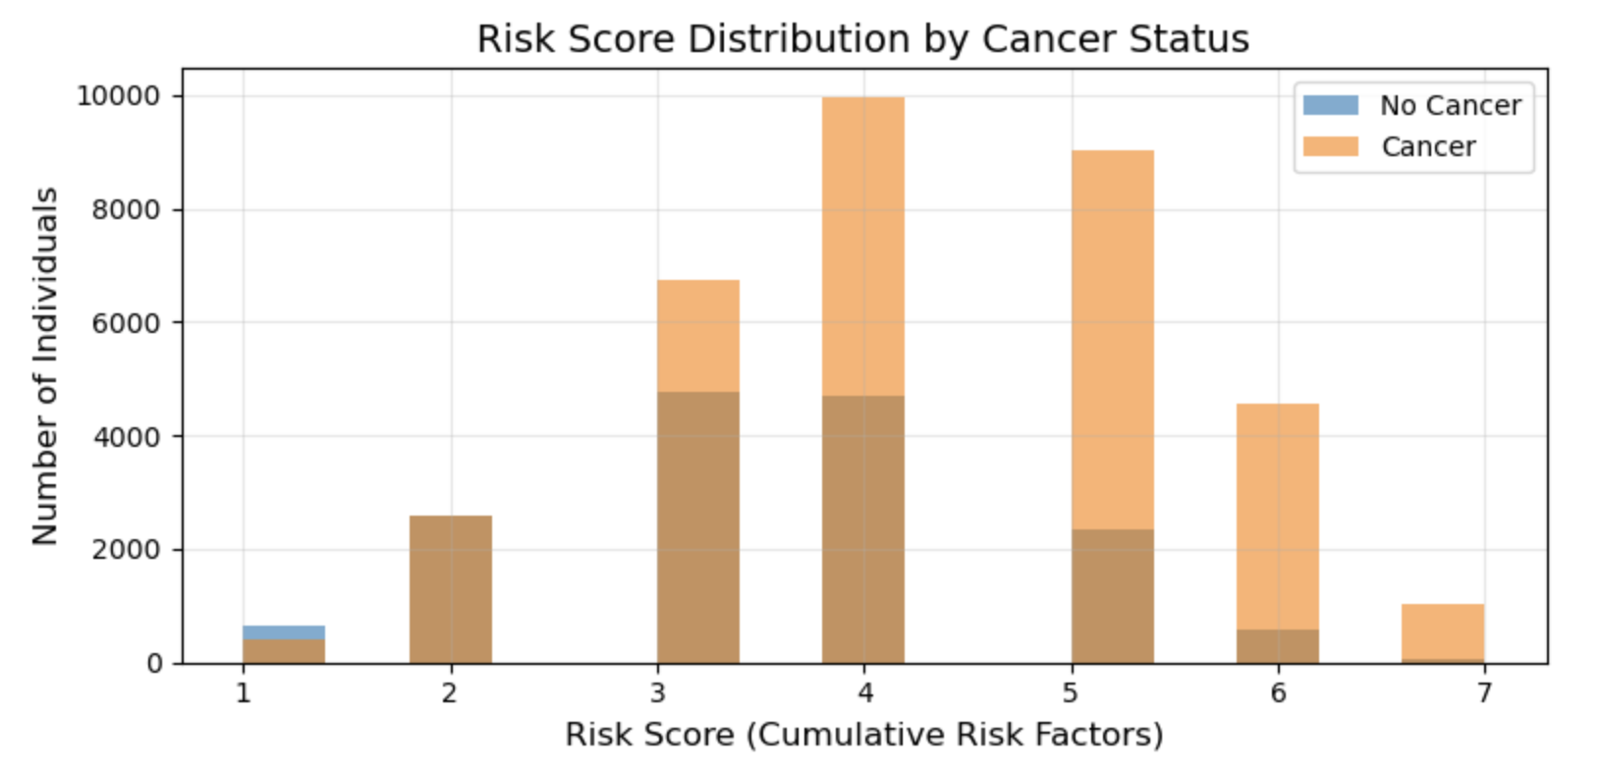
Distribution of Lung Cancer Risk Scores
Cancer cases are concentrated at higher risk scores.
Higher cumulative risk factors correspond to increased cancer likelihood.
Demonstrates effectiveness of risk scoring approach
Key Insight: Higher risk scores strongly correlate with cancer presence, validating risk stratification.

Slide 10
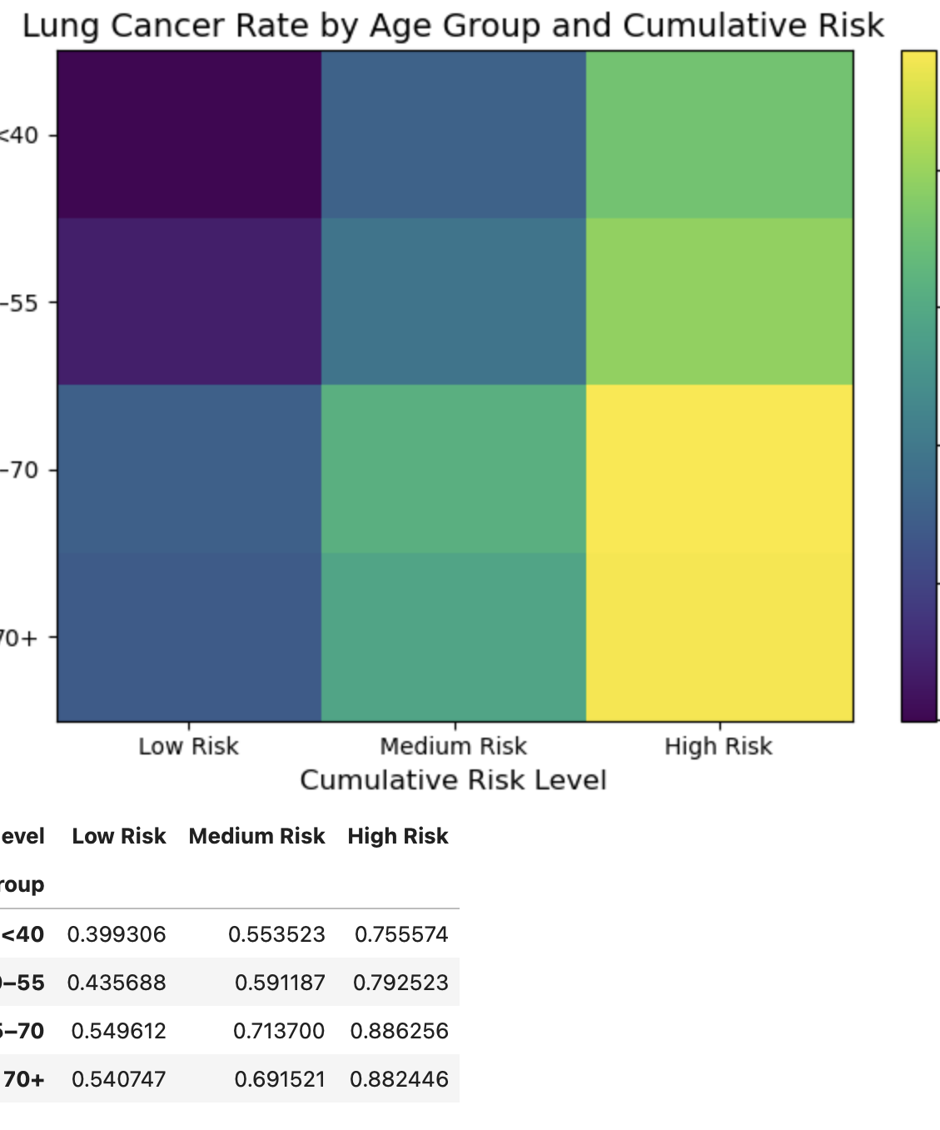
Interaction Between Age and Cumulative Risk on Lung Cancer
Highest cancer risk occurs when both age and cumulative risk are high.
Demonstrates combined effect of demographic and risk factors.
Supports targeted screening at high-risk intersections
Key Insight: Combined risk factors significantly amplify cancer risk, validating multi-factor stratification

Slide 11

Conclusion
Lung cancer remains a high-mortality disease
Risk varies significantly across individuals
Targeted screening based on risk stratification improves outcomes.

