Slide 1
Credit Card Fraud Detection
Name: Amnah Aldayri
Dr. Essam Al Daoud
SDAIA T5 Data Scince Bootcamp

Slide 2
Outline
Introduction
Methodology
Results
Conclusion
Future Work
Appendix

Slide 3
Introduction
“Fraud detection is a set of activities that are taken to prevent money or property from being obtained through false pretenses.”
Motivation
Increase in the rate of fraud and theft in credit card transactions
The emergence of new and different methods of fraud
Objectives
Bulide a classification Model to detect fraud transaction
Evaluate the models by using some of the performance metrics
Goal
This project aim to propose a credit card fraud detection system by comparing the performance of different algorithms with neural network.

Slide 4
Methodology
Data
The data is obtain from “Credit Card Fraud Detection” dataset in Kaggle, which contain 284,807 transactions, with 29 features.
Model Architecher
Model
Validation
Explore Data
SVM
RF
Fraud
Load Data
Cross Validation
Balance Data
KNN
XG
Non- Fraud
NB
NN

Slide 5
Methodology
Metrics
Confiusion Metrices
Precision
Recall
Accuracy
Tools
NumPy and Pandas for data manipulation
Scikit-learn for modeling
Matplotlib and Seaborn for plotting

Slide 6
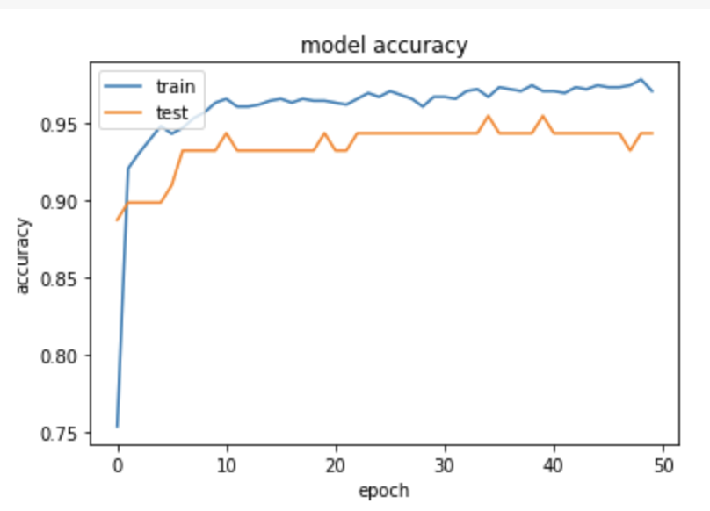
Results
Accuraccy
Algorithms | Accuracy
SVM | 0.96%
KNN | 0.92%
Naive Bayes | 0.92%
Random Forest | 0.96%
XG BOOST | 94.95%
Neural Network | 98.3%

Slide 7
Conclusion
Fraud is a major problem for the whole credit card industry that grows bigger with the increasing popularity of electronic money transfers. To effectively prevent the criminal actions that lead to the leakage of bank account information leak, skimming, counterfeit credit cards, the theft of billions of dollars annually, and the loss of reputation and customer loyalty, credit card issuers should consider the implementation of advanced Credit Card Fraud Prevention and Fraud Detection methods. Machine Learning-based methods and deep learning-base methods can continuously improve the accuracy of fraud prevention based on information about each cardholder’s behavior.

Slide 8
Future Work
Use Autoencoder for anomaly operation detection

