Slide 1
Weather Monitoring System
Observer Design Pattern Project
A real-time weather station that broadcasts temperature and humidity updates to multiple displays.
Java • UML • Design Pattern
01

Slide 2
Presentation Roadmap
How the project will be explained
01
Problem
Why direct communication creates tight coupling
02
Pattern Choice
Why Observer is the best fit
03
UML Design
How the classes and interfaces connect
04
Code Walkthrough
Each class explained on its own slide
05
Evaluation
Benefits, trade-offs, and conclusion
02

Slide 3
Project Idea
Weather Station with multiple display screens
Main Scenario
Real System Behaviour
The WeatherStation stores weather measurements such as temperature and humidity. When these values change, all subscribed displays receive the update automatically.
PhoneDisplay shows temperature and humidity, while TVDisplay only shows temperature. Both displays react to the same update from one central source.
WeatherStation
notifyObservers()
PhoneDisplay
TVDisplay
03

Slide 4
Problem Analysis
What the project is solving
Tight Coupling
State Synchronization
Extensibility
Without the pattern, the station would need to know each display type and call each one directly.
All displays must stay updated immediately whenever weather data changes.
Adding a new display should not require changing the core WeatherStation class.
Key idea: the data source should broadcast changes without depending on the internal details of every display.
04

Slide 5
Observer Pattern Solution
One subject notifies many observers
Observer PhoneDisplay
Subject WeatherStation
New Display can be added
Observer TVDisplay
• Subject keeps a list of observers.
• Observers register or remove themselves.
• When data changes, notifyObservers() calls update() on each observer.
• Each observer decides how to display the received data.
05

Slide 6
Why Observer Pattern?
Justification for the pattern selection
Automatic Updates
Loose Coupling
Displays update instantly when setMeasurements() changes the weather data.
WeatherStation only uses the Observer interface, not the internal code of each display.
Easy Scalability
Flexible Output
New displays can be added by implementing Observer, without editing WeatherStation.
Different screens can present the same data in different ways.
06

Slide 7
UML Component Roles
How the architecture is divided
Subject interface
WeatherStation
Defines registerObserver(), removeObserver(), and notifyObservers().
Concrete subject. Stores weather state and maintains a List<Observer>.
Observer interface
PhoneDisplay & TVDisplay
Defines update(temperature, humidity) so all displays receive updates the same way.
Concrete observers. They receive data and display it according to their purpose.
08

Slide 8
Observer vs. Chain of Responsibility
Why Chain of Responsibility was not selected
Observer Pattern
Chain of Responsibility
One subject sends the same update to all subscribed observers at the same time. This matches the weather
system because all displays should receive updates directly.
A request moves through a chain of handlers. Each handler decides whether to process or forward it. This does not match the project because displays should not pass data between each other.
Best fit: Observer Pattern
09

Slide 9
Trade-offs
Strengths and limitations of the design
Advantages
Considerations
• Loose coupling between WeatherStation and display classes
• Natural broadcast communication through notifyObservers()
• Supports adding new displays without modifying the subject
• Fits SOLID principles such as Open/Closed Principle
• Observers should be removed when they are no longer needed
• Many observers can create notification overhead
• One failing update() method may affect the notification process
• Push model may send extra data that some observers do not use
10

Slide 10
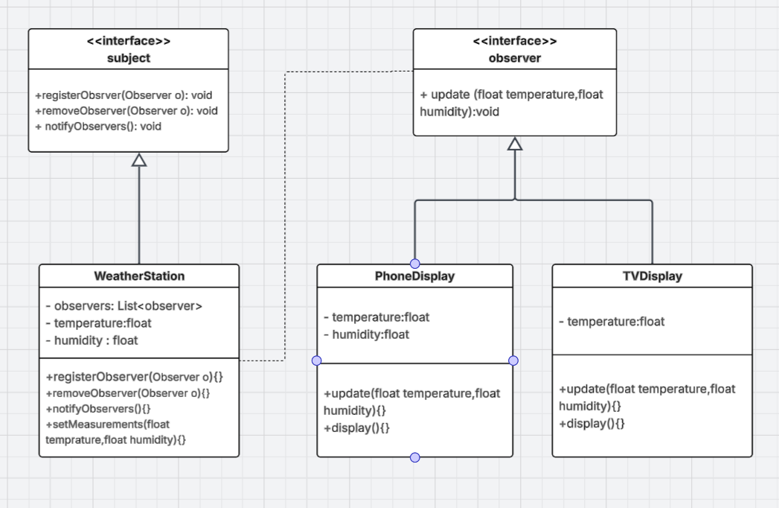
UML Class Diagram
Full diagram included as provided
07

Slide 11
Code Walkthrough
Each interface and class is shown on its own slide.
Subject
Observer
WeatherStation
PhoneDisplay
TVDisplay
Main
11

Slide 12
Subject
Publisher Contract
interface Subject {
void registerObserver(Observer o);
void removeObserver(Observer o);
void notifyObservers();
}
What this class does
This interface defines the contract for the data source. Any class that implements Subject must be able to register, remove, and notify observers.
Key points to explain
registerObserver(): adds a display
removeObserver(): removes a display
notifyObservers(): sends updates
12

Slide 13
Observer
Subscriber Contract
interface Observer {
void update(float temperature, float humidity);
}
What this class does
This interface defines the update method. Every display implements this method so the WeatherStation can send updates in one standard way.
Key points to explain
update(): receives new weather values
13

Slide 14
WeatherStation
Concrete Subject
import java.util.ArrayList;
import java.util.List;
class WeatherStation implements Subject {
private List<Observer> observers = new ArrayList<>();
private float temperature;
private float humidity;
@Override
public void registerObserver(Observer o) {
observers.add(o);
}
@Override
public void removeObserver(Observer o) {
observers.remove(o);
}
@Override
public void notifyObservers() {
for (Observer observer : observers) {
observer.update(temperature, humidity);
}
}
public void setMeasurements(float temperature, float humidity) {
this.temperature = temperature;
this.humidity = humidity;
notifyObservers();
}
}
What this class does
This class is the concrete subject. It stores temperature and humidity, keeps a list of observers, and notifies them whenever measurements change.
Key points to explain
observers: stores subscribers
setMeasurements(): changes state
notifyObservers(): broadcasts state
14

Slide 15
PhoneDisplay
Concrete Observer
class PhoneDisplay implements Observer {
private float temperature;
private float humidity;
@Override
public void update(float temperature, float humidity) {
this.temperature = temperature;
this.humidity = humidity;
display();
}
public void display() {
System.out.println("Phone display updated -> Temperature: " + temperature + "°C | Humidity: " + humidity + "%");
}
}
What this class does
This class is a concrete observer. It receives both temperature and humidity, stores them locally, and prints them for the user.
Key points to explain
update(): receives values
display(): prints phone message
15

Slide 16
TVDisplay
Concrete Observer
class TVDisplay implements Observer {
private float temperature;
@Override
public void update(float temperature, float humidity) {
this.temperature = temperature;
display();
}
public void display() {
System.out.println("TV weather report -> Current temperature: " + temperature + "°C");
}
}
What this class does
This class is another concrete observer. It receives the update, but only uses temperature because TV output does not need humidity.
Key points to explain
update(): stores temperature
display(): prints TV report
16

Slide 17
Main
Program Runner
public class Main {
public static void main(String[] args) {
WeatherStation weatherStation = new WeatherStation();
PhoneDisplay phoneApp = new PhoneDisplay();
TVDisplay livingRoomTV = new TVDisplay();
System.out.println("--- System Simulation: Registering displays with the weather station ---");
weatherStation.registerObserver(phoneApp);
weatherStation.registerObserver(livingRoomTV);
System.out.println("\nFirst station update:");
weatherStation.setMeasurements(28.5f, 65.0f);
System.out.println("\nSecond station update:");
weatherStation.setMeasurements(22.1f, 85.3f);
System.out.println("\nAction: Turning off the TV display and removing its subscription...");
weatherStation.removeObserver(livingRoomTV);
System.out.println("\nThird station update:");
weatherStation.setMeasurements(25.0f, 50.0f);
}
}
What this class does
This class runs the simulation. It creates the station and displays, registers observers, changes measurements, and removes one observer to prove the pattern works.
Key points to explain
Creates objects
Registers displays
Changes measurements
Removes TV observer
17

