Slide 1
Nifty Assignments 2005
Photomosaics
Rich Pattis
Computer Science Department
Carnegie Mellon University
Pittsburgh, PA 15213
email: pattis@cs.cmu.edu

Slide 2
Overview
What are Photomosaics ® + Examples
Programming Concepts
Programming Options
Contests and Databases
Patent Implications
® Photomosaic is a registered trademark of Runaway Technology

Slide 3
What are Photomosaics
A mosaic is a image rendered by a large number of small objects (historically glass and stone)
In a photomosaic, the image is a large picture, which is rendered from smaller pictures
  Viewed up close, the smaller pictures should be identifiable; from afar they integrate into the image
Often there is a relationship between the two:
  An artist rendered from his/her art works
  A student rendered from his/her classmates
  A campus landmark rendered from campus photos
  …your students will come up with “interesting” combinations, guaranteed to upset someone: its art!

Slide 4

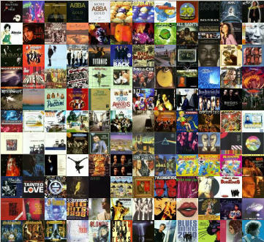
Database Pictures
Each database picture is rectangular,
with the same aspect ratio
(here photos are square)
Excerpt from a database of CD covers, containing about 1,200 pictures.

Slide 5
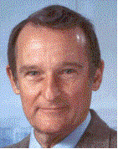
A Large Image to Render
Seymour Cray

Slide 6
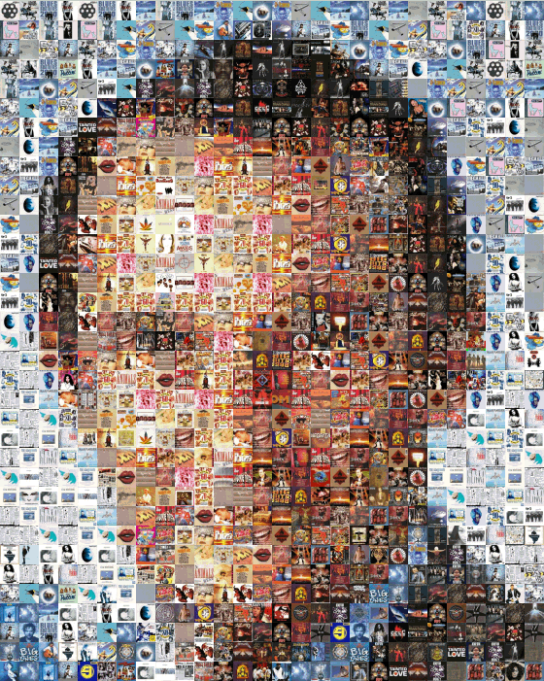
The Image Rendered by 980 CD Covers
Limiting 10 reuses of any database picture with a minimum distance of 3 between reused pictures
(it helps to squint)

Slide 7
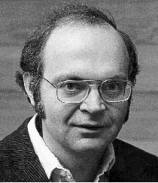
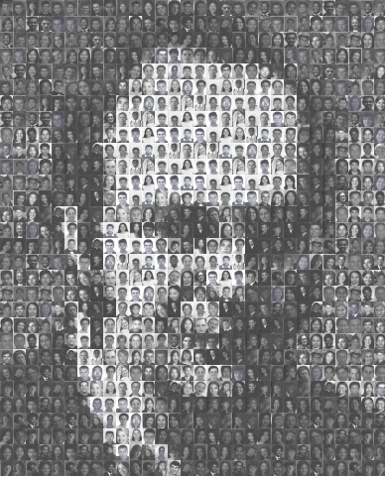

Don Knuth Rendered by 900 Student Photos
Full Size Student Photo

Slide 8
The Assignment
Write a program that produces photomosaics
The minimal program must…
  Read a database of pictures, displaying it
    Displaying a database ~ constructing a photomosaic, spatially
  Read an image to render
  Render/display image (regions->database pictures)
Optional (simple vs. complicated assignment)
  Square vs. Rectangular picture database
  Sampling size (increase/decrease rendered image size)
  Built-in vs. plug-in similarity metric(s)
  Special constraints on rendering: reuse/distance
  Input/Calculate/Output vs. GUI (via MVC pattern)

Slide 9
Programming Concepts
Arrays
  1-d array of Picture objects (in a picture database)
  2-d array of pixels (“implicit” in each picture)
Loops
  Reading all the Picture files in a folder
  Examining all the pixels in pictures to summarize them
  Scanning regions in the Image to render
  Scanning for the “closest” match in the database
Using many classes to build an application
Reading Javadoc
  The FileSelector and Picture classes
  Metric interface

Slide 10
Major Provided Components
FileSelector class
  Easy interface to file-selection GUI
Picture class (about a dozen methods total)
  constructor
  makeEmptyPicture
  Overlay (a region by another picture)
  display
  get/set Color (at coordinate), other accessors
  …
Metric interface
  copy
  makeSummary (overloaded for whole picture/region)
  distanceTo (another Metric object)

Slide 11
More On (plug-in) Metrics
I provide one: Intensity
  Assume a gray scale
  Computes/Stores 1 average in [0,255]
Students write at least one: RGB
  Computes 3 averages (for R, G, B separately) in [0,255]
I provide a Quad Metric-Decorator
  Implements Metric, constructor has Metric parameter
  Is a Metric that duplicates its Metric parameter for each of 4 quadrants (storing more fine-grained data)
  Summary delegate; distance delegate (sum of distances)
  new Quad(new Quad(some metric)) provides 16 regions!
someMetric
someMetric
someMetric
someMetric

Slide 12
Programming Options
Constraints
  Maximum reuse for database pictures
  Minimum distance from a picture to any other use of it
  Spiral rendering from center (vs. top-down/left-right)
Color shifting to increase database size/usefulness
Filtering of pictures (e.g., color -> gray scale)
Control Flow
  Input/Calculate/Output
  Menu (but still text) Driven (write as “Model”)
  Full-blown GUI
    I have students write the Model as an earlier assignment (providing them with a textual View/Controller), then have them write a full MVC GUI at the end of the semester

Slide 13
Contests: Something for Everyone
Best Metric (on instructor database and image)
Best Art: (on student database image)
  Use the Pritchard Scale
  If the photomosaic's score for perfection is plotted along the horizontal of a graph, and its importance is plotted on the vertical, then calculating the total area of the curve yields the measure of its greatness.
Quick Rendering: Severe Time Limitations
Best Databases found or created

Slide 14
Database Sources
Google the Web
  I’ve found cd covers, beer labels, Christmas cards, etc. (tools are available to batch convert pictures to the appropriate sizes)
Ask students
  They do even better googling
  If they have digital cameras, create your own
Tools: Converting Movies -> Frames
Cheating: shift pictures
  redder/greener/bluer
    Students can easily write filters for the Picture class

Slide 15
Patent Issues
This topic is a 50 minute talk itself!
I am not a lawyer; here are some “facts”
  Creating photomosaics is patented
    Unlike copyright, there is no fair use
    Can teach how to make them, but not make them
  Owner wouldn’t license patent for class use
  Damages are based on lost income
  David Evans (UVa) has made photomosaics; published in campus newspaper and on web
  Photomosaic program on the web
Will your school support you in a lawsuit? Talk to your school’s legal folks

Slide 16
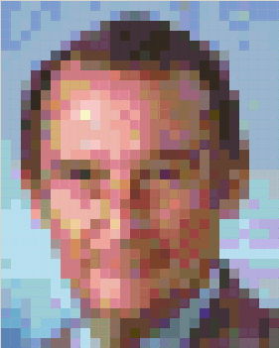
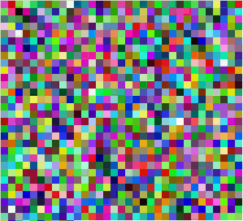
Using Blobs
Students can use bw/color blobs to test their programs without ever producing a “photomosaic”
Database of 1000 random colors

