Slide 1
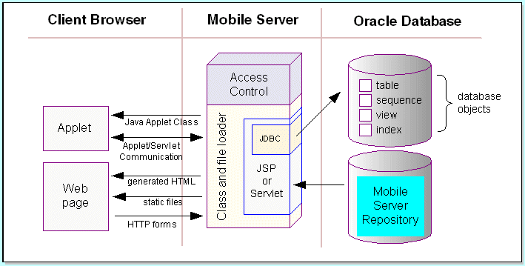
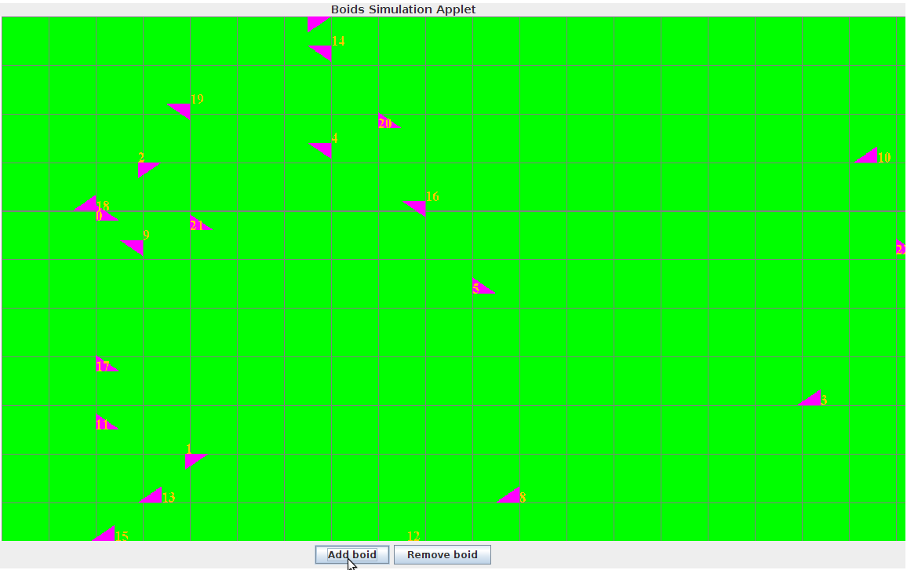
A Framework for the Development of Java Applets and Servlets
Amndeep Singh Mann
Computer Systems Research 2013
Abstract
The development of Java applets and servlets can be difficult for novices to web development. If there were an extensible framework and basic guide in creating applets/servlets that was free and open-source, then it would lower the barrier in using this technology. The creation of such a framework was the focus of my project.
Discussion
The manner in which the applet and servlet communicate is through an enum of commands from the applet to the servlet and an enum of messages from the servlet to the applet. The commands tell the servlet about the specific request that the applet has, such as to log some information. The messages tell the applet important information, such as whether the receipt of the command failed in some manner.
The logger is based in the servlet, as it is not always possible to get permissions to create files on a client's computer. And even if permission would be granted, it would still be difficult to have Java ask for permission in the first place since it would require special, signed packaging of the entire program. The manner in which the applet accesses the logger is through sending a command to the servlet to log an attached message.
The applet is sparse in content. It does not contain any code for GUI creation as that is always implementation dependent. Instead it contains one method through which the end-developer can send and receive communication with the servlet. It also contains a way to temporarily store errors so that they can be passed along to the servlet and, if desired, displayed on the screen.
The servlet is also relatively sparse in content. It sets up the logger and manages sending and receiving messages with the applet. It also contains a method, which can be overridden by the end-developer, that specifies what sort of input the servlet is looking for and what it will do when it receives it.
The examples and documentation will certainly be the item of most interest and use to an end-developer. He or she will be guided through how to create an applet and servlet, using my framework as a basis if they so desire. This process, to the unexperienced is long and difficult, filled with a vast number of unknown, incomprehensible bugs and errors. Through the use of these examples and documentation, the end-developer will be able to quickly produce an applet and servlet.
Background
It can be difficult to create an application that is able to do computationally intensive tasks, such as running a simulation, without programming both server and client-side. Java, a language with which I was already familiar, enables one to do so with more or less difficulty. With this Java framework, I intend to reduce the average difficulty of such development for novices in this area.
Discussion
The framework consists of five main parts: an extensible servlet; an extensible applet; a series of shared, static means of communication, which can be extended in a manner; a logger; and a series of examples and documentation.
Results
This framework was intended to be as DRY and extensible as possible, in order to facilitate the development of Java applets and servlets. The lack of many features was intentional so that the learning curve attached with using the framework would be reduced, and so that the end-developer would have as much freedom as he or she desired in creating an implementation of their ideas.
Fig. 1 Diagram showing Java applet/servlet environment
Fig. 2 GUI of one of the Boids example
http://docs.oracle.com/html/A97671_01/img/dev_arc.gif

