Slide 1
Cost-Aware Nesting
for Rectangular Metal Stock
Standout thesis
“A drop is not scrap; it is an uncertain inventory asset.”
Nox Metals Windsor - SWE Design Challenge
Core framing: optimize total business cost, not just today’s visible material waste.
Use order history to decide which leftovers to consume, preserve, or price as near-scrap.
Design doc + tiny prototype
Prepared by Amnisha

Slide 2
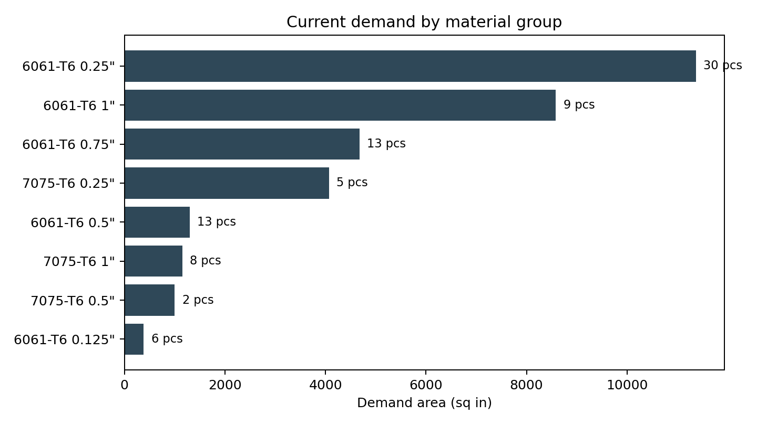
1. Problem framing
Daily decision: pick stock, placement, and orientation for current rectangular orders.
Inputs
Dataset snapshot
jobs.json
10
86
36
220
Current customer parts: alloy, thickness, dimensions, quantity, and due dates.
current jobs
pieces to cut
inventory items
historical lines
inventory.json
Fresh plates are buyable SKUs; drops are finite one-of-a-kind remnants.
order_history.json
One year of prior demand used to estimate which drops future orders can reuse.
Why this matters: each group is a separate problem because alloy and thickness must match.

Slide 3
2. What “good” means
A nesting plan should minimize expected business cost across today and tomorrow.
Layout score
fresh material + setup/labor + cutting time + scrap penalty − expected reusable drop value
Material cost
Machine/labor cost
Manufacturability
Future option value
Plates are priced by weight. A part cut from a drop avoids fresh material purchase.
Setup dominates small jobs; cutting time grows with cut length, thickness, and material hardness.
First version assumes rectangles, 90° rotation, kerf, and guillotine-friendly cuts.
Keep leftovers only when order history suggests future reuse above a confidence threshold.
Key tradeoff: accept slightly more visible scrap today if it creates a reusable future drop; avoid preserving awkward leftovers that history says nobody uses.

Slide 4
3. Drop valuation model
Use history to price a leftover as an uncertain inventory asset.
Candidate drop
Historical fit test
Reuse probability
Expected value
same alloy
+ thickness
count prior pieces
that fit with rotation
saturating function
+ confidence discount
material value ×
reuse probability × confidence
Thin-history fallback
•
Lower confidence when matching history is sparse.
Practical interpretation
•
Broaden similarity only cautiously: same alloy/thickness first, then nearby dimensions.
Use awkward, low-option-value drops first. Preserve flexible, high-option-value drops for future larger orders.
•
Use conservative value and require human review for high-cost decisions.

Slide 5
4. Proposed first-version algorithm
A realistic heuristic that a small team could ship quickly.
1
Group
2
Prioritize
3
Place
4
Score
5
Review
Split demand by alloy + thickness.
Sort parts largest-first and by due-date risk.
Try matching drops before fresh plate, but score opportunity cost.
Include fresh material, setup/cutting, scrap, and future drop value.
Return human-readable layout and a reason for each stock choice.
Where it scales
Where it breaks
Why it is still useful
Fast enough for daily batches because it avoids global exact optimization. Run multiple heuristic variants and pick the best score.
May miss globally optimal nests and may oversimplify cut sequencing, kerf interactions, grain direction, and machine-specific rules.
Operators get a decision-support tool: transparent recommendations, not a black-box “perfect” packer.
Deliberate scope control: rectangle-only, 90° rotation, minimum keepable drop threshold, guillotine-friendly placements.

Slide 6
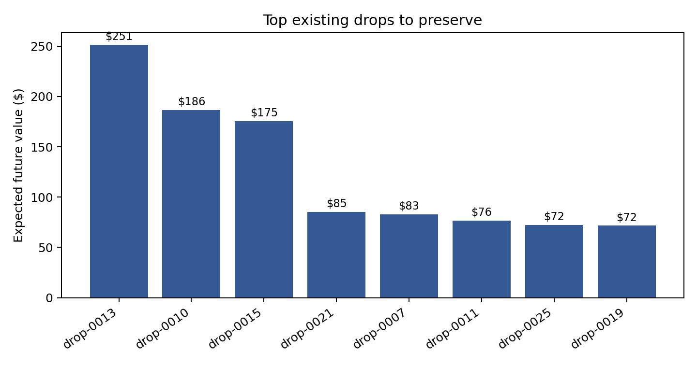
5. Prototype result: not all drops are equal
The prototype ranks existing drops by expected future reuse value from order history.
Preserve when possible
•
Large 6061-T6 0.5in drops show the highest option value.
•
They can fit many historical order shapes, so consuming them for tiny parts may be expensive.
•
Low-value drops with weak history are better candidates for current small parts.
Prototype goal: demonstrate the valuation idea, not build a production nesting engine.

Slide 7
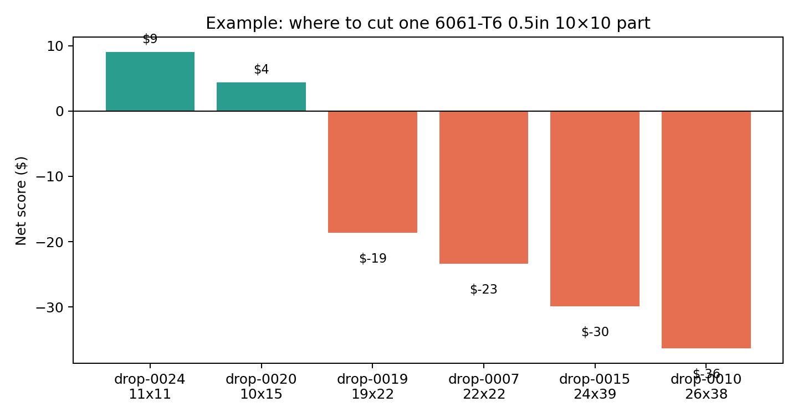
6. Example decision: one 6061-T6 0.5in 10×10 part
The algorithm prefers low-opportunity-cost drops, not simply the largest fitting drop.
Naive rule
“Use the first or biggest matching drop.” This can destroy a high-value remnant for a small part.
Cost-aware rule
Prefer the 11×11 or 10×15 style drop when it fits; preserve 24×39 or 29×45 drops because history says they are flexible.
Business meaning
The part still gets cut, but the shop keeps better future options and reduces expected long-run material spend.

Slide 8
7. Evaluation plan
Prove the system is better than simple rules using cost, waste, and future option value.
Baselines
Success metrics
Fresh plate only
•
Fresh material dollars purchased
Validation loop
No drops used. Easy but expensive.
•
Machine setup count and estimated cut time
Run the heuristic on historical batches, compare to baselines, and simulate how remaining drops perform against future orders.
•
Scrap area and scrap dollar value
Drop first
Always consume a fitting drop. Saves material today but may burn valuable inventory.
•
Useful drop value created or destroyed
•
Percent of demand fulfilled from existing drops
Expected outcome: lower total cost even when immediate waste is not always minimal.
Area waste only
•
Planner override rate and operator feedback
Minimize visible scrap without valuing future usefulness.

Slide 9
8. Ambitious version: full production planning system
With more time and budget, I would evolve the first-version heuristic into an operator-in-the-loop optimization platform.
Optimization engine
Real machine model
Demand forecasting
Shop-floor UI
Generate many candidate nests, not one greedy pass.
Use CP-SAT/MIP for hard constraints and local search for packing quality.
Optimize across multiple jobs to share plate setup intelligently.
Exact kerf accumulation and cut sequencing.
Guillotine vs. non-guillotine feasibility.
Speed factors for thickness, alloy hardness, machine availability, and operator setup.
Estimate drop reuse from history, seasonality, and customer/order patterns.
Attach confidence intervals to each drop value.
Learn when a technically reusable drop is actually too awkward to keep.
Visual layout preview with editable placements.
Explain “why this stock” in dollars.
Capture planner overrides as training data.
Inventory integration
Simulation & evaluation
Risk controls
Why not first?
Sync fresh plate SKUs, bin locations, and one-of-a-kind drops.
Track leftover lineage after each cut.
Update expected drop value as inventory changes.
Replay historical batches and compare to baselines.
Simulate how today’s leftovers perform against future orders.
Measure material dollars, setup time, scrap, and planner acceptance.
Flag low-confidence recommendations for human review.
Keep a conservative mode for rush or high-dollar jobs.
Never auto-consume high-value drops without explanation.
Requires clean operational data and trust from planners.
Hard to validate before a simple decision-support version is in daily use.
Optimization depth should follow real shop feedback.
Ambitious goal: move from “find a feasible layout” to “recommend the lowest-risk, lowest-cost production decision with explainable dollar tradeoffs.”

Slide 10
9. First version vs. ambitious version
A credible path from useful prototype to production planning system.
First version
Ambitious version
•
Cost-aware greedy heuristic
•
2D nesting optimizer or CP-SAT/MIP hybrid
•
Rectangle-only, rotation allowed
•
Exact kerf and cut sequencing
•
Guillotine-friendly placements
•
Machine-specific constraints and throughput
•
Simple historical drop valuation
•
Demand forecasting and confidence intervals
•
Human-readable recommendations
•
Operator UI with editable layouts
•
Small prototype + sample output
•
Inventory/ERP integration and feedback loop
The gap is intentional: ship a transparent decision-support tool first, then improve optimization depth as real shop data and operator feedback accumulate.

Slide 11
Closing: why this submission is different
It focuses on the highest-judgment part of the brief: valuing uncertain leftovers.
Most nesting tools answer: “Can the part fit?”
This design also asks: “What future option are we giving up?”
Deliverables
Slides
Prototype.py
README
Sample output
Designed for a few-hours take-home: clear judgment, data-backed reasoning, and a tiny prototype that demonstrates the tradeoff.

