Slide 1
Architecture
Amodini A P

Slide 2
Image Examination and Optimization
Image Review:
Conducted a thorough examination of all images within the folder.
Duplicate Identification:
Identified several duplicate images during the review process.
Optimization:
Successfully removed all duplicate images to streamline the folder contents.

Slide 3
Feature Generation
Initial Feature Selection:
Considered multiple features, including:
Area , Perimeter, Angles ,Number of corners ,Compactness ,Number of hull points ,Mean edge length
Exploratory Data Analysis:
Conducted a thorough exploratory data analysis (EDA) to evaluate the relevance and significance of each feature.
Feature Optimization:
Selected the most relevant features based on EDA results for further analysis and model development.

Slide 4
Task 1 – Grouping images into families
Dimensionality Reduction:
Reduced the dimensionality of the image data for efficient processing.
Clustering Method:
Employed K-means clustering to group similar images into distinct families.
Outcome:
Successfully categorized images into coherent groups based on similarity.

Slide 5






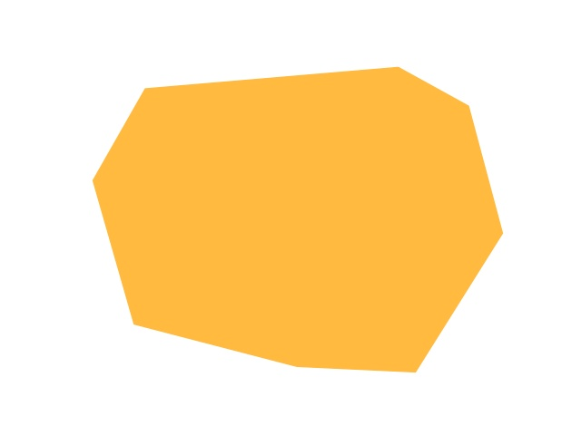


Group 0
Group 1
Group 2

Slide 6
Task 2: Classifying Layout Complexity
Feature Selection:
Utilized compactness as a key feature to assess layout complexity.
Classification Criteria:
Categorized layouts into three complexity levels:
Low complexity
Medium complexity
High complexity
Outcome:
Successfully classified images based on their layout complexity using the established criteria.

Slide 7





HIGH
MEDIUM
LOW
Accuracy = 97%

Slide 8
TASK 3 – Identifying The family for AN Image
Classification Approach:
Developed a classification model to assign images to predefined families based on their visual characteristics.
Methodology:
Leveraged supervised learning techniques to train the model on labeled image data from identified families.
Implementation:
Implemented the model to accurately classify new images into their respective families based on learned features.

Slide 9


This image was classified as belonging to Group 2
This image was classified as belonging to Group 1
Accuracy = 93%

Slide 10
Additional IDEA
Automated Layout Suggestions:
Use generative models (such as GANs or VAEs) to suggest new layouts based on existing successful designs,
helping architects during the ideation phase.

