Slide 1

Basic Details of the Team and Problem Statement
Ministry/Organization Name/Student Innovation:
National Digital Education Architecture (NDEAR), Department of School Education & Literacy (DoSEL)
PS Code: AK1083
Problem Statement Title: Creating games/ open source solutions to develop games which help in teaching / learning concepts
Team Name: Group-05 ( 17,18,19,20 )
Team Leader Name: Karthik Shetty
Institute Code (AISHE):
Institute Name: Thakur College of Engineering and Technology
Theme Name: Educational Game

Slide 2
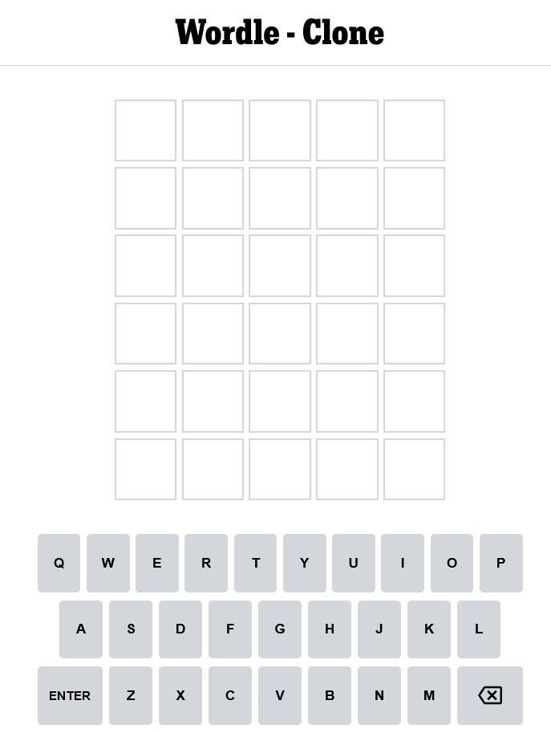
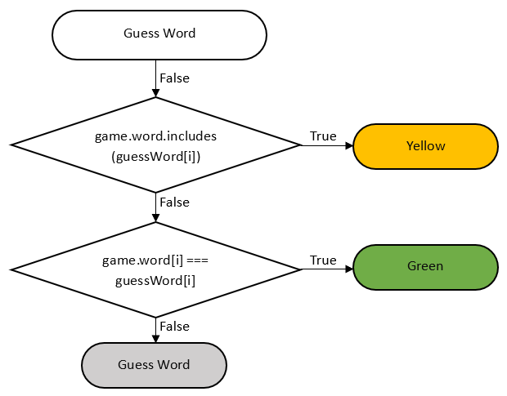
Idea/Approach Details
Idea/Solution/Prototype:
In this project, we will be recreating the guessing game Wordle.
This project covers the core game logic but does not implement sharing the results.
The project doesn't cover the functionality that generates game statistics.
It is intended for front-end developers that want to build a fun, vanilla JavaScript or Python project.
Technology stack:
This project assumes a basic understanding of:
HTML
CSS
JavaScript
NPM
Python

Slide 3
Idea/Approach Details
Use Cases:
Dependencies:
Creating the game board
Creating the on-screen keyboard
Accepting user input
Adding notifications
Making the on-screen keyboard generate input
Adding animation
If we use JavaScript:
axios
cors
dotenv
express
If we use Python:
NumPy
Pandas
Matplotlib
String
re

Slide 4
Team Member Details
Team Leader Name: Karthik Shetty - 18
Branch (BTech/MTech/PhD etc.): B.E. Stream (ECE, CSE etc.): CSE Year (I,II,III,IV): VI
Team Member 1 Name: Ananya Shetty - 17
Branch (BTech/MTech/PhD etc.): B.E. Stream (ECE, CSE etc.): CSE Year (I,II,III,IV): VI
Team Member 2 Name: Sparsha Shetty - 19
Branch (BTech/MTech/PhD etc.): B.E. Stream (ECE, CSE etc.): CSE Year (I,II,III,IV): VI
Team Member 3 Name: Pranali Shirsat - 20
Branch (BTech/MTech/PhD etc.): B.E. Stream (ECE, CSE etc.): CSE Year (I,II,III,IV): VI
Team Mentor 1 Name: Ms. Huda Khan
Category (Academic/Industry): Academic Expertise (AI/ML/Blockchain etc.): Domain Experience (in years):
Team Mentor 2 Name: Ms. Tammayi Nagale
Category (Academic/Industry): Academic Expertise (AI/ML/Blockchain etc.): Domain Experience (in years):

