Slide 1
Explainable Quantum-Assisted PINNs
Reduced thermo-optic phase-shifter modeling
Static and transient thermal PDEs | Classical controls | Q0/Q1 entanglement ablation
Amoggh Bellad <amogghb@gmail.com> | Shahar Ankonina <shahar.ankonina05@gmail.com>
WISER-BQP Quantum-Assisted PINN Challenge
1
Notes:
[Sources] BQP - WISER Quantum Challenge [SHARED] (3).pdf; Summer Program 2026 BQP Challenge (1).pdf; configs/final_experiment_manifest.yaml.

Slide 2
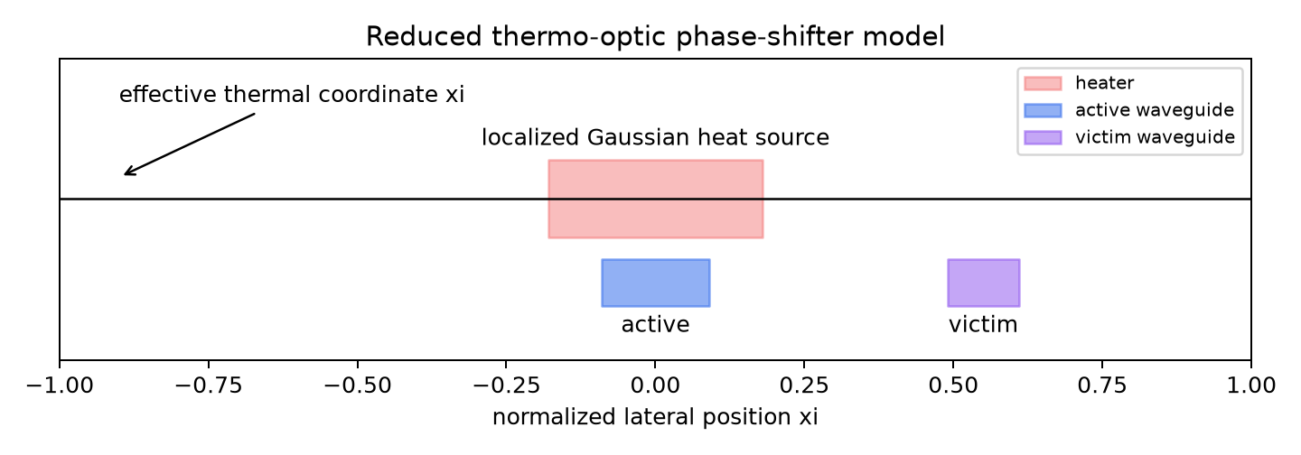
The study asks what the quantum layer changes
The reduced device model keeps the physics defensible and the ablation controlled.
- Thermal PDE is learned; optical phase and crosstalk are computed afterward.
- Q0 and Q1 are parameter matched; Q1 differs by one CNOT.
- No hardware speedup, quantum advantage, or fabricated-device calibration is claimed.
2
Notes:
[Sources] report/technical_report.pdf; results/figures/reduced_device_schematic.png.

Slide 3
The protocol was frozen around four core models
Same physics, seeds, optimizer, dtype, collocation rule, and evaluation grid.
Model
Role
Budget
classical_matched
parameter budget control
343 params
classical_standard
higher-capacity classical PINN
2241 params
Q0 separable
two-qubit feature layer without CNOT
343 params
Q1 entangled
Q0 plus one CNOT(0,1)
343 params
Derivative gate: finite dq/dxi, dq/dtau, d2q/dxi2, and quantum parameter gradients.
3
Notes:
[Sources] results/metrics/quantum_derivative_gate.json; results/metrics/reference_validation.json; configs/final_experiment_manifest.yaml.

Slide 4
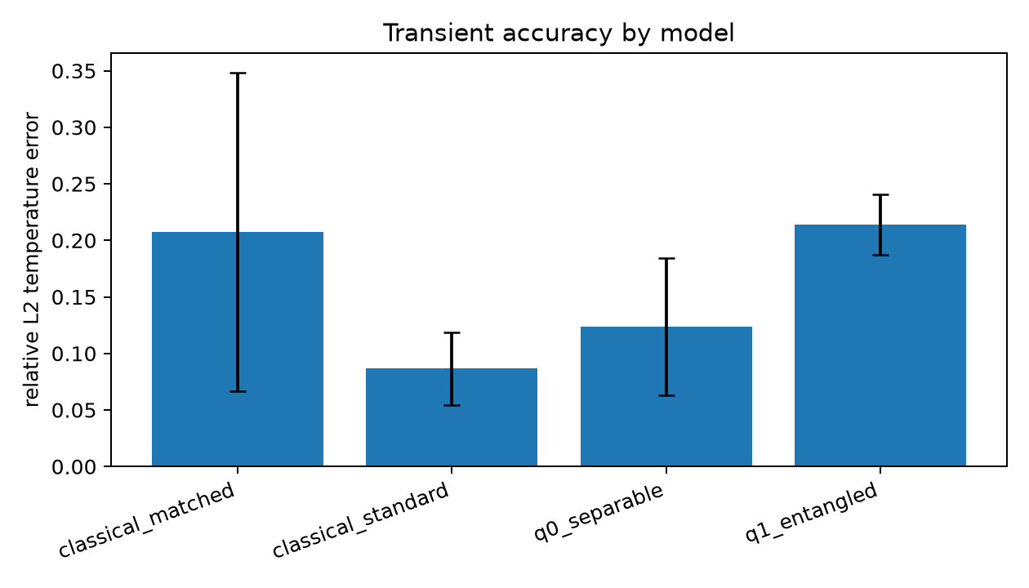
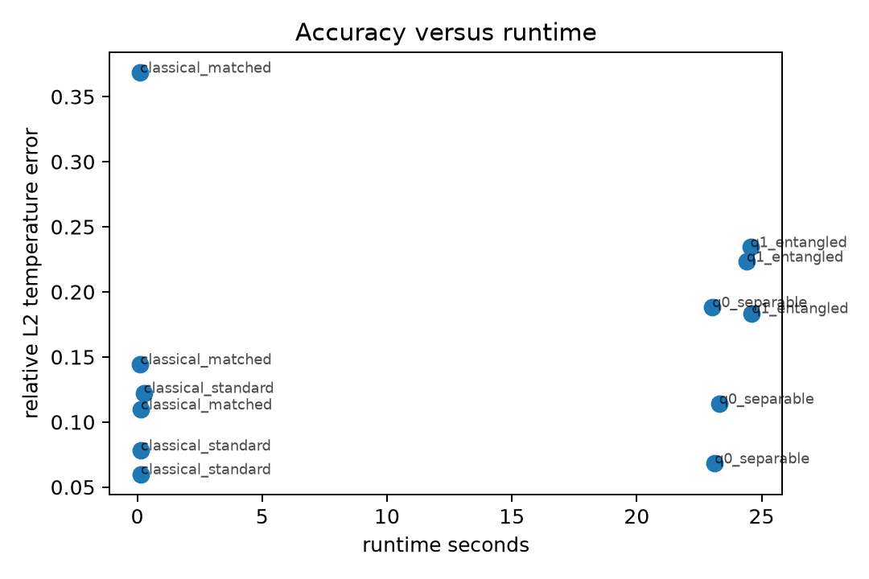
On the transient PDE, Q0 beat the matched baseline but not the standard PINN
The standard classical control prevents overclaiming a parameter-efficiency result.
Mean relative L2: standard classical 0.0868, Q0 0.1235, matched classical 0.2074, Q1 0.2137.
4
Notes:
[Sources] results/metrics/final_transient_metrics.csv; results/metrics/final_transient_summary.csv; generated figures.

Slide 5
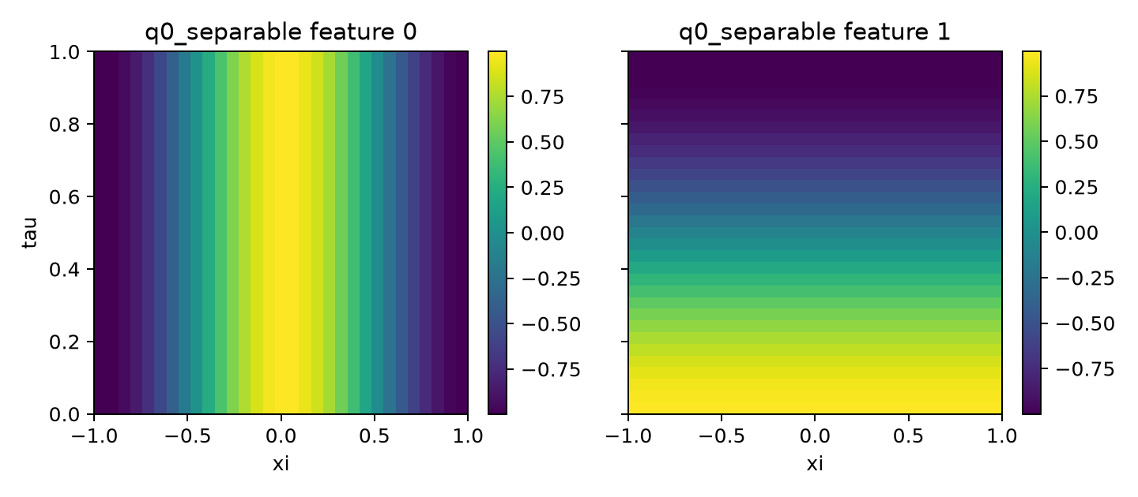
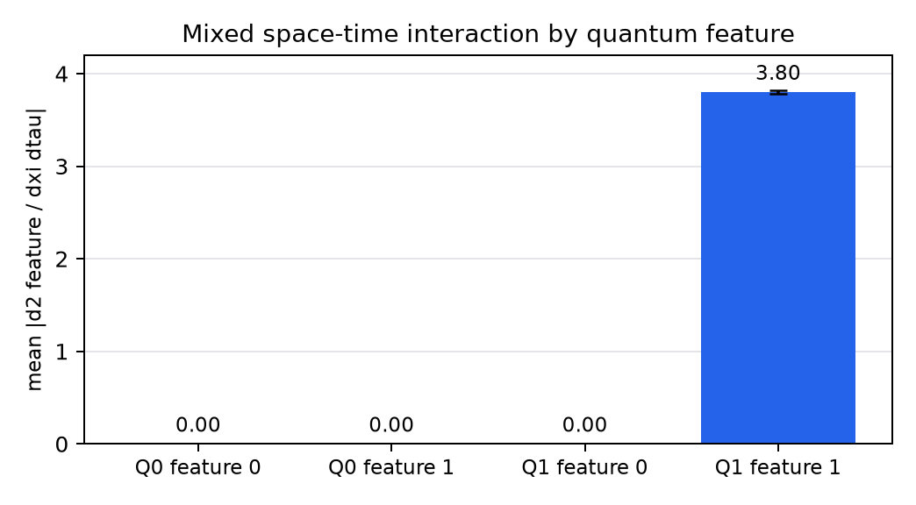
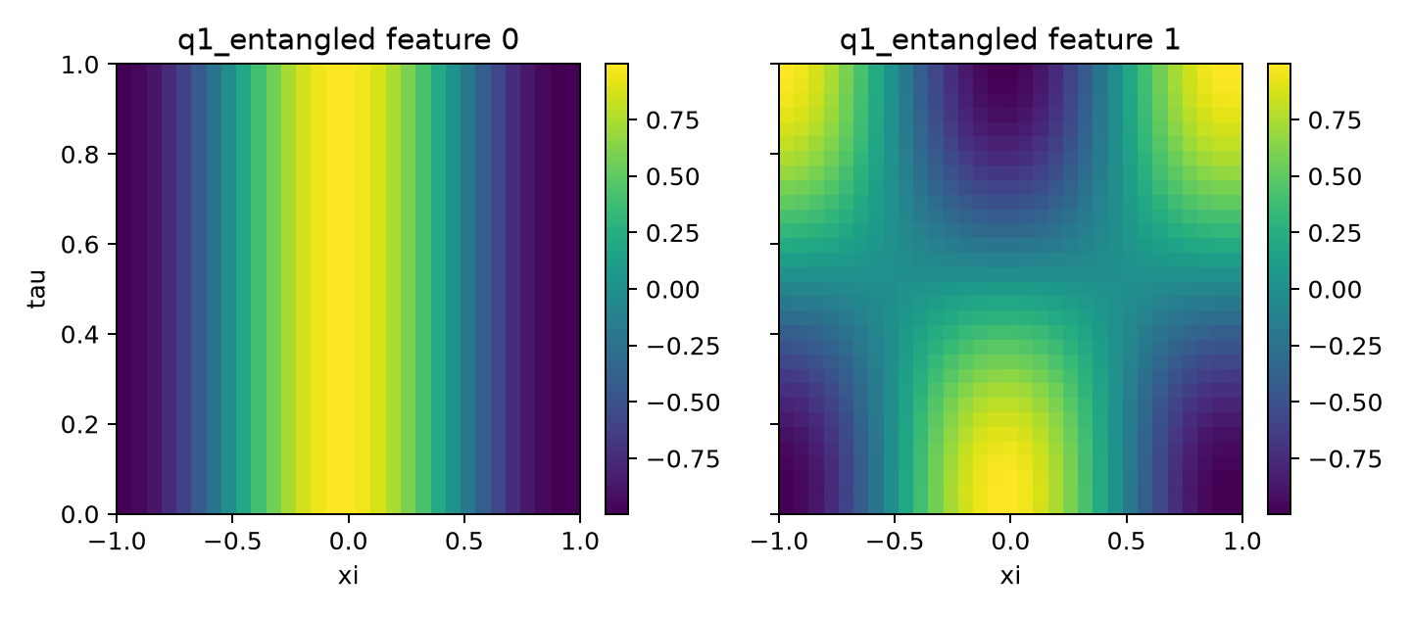
Entanglement created interaction, not better transient accuracy
The CNOT changed representation in the intended way, but the physical error did not improve.
Q1 feature 1: mean interaction 3.80; Q0 features remain near zero.
5
Notes:
[Sources] results/metrics/feature_diversity.csv; results/runs/*_explainability.npz; generated feature-map figures.

Slide 6
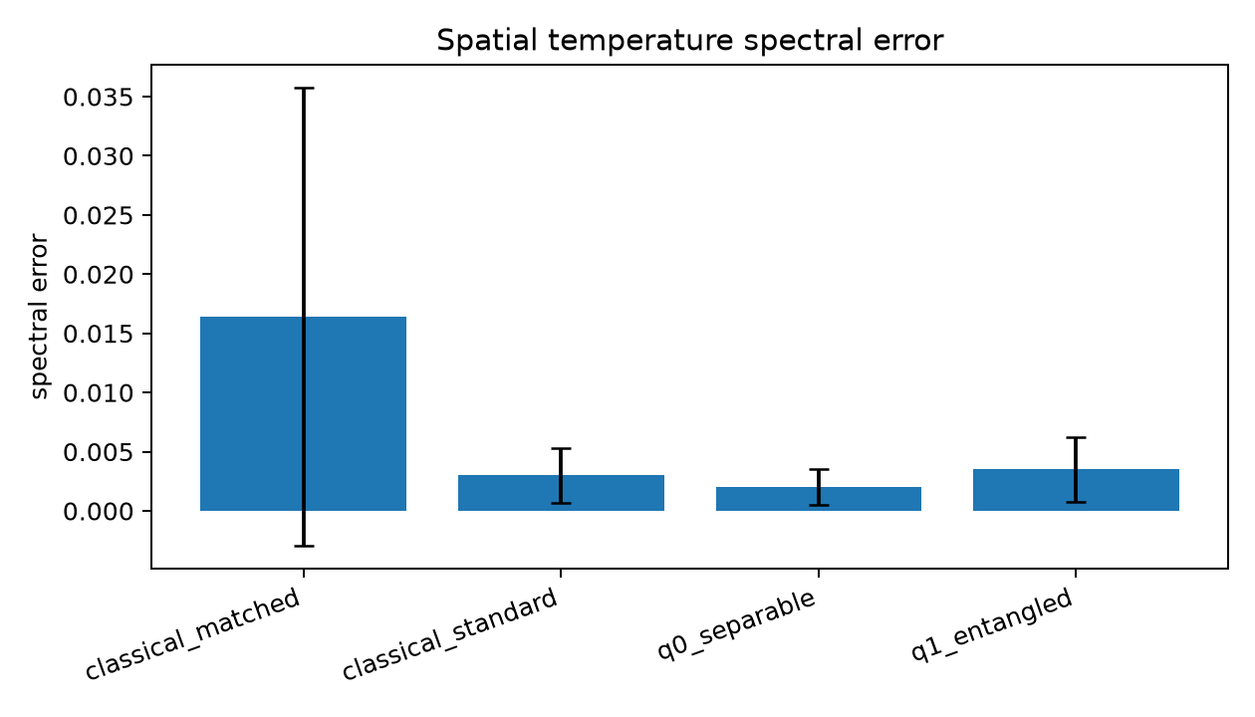
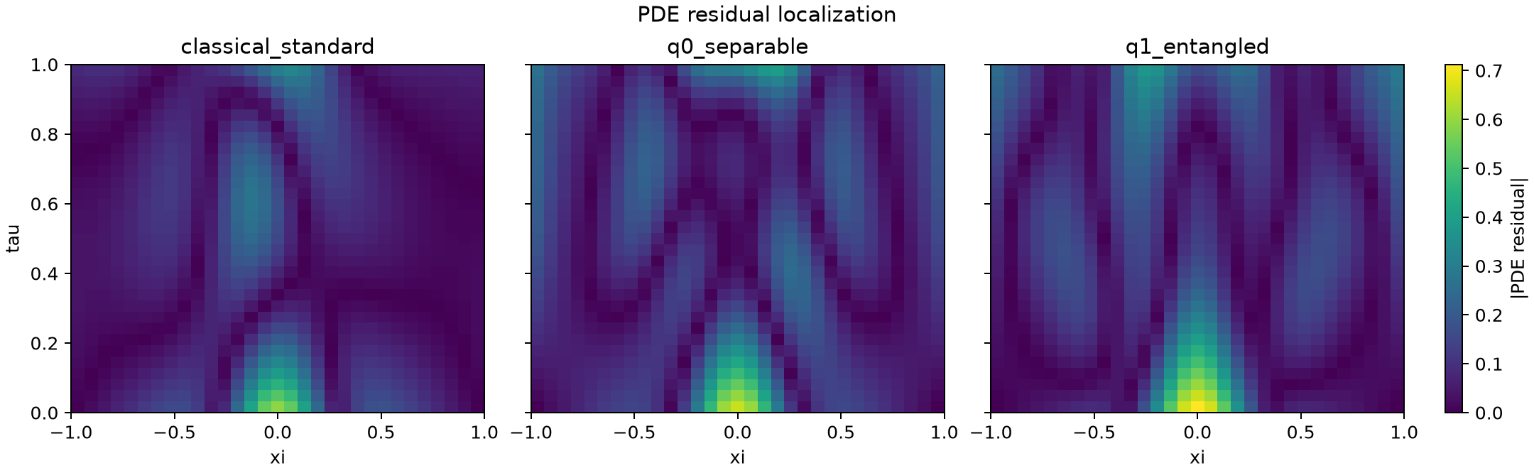
Spectra and residuals show why accuracy matters more than feature complexity
Extra representation structure is only useful if it reduces physical error.
Fourier and residual analyses are computed from saved arrays, not manually typed result values.
6
Notes:
[Sources] results/metrics/fourier_spectral_errors.csv; results/metrics/fourier_spectral_summary.csv; results/runs/*_arrays.npz.

Slide 7
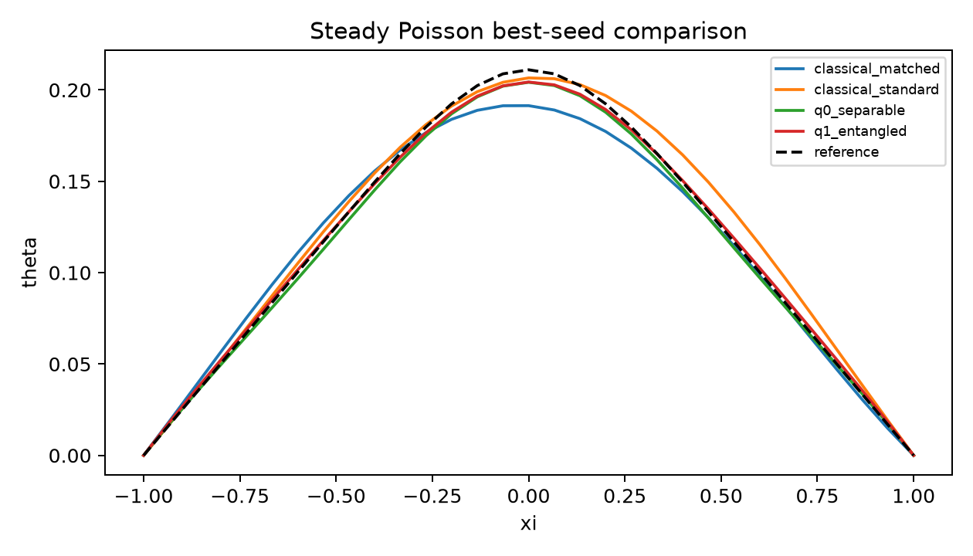
The steady Poisson task adds a second PDE class
Only position is required, so entanglement should not be assumed useful.
- Q1 had the lowest mean steady relative L2 in this small-budget protocol.
- The standard classical model was close and far faster.
- The steady result is not enough to claim a general entanglement advantage.
7
Notes:
[Sources] results/metrics/steady_metrics.csv; results/metrics/steady_summary.csv; results/steady_runs/*.json.

Slide 8
The defensible conclusion is conditional
The project supports a circuit-selection rule, not a quantum-advantage claim.
- Use the shallow separable circuit as a compact parameter-efficiency control.
- Add entanglement only when interaction, spectrum, and physical metrics improve together.
- Report parameter count separately from simulator runtime.
- Preserve negative results: Q1 added interaction but did not help transient accuracy.
8
Notes:
[Sources] docs/results_interpretation.md; report/technical_report.pdf.

Slide 9
The submission is reproducible from scripts and saved records
Every table and figure is backed by machine-readable outputs.
- Environment: Python 3.11, Torch 2.2.2, PennyLane 0.35.1, NumPy 1.26.4.
- Core commands: pytest, validate_physics.py, test_quantum_derivatives.py, run_final_transient.py, run_steady.py, analyze_results.py.
- Outputs: metrics CSVs, JSON run records, NPZ arrays, figures, report PDF, and this deck.
8 passed
2 gates
1 package
focused tests
reference and derivative
report, slides, source, evidence
9
Notes:
[Sources] README.md; requirements-lock.txt; results/metrics/*.csv; results/runs/*.json; results/steady_runs/*.json.

Slide 10
Next work should test mechanisms, not bigger circuits
The current result supports a cautious research path.
1
Run optimizer-budget sensitivity
Check whether Q0, Q1, and the classical baselines change rank order with more training.
2
Add Q2 data re-uploading
Report added parameters, gates, depth, runtime, spectra, gradients, and physical error together.
3
Add classical Fourier features
Separate quantum angle encoding from a general trigonometric inductive bias.
Defer 2D/3D photonic simulation until the reduced-order workflow is stable under these tests.
10
Notes:
[Sources] configs/final_experiment_manifest.yaml; docs/results_interpretation.md.

