Slide 1
NOVO NORDISK GBS HACKATHON 2026
PayerLens AI
Predicting Patient Access Through Payer & Healthcare Ecosystem Intelligence
One-line problem: manufacturers spend weeks of fragmented, manual HEOR analysis to guess how NICE, G-BA, and HAS will respond to a new heart-failure therapy — PayerLens simulates the answer, live.
COLLEGE
HEADLINE OUTCOME
International Institute of Information Technology Bangalore
Collapses a 4-week, multi-team market-access strategy exercise into an interactive, citation-backed simulation — country-prioritized launch recommendations in minutes, not weeks.
TEAM
Chamrajpet
TEAM MEMBERS
Amogh Gurudatta, Surya Kiran Basava, Saaket Ajay Manjrekar, Kedar Mallya, Vamshidhar Vagish

Slide 2
THE CHALLENGE
Problem & Innovation
02
What problem are we solving?
OUR INNOVATION
Post-clinical-success reimbursement is uncertain across divergent European HTA systems: NICE weighs cost-effectiveness (£20–£30k/QALY), G-BA's AMNOG process legally bans ICERs and assesses added clinical benefit only, and HAS runs a dual SMR/ASMR track. The same evidence package can succeed in Germany and fail in the UK — and no platform lets a manufacturer simulate that divergence before committing to a submission strategy.
• Dual-engine design. A transparent, citation-audited multi-attribute simulation runs alongside a calibrated ML ensemble trained on real HTA rulings — explainability and predictive power in one tool, not a black box.
• Provenance-tagged everything. Every number carries a Statutory / Clinical / Epidemiological / Simulated tag traceable to its source document — a prediction a HEOR team could actually defend to a payer.
Who is impacted?
• Market Access & HEOR teams — must build a defensible, evidence-cited access strategy per country.
• Commercial & Pricing teams — need to price-test before a single irreversible launch decision.
• Regulatory & Medical Affairs — must align trial design with what each payer will actually require.
• Patients — wait longer for access every time launch strategy misses the mark.
PayerLens AI • Novo Nordisk GBS Hackathon 2026

Slide 3
THE SOLUTION
Solution Summary
03
PayerLens AI is an interactive dashboard that predicts reimbursement probability for a heart-failure therapy across the UK, Germany, and France — letting a team test price points, diagnostic requirements, and patient-population strategy against five real historical drug precedents.
How it works
1
2
3
4
Pick a precedent
Set the scenario
Engine blends
Get the strategy
Farxiga, Verquvo, Entresto, Jardiance, or a broad-class archetype
Annual price (€1.5k–8.5k) + companion-diagnostic requirement
Calibrated ML prediction + documented regulatory-friction rules
Country scores, budget alerts, launch sequence — live
Target users & use case
Expected benefits
A HEOR / Market Access analyst preparing a pre-launch access strategy for a novel-mechanism HF drug. Use case: “Given our Phase 3 data and target price, which country do we launch first — and what evidence gap must we close before submission?”
Time
Cost
Weeks → minutes per scenario
Fewer cross-functional workshops
Quality
Outcomes
Every score cites its precedent
Faster, better-targeted access
PayerLens AI • Novo Nordisk GBS Hackathon 2026

Slide 4
UNDER THE HOOD
Technical Implementation
04
Training Data
train_model.py
Model Artifact
STACK
HAS ASMR/SMR CSVs, curated NICE TAs, curated G-BA §35a, ESC/NHS/OECD epidemiology
Feature engineering + jittered de-leaking, RF+GBM+LR voting, sigmoid calibration
payerlens_rf_model.pkl — per-country calibrated ensembles
– React 19
– Vite 8 + Tailwind
– FastAPI + Pydantic
– scikit-learn
– Recharts
– Vercel / Render
offline, one-time training pipeline
React 19 + Vite 8
FastAPI ML Service
Calibrated Ensemble
Tailwind UI • Recharts • Vercel deployment. Local calibrated MCDM engine as offline fallback.
/predict /health /model-info — Render deployment, CORS-enabled, Pydantic-validated schema
Random Forest + Gradient Boosting + Logistic Regression, soft-voting, per-country
live request/response path
Key technical choices
Algorithms
Data sources
Evaluation
Soft-voting ensemble (RF + GBM + LR) with sigmoid probability calibration (CalibratedClassifierCV); per-country StratifiedKFold cross-validation.
data.gouv.fr HAS ASMR/SMR registry, hand-curated NICE & G-BA statutory precedents, ClinicalTrials.gov landmark endpoints, ESC/NHS/OECD epidemiology.
Held-out per-country test accuracy + rule-based explainability (decision catalysts/frictions) returned alongside every live prediction.

Slide 5
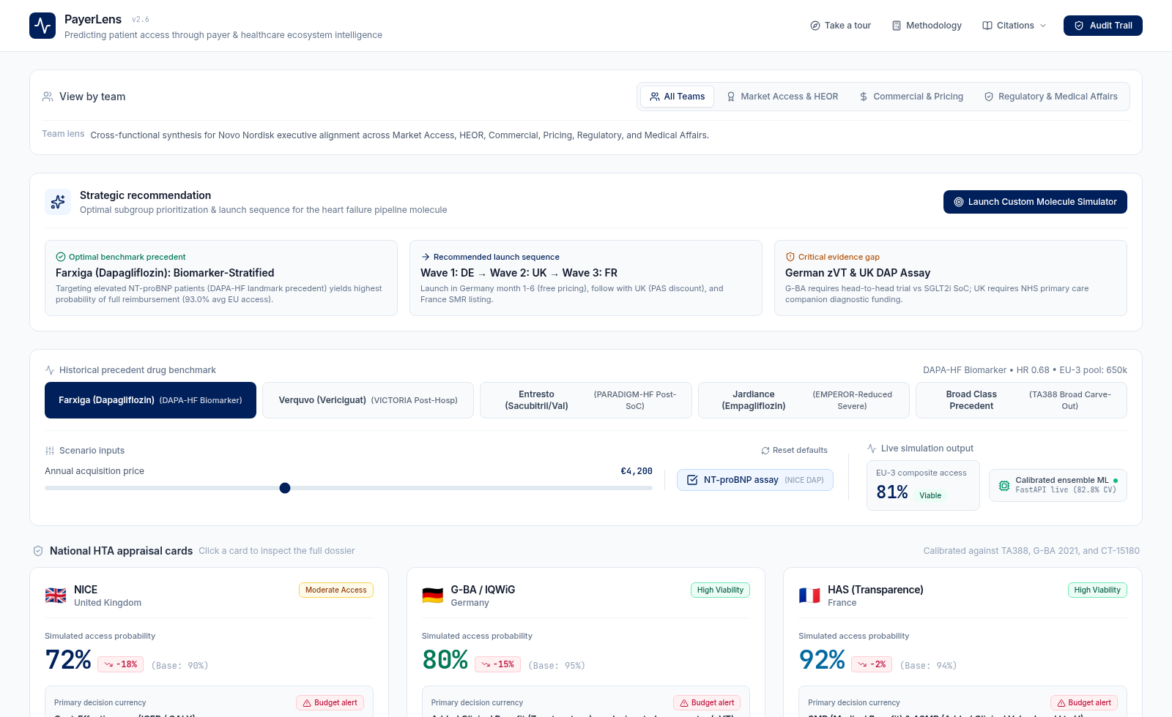
IT WORKS TODAY
Results & Demo Highlights
05
What works right now
• Full interactive dashboard — 5 historical precedents, live price + diagnostic sliders
• Real-time ML inference with sub-second response + live explainability
• 3 chart views vs. a 70% historical viability benchmark
• Full audit trail — every metric cites its source
• Guided first-time onboarding tour
Model accuracy (held-out test)
UK (NICE)
73.3%
Germany (G-BA)
88.9%
France (HAS)
94.8%
Live dashboard — default scenario, price €4,200, diagnostic required
Combined CV
82.8%
Example walkthrough — Scenario D (Farxiga / DAPA-HF), €4,200, diagnostic required
Limitations discovered
Input: HR 0.68, 32% hosp. reduction, biomarker-defined, direct comparator → Output: UK 72% · Germany 80% · France 92% · composite 81% (“Viable”). At €8,500: UK 40% · DE 60% · FR 84% · composite 61% (“High friction”).
France's synthetic features initially leaked their own label; fixed via jittering. UK/DE train on small curated corpora (73/42 rows) — more variance than France's 1,337.
PayerLens AI • Novo Nordisk GBS Hackathon 2026

Slide 6
WHAT'S NEXT
Feasibility & Roadmap
06
Feasible next: independent real per-drug trial features (closing France's remaining data circularity), native SHAP-based explainability, and EU-5 expansion (Italy AIFA, Spain AEMPS) per the original problem-statement scope.
Roadmap — next 4 milestones
M1
M2
M3
M4
Independent Feature Pipeline
EU-5 Expansion
Native XAI
Enterprise Readiness
Replace remaining imputed France features with real per-drug trial data
Add Italy (AIFA) and Spain (AEMPS) HTA models
SHAP-based explainability directly from the trained ensemble
Auth, scenario-library persistence, audit logging
Dependencies & risks
Mitigation plan
• Stability of public data portals (data.gouv.fr schema/URLs)
• Regulatory data licensing for NICE/G-BA at scale beyond hand-curated samples
• Model generalization to therapeutic areas outside cardiology
• Render free-tier cold starts affecting live-demo reliability
• Local calibrated fallback keeps the app usable if the ML service is unreachable
• Versioned model artifacts + transparent /model-info accuracy reporting
• Jittered-imputation methodology documented in MODEL_CARD.md for audit reproducibility
PayerLens AI • Novo Nordisk GBS Hackathon 2026

Slide 7
WHY IT MATTERS
Business Impact
07
PayerLens directly answers the problem statement's mandate: deliver a country-prioritized access strategy within 4 weeks — replacing fragmented, multi-week manual HEOR analysis with a live, evidence-cited simulation.
Adoption pathway
Pilot
(Heart Failure)
Validate
(MA/HEOR/Reg/Comml)
Expand
(EU-5 + indications)
Embed
(Launch workflow)
Evidence & assumptions
Calibrated against real historical HTA rulings (NICE TA388/679/773/793, G-BA resolutions, HAS CT opinions). Assumes payer behavior for a novel-MoA HF drug will pattern-match these precedents — stated explicitly as an assumption, positioned to augment, not replace, HEOR expert judgement.
Three things to remember
1
2
3
One platform replaces weeks of fragmented manual analysis with a live simulation.
Every prediction is citation-backed and audit-ready — not a black box.
Transparent MCDM + calibrated ML balances explainability with predictive power.
PayerLens AI • Novo Nordisk GBS Hackathon 2026

Slide 8
RESPONSE TO PRE-FINALE REVIEW
Scoring Methodology: How the Matrix Works
APPENDIX
A two-layer architecture: an expert-calibrated rubric sets each scenario's baseline; two computational engines make it live.
Scenario names below are the drug precedents each was calibrated against — our original submission used generic labels (e.g. “Biomarker-Defined High Risk”); see the accompanying Word document, Section 1.1, for the full naming correspondence.
Reimbursement Potential Score = ( P + U + C + A + F + E ) − ( G_impl + G_evid )
Factor | Scale | What it measures | Evidence it reads
P — Patient Opportunity | 0–15 | Eligible population share | OECD/Eurostat/BHF epidemiology
U — Unmet Medical Need | 0–20 | Burden of disease, CV event risk | ESC 2021 guidelines; NHS HES data
C — Clinical Differentiation | 0–25 | Effect size vs. comparator | Landmark trial hazard ratios
A — Country Payer Archetype Alignment | 0–35* | Fit with THAT agency's decision currency | NICE ICER / G-BA benefit / HAS SMR-ASMR logic
F — Affordability / Budget Fit | 0–10 | Budget impact vs. statutory threshold | NHS £20m / German €30m / French €20m tests
E — Evidence Strength | 0–15 | Trial design rigor | Trial phase & pre-specification
G — Implementation + Evidence-Gap Penalties | −0 to −35 | Diagnostic friction & unresolved objections | NICE DAP, G-BA Labor-Richtlinie, French RIHN
* Corrected from 0–15 in our original deck once we solved for A against our own published probabilities — see next slide.
From static score to live app — not equal partners:
• Our first submission used only the deterministic formula above. We've since added a calibrated ML ensemble (13 features, 1,452 records) that is what the live dashboard actually shows when our backend is reachable; the deterministic formula now runs only as the offline fallback.
PayerLens AI • Response to pre-finale review — scoring methodology appendix

Slide 9
RESPONSE TO PRE-FINALE REVIEW
Reconciled Scoring Component Matrix
APPENDIX
Every cell below sums exactly to the calibrated probability in our Scenario Evaluation Matrix — P, U, C, F, E and G are scenario-level; A is the only country-dependent term.
Scenario | P | U | C | A (UK/DE/FR) | F | E | G_impl | G_evid | Score (UK/DE/FR)
Farxiga (D) — Biomarker-Defined High Risk | 8 | 18 | 22 | 27/32/31 | 8 | 15 | -6 | -2 | 90/95/94%
Verquvo (C) — Frequent Hospitalisation | 9 | 15 | 19 | 25/30/28 | 7 | 14 | -2 | -3 | 84/89/87%
Entresto (B) — High Risk Despite SoC | 10 | 16 | 18 | 23/30/27 | 6 | 13 | -3 | -3 | 80/87/84%
Jardiance (E) — Later-Line Severe Unmet Need | 5 | 20 | 17 | 24/28/28 | 9 | 11 | -4 | -5 | 77/81/81%
Broad Class (A) — Broad HF Population | 14 | 10 | 14 | 17/23/20 | 3 | 12 | -2 | -4 | 64/70/67%
Verification example (Scenario D, Germany):
8 (P) + 18 (U) + 22 (C) + 32 (A) + 8 (F) + 15 (E) − 6 (G_impl) − 2 (G_evid) = 95% ✓ matches the published German probability exactly.
Pattern: A(Germany) ≥ A(France) ≥ A(UK) in every scenario — Germany's added-benefit-only AMNOG process rewards evidence alignment most directly; the UK's hard ICER ceiling constrains it most.
PayerLens AI • Response to pre-finale review — scoring methodology appendix

