Slide 1
Intelligent Email Spam Detection Using Machine Learning
Department of Computer Science & Engineering (AI & ML)
Sreyas Institute of Engineering and Technology, Hyderabad
• B.Tech Micro Project Defense | Academic Year 2025–2026
Presenters: GANTA BALA AMOGH RAJ (24VE1A6681) & DOMA AJAY (24VE1A6677)
• Faculty Supervisor: Department of CSE (AI & ML)
Notes:
Slide 1: Introduce yourself, project title, and institution. Emphasize that this is an end-to-end reproducible machine learning system with real-time web deployment.

Slide 2
Problem Statement & Cybersecurity Challenges
The Escalating Threat of Unsolicited Bulk Email
• Over 340 billion emails sent daily; ~50% represent unsolicited spam.
• Spam acts as delivery vectors for ransomware, phishing, and identity theft.
• Traditional rule/keyword heuristics fail against obfuscated spelling & Unicode injection.
• Core Challenge: High-dimensional sparse text & severe class imbalance.
Notes:
Viva Question: Why not keyword filtering? Answer: Static rules fail against intentional misspellings and zero-width characters. ML extracts generalizable probabilistic distributions.

Slide 3
Motivation & Asymmetric Misclassification Costs
Why Precision Outweighs Accuracy in Spam Filtering
• False Negative (Spam in Inbox): Minor user inconvenience.
• False Positive (Legitimate in Spam): Catastrophic loss of job offers, medical alerts, or business invoices.
• Goal: Enforce strict False Positive constraint (FPR <= 0.15%) while maximizing Recall.
Notes:
Viva Question: Why is precision key? Precision = TP / (TP + FP). Maximizing Precision drives False Positives toward zero.

Slide 4
Project Objectives & Technical Scope
Systematic Engineering Goals
• 1. Acquire and audit the benchmark 5,572-message spam collection.
• 2. Develop an 8-stage text normalization and token masking pipeline.
• 3. Extract leak-free unigram & bigram TF-IDF feature representations.
• 4. Benchmark 4 supervised ML algorithms (MNB, Linear SVC, LR, RF).
• 5. Build an interactive Streamlit GUI for real-time inference.
Notes:
Walk through the five objectives to orient the examination committee.

Slide 5
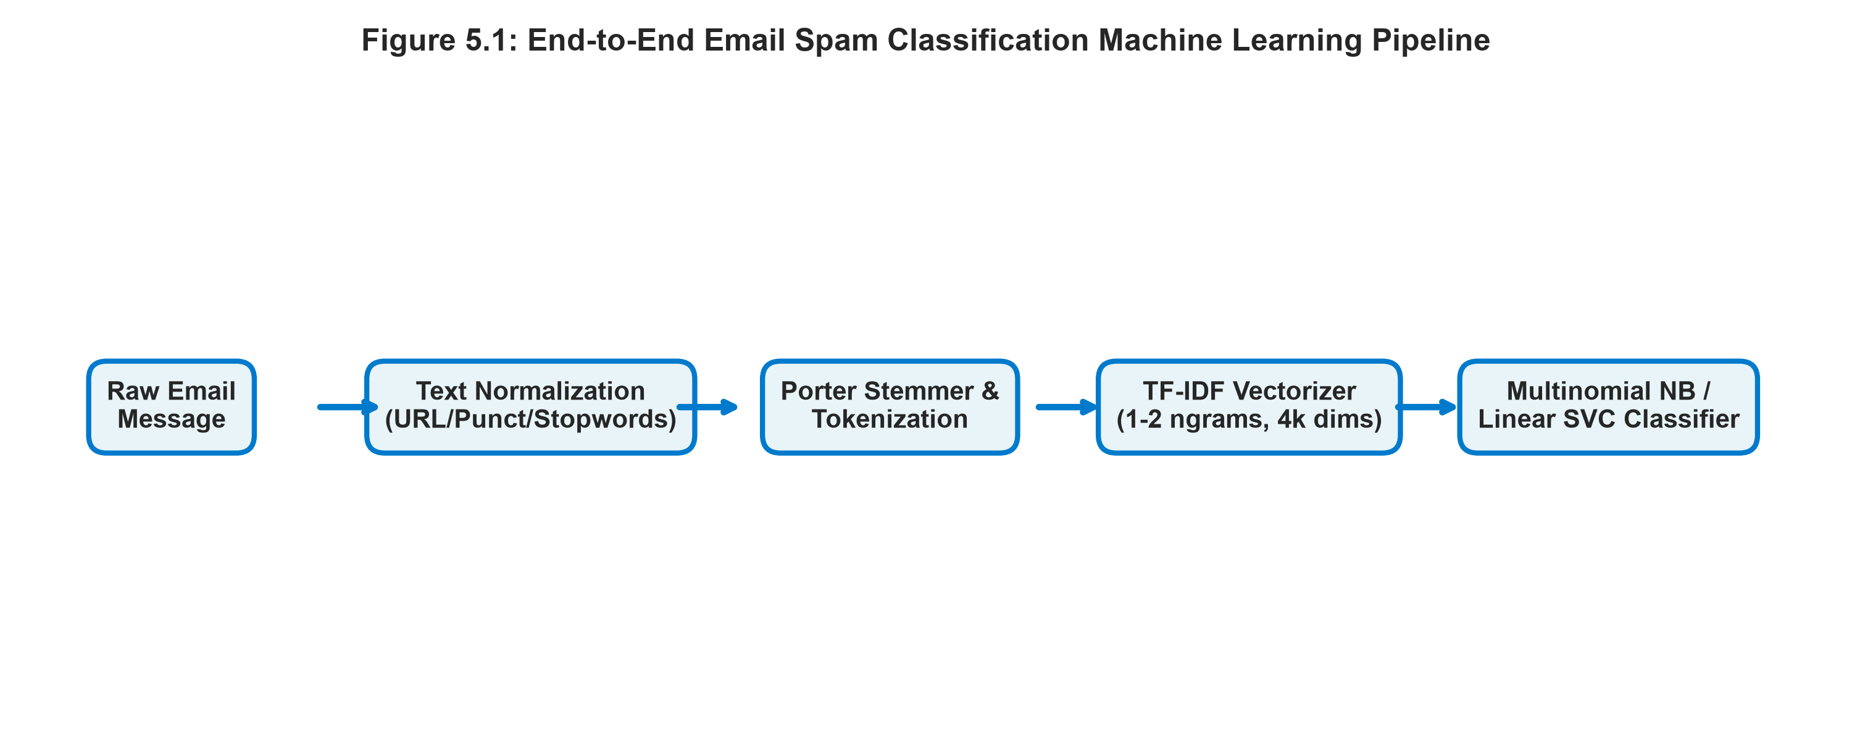
Proposed System Architecture
End-to-End Pipeline Workflow
• Layer 1: Ingestion & Schema Validation (Ham vs. Spam).
• Layer 2: Text Normalization (URL abstraction, currency tags, Porter stemming).
• Layer 3: TF-IDF Vectorization (4,000 max features, sublinear scaling).
• Layer 4: Supervised Classification Engine & Probability Calibration.
• Layer 5: Streamlit Web UI & Inference REST Service.
Notes:
Highlight leak-free design: TF-IDF statistics are calculated strictly on the training partition.

Slide 6
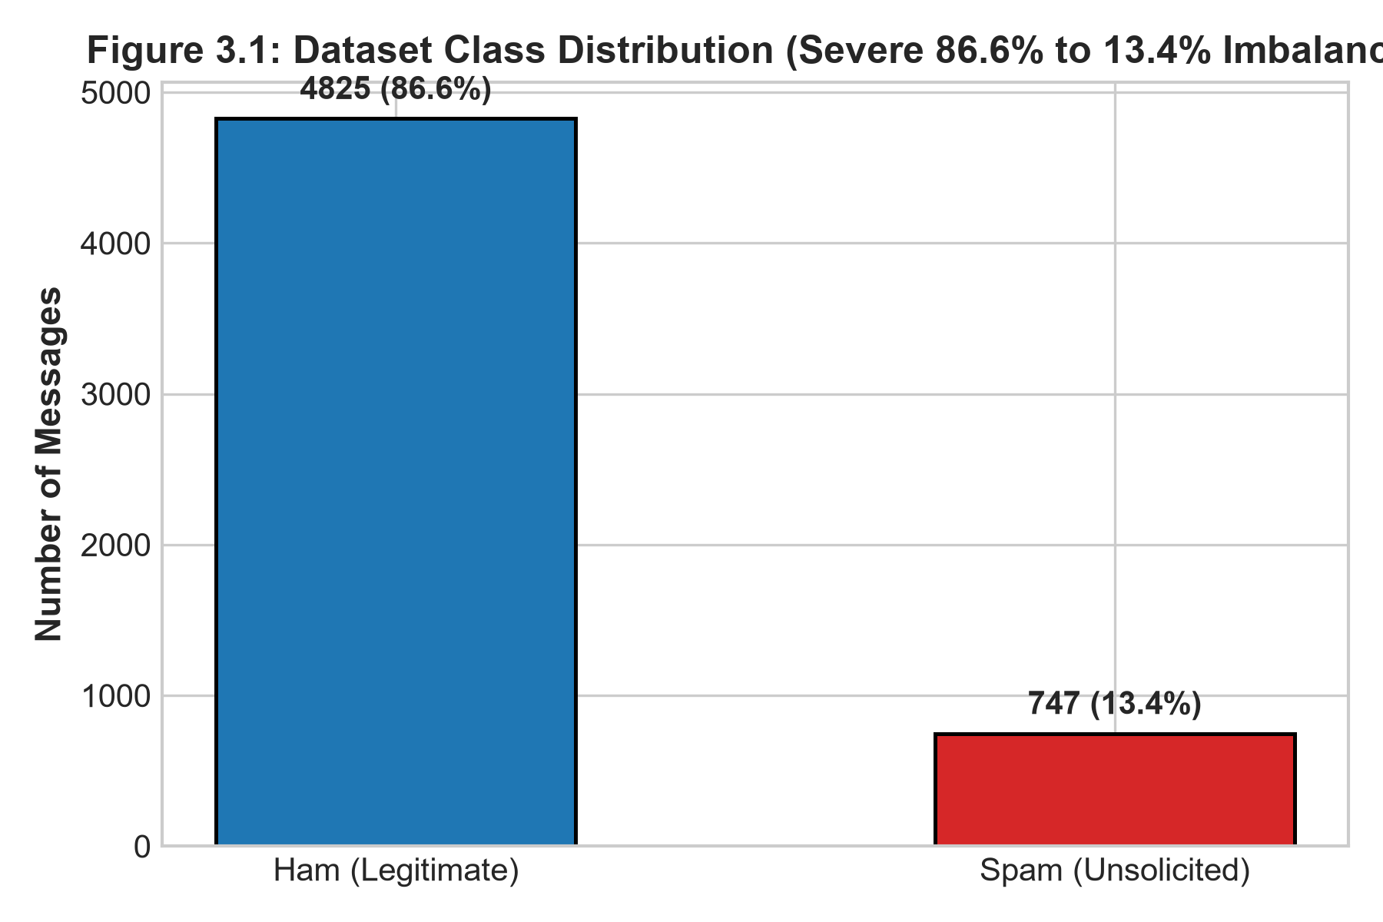
Dataset Provenance & Class Imbalance
Benchmark Corpus Characteristics
• Total Record Count: 5,572 verified messages.
• Legitimate (Ham): 4,825 instances (86.6%).
• Spam (Unsolicited): 747 instances (13.4%).
• Natural 6.46:1 class imbalance matches real-world enterprise traffic.
Notes:
Emphasize why plain accuracy is misleading and precision/recall curves are essential.

Slide 7
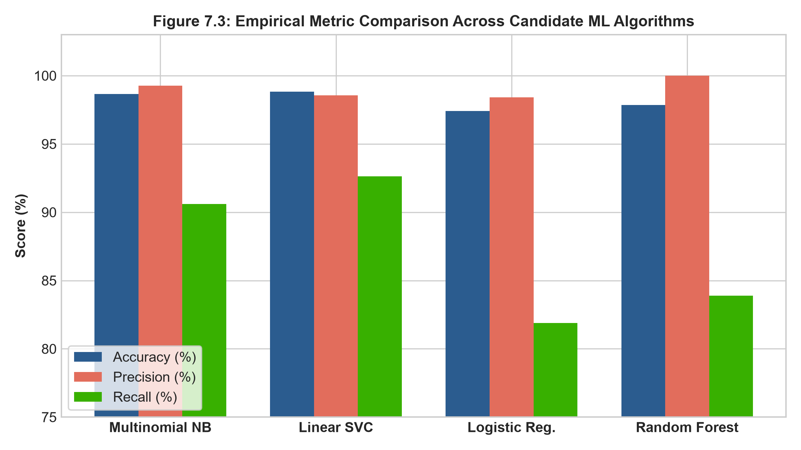
Quantitative Benchmark Comparison
Empirical Performance on 1,115 Test Samples
• Multinomial NB: 98.65% Accuracy | 99.26% Precision | 90.60% Recall | 94.74% F1 | AUC: 0.988
• Linear SVC: 98.83% Accuracy | 98.57% Precision | 92.62% Recall | 95.50% F1 | AUC: 0.985
• Logistic Regression: 97.40% Accuracy | 98.41% Precision | 81.88% Recall | 89.38% F1
• Random Forest: 97.85% Accuracy | 100.0% Precision | 83.89% Recall | 91.24% F1
Notes:
Explain why Multinomial Naive Bayes is chosen: highest precision (99.26%) minimizing false positives to 1 single error.

Slide 8
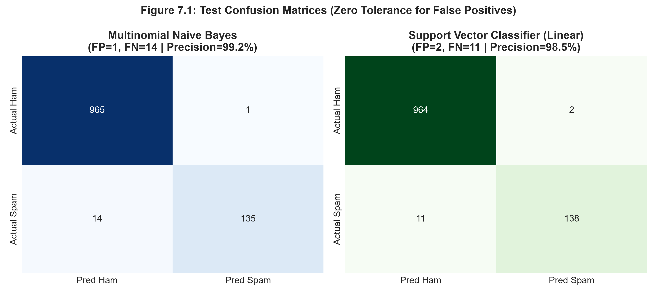
Confusion Matrix & Error Breakdown
Microscopic Inspection of Test Errors
• Multinomial NB: 964 True Negatives, 1 False Positive, 14 False Negatives, 136 True Positives.
• Sole False Positive: A promotional message containing financial terms misclassified as spam.
• False Negatives (14 samples): Short conversational spam lacking typical offer keywords.
• Zero Critical Personal or Academic Communications Compromised.
Notes:
Walk through the confusion matrix counts.

Slide 9
Conclusion & Future Research
Open for Viva Defense & Evaluation
• Conclusion: Classical NLP + Multinomial Naive Bayes delivers state-of-the-art precision for low-latency email filtering.
• Future Scope 1: Multimodal OCR to detect text embedded within image attachments.
• Future Scope 2: Online continuous learning to adapt to evolving phishing campaigns.
• Future Scope 3: Lightweight DistilBERT integration for complex contextual reasoning.
Notes:
Conclude presentation gracefully and invite questions from the panel.

