Slide 1

Introduction to Flutter

Slide 2
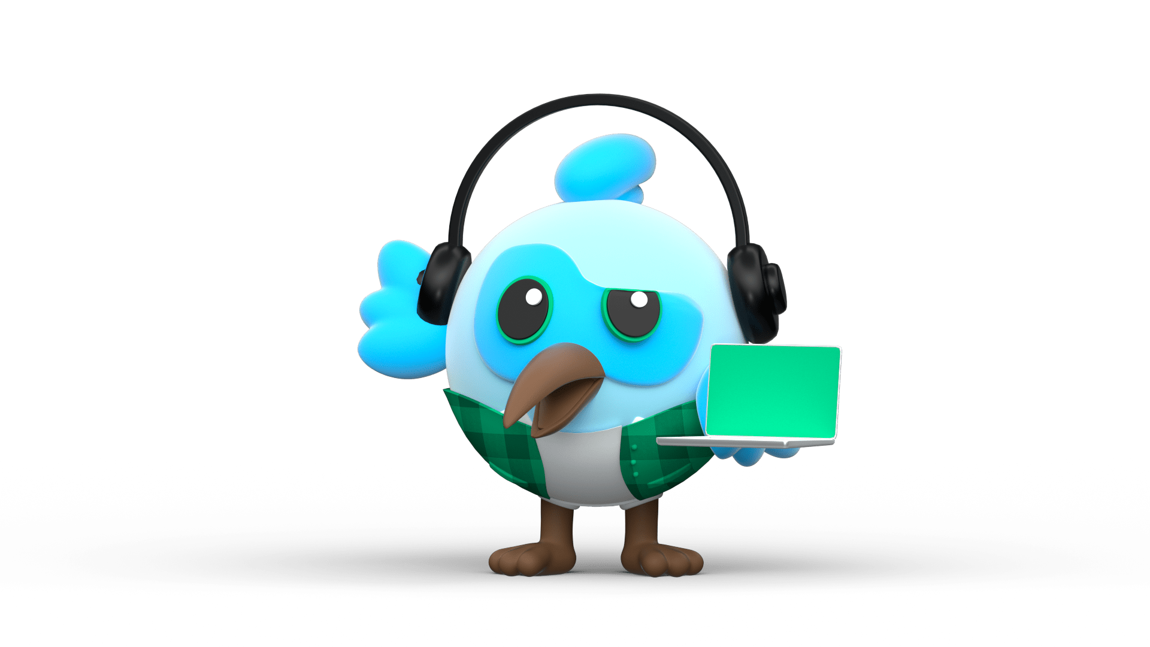

Flutter
Flutter is framework created by google.
A cross-platform framework used to develop application for
Android
iOS
Web
and Desktop
Dart Programming language

Slide 3


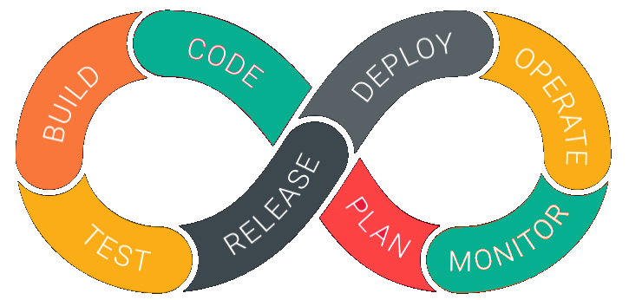
Why Flutter for App Development
1. Open Source | 2. Faster development Cycle | 3. Super Productive
Flutter is Open-Source framework
Therefore, anyone can use it for any given purpose.
Flutter is so fast that it takes less then 30 sec for first full compilation.
Comes with Hot-Reload & Hot-Restart.
Comes with Hot-Reload & Hot-Restart.
Due to Stateful widget hot-reload feature Flutter is very fast iterative coding style.

Slide 4

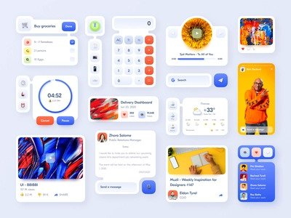

Why Flutter for App Development
4. Ease to learn & code sharing | 5. Widget Libraries | 6. Community Support
Any one who have basic knowledge of OOPS & UI Designing can easily learn Flutter.
Ready to use widget, Flutter have many widget that you can use to build flutter application.
Such as : http, get, share plus, toggle switch etc.
Flutter Community is bit small if we compare with other framework like React.
But Flutter is grow very fast then other framework.

Slide 5
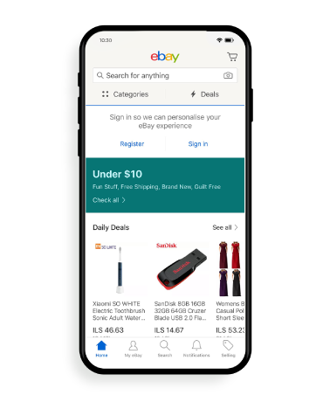
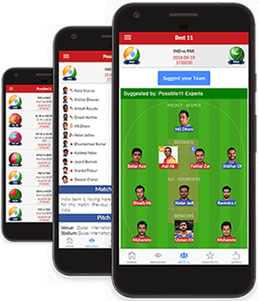
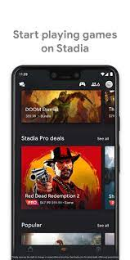
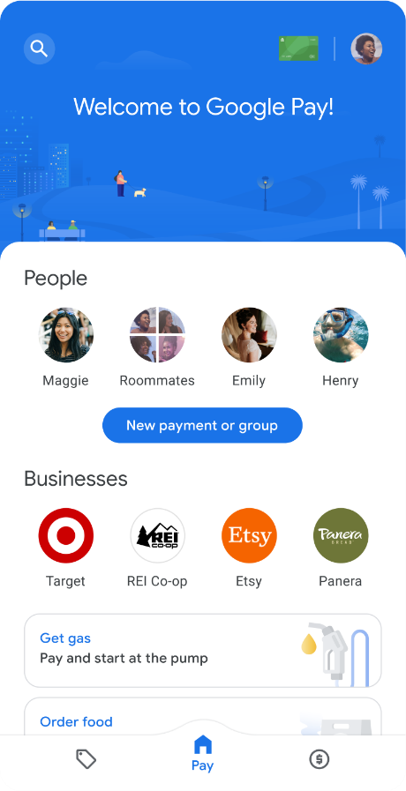
Apps that are build using Flutter
Stadia gaming platform.
Dream 11
eBay
Google Pay

Slide 6
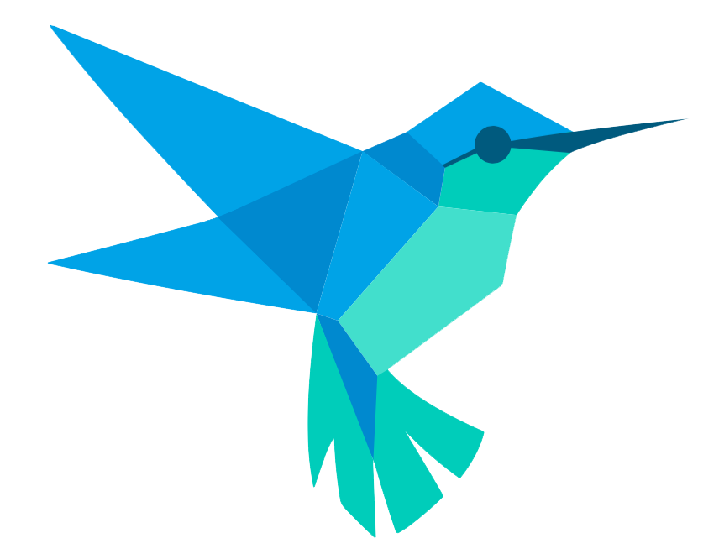
Feature of Flutter
Cross Platform App Development.
Easy access to Native Features.
Minimal Coding.
Fast Development
Hot Reload & Hot Restart

Slide 7
Let’s Start Coding…..

