Slide 1
HPC MONITORING
Vidyavardhaka College of Engineering, Mysore
CTY Members :
Amogh Vasishta M S
Bhargavi Rao R
Brinda S
H A Vishwadatta
Sakshya M M
CTY Mentor-HPE : Sanjay Yugal Kishore Hassa
HPE PM : Geeta Ganapayya Patgar
HPE DIR : Amarnath Chilumukuru
08-04-2023

Slide 2
Problem statement
HPC clusters managed by HPCM and CSM generate and capture a lot of metrics related to hardware and software infrastructure. In hardware, they are related to cooling, power, high speed interconnect and in the software the metrics are related to workloads and various HPC subsystems. The metrics are reported and visualized using tools like Grafana, Kafka and Prometheus.
Initial Solution
To develop a running simulator that generates the random set of metrics within a pre-defined range. A selenium based application which detects the metrics generated on Grafana and Prometheus, cross-comparing with the simulated value.

Slide 3






requirements
Technologies used :
Kafka : A distributed streaming platform that is used to produce and consume custom metrics.
Prometheus : Monitoring and alerting toolkit for gathering metrics and visualizing time-series data.
TimescaleDB : An open-source database invented to make SQL scalable for time-series data.
JMX Exporter: Collects Java application metrics via JMX and makes them available for monitoring and analysis.
Grafana : A web-based dashboard that is used to visualize the metrics collected by Prometheus.
Selenium : A suite of tools for automating web browsers.

Slide 4
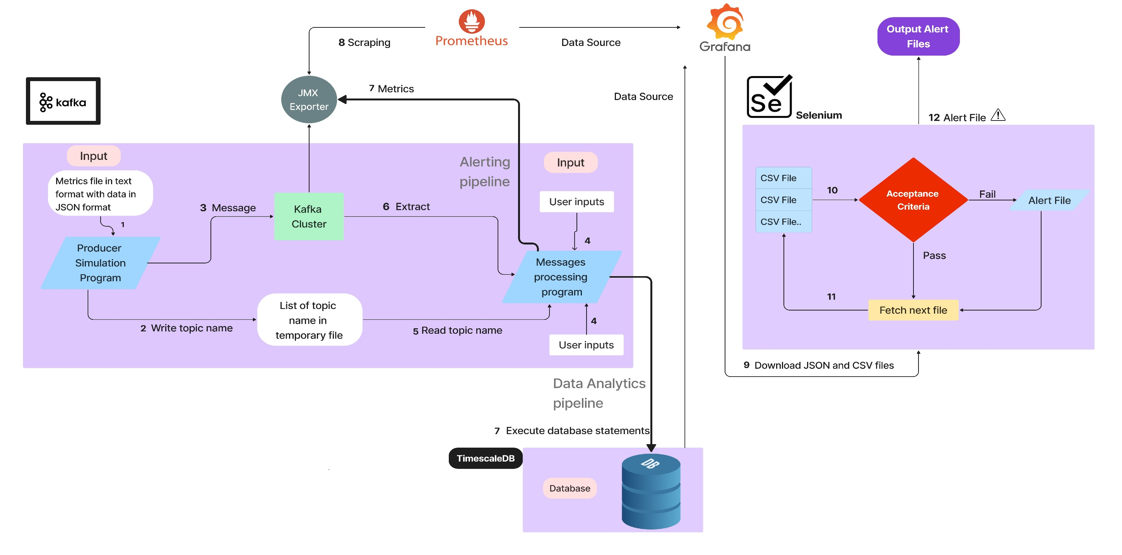
Project Architecture

Slide 5
Requirements and demo objectives
Dataset used :
The dataset used must be relevant that mimics the characteristics of HPC workloads and system metrics. Those includes synthetic workload data, system metrics, job scheduling data, application specific metrics. The dataset used in this project are :
PDU metrics
Sensors metrics
Demo objectives:
Highlighting the simulation framework.
Updating the simulated metrics to a relational database.
Demonstrating the visualization through dashboard.
Validating against acceptance criteria.

Slide 6
Challenges faced
Inability to access the Google Cloud Platform.
Learning curve.
Complex configuration Issues.
Producer code enhancements.
Integration with different data source like OpenSearch.
Confluent setup failure.
Minimizing user intervention.

Slide 7
Thank you

