Slide 1
Market Makers: Analyzing Quantitative and Qualitative Data; Establishing, Validating and Enhancing Rules (potentially leveraging machine learning)-FINAL REPORT
VISHNU CHEBOLU – 2022A7PS0124P –CS
Kshitiz bhatta -2022A7PS0049P -CS
AlGOBULLS , Mumbai
FIC: Dr. Pankaj ARORA

Slide 2
The Projects
1)Preliminary Project- One which gave us the basic outline of the projects to come.
This project dealt with
Analysis of stocks- Calculating the mean returns , percentage changes, drawdowns , logarithmic returns, simple returns, moving averages for short periods, moving averages for long periods etc..
Creating a strategy- Here we used Standard moving average strategy where in the strategy goes high when the short term moving average exceeds the long term moving average and vice versa.
Backtesting the strategy- To check how the strategy fairs

Slide 3
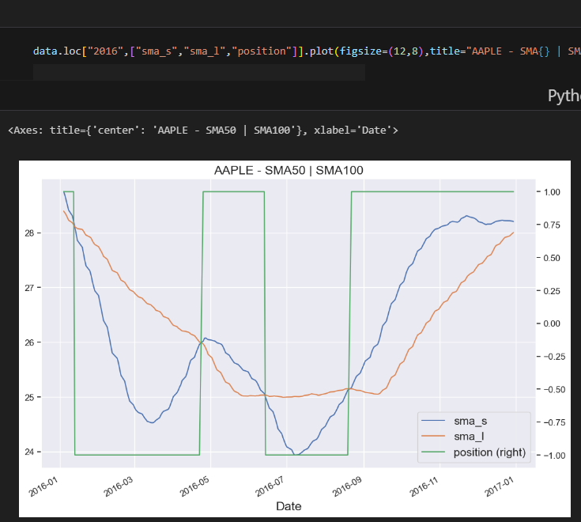
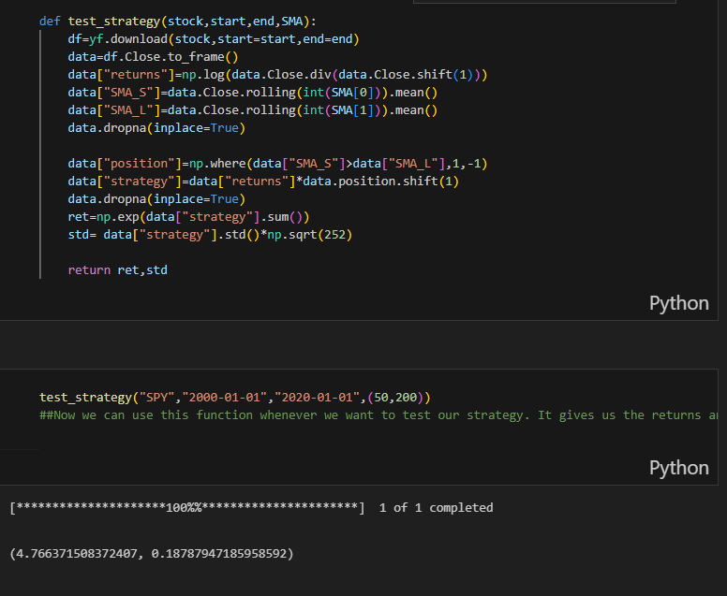
The strategy working and back-testing!

Slide 4
Background- Rolling Regression
Rolling regressions are one of the simplest models for analyzing changing relationships among variables overtime. They use linear regression but allow the data set used to change over time. In most linear regression models, parameters are assumed to be time-invariant and thus should not change overtime. Rolling regressions estimate model parameters using a fixed window of time over the entire data set. A larger sample size, or window, used will result in fewer parameter estimates but use more observations.
When setting the width of your rolling regression you are also creating the starting position of your analysis given that it needs the a window sized amount of data begin. An expanding window can be used where instead of a constantly changing fixed window, the regression starts with a predetermined time and then continually adds in other observations until the entire data set is used.

Slide 5
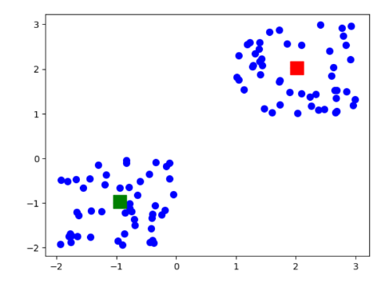
Background- K means clustering

Slide 6
Unsupervised Learning Trading Strategy
Flow:
Download/Load SP500 stocks prices data.
Calculate different features and indicators on each stock.
Aggregate on monthly level and filter top 150 most liquid stocks.
Calculate Monthly Returns for different time-horizons.
Download Fama-French Factors and Calculate Rolling Factor Betas.
For each month fit a K-Means Clustering Algorithm to group similar assets based on their features.
For each month select assets based on the cluster and form a portfolio based on Efficient Frontier max sharpe ratio optimization.
Visualize Portfolio returns and compare to SP500 returns.
Limitation: We are going to use the most recent SP500 Stocks list , which means that there may be a survivorship bias in the list.

Slide 7
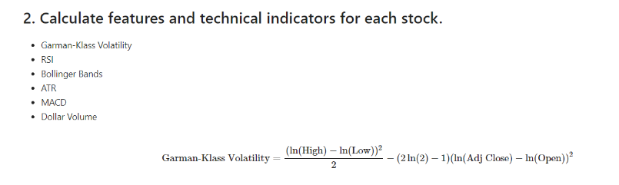
Time Crunch: Can’t Explain Everything … But will explain the key concepts used

Slide 8
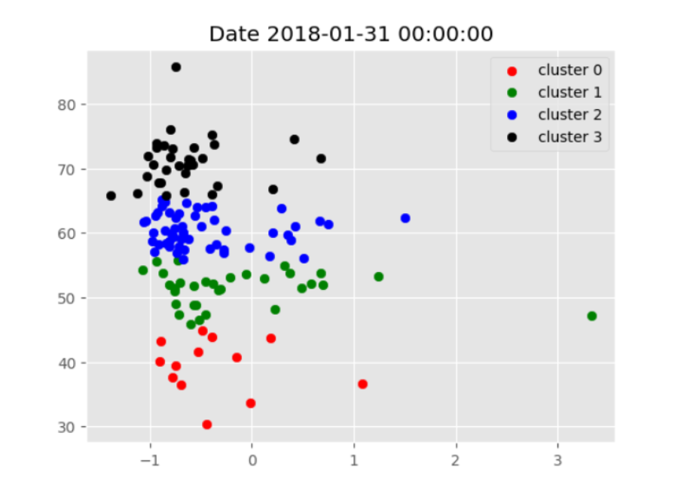
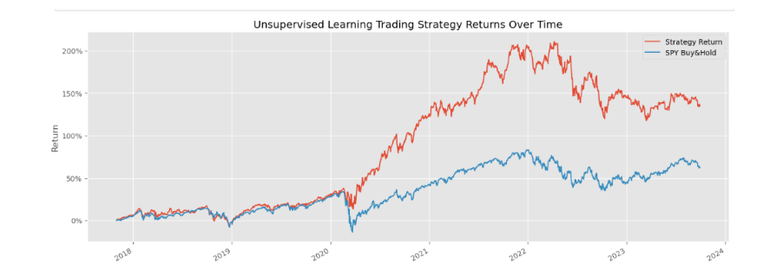
K-Means Clustering use case:

Slide 9
Twitter Sentiment Investment strategy
This approach focuses on analyzing how people feel about certain stocks, industries, or the overall market. It assumes that public sentiment can impact stock prices and markets. For example, if many people are positive about a particular company on Twitter, it might indicate that potential for that company’s stock to perform well.
Flow:
Load NASDAQ stocks twitter sentiment data.
Calculate a quantitative feature of the engagement ratio in Twitter of each stock.
Rank all stocks every month and construct an equal-weight portfolio.(An equal-weight portfolio is constructed to ensure diversification, reduce the impact of any single asset's performance on the overall portfolio, and to potentially enhance returns by avoiding overconcentration in larger or more popular assets.)
Compare it against NASDAQ Performance.

Slide 10
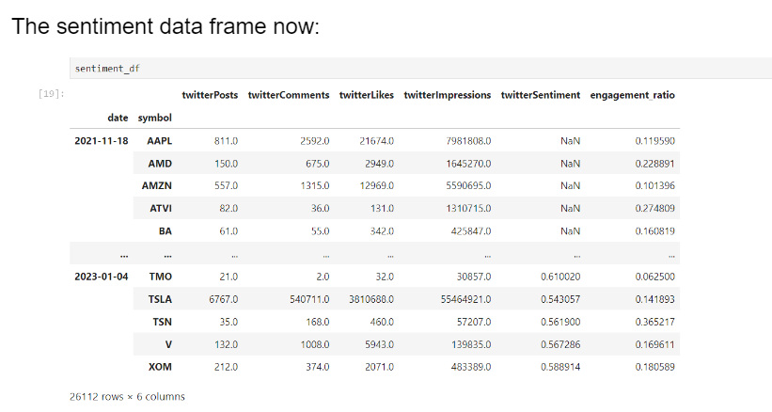

Slide 11
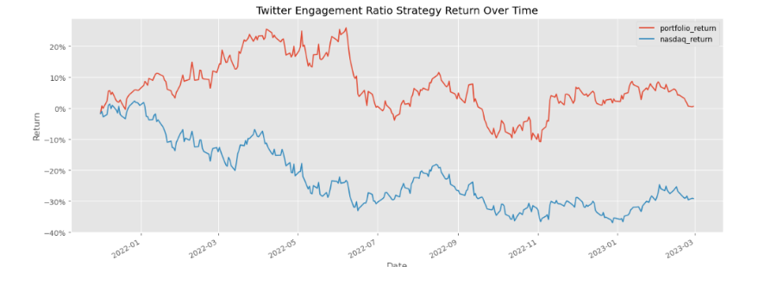
QQQ:QQQ is an exchange-traded fund (ETF) that tracks the Nasdaq-100 Index, which includes 100 of the largest non-financial companies listed on the Nasdaq stock market.

Slide 12
Intraday Strategy using GARCH Model
This approach involves buying and selling financial assets within the same trading day to profit for short-term price movements. Intraday traders use technical analysis, real-time data, and risk management techniques to make quick decisions, aiming to capitalize on market volatility.
Flow:
Load simulated daily data and simulated 5-minute data.
Define function to fit GARCH model and predicted volatility 1-day ahead in a rolling window.
Calculate prediction premium and form a daily signal on it.
Merge with intraday data and calculate intraday indicators to form the intraday signal.
Generate the position entry and hold until the end of the day.
Calculate final strategy returns.

Slide 13
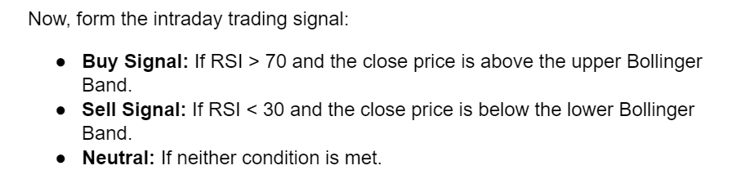
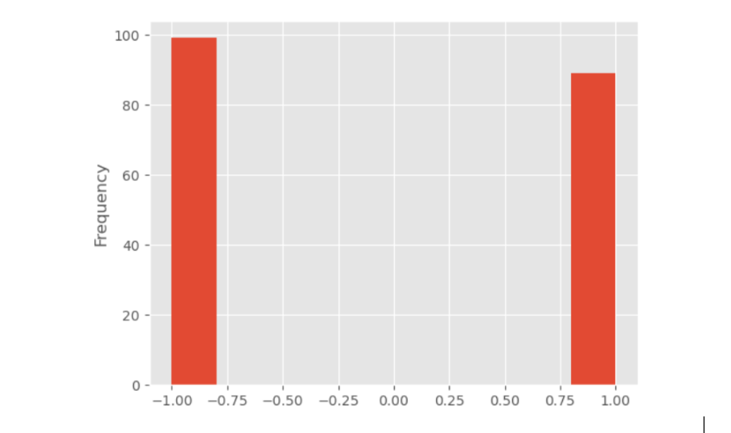
Signal plotted!

Slide 14
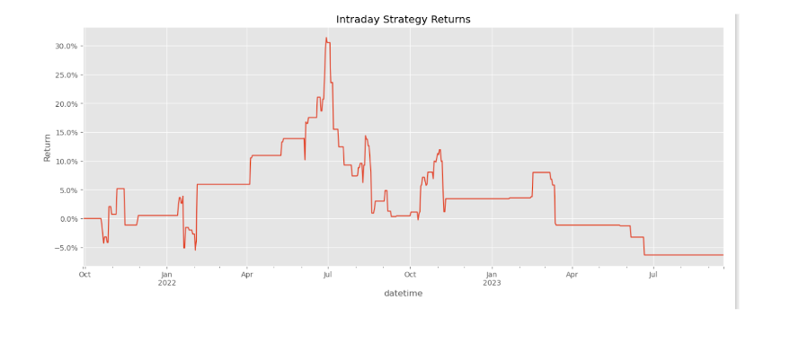

Slide 15
Novelty
1. Behavioral Finance Analytics Cognitive Bias Detection: Develop models to detect and exploit market inefficiencies caused by common cognitive biases like overconfidence, loss aversion, or herd behavior among traders.
2. AI-Driven Market Sentiment Analysis with Deepfake Detection Advanced Sentiment Analysis: Create sophisticated AI models that not only analyze market sentiment from various sources but also detect deepfake news and misinformation, ensuring more reliable sentiment-based trading decisions.5. Blockchain and Smart Contracts for Trade Execution Decentralized Trading Platforms: Implement blockchain technology to create decentralized, transparent, and immutable trading platforms. Use smart contracts to automate and securely execute trades, settlements, and compliance checks in real-time.These ideas aim to push the boundaries of traditional algorithmic trading by integrating cutting-edge technologies and unconventional data sources.

Slide 16
Conclusion and recommendations
We believe that HFT is a booming field in itself and though it might have relied on traditional algorithms up to this point, with ML and DL becoming research hotbeds, the potential to exploit them in HFTs/ MFTs is huge. We believe that we are truly naive to pass a consequential educated remark on the subject, but empirical data suggests that the move to ML-oriented trading is already on. ¹
Thus, it is highly beneficial for the trading community if ML and DL, along with skills like competitive programming that encourage algorithmic thinking and boost problem solving skills be encouraged from college level.
Apart from this, the following remark is exclusively for the Indian educational scene. Quant culture should be encouraged at the undergrad level. AlgoTradingNinjas, a slack space created by AlgoBulls represents one such step in the positive direction.

Slide 17

Questions/Discussion follows.

