Slide 1
Comparison of different inverter topologies
- Amogh G. Okade (EP22B020)

Slide 2
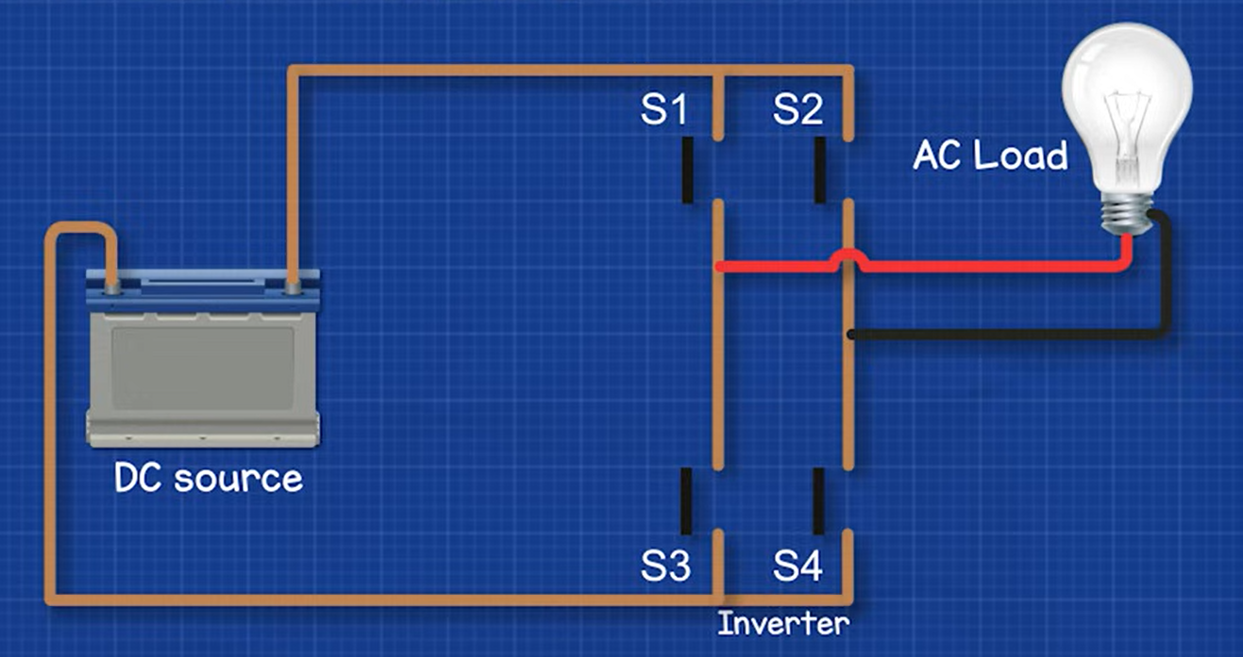
What is an inverter
An inverter is an electronic device that converts direct current (DC) to alternating current (AC).
Applications - UPS systems, motor drives, electric vehicles, etc. Also enable renewable energy systems (like solar) to feed AC loads or the grid.
Inverters
VSI (Voltage Source Inverters)
CSI (Current Source Inverters)
ZSI (Impedance Source Inverters)
PWM inverters
Square Wave Inverters
Square Wave Inverters with voltage classification
Notes:
In a UPS, the energy stored in the battery needs to be supplied as an AC voltage to the house’s appliances.

Slide 3
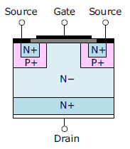
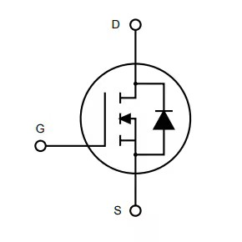
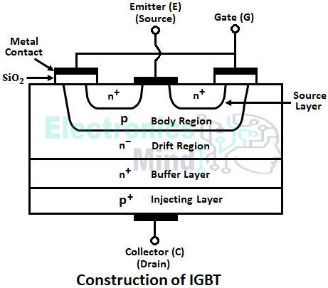
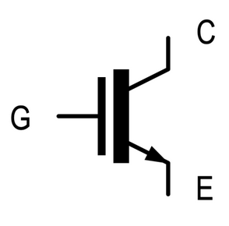
Selection of switches
There are a wide variety of switches available, for different voltage/current ratings and switching frequencies.
Inverter applications:
MOSFETs – low power (100s of Vs), high frequency applications (few MHz)
IGBTs - high power (few KVs), low frequency applications (up to 50KHz)

Slide 4
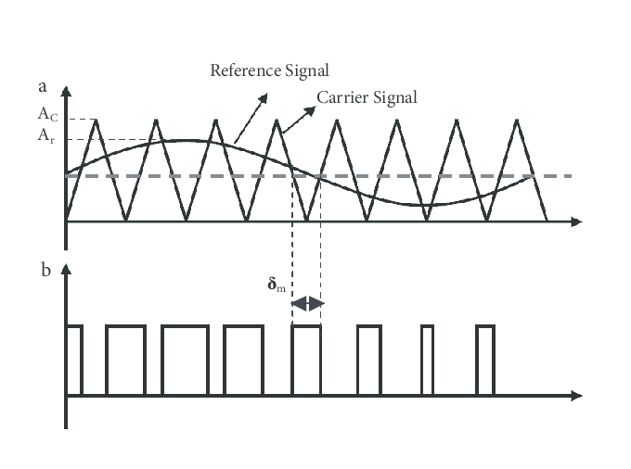
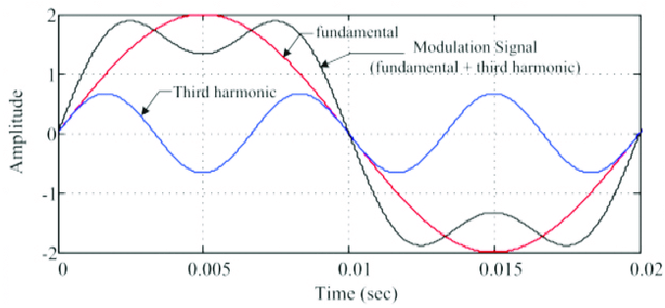
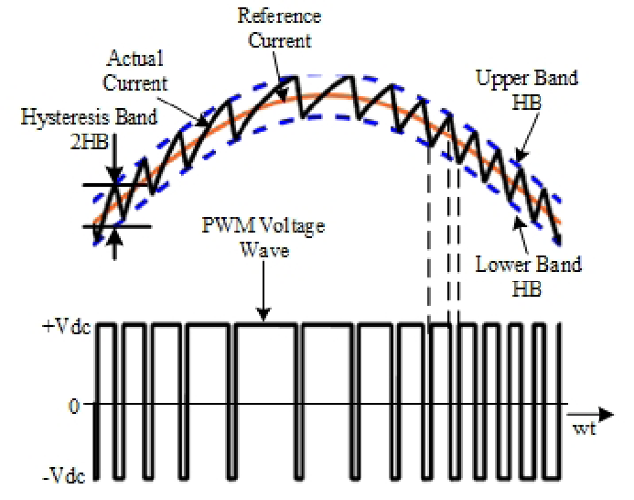
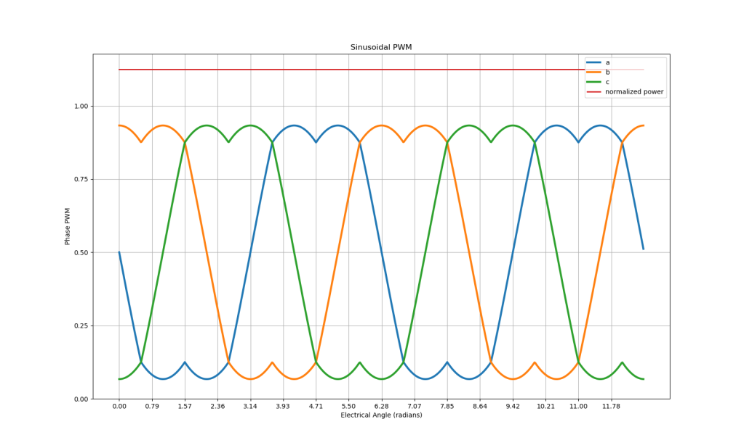
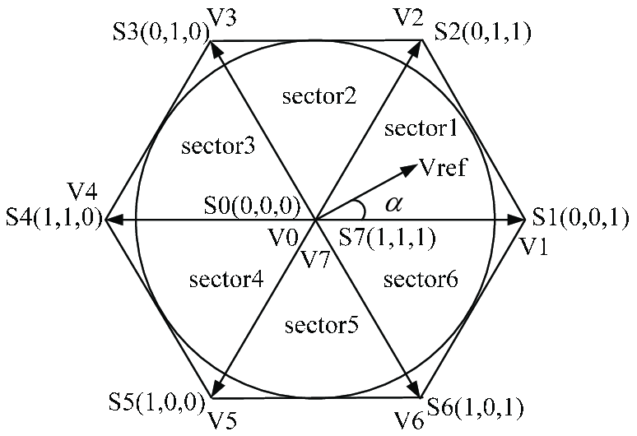
Switching Strategies
Sine triangle PWM
Space vector PWM
Third harmonic injection
Hysteresis control
Selective harmonic elimination

Slide 5
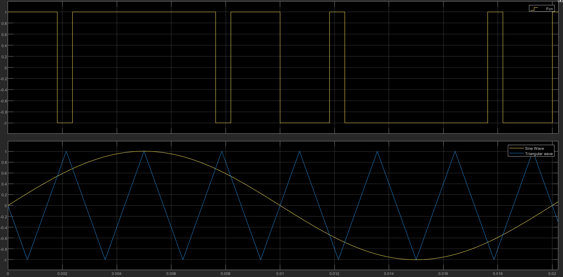
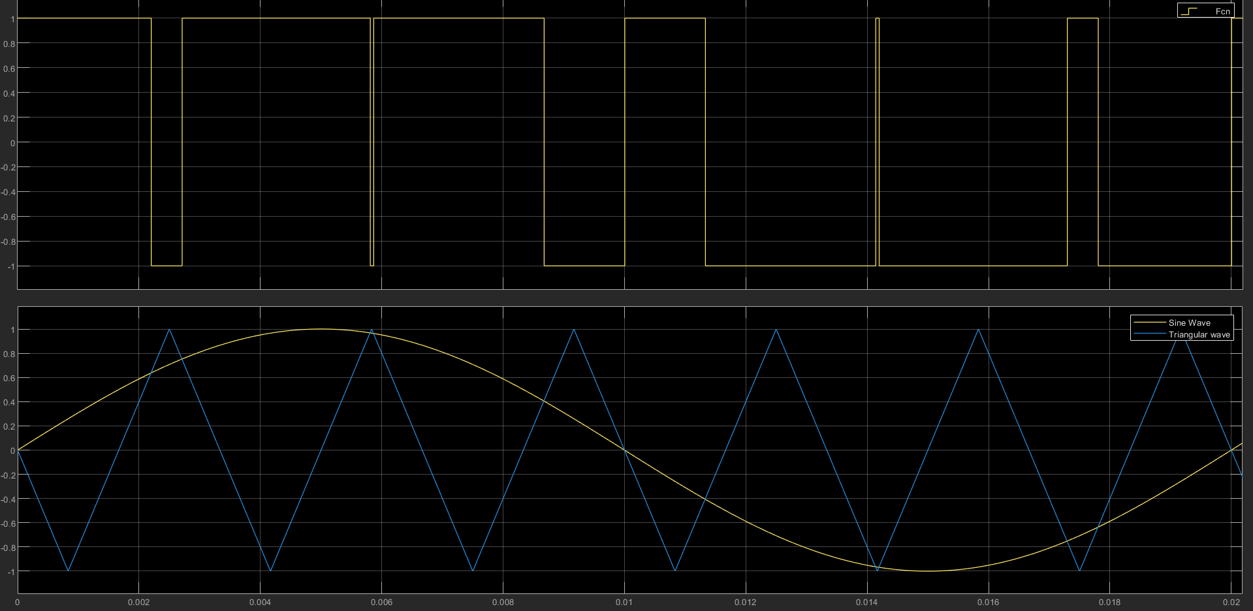
Important Parameters
Amplitude modulation ratio, m_{a} = V_{modulating}/V_{carrier}
0 ≤ m_{a} ≤ 1
Frequency modulation ratio, m_{f} = f_{carrier} /f_{modulating} = f_{sw} /f_{o}
m_{f} -> integer (to avoid sub harmonics)
m_{f} -> odd (preferable for low m_{f}) For half wave symmetry, or f(t+T/2) = -f(t) to eliminate even harmonics
m_{f} = 7
m_{f} = 6
Notes:
If mf is not an integer, the sine will cut the triangle after some time periods of the sine wave. Therefore, a low frequency component of this periodicity gets included in the gating signal.

Slide 6
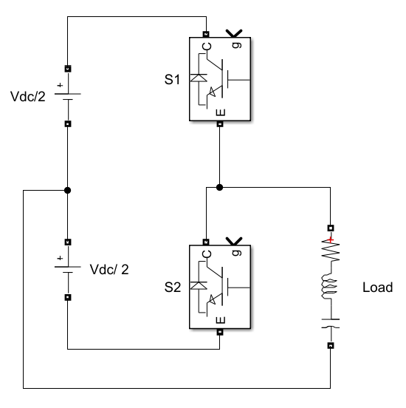
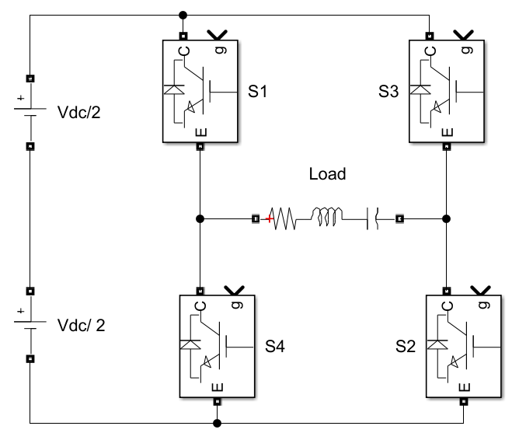
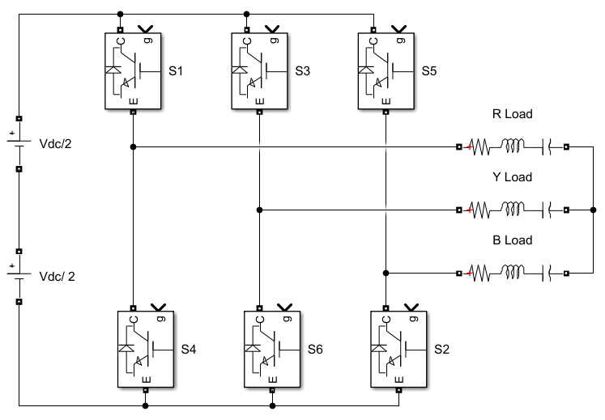
2 level inverters
V_{leg} = +Vdc/2 or –Vdc/2.
# of gate signals = # of legs (aside from their complements).
Simple and robust.
Blocking voltage = Vdc (per device)
Half-bridge
Full-bridge (1 phase)
3-phase

Slide 7
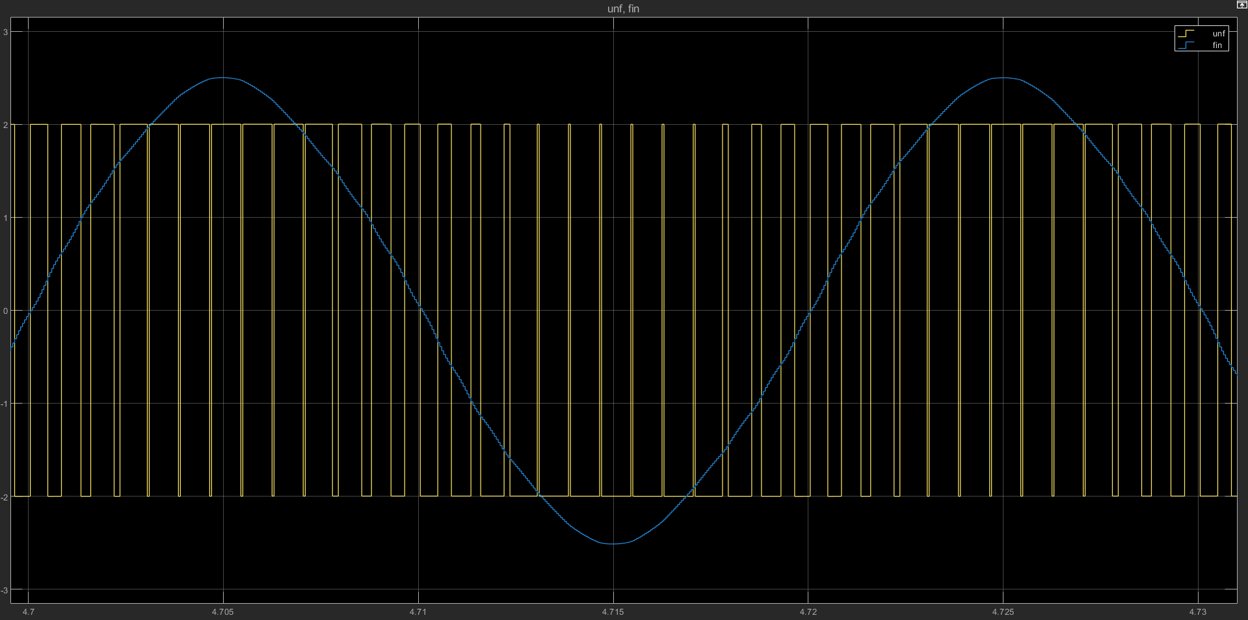
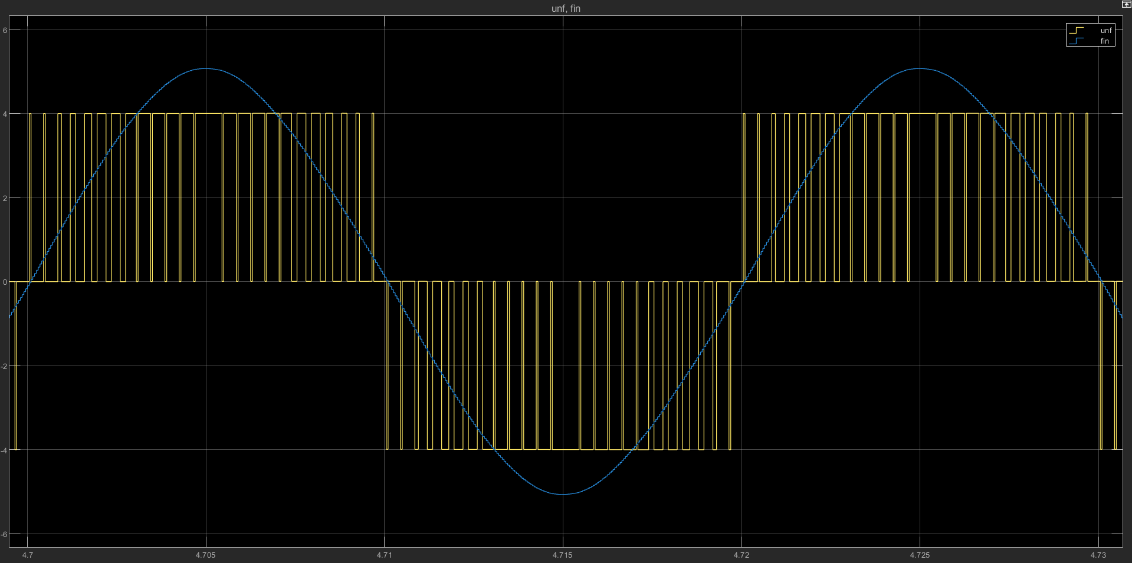
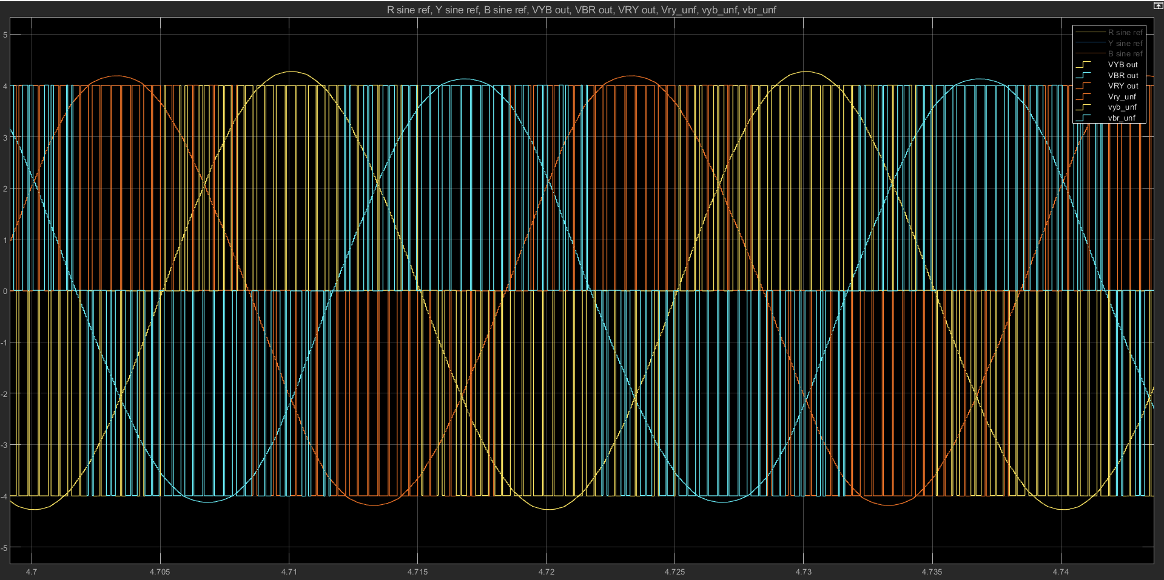
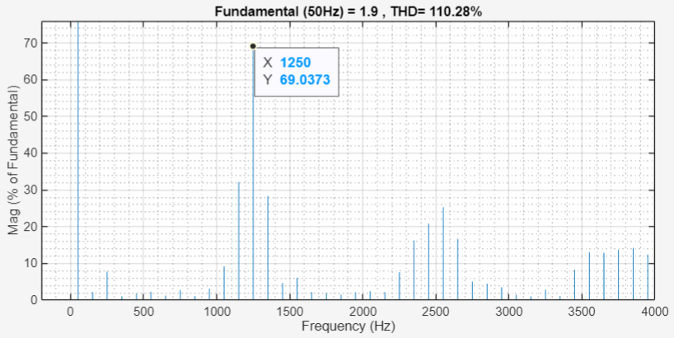
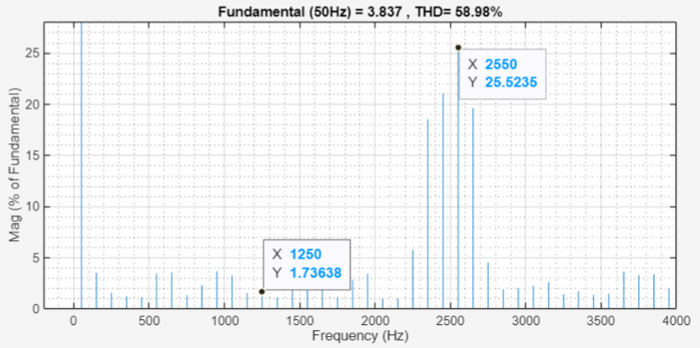
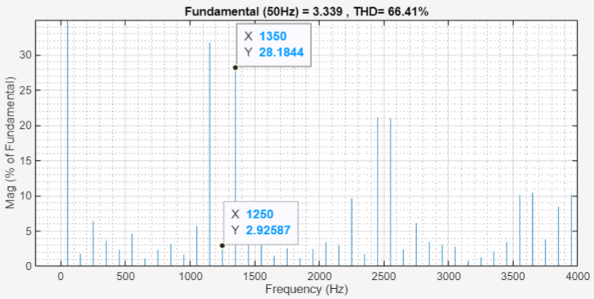
Comparison of waveforms and THDs
Half-bridge
Full-bridge (1 phase)
3-phase (V_{RY})
Notes:
THD – measure of how close the waveform is to a sine wave
mf = 25. fsw = 1250Hz, fo = 50Hz. Harmonics: mf, mf+-2, …; 2mf+-1, 2mf+-3. Explain how mf gets cancelled when you subtract the 2 legs’ output voltage.

Slide 8
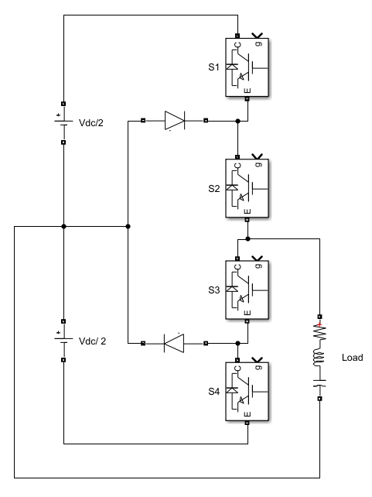
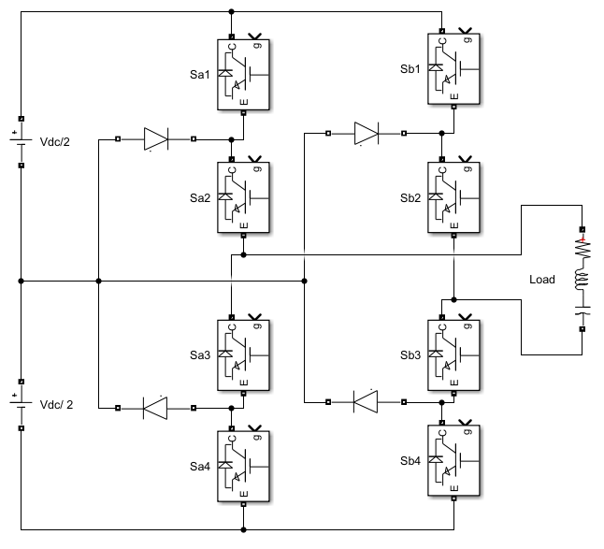
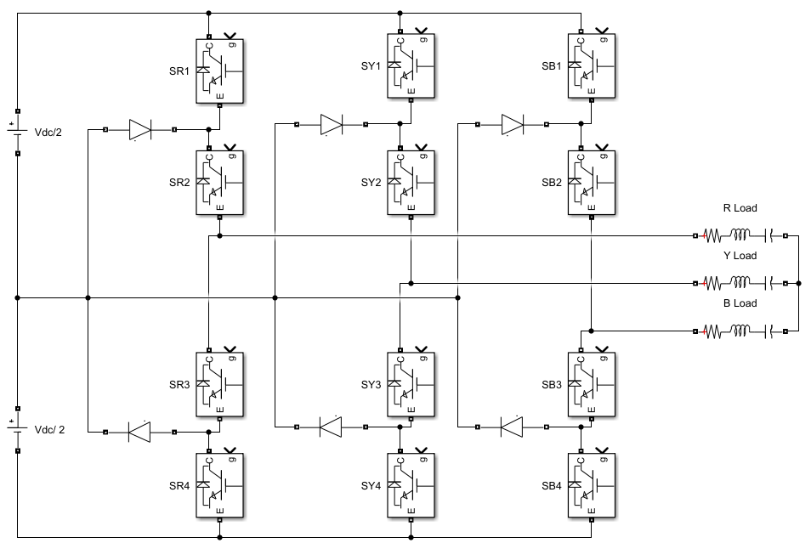
3 level inverter (Neutral Point Clamped)
V_{leg} = +Vdc/2, 0 or –Vdc/2.
# of gate signals = 2 * # of legs (aside from their complements).
Complex, but better performance (THD). Issues like voltage imbalance.
Blocking voltage = Vdc/2 (per device)
Half-bridge
Full-bridge (1 phase)
3-phase

Slide 9
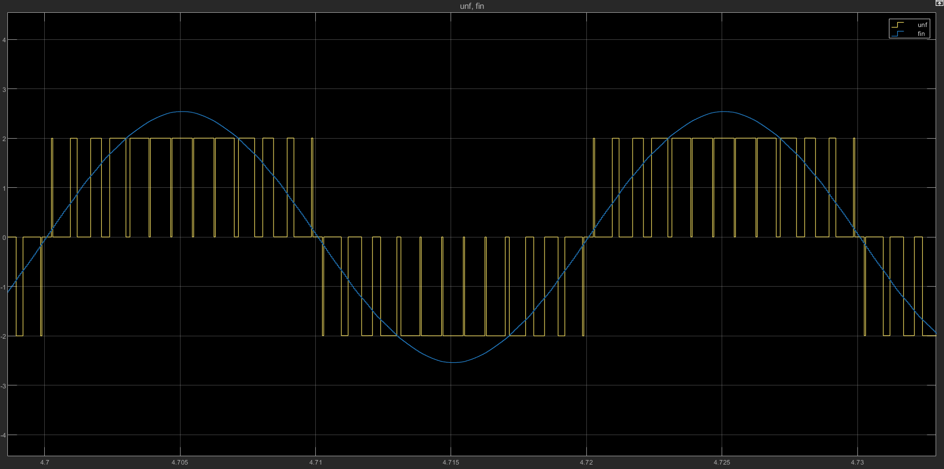
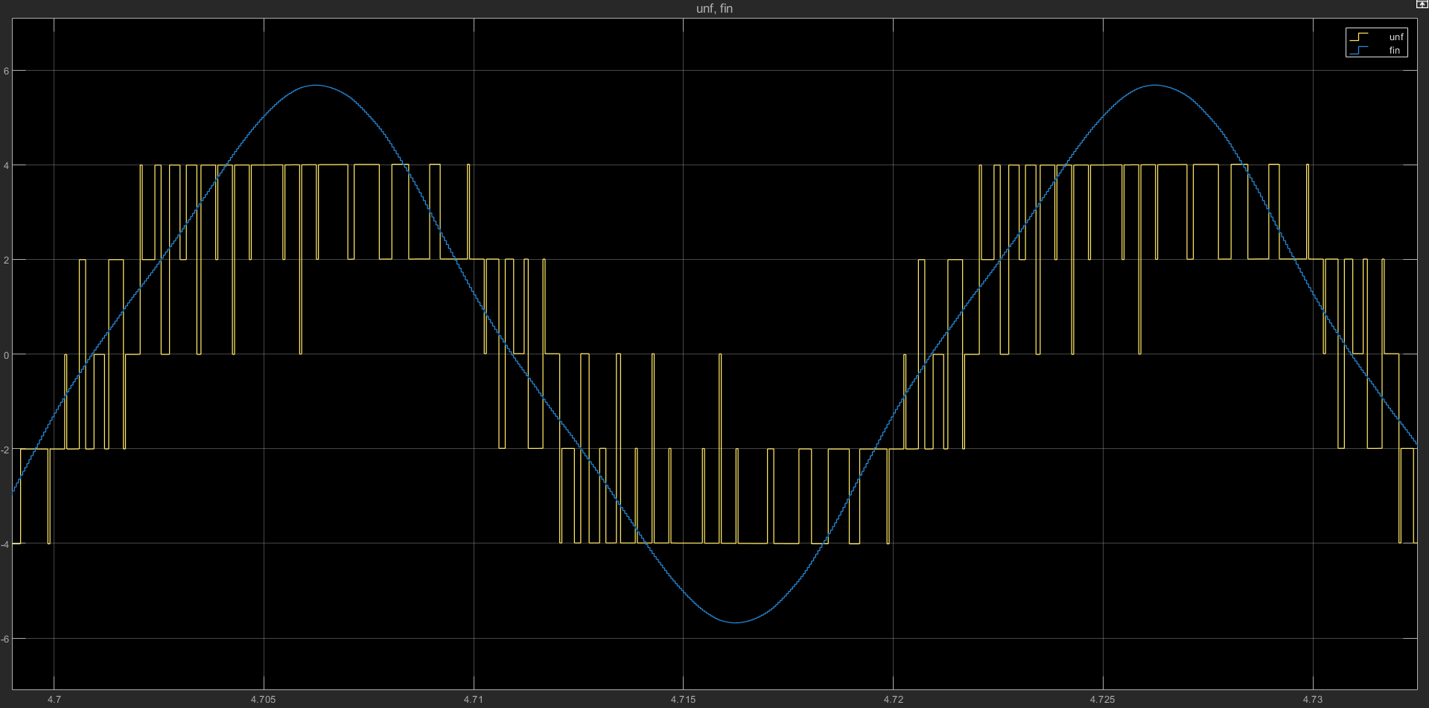
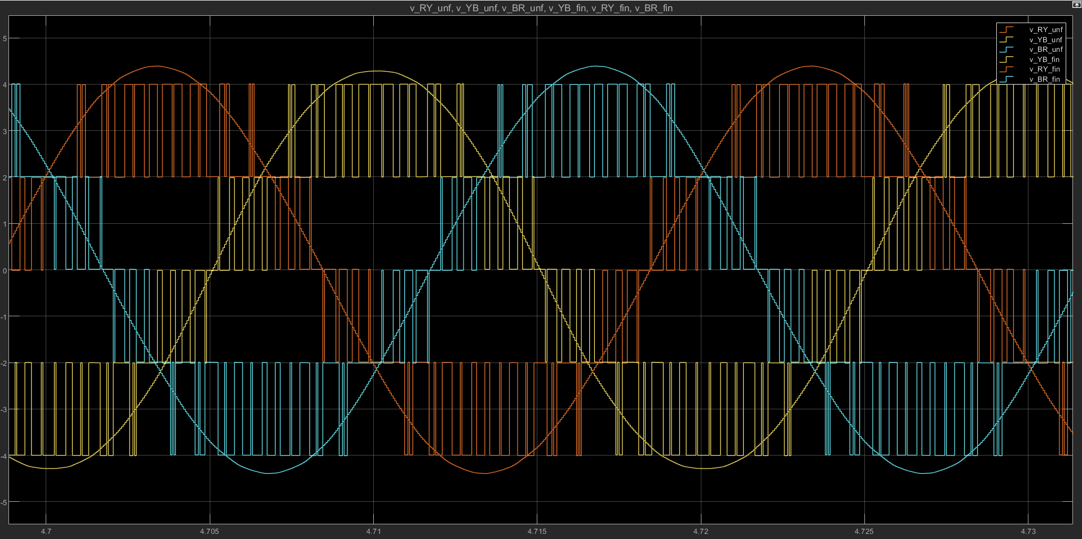
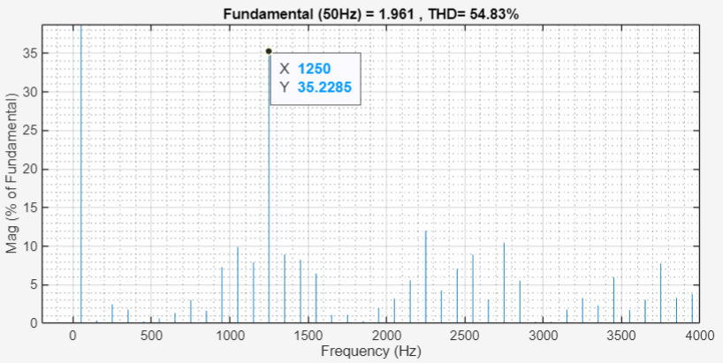
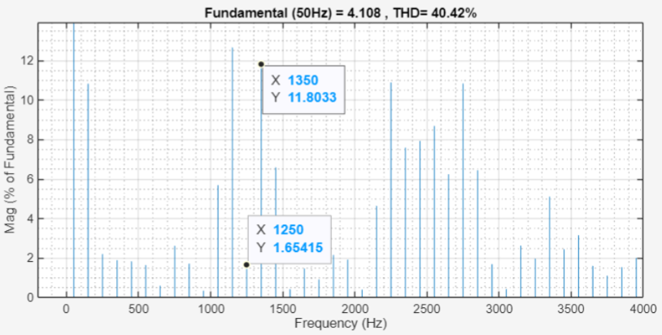
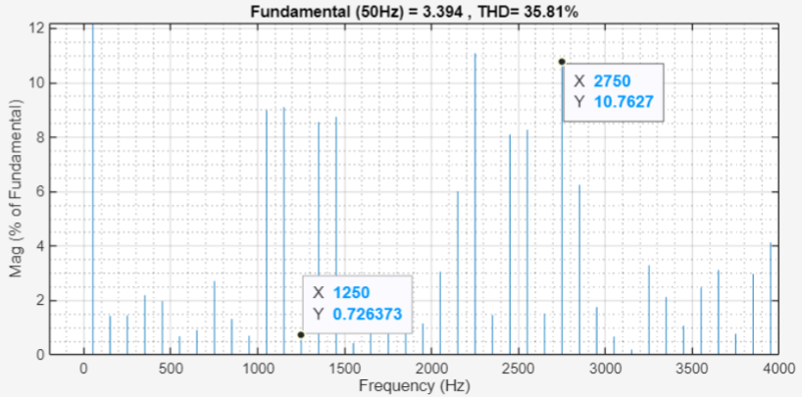
Comparison of waveforms and THDs
Half-bridge
Full-bridge (1 phase)
3-phase (V_{RY})
Notes:
Can see the addition of an extra level. Can see that the THD is much better.

Slide 10
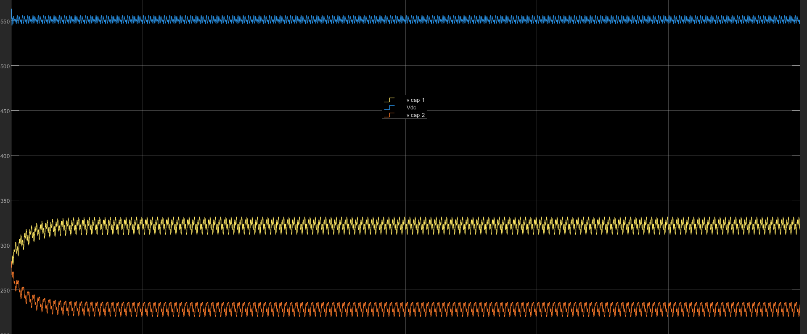
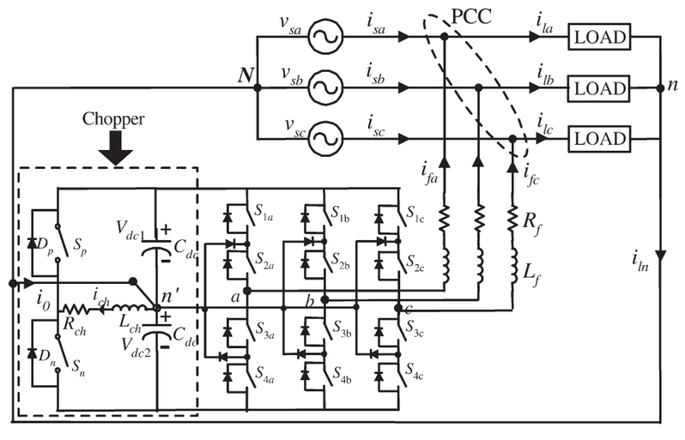
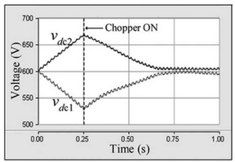
Unbalance problem of NPC inverters
Problem:
Input capacitor voltages can drift away from Vdc/2.
When a DC current is being drawn (by the load) out of the midpoint of the DC bus.
Affects THD, high voltages may damage switches.
Solution:
Control strategies to balance the time given to equivalent ‘pivot states’.
External circuits to distribute capacitor charges.
Notes:
Probably explain how +00 and 0– make the load see equivalent voltages, but draw different directions of DC current through the midpoint.

Slide 11
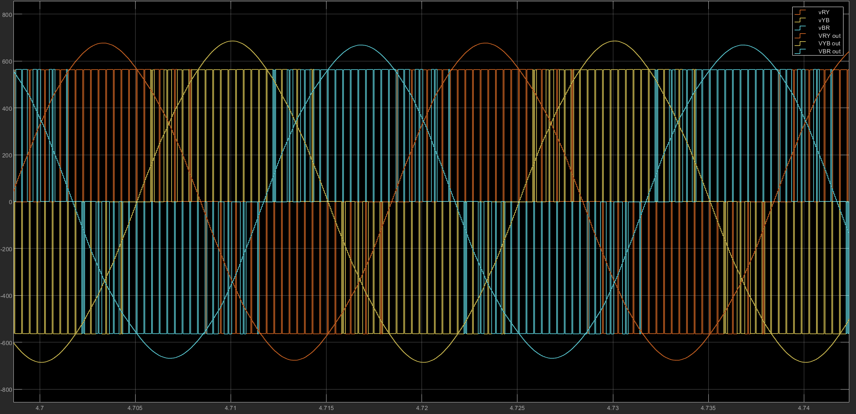
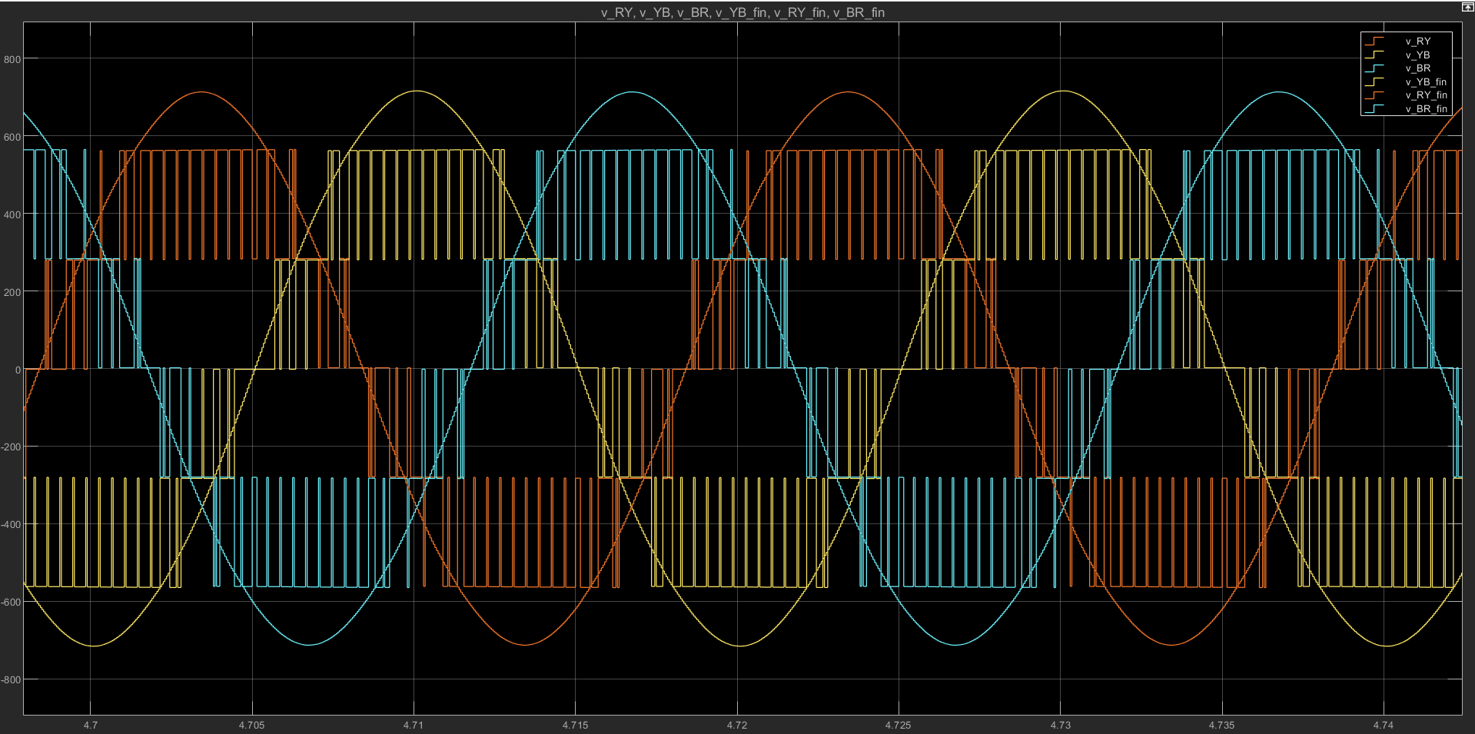
SPWM vs SVM
SPWM
Simple, robust
Digital or analog implementations
SVM
Higher DC bus utilization (cheaper switches)
Slightly lesser THD
THD = 66.41%
THD = 60.51%
THD = 35.81%
THD = 28.96%

Slide 12

Thank you

