Slide 1
Advanced JavaScript Session 2

Slide 2

Agenda
Call, apply, bind
Memoization
Currying
Notes:
https://developer.mozilla.org/en/docs/Web/JavaScript/Reference/Global_Objects/Object/create

Slide 3
Call, apply, bind
Notes:
https://developer.mozilla.org/en/docs/Web/JavaScript/Reference/Global_Objects/Object/create

Slide 4
Call in JavaScript
The call() method is a predefined JavaScript function method which is used to invoke a function with an owner object as the first argument
With call(), you can use a method belonging to another object.

Slide 5
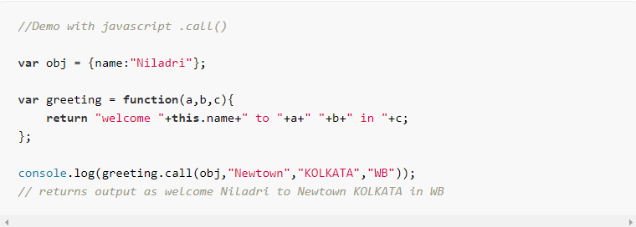
Call in JavaScript
For example
The first parameter in call() method sets the "this" value, which is the object, on which the function is invoked upon.
In this case, it's the "obj" object above.
The rest of the parameters are the arguments to the actual function.

Slide 6
Apply in JavaScript
The apply() method is similar to the call() method
The only difference is call() takes any arguments separately, apply() takes any function arguments as an array.
The apply() method is very handy if you want to use an array instead of an argument list.

Slide 7
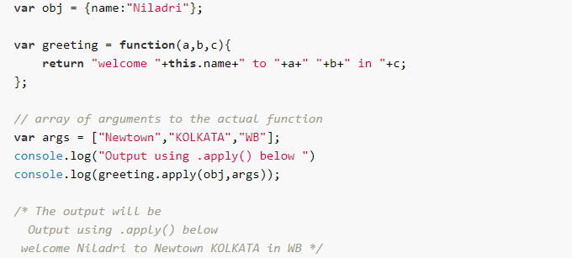
Apply in JavaScript
For example

Slide 8
Bind in JavaScript
The simplest use of bind() is to make a function that, no matter how it is called, is called with a particular this value.
The bind() method creates a new function that, when called, has its this keyword set to the provided value, with a given sequence of arguments preceding any provided when the new function is called.

Slide 9
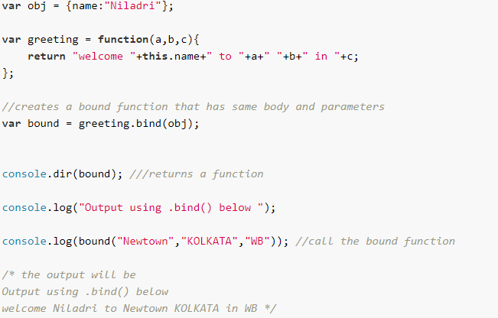
Bind in JavaScript
For example

Slide 10
Call, Apply and Bind
Use .bind() when you want that function to be later called with a certain context, useful in events.
Use .call() or .apply() when you want to invoke the function immediately, and modify the context.
Call/apply call the function immediately, whereas bind returns a function that, when later executed, will have the correct context set for calling the original function. This way you can maintain context in async callbacks and events.

Slide 11
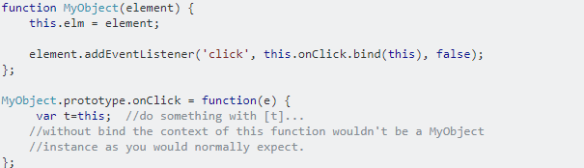
Call, Apply and Bind
For example:

Slide 12
Memoization
Memoization
Notes:
https://developer.mozilla.org/en/docs/Web/JavaScript/Reference/Global_Objects/Object/create

Slide 13
Memoization
Functions are an integral part of programming. They help add modularity and reusability to our code.
Sometimes, a function can become expensive to call multiple times (say, a function to calculate the factorial of a number). But there’s a way we can optimize such functions and make them execute much faster: caching.

Slide 14
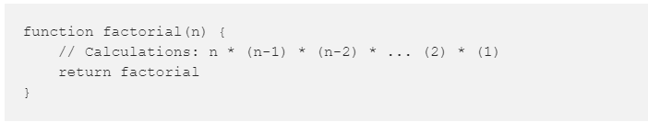
Memoization
For example, let’s say we have a function to return the factorial of a number:
Now let’s find factorial(50). The computer will perform calculations and return us the final answer, sweet!
When that’s done, let’s find factorial(51). The computer again performs a number of calculations and gets us the result,
but you might have noticed that we’re already repeating a number of steps that could have been avoided.
An optimized way would be:
factorial(51) = factorial(50) * 51
But our function performs the calculations from scratch every time it’s called:
Factorial(51) = 51 * 50 * 49 * ... * 2 * 1

Slide 15
Memoization
Here comes memoization, a way for our function to remember (cache) the results.
Now that you’ve a basic understanding of what we’re trying to achieve,
here’s a formal definition:
Memoization is an optimization technique used primarily to speed up computer
programs by storing the results of expensive function calls and returning
the cached result when the same inputs occur again.
Lets go through the codes.

Slide 16
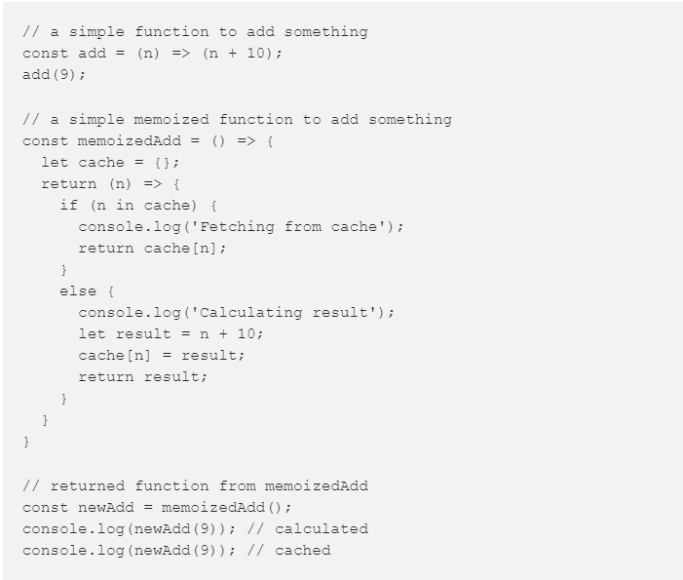
Memoization

Slide 17
Memoization
Is memoization same as caching?
Yes, kind of. Memoization is actually a specific type of caching.
While caching can refer in general to any storing technique, memoizing
specifically involves caching the return values of a function.

Slide 18
Memoization
When to memoize your functions?
The best use case for memoized functions is for heavy computational
functions which can significantly improve performance
(factorial and fibonacci are not really good real world examples)

Slide 19
Currying
Notes:
https://developer.mozilla.org/en/docs/Web/JavaScript/Reference/Global_Objects/Object/create

Slide 20
Currying
Currying is a technique of evaluating function with multiple arguments,
into sequence of function with single argument.
f(a,b) = f(a)(b)
In other words, when a function, instead of taking all arguments at one time,
takes the first one and return a new function that takes the second one and
returns a new function which takes the third one, and so forth, until all arguments
have been fulfilled.
For example: when we turn a function call add(1,2,3) into add(1)(2)(3)

Slide 21
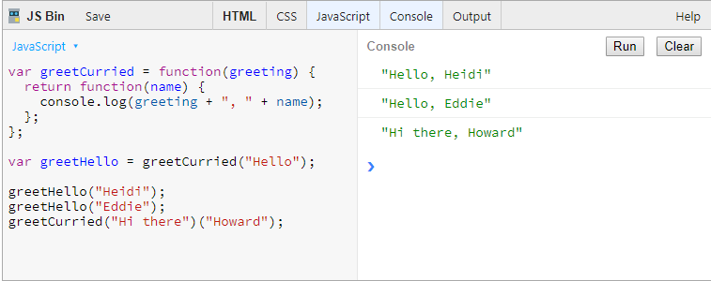
Currying
Here’s an example of what a curried function looks like:

Slide 22
Currying
Why it’s useful ?
Currying helps you to avoid passing the same variable again and again.
You can use currying to fix the known values and return a function that only accepts the
unknowns, to be invoked later when you actually have the values you wish to pass. This provides a better
way to avoid repeating yourself when you would have been calling the same JavaScript built-ins over and
over with all the same values but one.
Adding currying to your coding practice will encourage the use of partially applied functions.

Slide 23
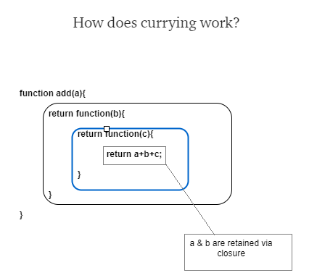
Currying
Currying works by natural closure.
The closure created by the nested functions
to retain access to each of the arguments.
So inner function have access
to all arguments.

Slide 24
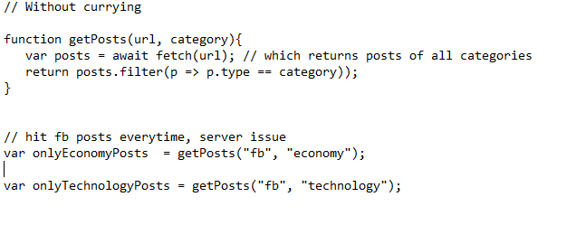
Currying- Use Case

Slide 25
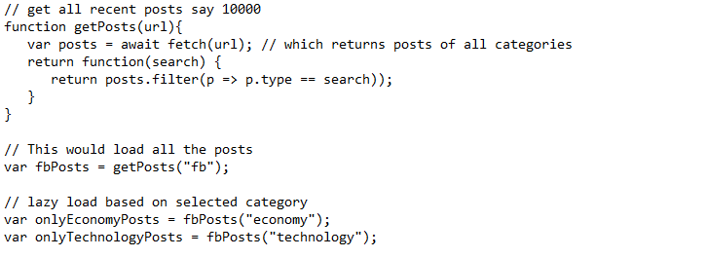
Currying- Use Case

Slide 26
THANK YOU!!!

