Slide 1
HABITS2.0 Design screenshots

Slide 2
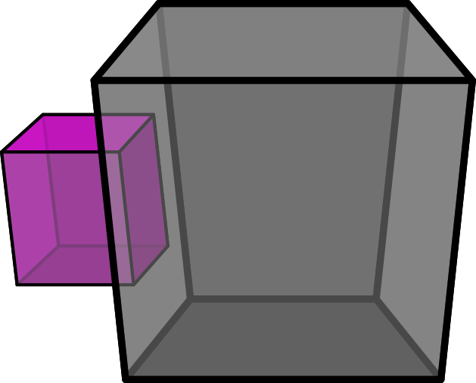

design_screenshot_choice

Slide 3
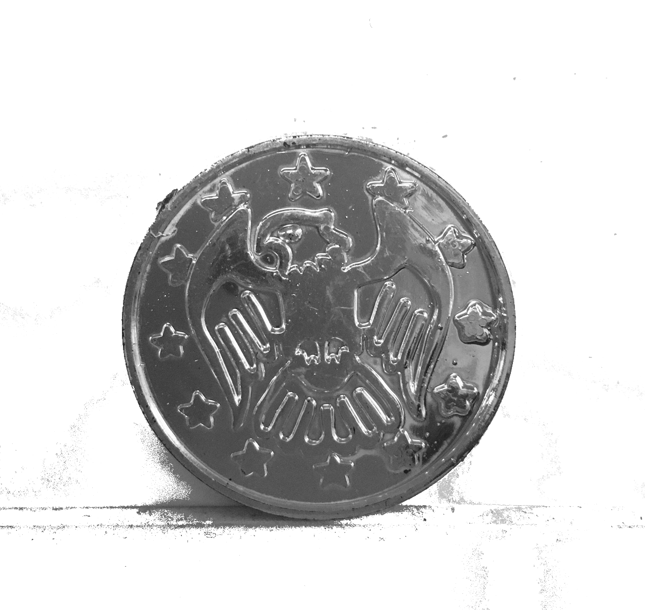
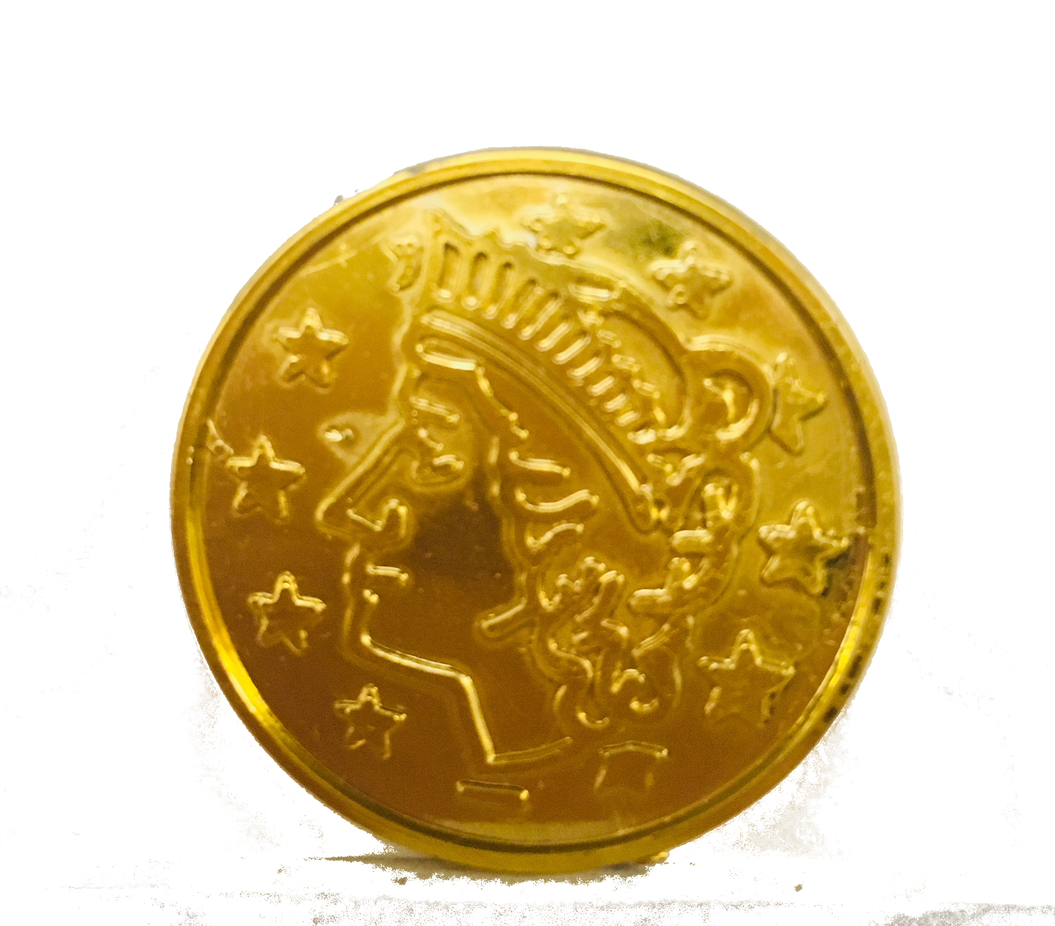
design_screenshot_consumption test

Slide 4
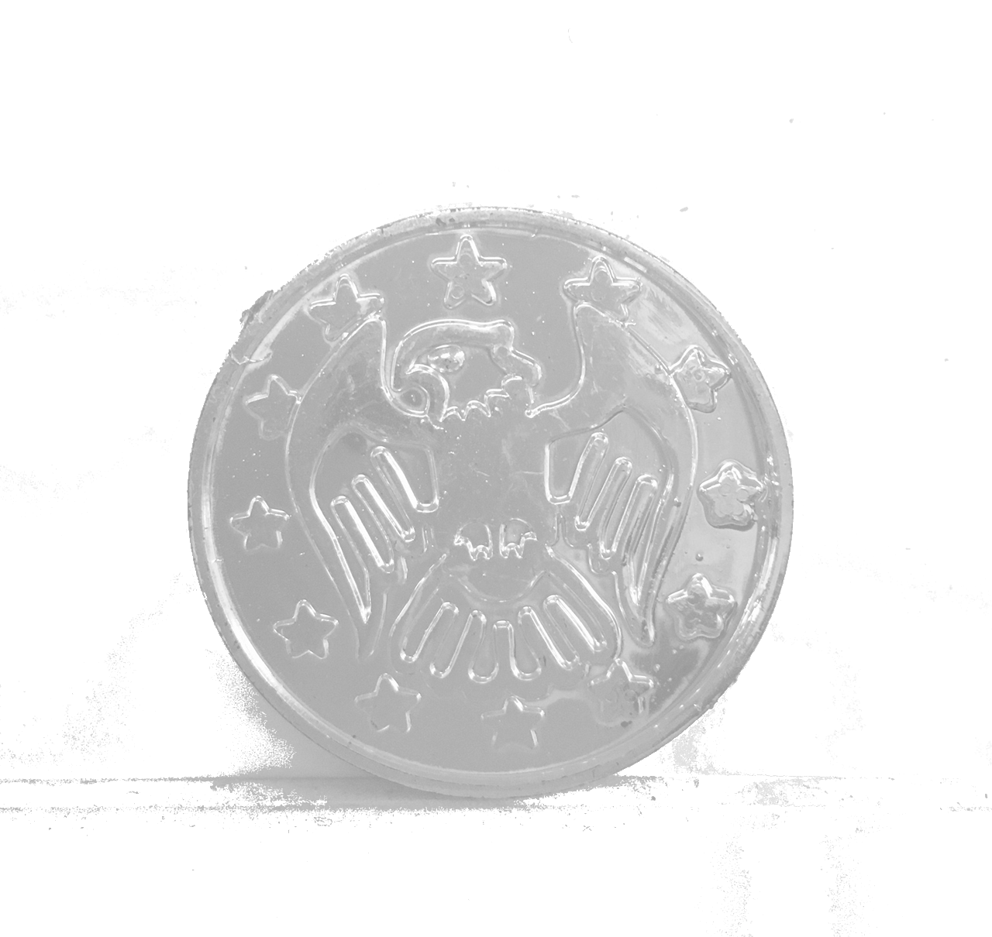
design_screenshot_rewarded_1

Slide 5
design_screenshot_rewarder

Slide 6

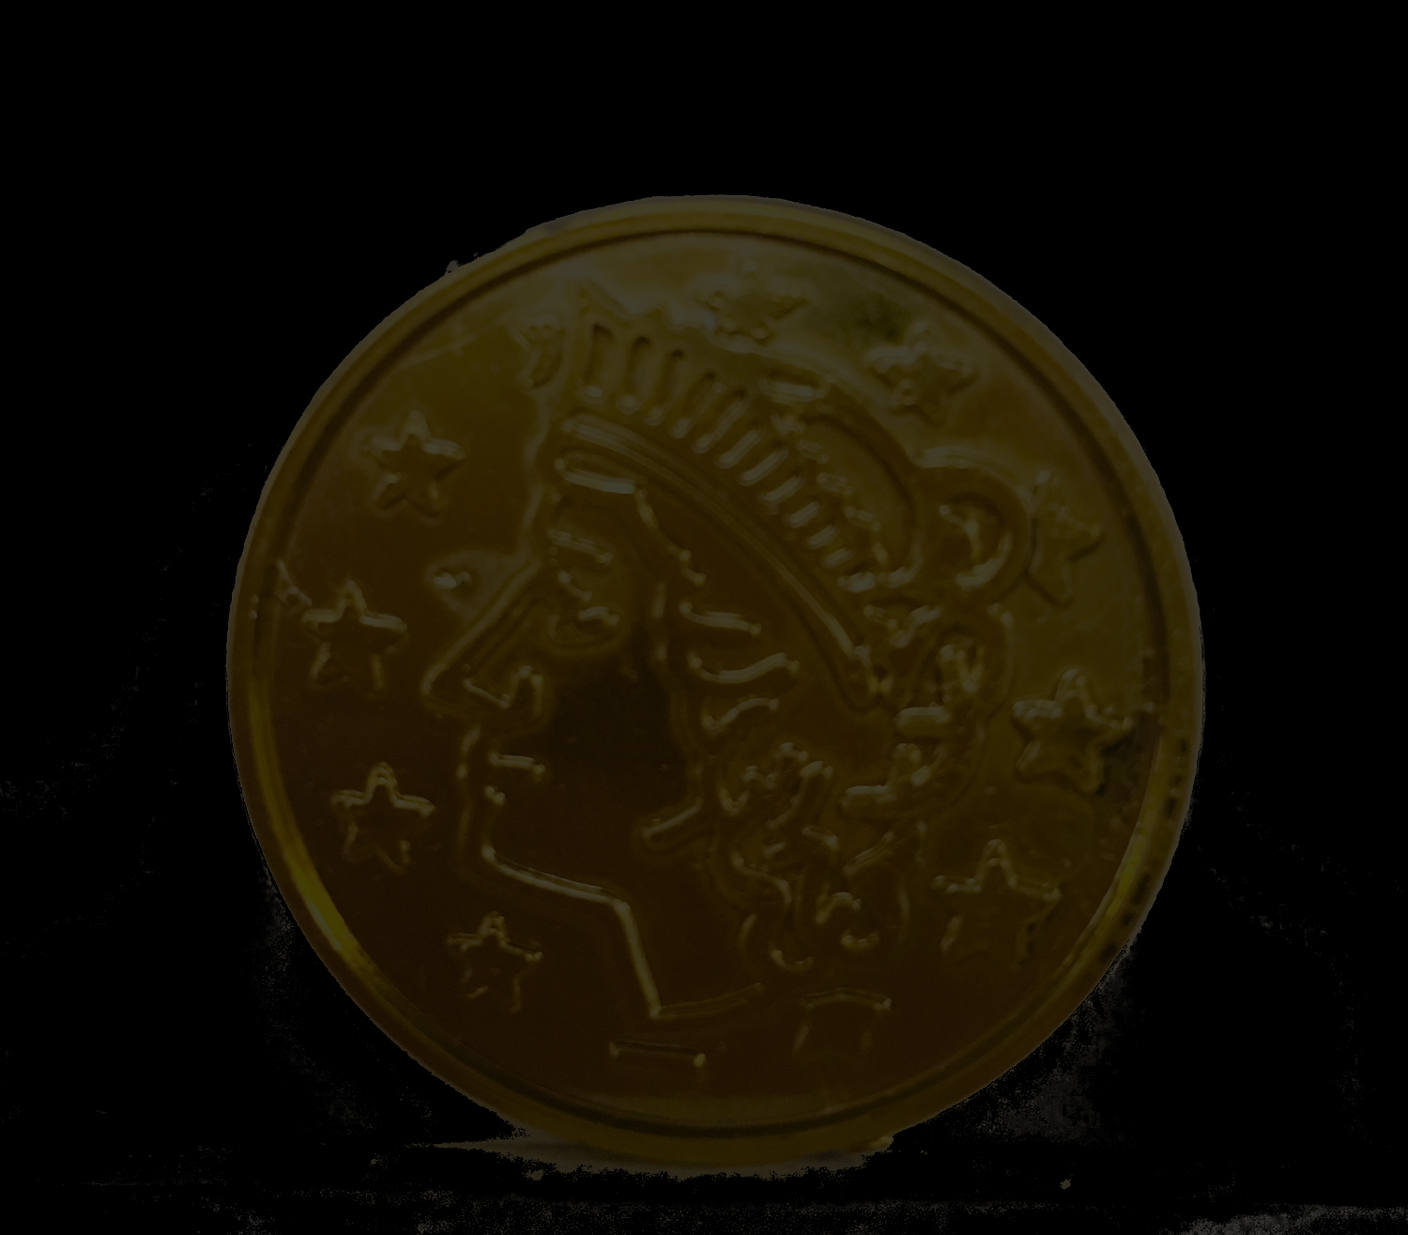
design_screenshot
Triangle flashes when response is performed

