Slide 1
rsHRF toolbox
2018.07.20

Slide 2
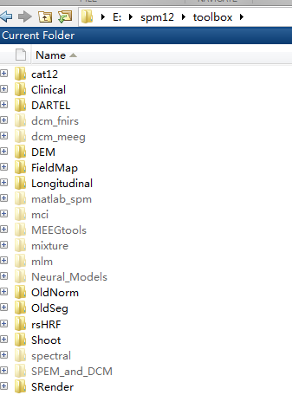
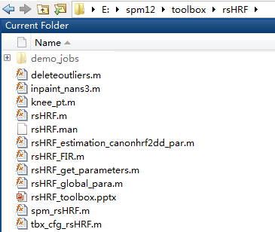
Add it into ./SPM/toolbox/

Slide 3
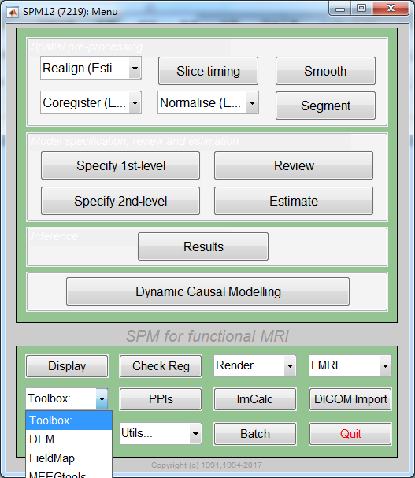
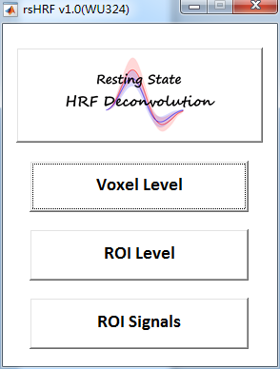
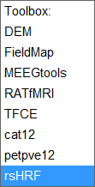
From SPM
Command window: >> spm fmri
From toolbox
Click rsHRF
Or >> rsHRF

Slide 4
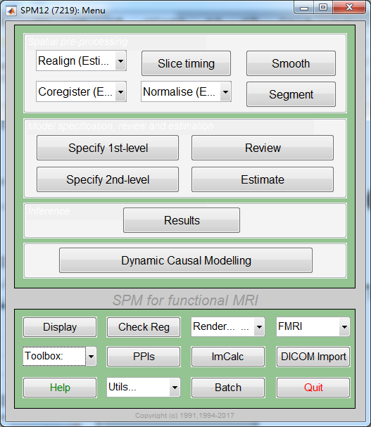
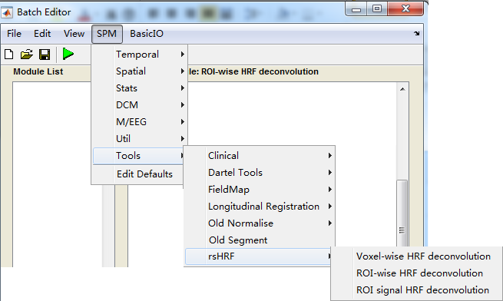
Batch
From batch

Slide 5
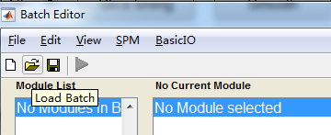
Example job
voxelwise_native_space_job01.mat
ROIwise_normalized_space_job01.mat
voxelwise_normalized_space_job01.mat
ROIsig_job01.mat

Slide 6
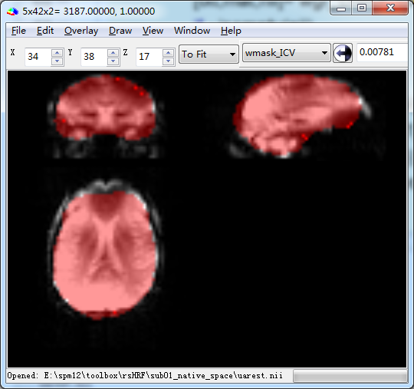
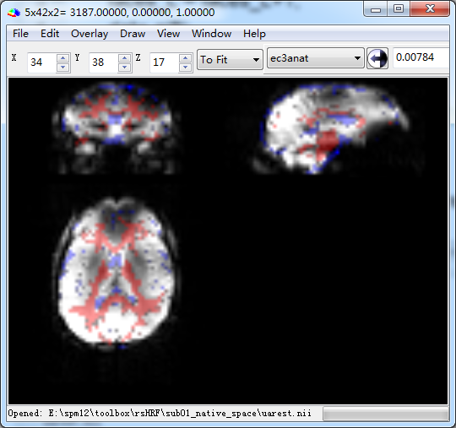
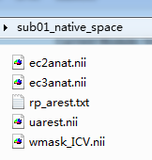
Voxelswise data
The Voxel sizes of fMRI data and WM/CSF/ brain mask image can be different (with same origin/space [see figure], This can be done by coregistration)
We only select voxels with value >0.9 in WM/CSF image for nuisance regression.

Slide 7
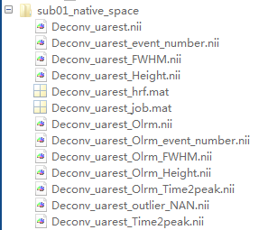
Voxelwise resutls
Deconv_uarest.nii % HRF deconvolved data
Deconv_uarest_FWHM.nii % HRF parameter FWHM
Deconv_uarest_Height.nii % HRF parameter response height
Deconv_uarest_Time2peak.nii % HRF parameter time to peak
Deconv_uarest_event_number.nii % BOLD event number
Deconv_uarest_hrf.mat % HRF
Deconv_uarest_job.mat % job file, parameters
%% remove outlier and Inpainted
Deconv_uarest_Olrm.nii
Deconv_uarest_Olrm_FWHM.nii
Deconv_uarest_Olrm_Height.nii
Deconv_uarest_Olrm_Time2peak.nii
Deconv_uarest_Olrm_event_number.nii
Deconv_uarest_outlier_NAN.nii % detected outlier (value=1)

Slide 8
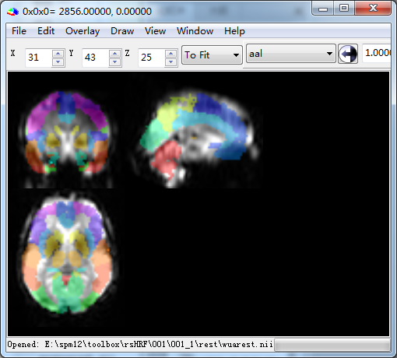
ROIwise data
The Voxel sizes of fMRI data and ROI image (atlas/ROI mask) can be different (with same origin/space [see figure])

Slide 9
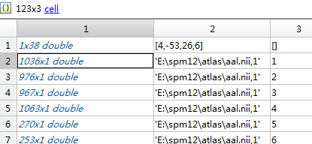
ROI level
Output:
Deconv_wuarest.mat data, data_deconv, roinfo
Deconv_wuarest_hrf.mat
Deconv_wuarest_job.mat
data: ‘cleaned’ data before HRF deconvolution
data_deconv: HRF deconvolved data
roinfo (3 column)
1st column: voxels id in 3D volume
2nd column: ROI name
3rd column: label value

Slide 10
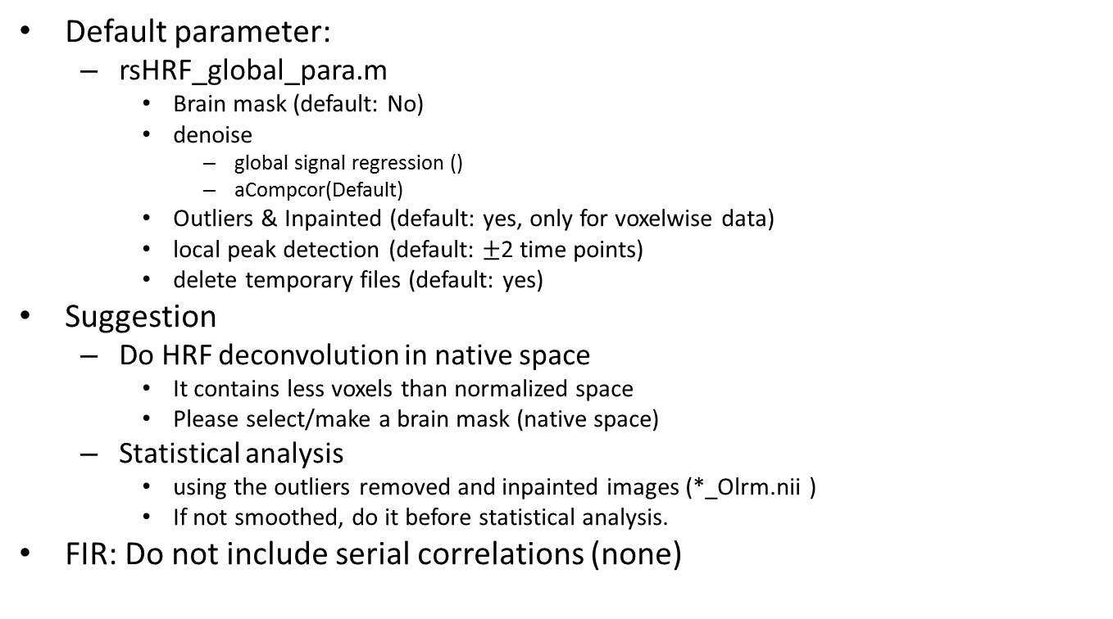
Note
Default parameter:
rsHRF_global_para.m
Brain mask (default: No)
denoise
global signal regression ()
aCompcor(Default)
Outliers & Inpainted (default: yes, only for voxelwise data)
local peak detection (default: $±$2 time points)
delete temporary files (default: yes)
Suggestion
Do HRF deconvolution in native space
It contains less voxels than normalized space
Please select/make a brain mask (native space)
Statistical analysis
using the outliers removed and inpainted images (*_Olrm.nii )
If not smoothed, do it before statistical analysis.
FIR: Do not include serial correlations (none)

Slide 11
Future
FC
Voxelwise
Deconv_*_Olrm.nii, Do not require further processing (e.g. regression, filtering,…)
ROIwise
Load ‘data_deconv’ data, [r,p]=corr(data_deconv)
GC

