Slide 1
Analyzing weather patterns using Spark and Tableau
Team Name: Data Diviners
Team Members:-
Sai Prakash Goud
Marthala Shiva Ram Reddy
Nalla Amogh Reddy

Slide 2
Outline
1. Introduction
2. Architecture Diagram
3. Demo
4. Results
5. Conclusion

Slide 3
1. Introduction
Using Spark and Tableau to analyze weather trends makes use of distributed computation and sophisticated visualization.
Tableau prep is used to convert the large dataset into clean and structured format.
Spark effectively analyzes large datasets, revealing patterns in wind, precipitation, and temperature.
These insights are converted into interactive dashboards using Tableau, which facilitates simple data exploration and decision-making.

Slide 4
Tools and Technologies used
Tableau Prep
PySpark
Jupyter lab notebooks to run python scripts
Tableau Desktop

Slide 5
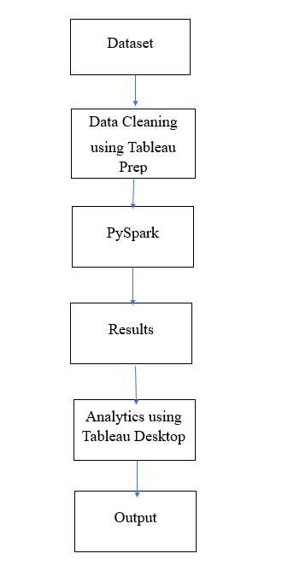
2. Architecture Diagram

Slide 6
3.Demo

Slide 7
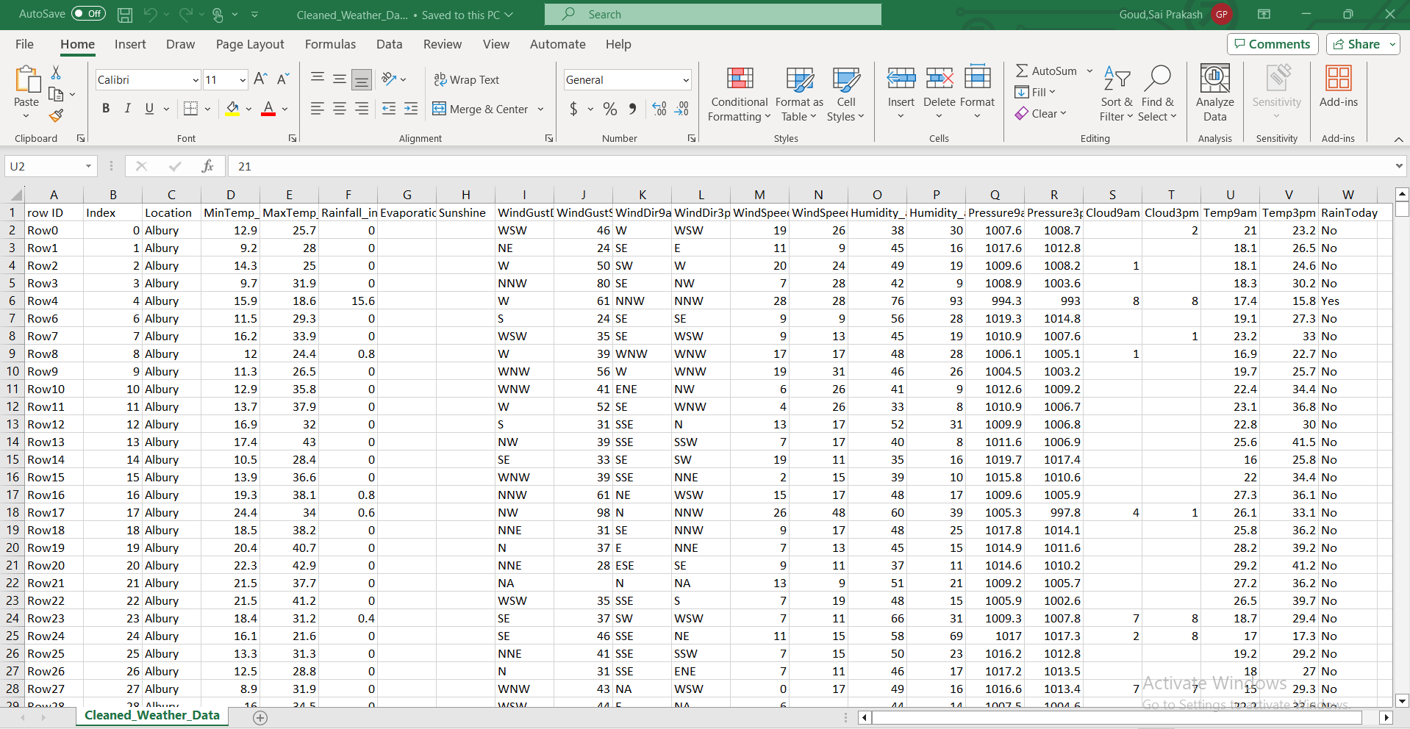
Dataset : Weather Data(Australia)

Slide 8
Goals
Goal 1 : Analyze average temperatures for each location (MinTemp in Celsius
and MaxTemp in Celsius).
Goal 2: Identify rows where MinTemp or MaxTemp exceeds certain
thresholds (e.g., MinTemp ¡ 0°C or MaxTemp ¿ 40°C)
Goal 3: Find the top 5 locations with the highest average Maximum
temperature
Goal 4: Identify days and locations where there was an unusually
large drop in temperature compared to the previous day.
Goal 5: Analyze the relationship between temperature (MinTemp,
MaxTemp), rainfall, and humidity to identify patterns of high humidity conditions
Goal 6: Analyze the number of days with rainfall greater than 0
for each location

Slide 9
Goal 1
Goal 1 : Analyze average temperatures for each location (MinTemp in Celsius and MaxTemp in Celsius).
PySpark code:-
avg_temp = spark.sql('''
select
Location,
Round(avg(MinTemp_in_Celcius),2) AS AvgMinTemp,
Round(avg(MaxTemp_in_Celcius),2) AS AvgMaxTemp
from
Aus_Weather_Data
group by
Location
''')
avg_temp.show()

Slide 10
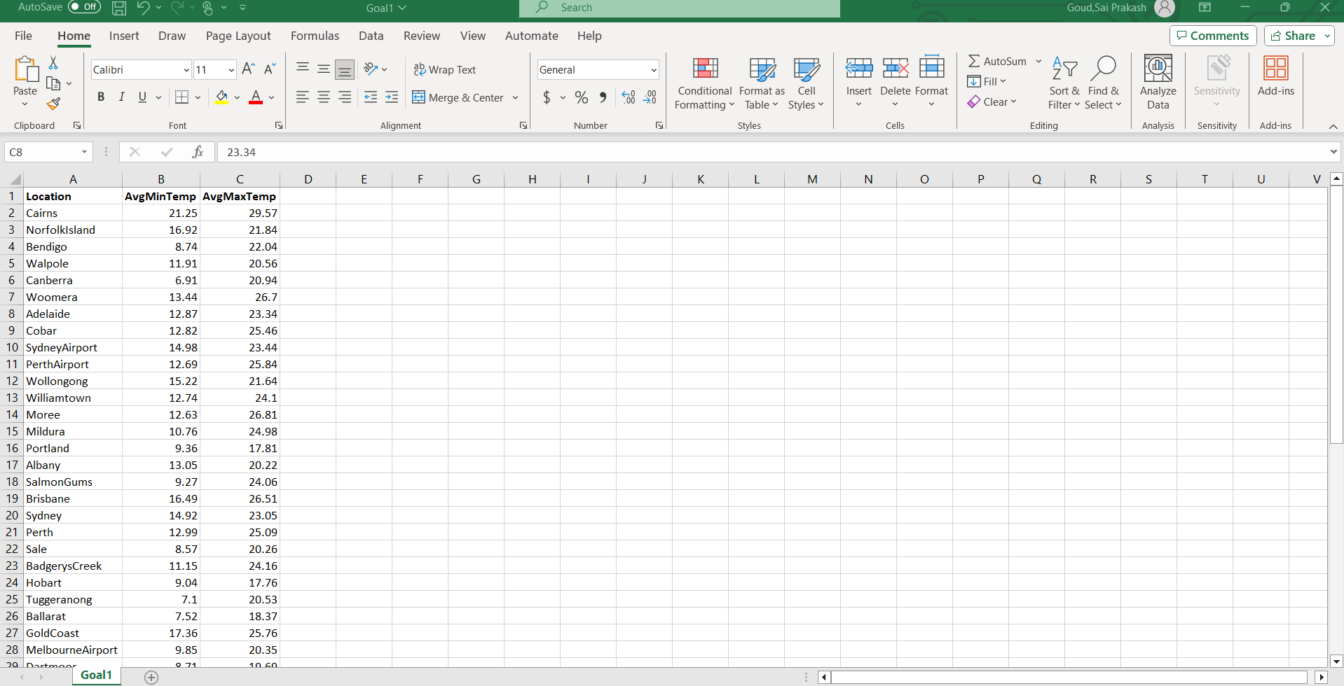
Goal 1
Result:-

Slide 11
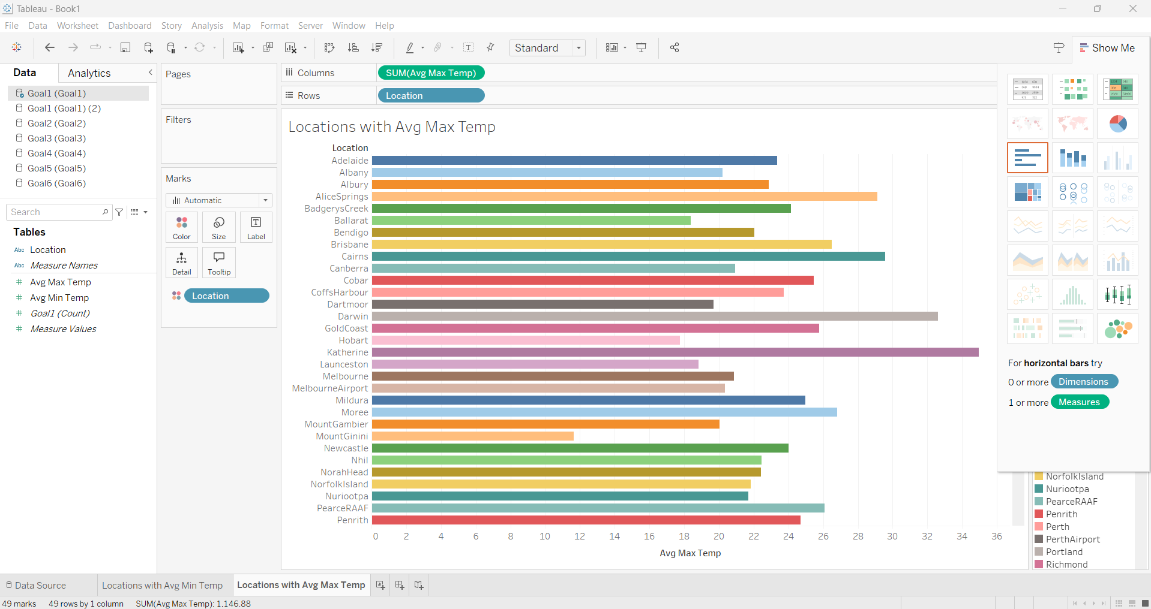
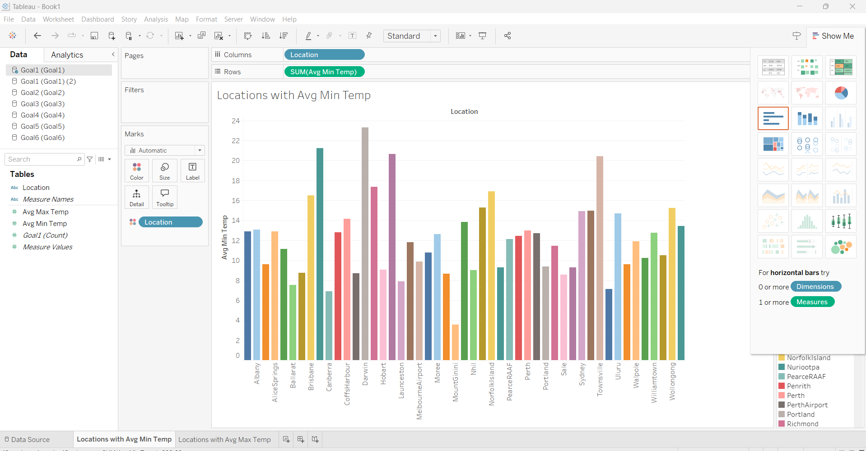
Goal 1

Slide 12
Result Summary:
The Above bar chart and column chart shows to Compute the average MinTemp and MaxTemp for each Location to understand general temperature trends.
First, Darwin city has highest average Minimum temperature with 23.31 celcius, Second location is Cairns with 21.25 celcius followed by katherine with 20.64 celcius at third and other cities has less averages .
The Katheine has highest Average maximum temperature with 34.97 celcius at first, Darwin city has 32.62 celcius at second and followed by Ulluru and Carins cities.
This chart summarized that cities which more average minimum temperature also has more average maximum temperature.

Slide 13
Goal 2
Goal 2 :Identify rows where MinTemp or MaxTemp exceeds certain thresholds (e.g., MinTemp < 0°C or MaxTemp > 40°C
PySpark code:
extreme_temps = spark.sql('''
select Location,
min(MinTemp_in_Celcius) as Lowest_Temperature,
max(MaxTemp_in_Celcius) as Highest_Temperature
from Aus_Weather_Data
where
MinTemp_in_Celcius < 0 OR MaxTemp_in_Celcius > 40
group by Location
''')
extreme_temps.show()

Slide 14
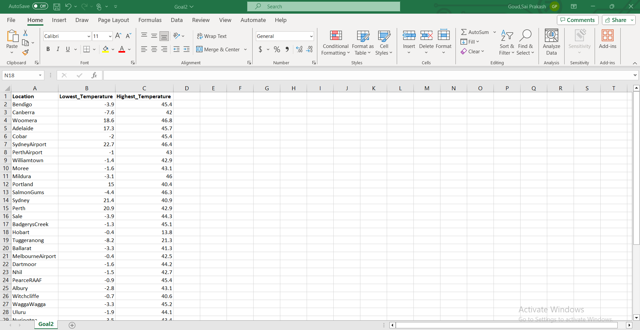
Goal 2 Result:

Slide 15
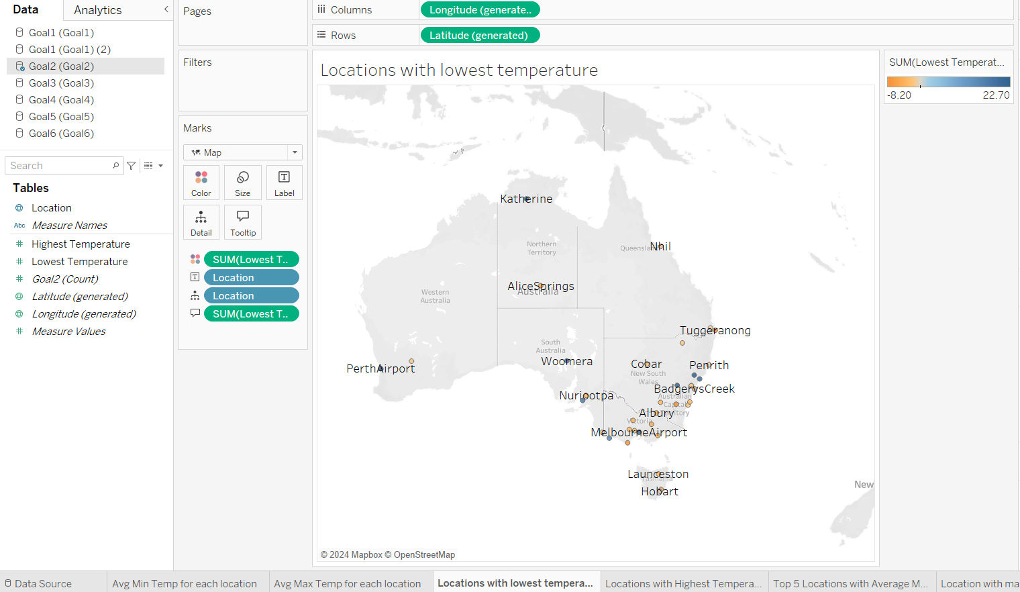
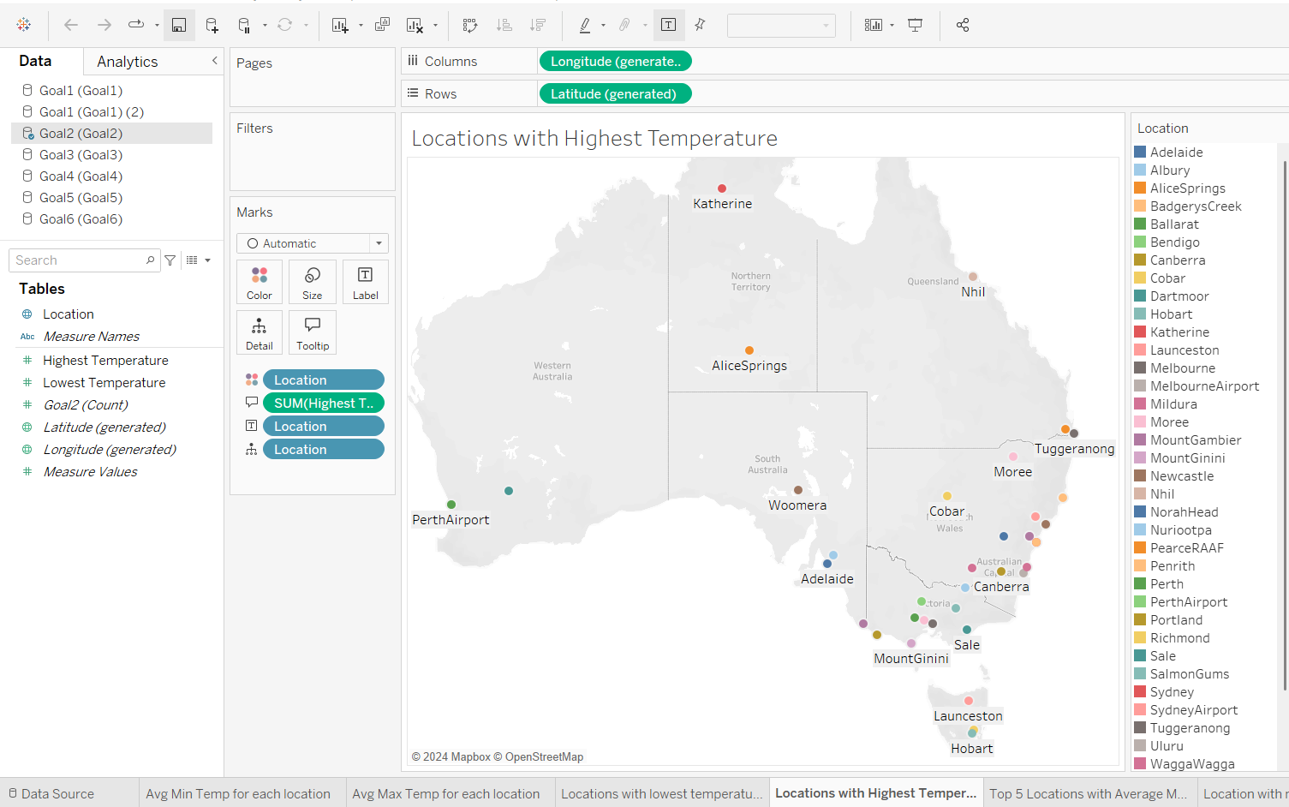
Goal 2

Slide 16
Result Summary:
The above 2 Filled Map shows the cities with lowest temperature and highest temperature among the data.
The Tuggerano city has the lowest temperature with -8.2 celcius and Richmond has highest temperature with 47 celcius.
The cities with moderate temperature has highest temperature and cities with low temperature has no increase in temperatures

Slide 17
Goal 3
Goal 3:Find the top 5 locations with the highest average Maximum temperature
PySpark code:
toplocations = spark.sql('''
select
Location, round(avg(MaxTemp_in_Celcius),2) AS AvgMaxTemp
from Aus_Weather_Data
group by Location
order by AvgMaxTemp DESC
LIMIT 5
''')
toplocations.show()

Slide 18
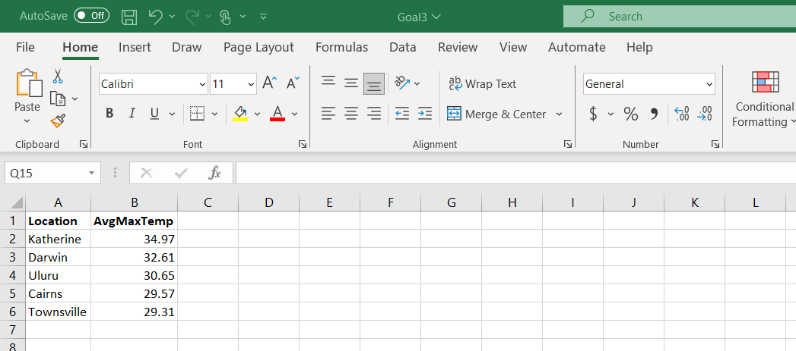
Goal 3 Result:

Slide 19
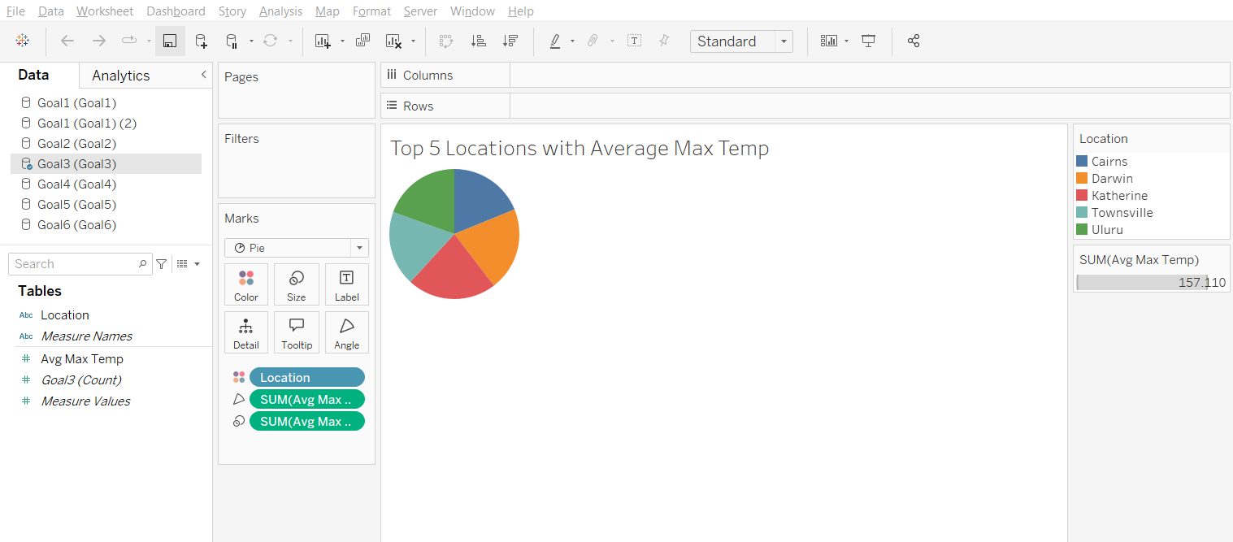
Goal 3

Slide 20
Result summary:
The pie chart shows the top 5 cities with highest temperature in the given dataset.
The Katherine has 34.97 celcius, Darwin has 32.61 celcius, Ulluru has 30.65 celcius, followed by Cairns and Townsville with 29.57 and 29.31 Celcius. Goal 4

Slide 21
Goal 4
Goal 4: Identify days and locations where there was an unusually large drop in temperature compared to the previous day
PySpark code:
sudden_drops = spark.sql('''
WITH TempChanges AS (
select
index, Location,MinTemp_in_Celcius,MaxTemp_in_Celcius,
LAG(MinTemp_in_Celcius) OVER (PARTITION BY Location ORDER BY index) AS PrevMinTemp,
LAG(MaxTemp_in_Celcius) OVER (PARTITION BY Location ORDER BY index) AS PrevMaxTemp
from Aus_Weather_Data )

Slide 22
Goal 4
PySpark code continue:
select
index,
Location,MinTemp_in_Celcius,MaxTemp_in_Celcius,
(PrevMinTemp - MinTemp_in_Celcius) AS MinTempDrop,
(PrevMaxTemp - MaxTemp_in_Celcius) AS MaxTempDrop
from TempChanges
where
(PrevMinTemp - MinTemp_in_Celcius) > 10 OR
(PrevMaxTemp - MaxTemp_in_Celcius) > 10
''')
sudden_drops.show()

Slide 23
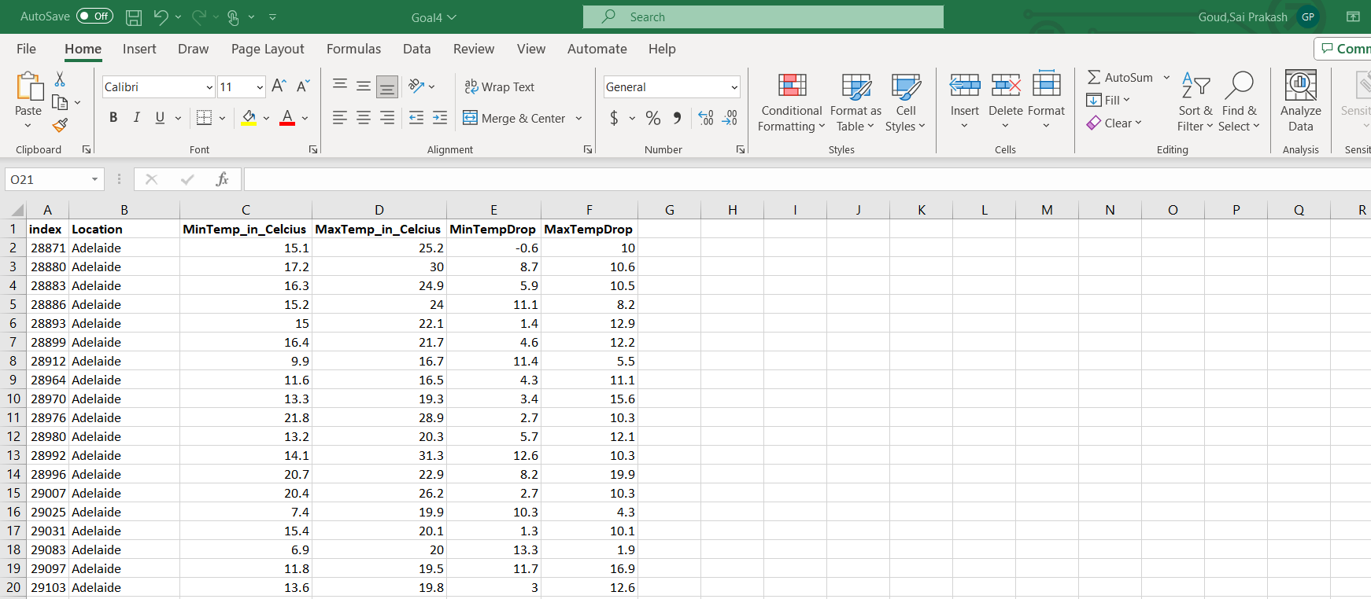
Goal 4 Result:

Slide 24
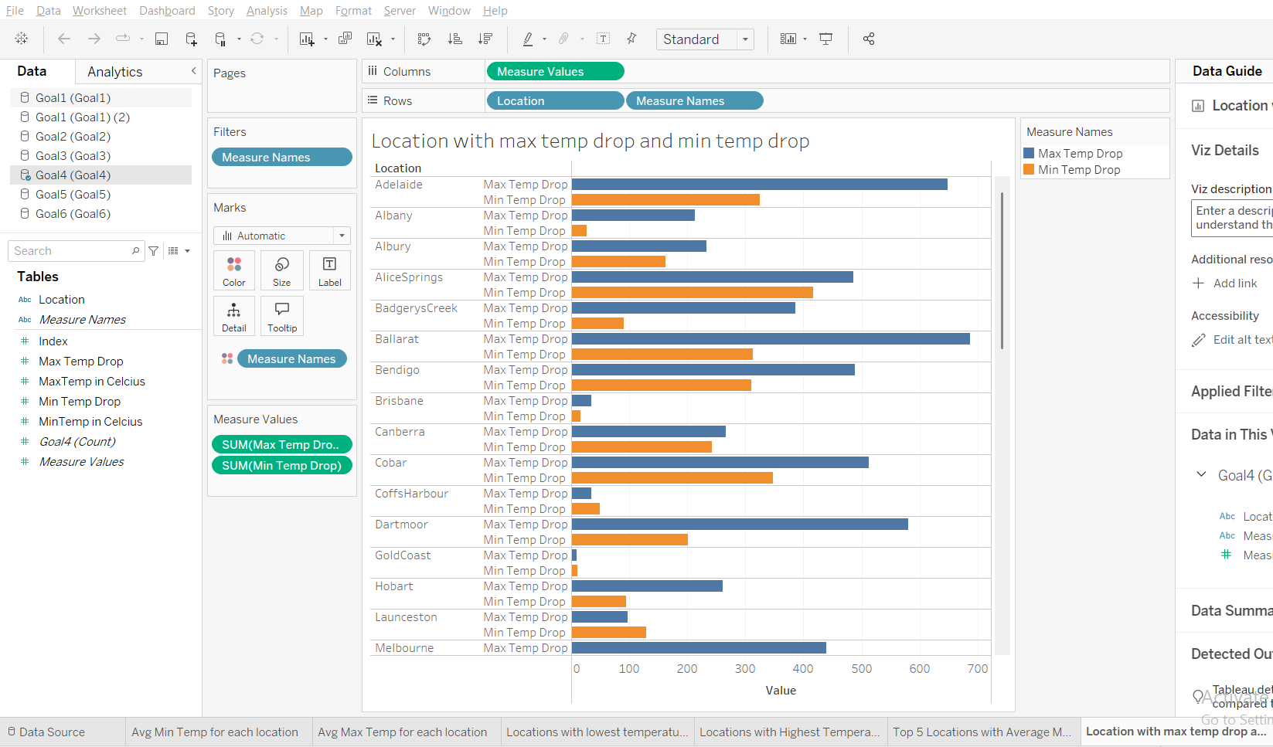
Goal 4

Slide 25
Result summary:
The clustered bar chart shows the cities with min temp drop and max temp drop for each city.
Bendigo city has minimum temperature drop with -10.8 Celcius and Cobar has maximum temperature with 25.1 Celcius. The cities with low temperature has high prediction of temperature drop compared to cities with low temperature cities

Slide 26
Goal 5
Goal 5: Analyze the relationship between temperature (MinTemp, MaxTemp), rainfall, and humidity to identify patterns of high humidity conditions.
PySpark code:
humidity_analysis = spark.sql('''
WITH TempCategory AS (
select *, case when MaxTemp_in_Celcius >= 30 THEN 'Hot'
when MaxTemp_in_Celcius >= 20 AND MaxTemp_in_Celcius < 30 THEN 'Moderate'
else 'Cool' end AS TempRange
from Aus_Weather_Data )

Slide 27
Goal 5
PySpark code continue:
select
TempRange,
round(avg(humidity_at_9am),2) AS AvgHumidity9am,
round(avg(humidity_at_3pm),2) AS AvgHumidity3pm,
round(avg(Rainfall_in_millimeters),2) AS AvgRainfall
from TempCategory
GROUP BY TempRange
''')
humidity_analysis.show()

Slide 28
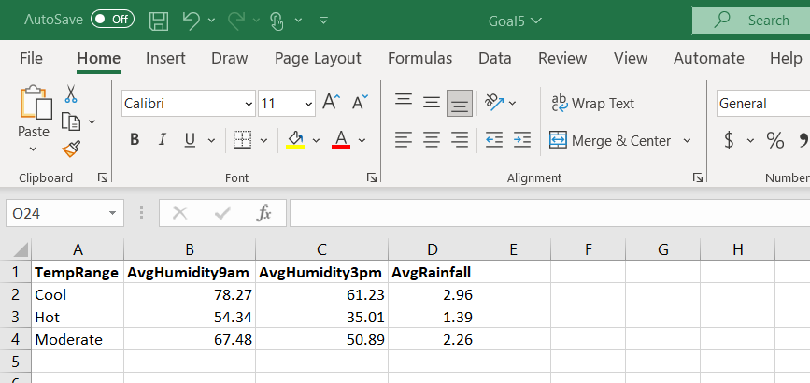
Goal 5 Result:

Slide 29
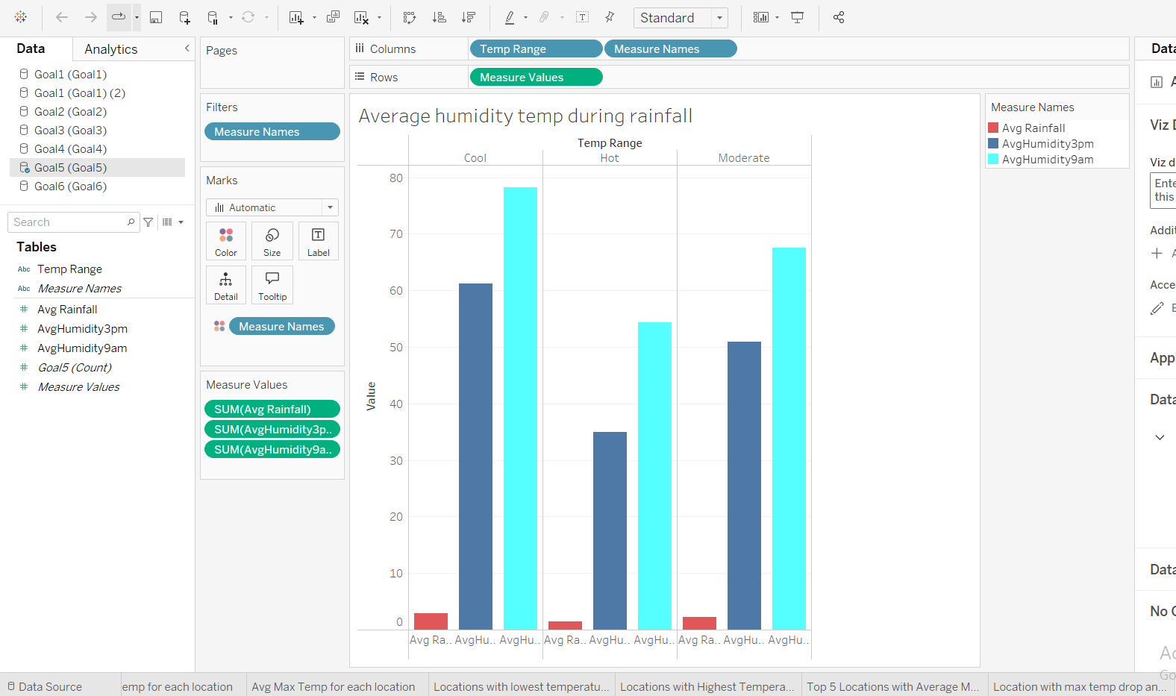
Goal 5

Slide 30
Result Summary:
The clustered column chart shows the relationship between temperature and humidity patterns using different ranges of temperature.
The cool temperature range with humidity at 9am and 3pm is 78.27 and 62.2 based on 2.96 average rainfall, Hot temperature range humidity at 9am and 3pm is 54.34 and 35.01 on 1.39 average rainfall and Moderate temperature range with humidity at 9am and 3pm is 67.48 and 50.89 on 2.26 average rainfall

Slide 31
Goal 6
Goal 6 : Analyze the number of days with rainfall greater than 0 for each location.
PySpark code:
rainy_days = spark.sql('''
select
Location,
COUNT(*) AS RainyDays
from
Aus_Weather_Data
where Rainfall_in_millimeters > 0
GROUP BY Location
''')
rainy_days.show()

Slide 32
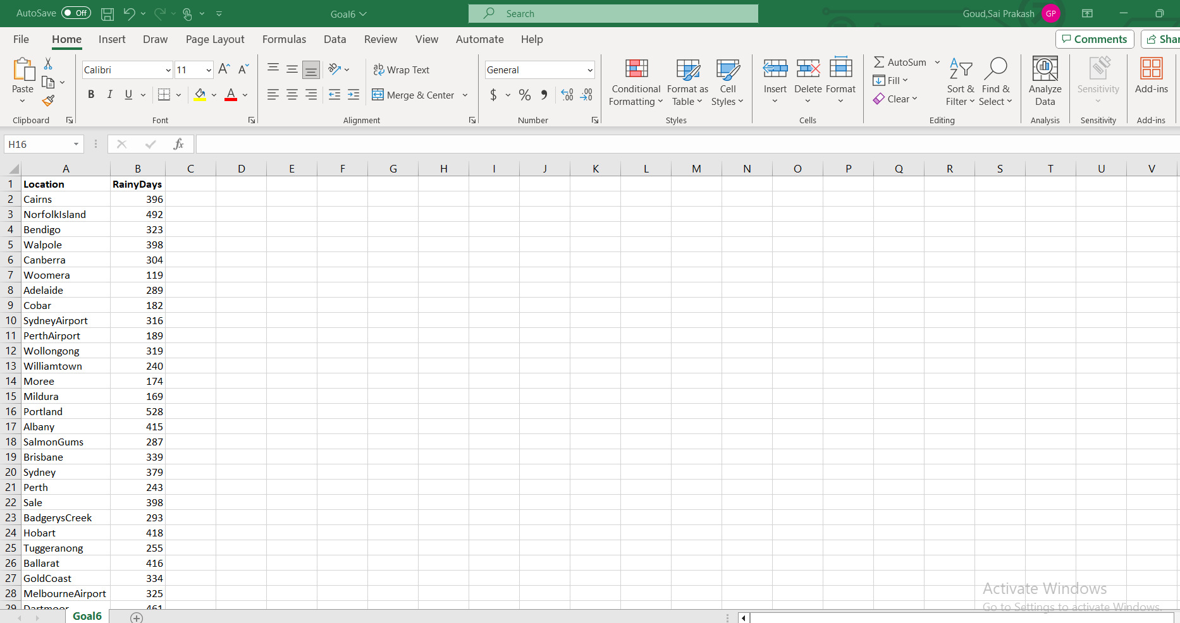
Goal 6 Result:

Slide 33
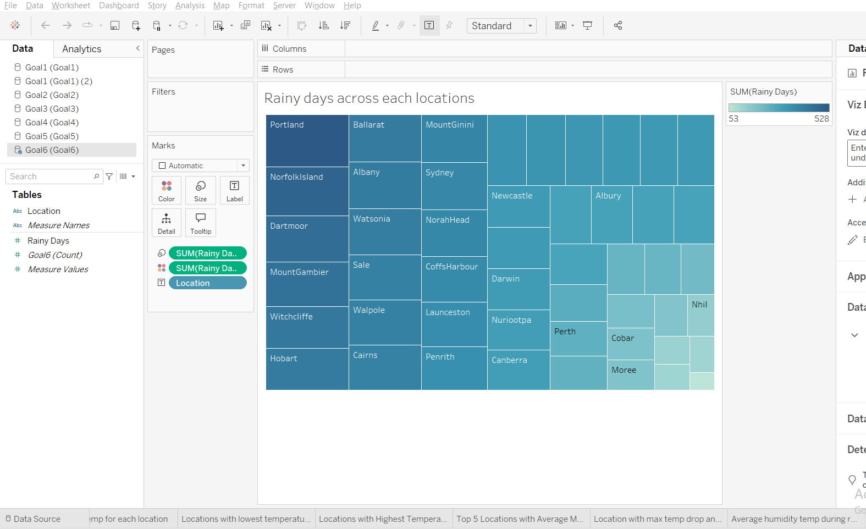
Goal 6

Slide 34
Result summary
The Tree map chart shows the analyze the number of days with rainfall greater than 0 for each location. Cairns city has highest rainy days with 396 and Uluru city has lowest rainy days with 53

Slide 35
Conclusion
In conclusion, the analysis of weather patterns using Spark and Tableau demonstrates the power of big data and visualization tools in deriving meaningful insights.
By leveraging Spark for efficient data processing, Tableau Prep for data cleaning, and Tableau for creating interactive dashboards, we successfully identified critical weather trends and patterns.
This project underscores the potential of integrating advanced technologies to make data-driven decisions and provides a foundation for future research and predictive weather modeling

Slide 36

Thank You

