Slide 1



Slide 2
Story behind
Sri Sannidhi Foundation
We are not different from you , we are just a step ahead trying to help the needy in form of a registered organization

Slide 3
Story behind
Sri Sannidhi Foundation
After doing various charitable activities for around 15 years , like minded friends have come together to form this organization, Sri Sannidhi Foundation ,(NGO - non government organization )

Slide 4
About us:
Sri Sannidhi Foundation
is a non-profit charitable trust, registered according to the Provision of Maharastra Public trust Act,1950, the income tax 1961, and Indian Trust act 1882.

Slide 5
Aims and Objectives of the Trust :
Sri Sannidhi Foundation is an organization benefitting underprivileged children
and their families through
various projects on healthcare, education, nutrition, shelter, livelihood, women empowerment, child protection, and other social issues.
However, our primary focus would be extending a helping hand for sponsoring educational expenses of underprivileged children.

Slide 6
People behind Sri Sannidhi Foundation :
Sujana Namuduri –Chief Trustee, Mumbai
Subramanyam Venkata Namuduri – Trustee , Mumbai
Uday Kumar Bommisetty – IT employee, USA
Eluru Krishna Mohan – Trustee, Bengaluru
Makam Harika – Trustee , Bengaluru

Slide 7
Modus operandi
A little about what we do:
When someone approaches us, requesting for some financial help, we collect the basic information like academic excellence, mark sheets, we do our background checks about the authenticity. And then go ahead and sponsor the child within our limits.

Slide 8
How do we pay the fee for students?
We pay the fee directly to the educational institutes, schools and colleges, we never pay any fee in cash to anyone. And receipts of the fees paid is taken from the educational institutes and the same can be shared with the donators if requested.

Slide 9
How much can we donate?
There is no minimum amount to be sponsored, we accept any amount
only through online transfer to our Foundation trust account.
Every drop counts and no amount is small.
Please remember one child’s educational fee for a year is less than our pizza cost in a weekend.

Slide 10
Sri Sannidhi Foundation

Slide 11
How do I know, how and to whom my donation is used?
We are open to share the details of the student to whom your donation will be used and if you wish, you can contact the child through us and know the details of their studies etc.

Slide 12
Where do I donate and how?
Following are the bank details of our foundation:
Name SriSannidhiFoundation
Bank account number: 50200071786939
IFSC Code HDFC0000053
Account type: Current
NRI AND NRO ACCOUNTS PLEASE DONOT TRANSFER ANY AMOUNTS AS OF NOW

Slide 13
Request you to please call us on
+91 9343475767 (sujana)
for any clarifications before
or after the donation.
Every donation will be acknowledged by a receipt.
Also kindly send us a mail to srisannidhi7@gmail.com
if you wish to give us a donation or if you have transferred any amount to us.

Slide 14
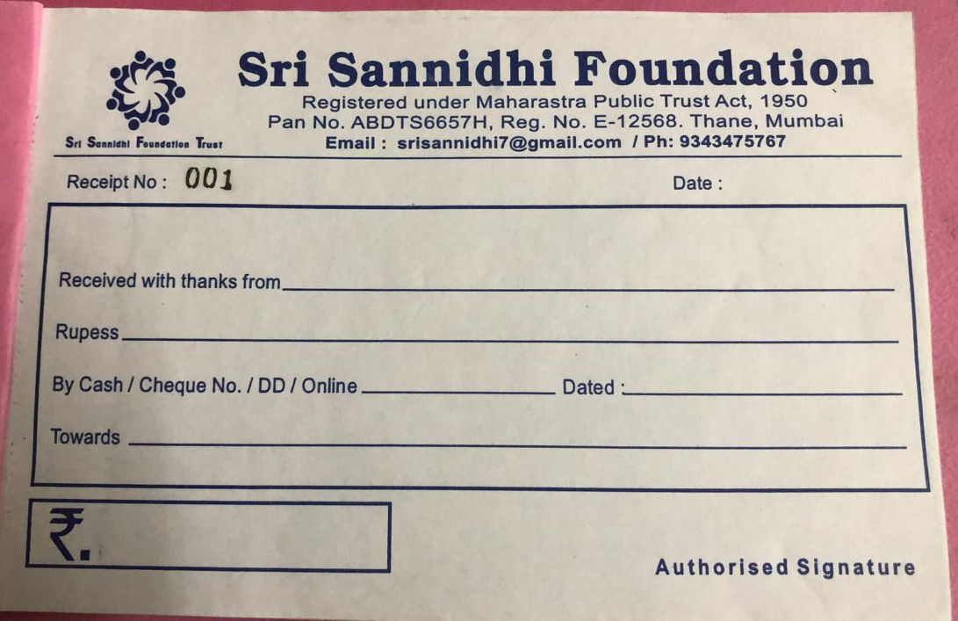
Sri Sanndihi Foundation Receipt copy :

Slide 15
Very important question
?
How do you trust us - ?
We are open to share all information , about where your
funding is used along with the banking transactions proofs that
we have paid to the educational institutes / hospitals etc
You can be in touch with the child/family you have sponsored,
if you wish to do so

Slide 16
Some of the funding
that activities we have
done so far

Slide 17
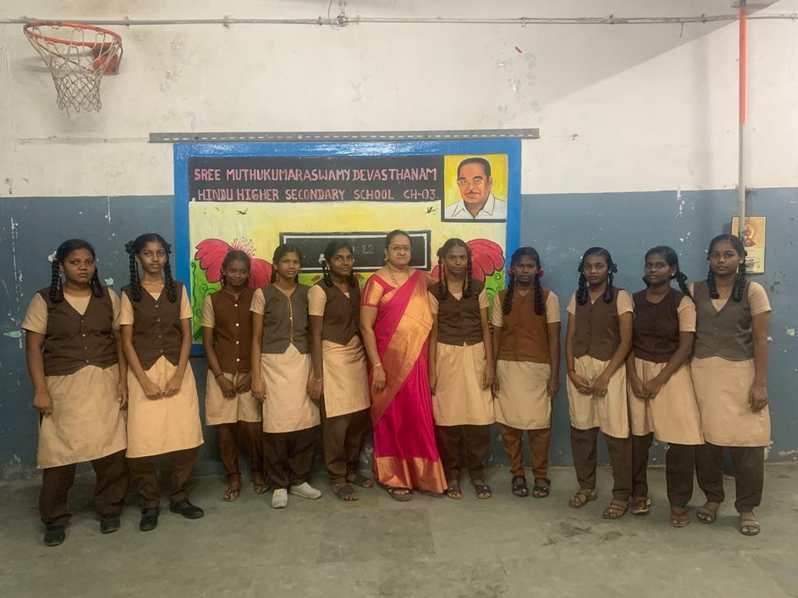
SMD Hindu Sec High school,chennai
We are sponsoring
education of 10 girls for
11th and 12th grades ,
children of coolies and
daily wages labour on
streets of Chennai .

Slide 18

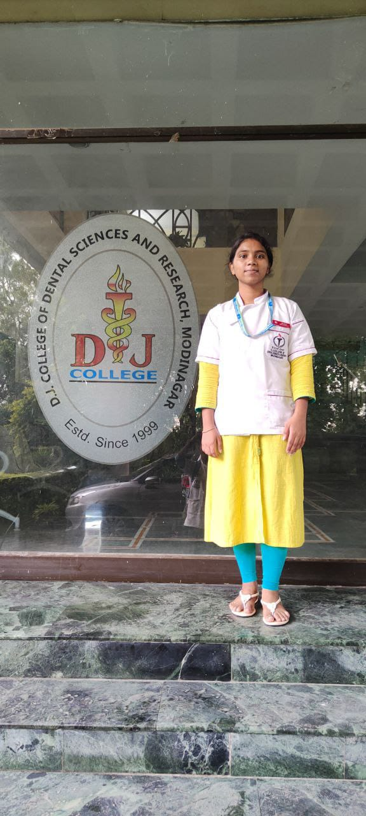
BDS - R Aarti , Delhi
Aarti , is a daughter of a tailor in Bengaluru,
Lost father, mother with three daughters.
We have taken up her educational expenses an amount of 10 lakhs for BDS ( dental sciences ) , Have already sponsored for first three years She aspires to be a dental doctor and help her other two sisters financially

Slide 19
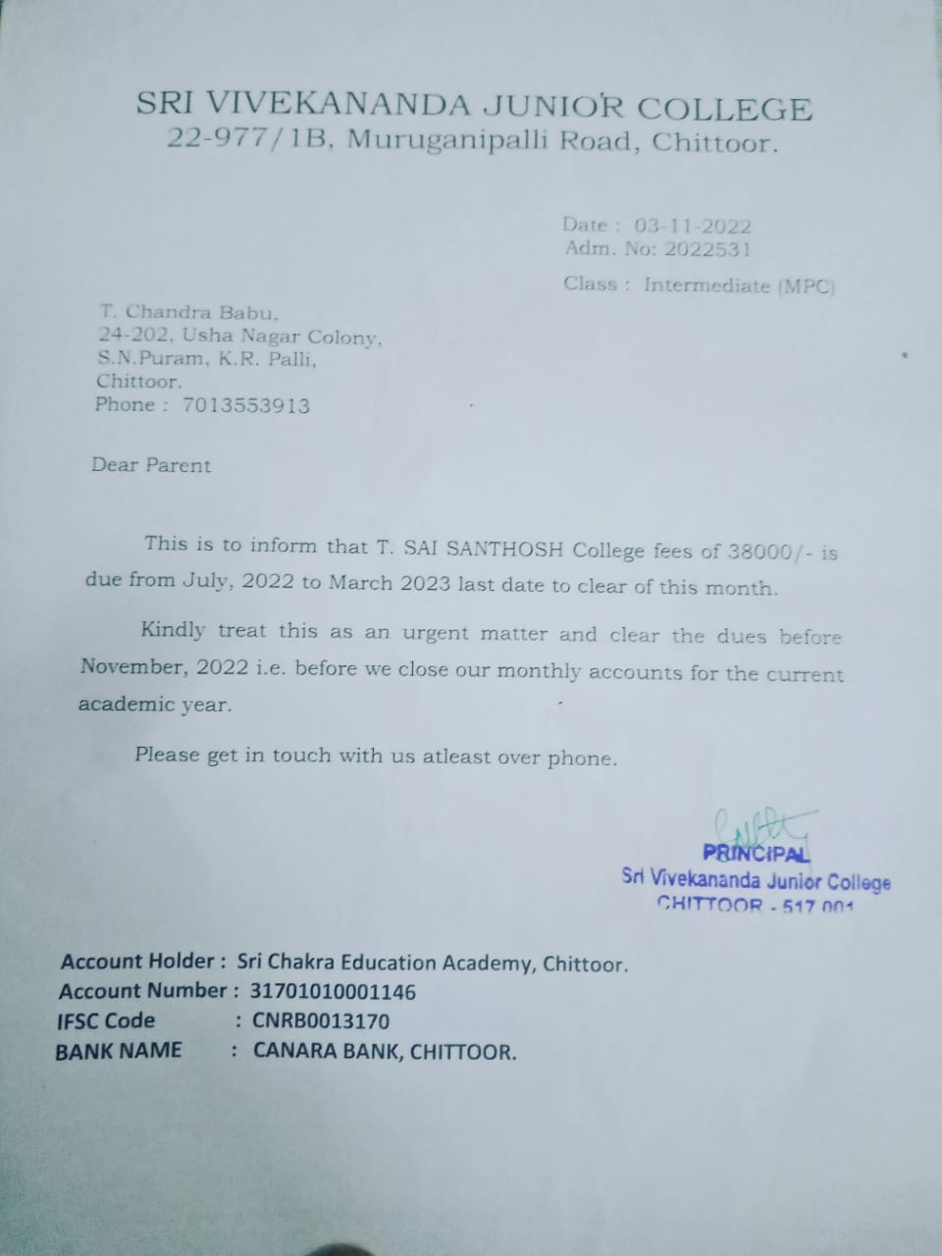
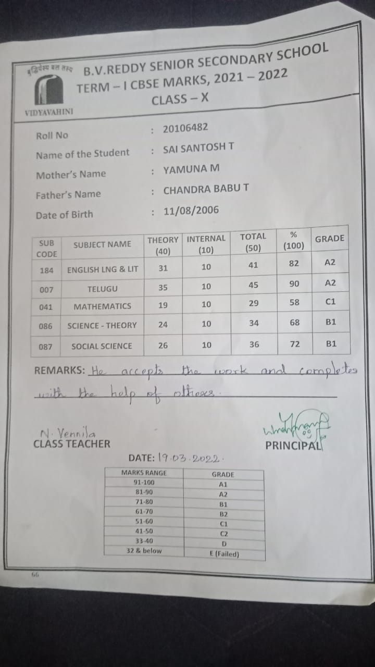
Two kids education sponsored- chitoor , Andhrapradesh
We have taken up the educational fees of these kids , as they lost their father with kidney failure, the only bread winner of
the family
Complete academic year fee is
paid through the foundation
T. Sai Ganesh - 9th Grade – BV Reddy
senior secondary school
T. Sai Santosh -11th Grade -MPC, chitoor

Slide 20
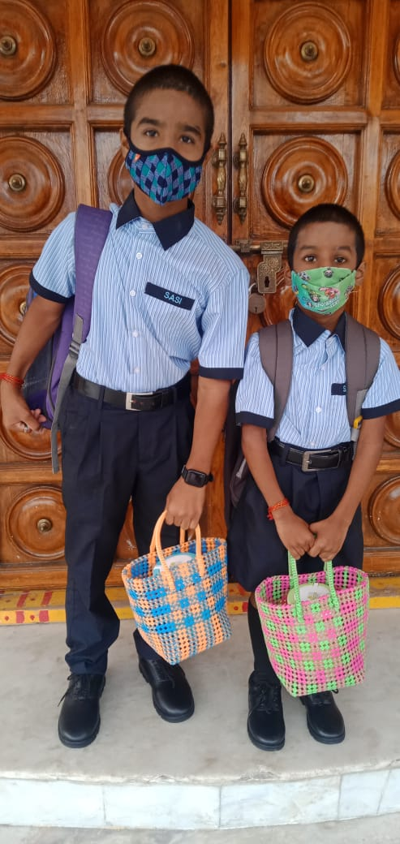
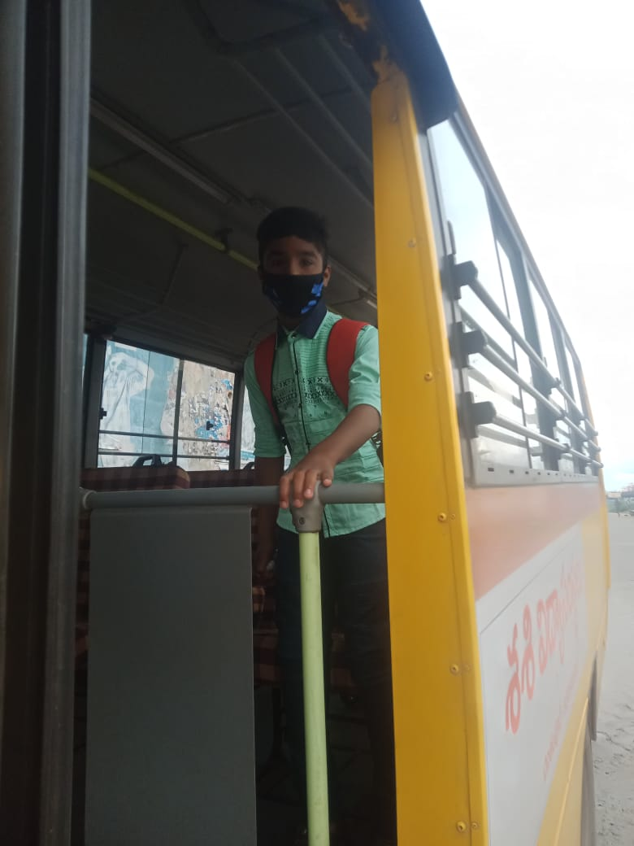

G.Balaji (9th grade
G.Jeevan ( 5th grade )
Two sons of a security guard ,
Tirupati
Educational expenses
Being paid for the past
two years and will sponsor
till they settle down in their lives
The elder one aspires to become
an IIT student, he is excellent
in his studies …

Slide 21

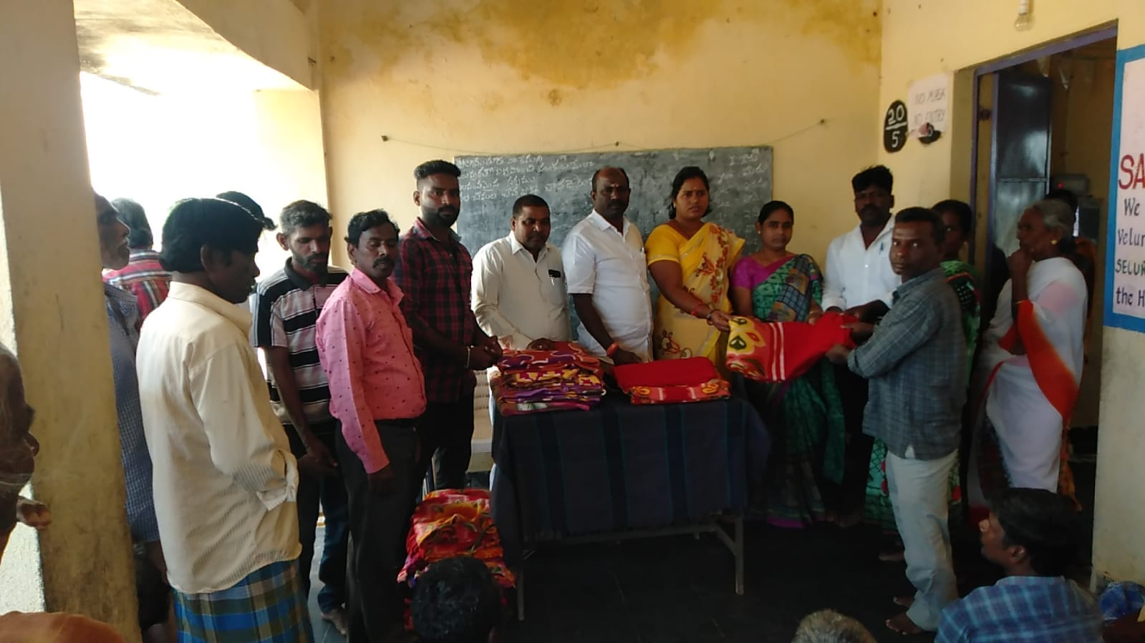
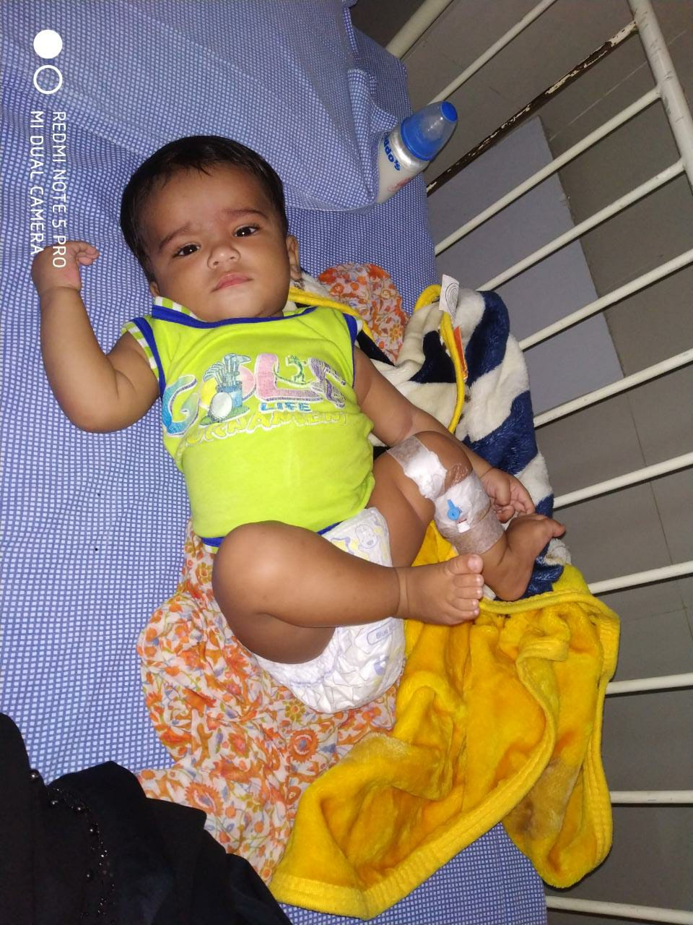
Jeevanadhara - Bedsheets,
Anna danam being sponsored
for more than 80 + physically
handicapped people at Veluru,
Chittor , every year
A ,7 month old baby, of Chennai, being sponsored for pelvic ureteric junction obstruction. Our foundation has sponsored for the surgery and baby is hale and healthy

Slide 22
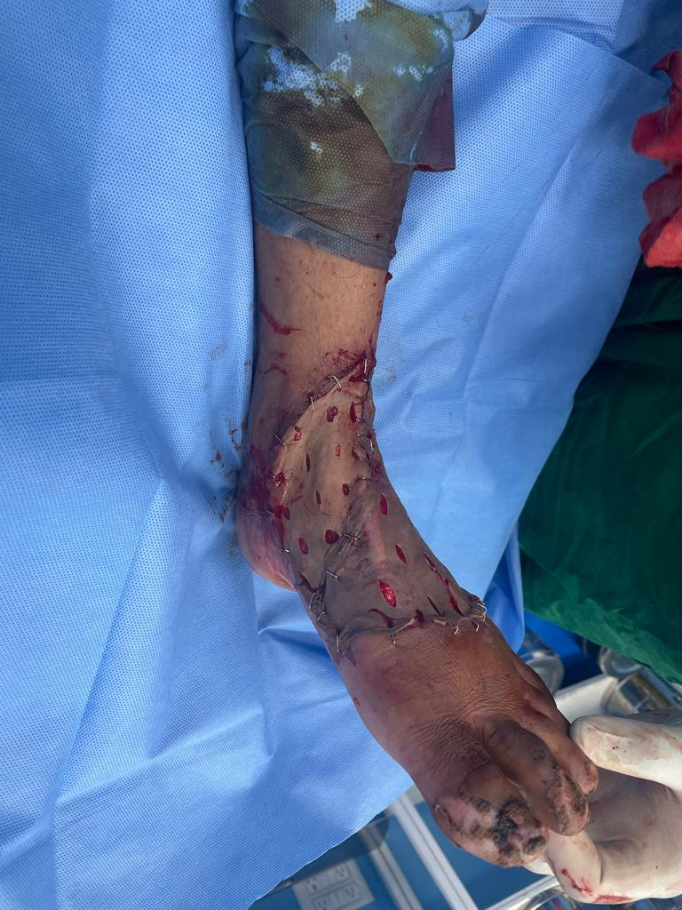
Plastic surgery expenses :
We have collected 3.38 lakhs for plastic surgery of a priest son , in Bangalore . The entire amount is sponsored from the residents of Gopalan Grandeur , White field , Bangalore .
We have paid amount for the surgery, directly to the hospital in Bengaluru

Slide 23

These are only some of the funding activities,
we have shared with you, if you wish to know more ….
We will be happy to share with you …
THANK YOU !!!

