Slide 1

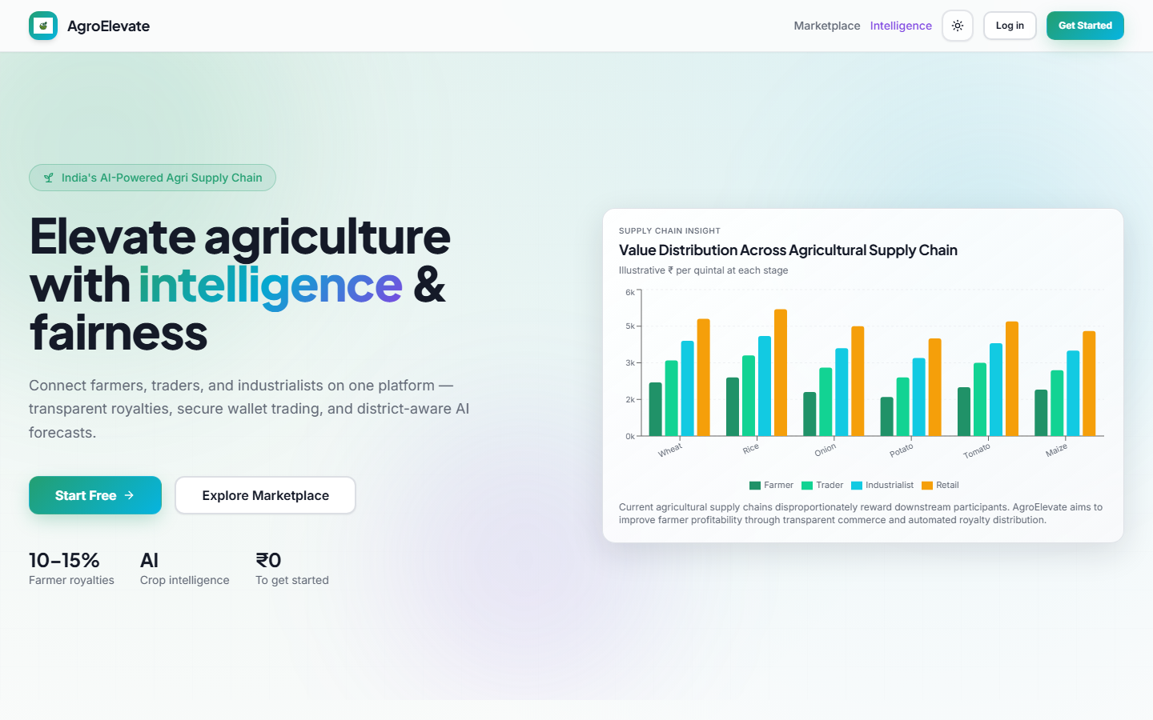
AgroElevate
AGROELEVATE: AI-POWERED AGRI-COMMERCE PLATFORM FOR FARMER TRANSACTIONS AND ANALYTICS
Bachelor of Engineering — Final Year Project
Pune Vidyarthi Griha's College of Engineering, Technology & Management, Pune – 411009
Department of Electronics and Telecommunication Engineering
Savitribai Phule Pune University
Submitted By:
Harshavardhan Kale (B190070239) | Siddheya Masurkar (B190070261)
Amogh Raidurg (B190070288) | Mohit Sonsale (B190070306)
Guide: Dr. V. B. Thakare | Academic Year: 2025–2026
Notes:
SLIDE 1 — TITLE
Good morning/afternoon respected examiners, faculty, and guests.
I am [Student Name], presenting our Final Year BE project: AgroElevate — an AI-powered agricultural marketplace with automated royalty distribution.
AgroElevate connects farmers, traders, industrialists, and customers on a single platform where downstream resale value is shared fairly with the original producer through a server-side royalty engine.
This presentation covers architecture, implementation, live deployment, and verified results from our production system at agro-fair-chain.vercel.app.

Slide 2
Problem Statement
Indian agriculture loses value across opaque supply chains
Farmers receive only farm-gate price — no share in downstream resale
Middlemen capture arbitrage without transparent royalty
Low profit visibility and fragmented digital infrastructure
Lack of trust, traceability, and fair payment rails
Existing AgriTech focuses on listings — not automated revenue sharing
Supply Chain Gap
Farmer → Trader → Industrialist → Retail Value concentrates downstream
Impact
< 15% farmer share in many commodity chains No programmatic royalty on resale
Notes:
SLIDE 2 — PROBLEM STATEMENT
Indian agriculture employs over half our workforce, yet farmers capture the smallest share of value in multi-hop supply chains.
Middlemen and processors absorb margins while the farmer receives only a one-time farm-gate payment. There is no transparency, no traceability, and no automated mechanism for revenue sharing on resale.
Existing AgriTech platforms focus on listings and logistics — not on encoding fair economics into the transaction layer itself. AgroElevate was designed to close this gap.

Slide 3
Our Solution — AgroElevate
Fair-chain commerce + server-side royalty + AI intelligence
Farmer
List produce, earn royalties
Trader
Procure & relist inventory
Industrialist
Bulk procurement + manufacturing
Customer
Marketplace checkout
Admin
Users & payments oversight
Platform Pillars
Marketplace • Wallet (Razorpay) • Royalty Engine (12.5%) • AI Copilot • Multi-role Analytics
Notes:
SLIDE 3 — OUR SOLUTION
AgroElevate is a multi-role marketplace serving five personas: Farmer, Trader, Industrialist, Customer, and Admin.
Each role has dedicated dashboards, wallet operations, and marketplace permissions. The platform pillars are: Marketplace commerce, Razorpay wallet top-ups, the Option B royalty engine at 12.5%, AI intelligence dashboards, and role-aware analytics.
All business logic — especially royalty calculation — runs server-side in PostgreSQL RPC functions, never on the client.

Slide 4
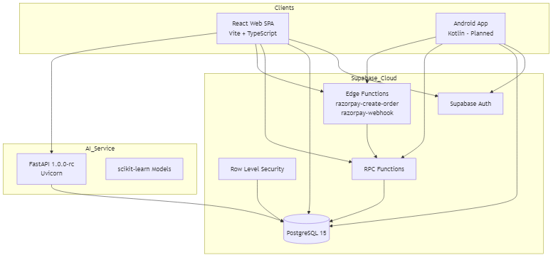
System Architecture
Thin clients — authoritative backend
Notes:
SLIDE 4 — SYSTEM ARCHITECTURE
The architecture follows a thin-client, authoritative-backend pattern.
React web and Android mobile clients communicate with Supabase for authentication, PostgreSQL data, Row Level Security, RPC functions, Edge Functions, and file storage.
The FastAPI AI microservice on Render provides predictions, recommendations, and the Copilot. Razorpay handles payment intents and webhook settlement. Vercel hosts the production web frontend.
This separation ensures security, scalability, and a single source of truth for commerce.

Slide 5
Technology Stack
Production-grade, industry-standard tools
Frontend
React 18 · TypeScript · Vite · Tailwind · shadcn/ui
Mobile
Android · Kotlin · Jetpack Compose · Supabase SDK
Backend
Supabase · PostgreSQL 15 · RLS · RPC · Edge Functions
AI
FastAPI · Python · scikit-learn · pandas · Render
Payments
Razorpay Test/Live · Webhook settlement
DevOps
GitHub · Vercel · Render · Docker
Notes:
SLIDE 5 — TECH STACK
We chose industry-standard, production-grade technologies.
Frontend: React 18, TypeScript, Vite, Tailwind, and shadcn/ui for a modern responsive UI.
Backend: Supabase with PostgreSQL 15, RLS policies, and SECURITY DEFINER RPCs.
AI: FastAPI with Python, scikit-learn, and pandas, containerized for Render deployment.
Payments: Razorpay with Edge Function webhooks. DevOps: GitHub, Vercel, Render, and Docker.

Slide 6
Core Features
End-to-end AgriTech commerce platform
Marketplace
Analytics
Admin Dashboard
Wallet
AI Intelligence
Notifications
Royalty Engine
Copilot
Android App
Orders
Authentication
Razorpay
Notes:
SLIDE 6 — CORE FEATURES
AgroElevate delivers twelve integrated capabilities: Marketplace listings and checkout, wallet with Razorpay top-up, automated royalty engine, order lifecycle management, role-based analytics, AI intelligence layer, grounded Copilot chat, Supabase authentication, admin dashboard, real-time notifications, Android client architecture, and full Razorpay payment integration.
Each feature is role-aware and backed by server-side validation.

Slide 7
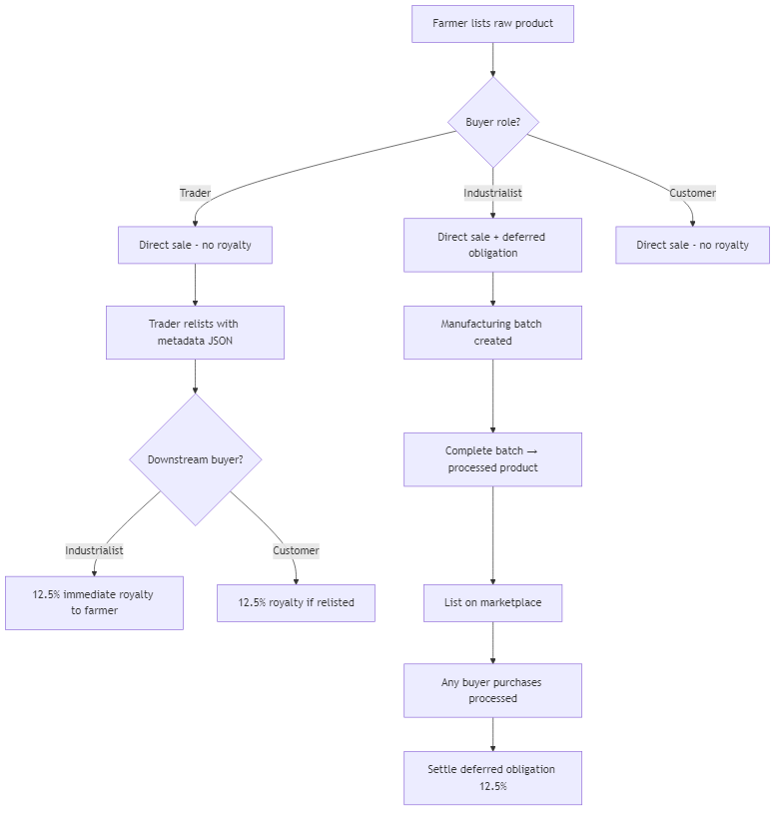
Royalty Engine — Core Innovation
Server-side Option B · 12.5% verified (26/26 E2E)
Royalty ONLY on qualifying resale (trader → industrialist)
Calculated in checkout_order RPC — never on client
wallet_history type: royalty_income
Verified: ₹43.75 on 5×₹70 resale scenario
Ownership metadata in products.description JSON
Notes:
SLIDE 7 — ROYALTY ENGINE (CORE INNOVATION)
This is our distinguishing innovation — Option B royalty remittance.
When a Trader relists produce with embedded ownership metadata and an Industrialist purchases at resale, 12.5% of the transaction value is automatically credited to the original Farmer's wallet as royalty_income.
The calculation happens inside the checkout_order RPC function — never on the client. We verified this with 26 automated end-to-end tests, including mathematical validation of ₹43.75 royalty on a 5 kg × ₹70 resale scenario.
This encodes fair agricultural economics directly in database logic.

Slide 8
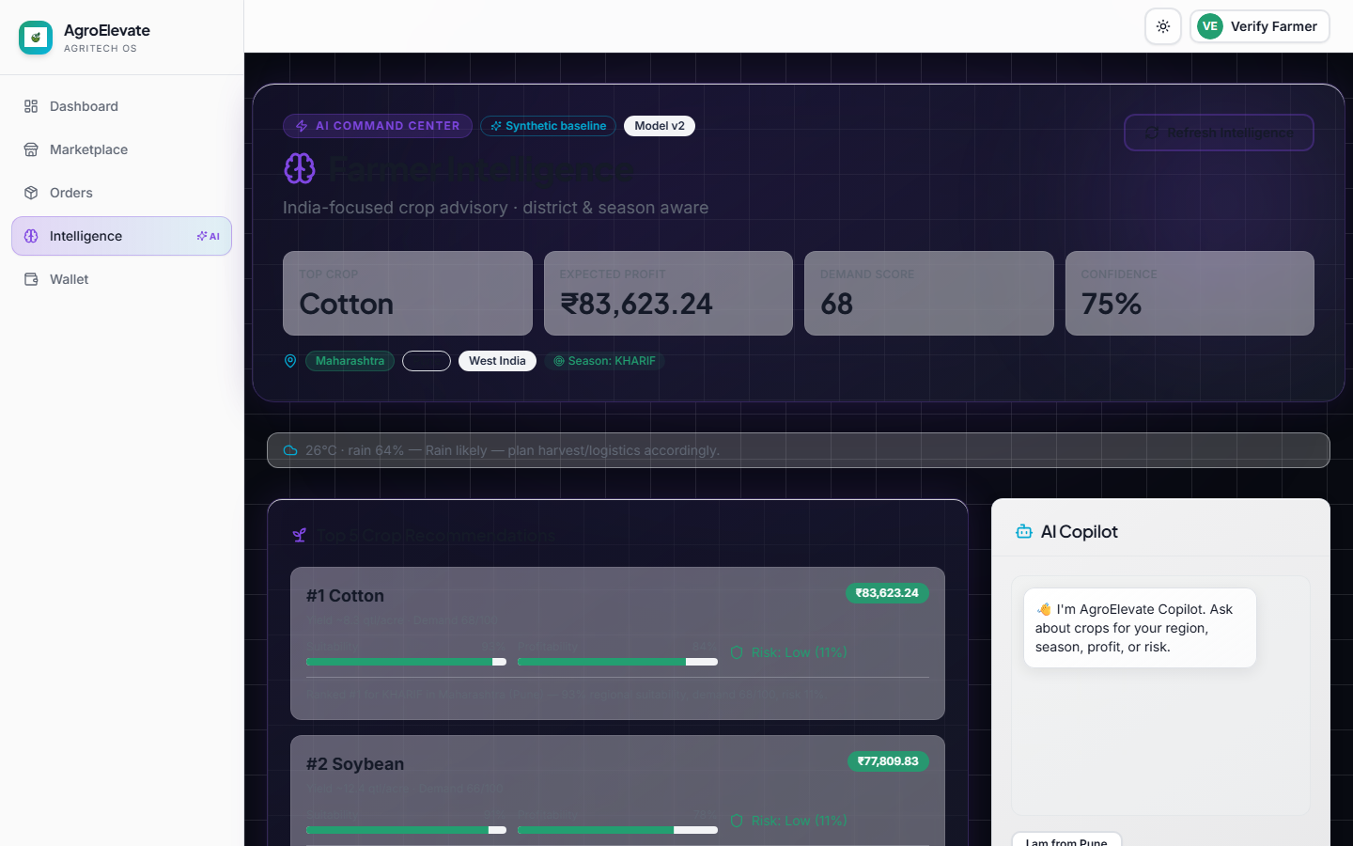
AI Intelligence Layer
FastAPI microservice — role-aware dashboards
Crop recommendations & market predictions
Income forecasts (3 scenarios)
District analytics & demand intelligence
AI Copilot with grounded context
Graceful offline fallback on web/mobile
Notes:
SLIDE 8 — AI INTELLIGENCE
The AgroElevate Intelligence API is a FastAPI microservice delivering crop recommendations, market price predictions, income forecasts in three scenarios, district-level analytics, and demand intelligence.
The AI Copilot provides grounded, context-aware responses using live user and marketplace data. The web client includes graceful offline fallback when the AI service is unavailable.
Dashboard screenshots shown here are from our live Intelligence hub at /intelligence.

Slide 9
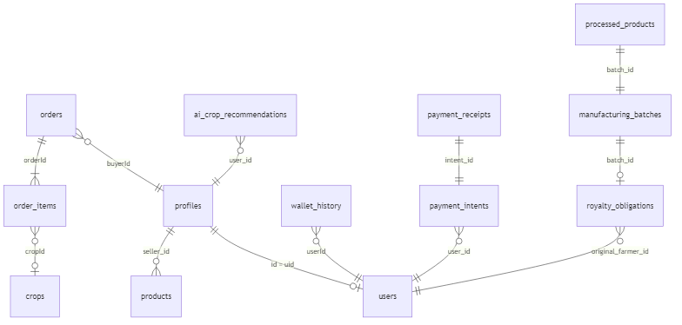
Database & Backend
Supabase PostgreSQL with RLS + SECURITY DEFINER RPCs
profiles · users · products · orders
order_items · wallet_history
payment_intents · payment_receipts
RPC: checkout_order, get_wallet_balance
Edge: razorpay-create-order, webhook
Notes:
SLIDE 9 — DATABASE & BACKEND
Supabase PostgreSQL is the authoritative data layer. Core tables include profiles, users, products, orders, order_items, wallet_history, payment_intents, and payment_receipts.
Row Level Security ensures users access only their own data. Critical RPCs — checkout_order, get_wallet_balance, transfer_funds — run as SECURITY DEFINER functions.
Edge Functions handle Razorpay order creation and webhook settlement, maintaining payment audit trails.

Slide 10
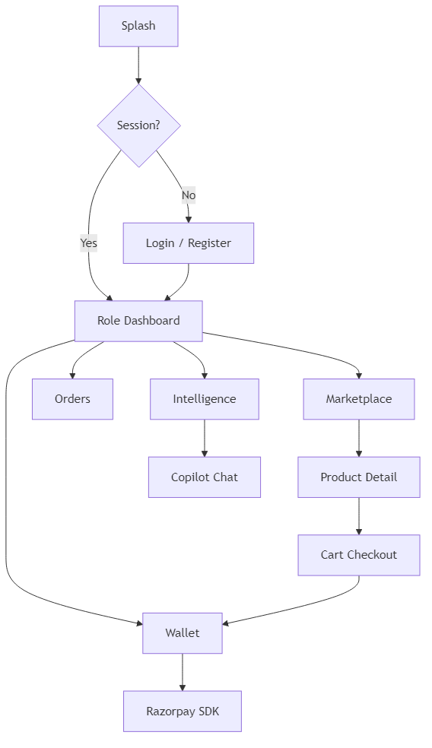
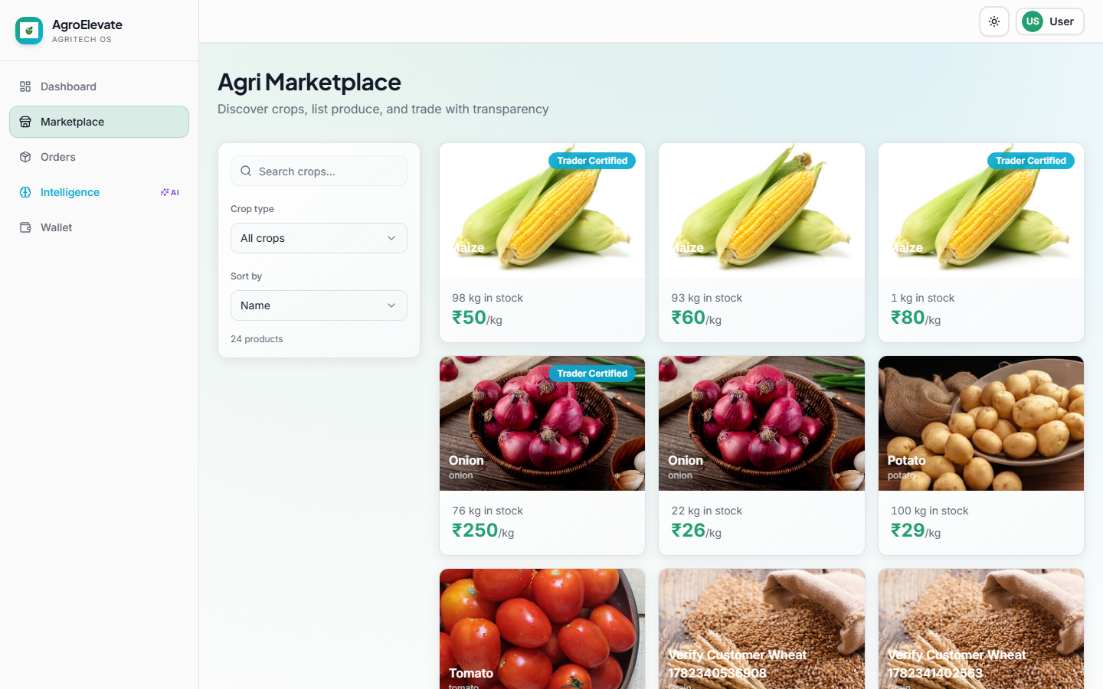
Android Application
Thin client — same Supabase backend as web
Kotlin + Jetpack Compose + Supabase SDK
Auth · Marketplace · Wallet · Orders
Razorpay Android Standard SDK
Poll payment_intents after checkout
Never duplicate royalty or wallet logic
Notes:
SLIDE 10 — ANDROID APPLICATION
The Android client follows the same thin-client architecture as the web app. Built with Kotlin, Jetpack Compose, and the Supabase SDK, it consumes identical RPCs and authentication flows.
Features include marketplace browsing, wallet operations, order tracking, and Razorpay Android SDK integration. The client polls payment_intents after checkout and never duplicates royalty or wallet logic locally.
Integration contracts are documented in our ANDROID_RAZORPAY_INTEGRATION.md specification.

Slide 11
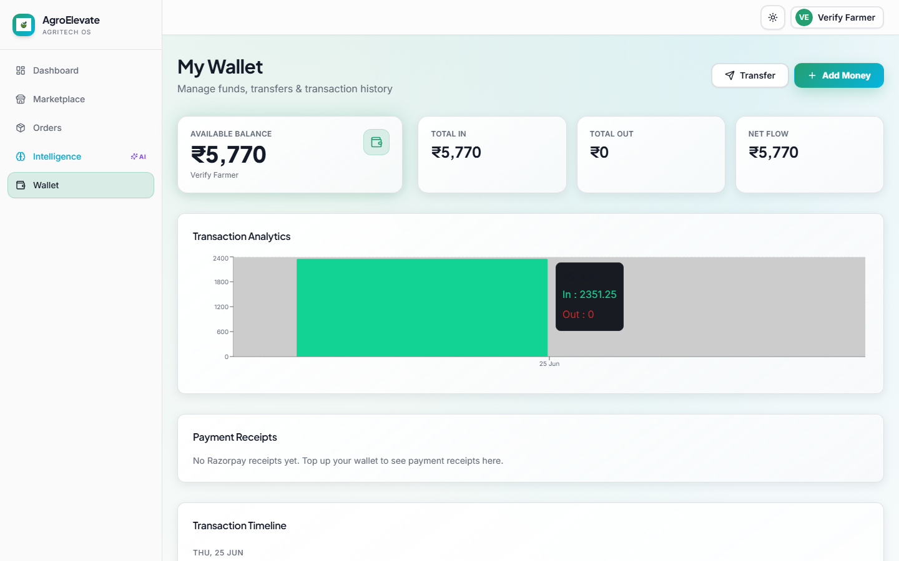
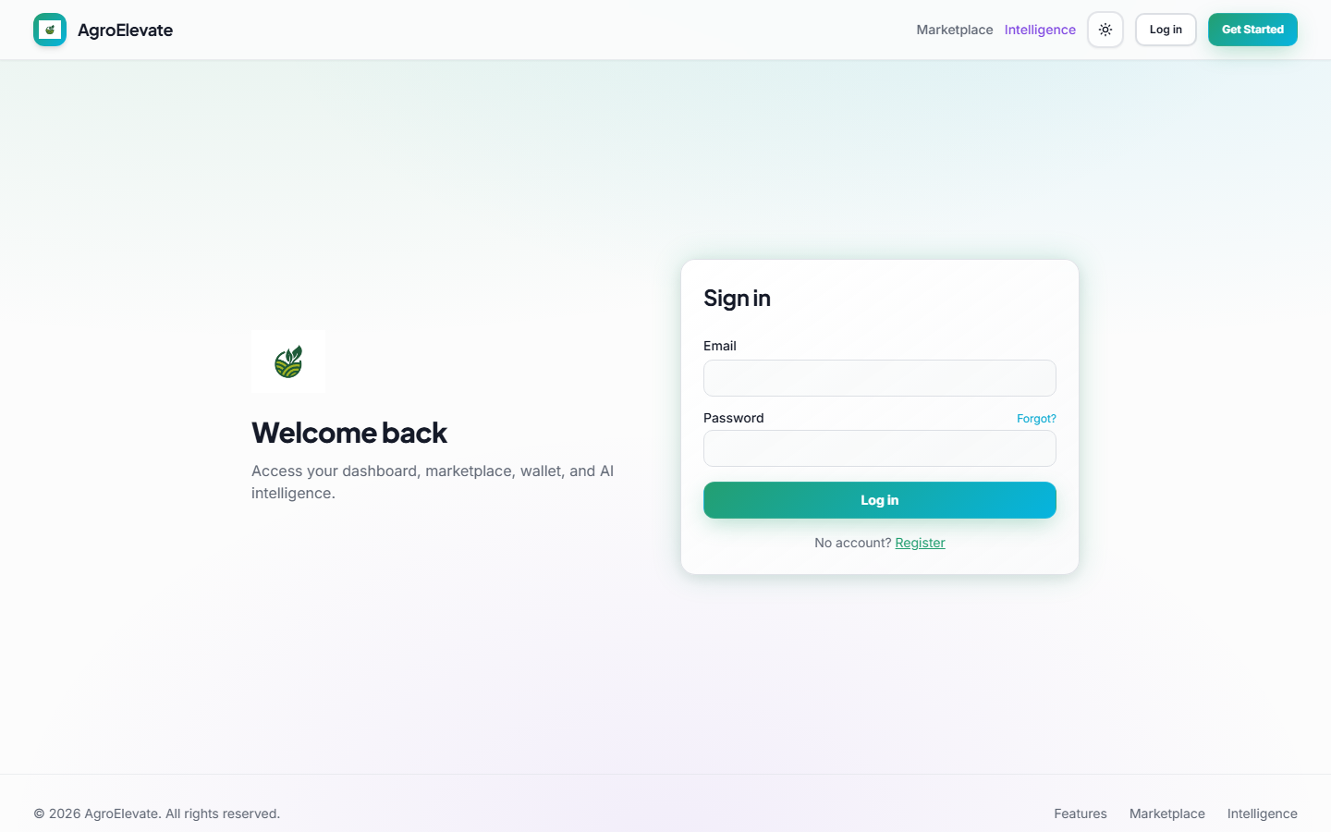
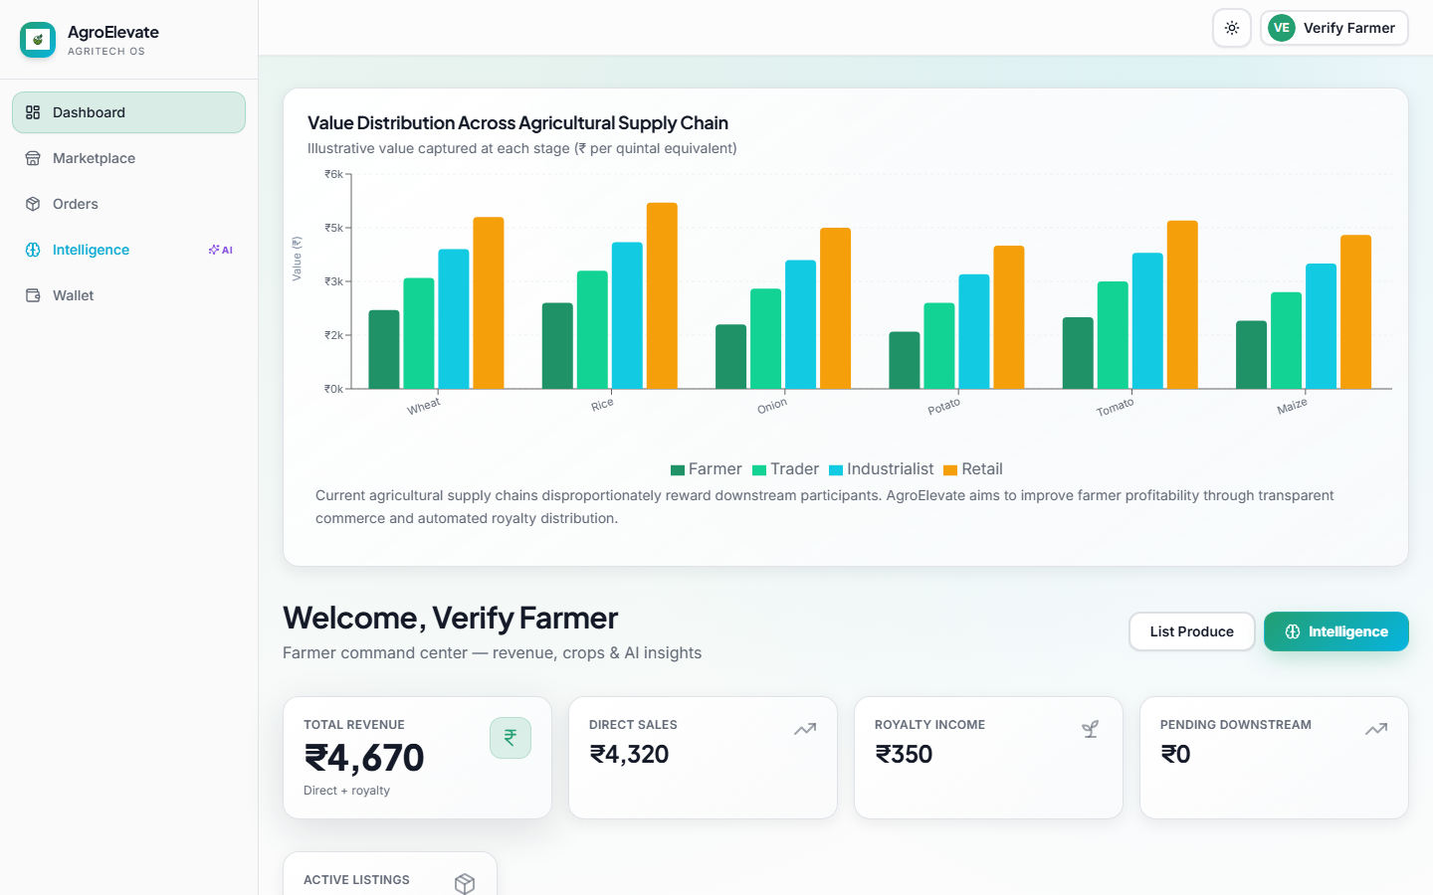
Live Demonstration
Production deployment — agro-fair-chain.vercel.app
Landing
Marketplace
Wallet
Login
AI page
User Dashboard
Dashboard
AI Hub
Notes:
SLIDE 11 — LIVE DEMONSTRATION
These screenshots are captured from our production deployment at agro-fair-chain.vercel.app.
The flow demonstrates: landing page, authentication, role dashboard, marketplace browsing, wallet with transaction history including royalty entries, and the AI Intelligence hub.
We invite you to explore the live system during the Q&A session. All commerce flows have been verified against the production Supabase backend.

Slide 12
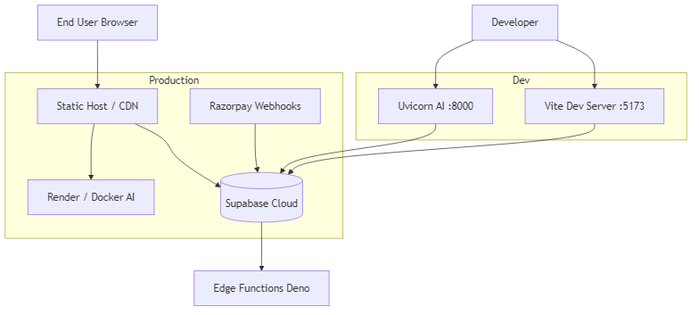
Deployment Architecture
CI/CD ready · multi-cloud production
Web: Vercel — agro-fair-chain.vercel.app
AI: Render — FastAPI Docker container
DB: Supabase Cloud (Auth + Postgres)
Payments: Razorpay + Edge Functions
Source: GitHub — AmoghRaidurg/agro-fair-chain
Notes:
SLIDE 12 — DEPLOYMENT
Our deployment pipeline is multi-cloud and CI/CD ready.
Source code is on GitHub. Vercel auto-deploys the React frontend on every push to main. The AI service runs as a Docker container on Render. Supabase Cloud hosts Auth, PostgreSQL, Edge Functions, and Storage.
Razorpay Edge Functions process payments in production. Release tag v1.0.0 marks our public release candidate.

Slide 13
Results & Achievements
Verified against live production backend
26/26
Commerce E2E tests
v1.0.0-rc
Release candidate
12.5%
Royalty rate verified
100
Lighthouse SEO score
5
User roles supported
0
Client-side royalty calc
Project Readiness Score: 87/100
Full-stack: Web + Android spec + AI + Razorpay + Option B royalty engine
Notes:
SLIDE 13 — RESULTS
Key verified achievements: 26 out of 26 commerce end-to-end tests passing, 12.5% royalty rate mathematically verified, five user roles fully supported, release candidate v1.0.0 tagged and deployed, Lighthouse SEO score of 100, and zero client-side royalty calculation — all royalty logic is server-authoritative.
Overall project readiness score: 87 out of 100 across web, Android specification, AI, Razorpay, and the royalty engine.

Slide 14
Future Scope
Extending fair-chain agriculture at scale
Export marketplace
Supply chain analytics
IoT soil & weather sensors
Satellite NDVI integration
FPO bulk listing
ML model retraining pipeline
Drone crop monitoring
e-NAM mandi price feeds
Blockchain traceability
Multilingual AI Copilot
Notes:
SLIDE 14 — FUTURE SCOPE
Future enhancements include IoT soil and weather sensors, drone crop monitoring, satellite NDVI integration, e-NAM mandi price feeds, blockchain traceability, multilingual AI Copilot, export marketplace, FPO bulk listing, supply chain analytics, and an ML model retraining pipeline.
These extensions build on the fair-chain foundation already encoded in AgroElevate's backend.

Slide 15

Thank You
Questions & Live Demo Welcome
Pune Vidyarthi Griha's College of Engineering, Technology & Management, Pune – 411009
Department of Electronics and Telecommunication Engineering
Guide: Dr. V. B. Thakare | Academic Year: 2025–2026
Team: Harshavardhan Kale, Siddheya Masurkar, Amogh Raidurg, Mohit Sonsale
Live: https://agro-fair-chain.vercel.app
GitHub: https://github.com/AmoghRaidurg/agro-fair-chain
Scan QR code for live demo
Notes:
SLIDE 15 — THANK YOU
Thank you for your attention. We welcome your questions and a live demonstration of AgroElevate.
Scan the QR code or visit agro-fair-chain.vercel.app. Source code is available at github.com/AmoghRaidurg/agro-fair-chain under release tag v1.0.0.
We are happy to demonstrate the royalty engine, wallet flow, and AI intelligence live. Thank you.

