Slide 1

Mini Project First Review Presentation
on
AI-Powered Banking Fraud & Compliance Intelligence Platform
SIDDAGANGA INSTITUTE OF TECHNOLOGY, TUMKUR
Department of Computer Science and Engineering
By
Saurav S 1SI23CI047
Anikethan M 1SI23CI007
Lekha HK 1SI23CS097
Manish Anand 1SI24CS095
Under the guidance of
Gururaj S P
Assistant Professor
Dept. of CSE, SIT, Tumakuru

Slide 2
INTRODUCTION
Banks process hundreds of millions of transactions daily; hidden inside are fraudsters, money launderers and criminal networks — losses exceed $45 billion/year globally.
Most banks still rely on static, rule-based fraud detection, which is reactive, siloed and generates overwhelming false positives (95%+ of alerts).
This project proposes a unified AI platform that links transactions, KYC, device and behavioural data into one knowledge graph, analysed by a network of collaborating AI agents.
Core idea: shift from asking “is this transaction suspicious?” to “does this entity's whole network and history fit a known criminal pattern?”
The platform aims to detect fraud proactively, score risk in real time, and automate regulatory reporting — with every decision explainable to analysts and regulators.
Dept. of CSE, SIT, Tumkur
1

Slide 3
LITERATURE SURVEY — I: Graph AI for Fraud Detection
Source | Year | Paper Title | Key Contribution
arXiv 2411.05815 | 2024 | Graph Neural Networks for Financial Fraud Detection: A Review | Surveys GNN architectures applied across fraud domains
arXiv 2402.14708 | 2024 | CaT-GNN: Causal Temporal GNNs for Credit Card Fraud Detection | Adds causal + temporal reasoning to graph-based detection
arXiv 2504.08183 | 2025 | Detecting Credit Card Fraud via Heterogeneous GNNs with Graph Attention | Models users, merchants & transactions as a heterogeneous graph
arXiv 2503.22681 | 2025 | Harnessing GNNs for Enhanced Fraud Detection | Benchmarks GNN gains over traditional ML baselines
arXiv 2606.18444 | 2026 | TMR-GGNN: Time-Aware Multi-Relational Guided GNN for Card Fraud | Combines temporal and multi-relational graph signals
Dept. of CSE, SIT, Tumkur
2

Slide 4
LITERATURE SURVEY — II: AML & Money Laundering Detection
Source | Year | Paper Title | Key Contribution
ACM ICAAI | 2024 | Enhancing AML Protocols: ML to Minimise False Positives & Improve Cost Efficiency | Reduces false-positive AML alerts using ML scoring
LACCEI 2024 | 2024 | Machine Learning Models for Money Laundering Detection (Systematic Review) | Consolidates ML approaches used across AML literature
Discover AI (Springer) | 2025 | Comparative Analysis of ML Algorithms for Money Laundering Detection | Benchmarks classifiers for suspicious-transaction detection
Discover Computing (Springer) | 2026 | Leveraging AI for Enhanced Anti-Money Laundering in Financial Institutions | Reviews AI adoption patterns in bank AML programs
arXiv 2603.19314 | 2026 | DPxFin: Adaptive Differential Privacy for AML via Federated Learning | Adds privacy-preserving federated training to AML detection
Dept. of CSE, SIT, Tumkur
3

Slide 5
LITERATURE SURVEY — III: Explainability & LLM/RAG Compliance
Source | Year | Paper Title | Key Contribution
MDPI 18(4):179 | 2025 | Secure & Transparent Banking: XAI-Driven Federated Learning for Fraud Detection | Combines federated learning with SHAP/LIME explainability
arXiv 2505.10050 | 2025 | Financial Fraud Detection Using Explainable AI and Stacking Ensembles | Ensemble model with human-readable SHAP explanations
ScienceDirect | 2024 | A User-Centered Explainable AI Approach for Financial Fraud Detection | Designs XAI explanations around analyst usability needs
arXiv 2605.29427 | 2026 | FinGuard: Detecting Financial Regulatory Non-Compliance in LLM Interactions | Uses LLMs to flag regulatory non-compliance in workflows
Dept. of CSE, SIT, Tumkur
4

Slide 6
LIMITATIONS OF THE EXISTING SYSTEM
GNN-based fraud detection papers optimise a single detection model in isolation — not integrated into a full compliance/investigation pipeline.
AML machine-learning papers reduce false positives but largely still operate per-institution, without a shared knowledge graph across data sources.
Explainable-AI papers add interpretability (SHAP/LIME) to one model at a time, rather than across a multi-agent decision pipeline.
LLM/RAG compliance papers automate document analysis but are not integrated with real-time fraud or AML detection models.
Most reviewed systems are validated on public/synthetic datasets (e.g. Kaggle credit card data), not at real bank transaction scale.
Gap: no reviewed work unifies a cross-source knowledge graph, multi-agent collaboration, RAG-based compliance automation, and explainability in one deployable platform.
Dept. of CSE, SIT, Tumkur
5

Slide 7
PROBLEM STATEMENT
Most banks rely on rule-based fraud detection — manually written static rules.
Flaw 1 — Overwhelming false positives:
  95%+ of rule-based fraud alerts are false positives
  Analysts spend 30–70 minutes investigating each alert; genuine customers get blocked
  Banks spend ~$3.5 billion/year investigating false positives, while real fraud slips through
Flaw 2 — Purely reactive detection:
  Rules only catch fraud after money has already moved; no predictive capability
Flaw 3 — Completely siloed data:
  Transactions, KYC, device & login data all sit in disconnected systems — nobody sees the whole picture, which is exactly where criminals hide
Dept. of CSE, SIT, Tumkur
6

Slide 8
OBJECTIVES
Build a unified knowledge graph that links transaction, KYC and behavioural data for a chosen set of accounts.
Implement an AI-based transaction risk-scoring model (GNN/anomaly-detection driven) that flags suspicious transactions in real time.
Automate generation of a compliant SAR draft from flagged cases using a RAG-grounded LLM.
Dept. of CSE, SIT, Tumkur
7

Slide 9
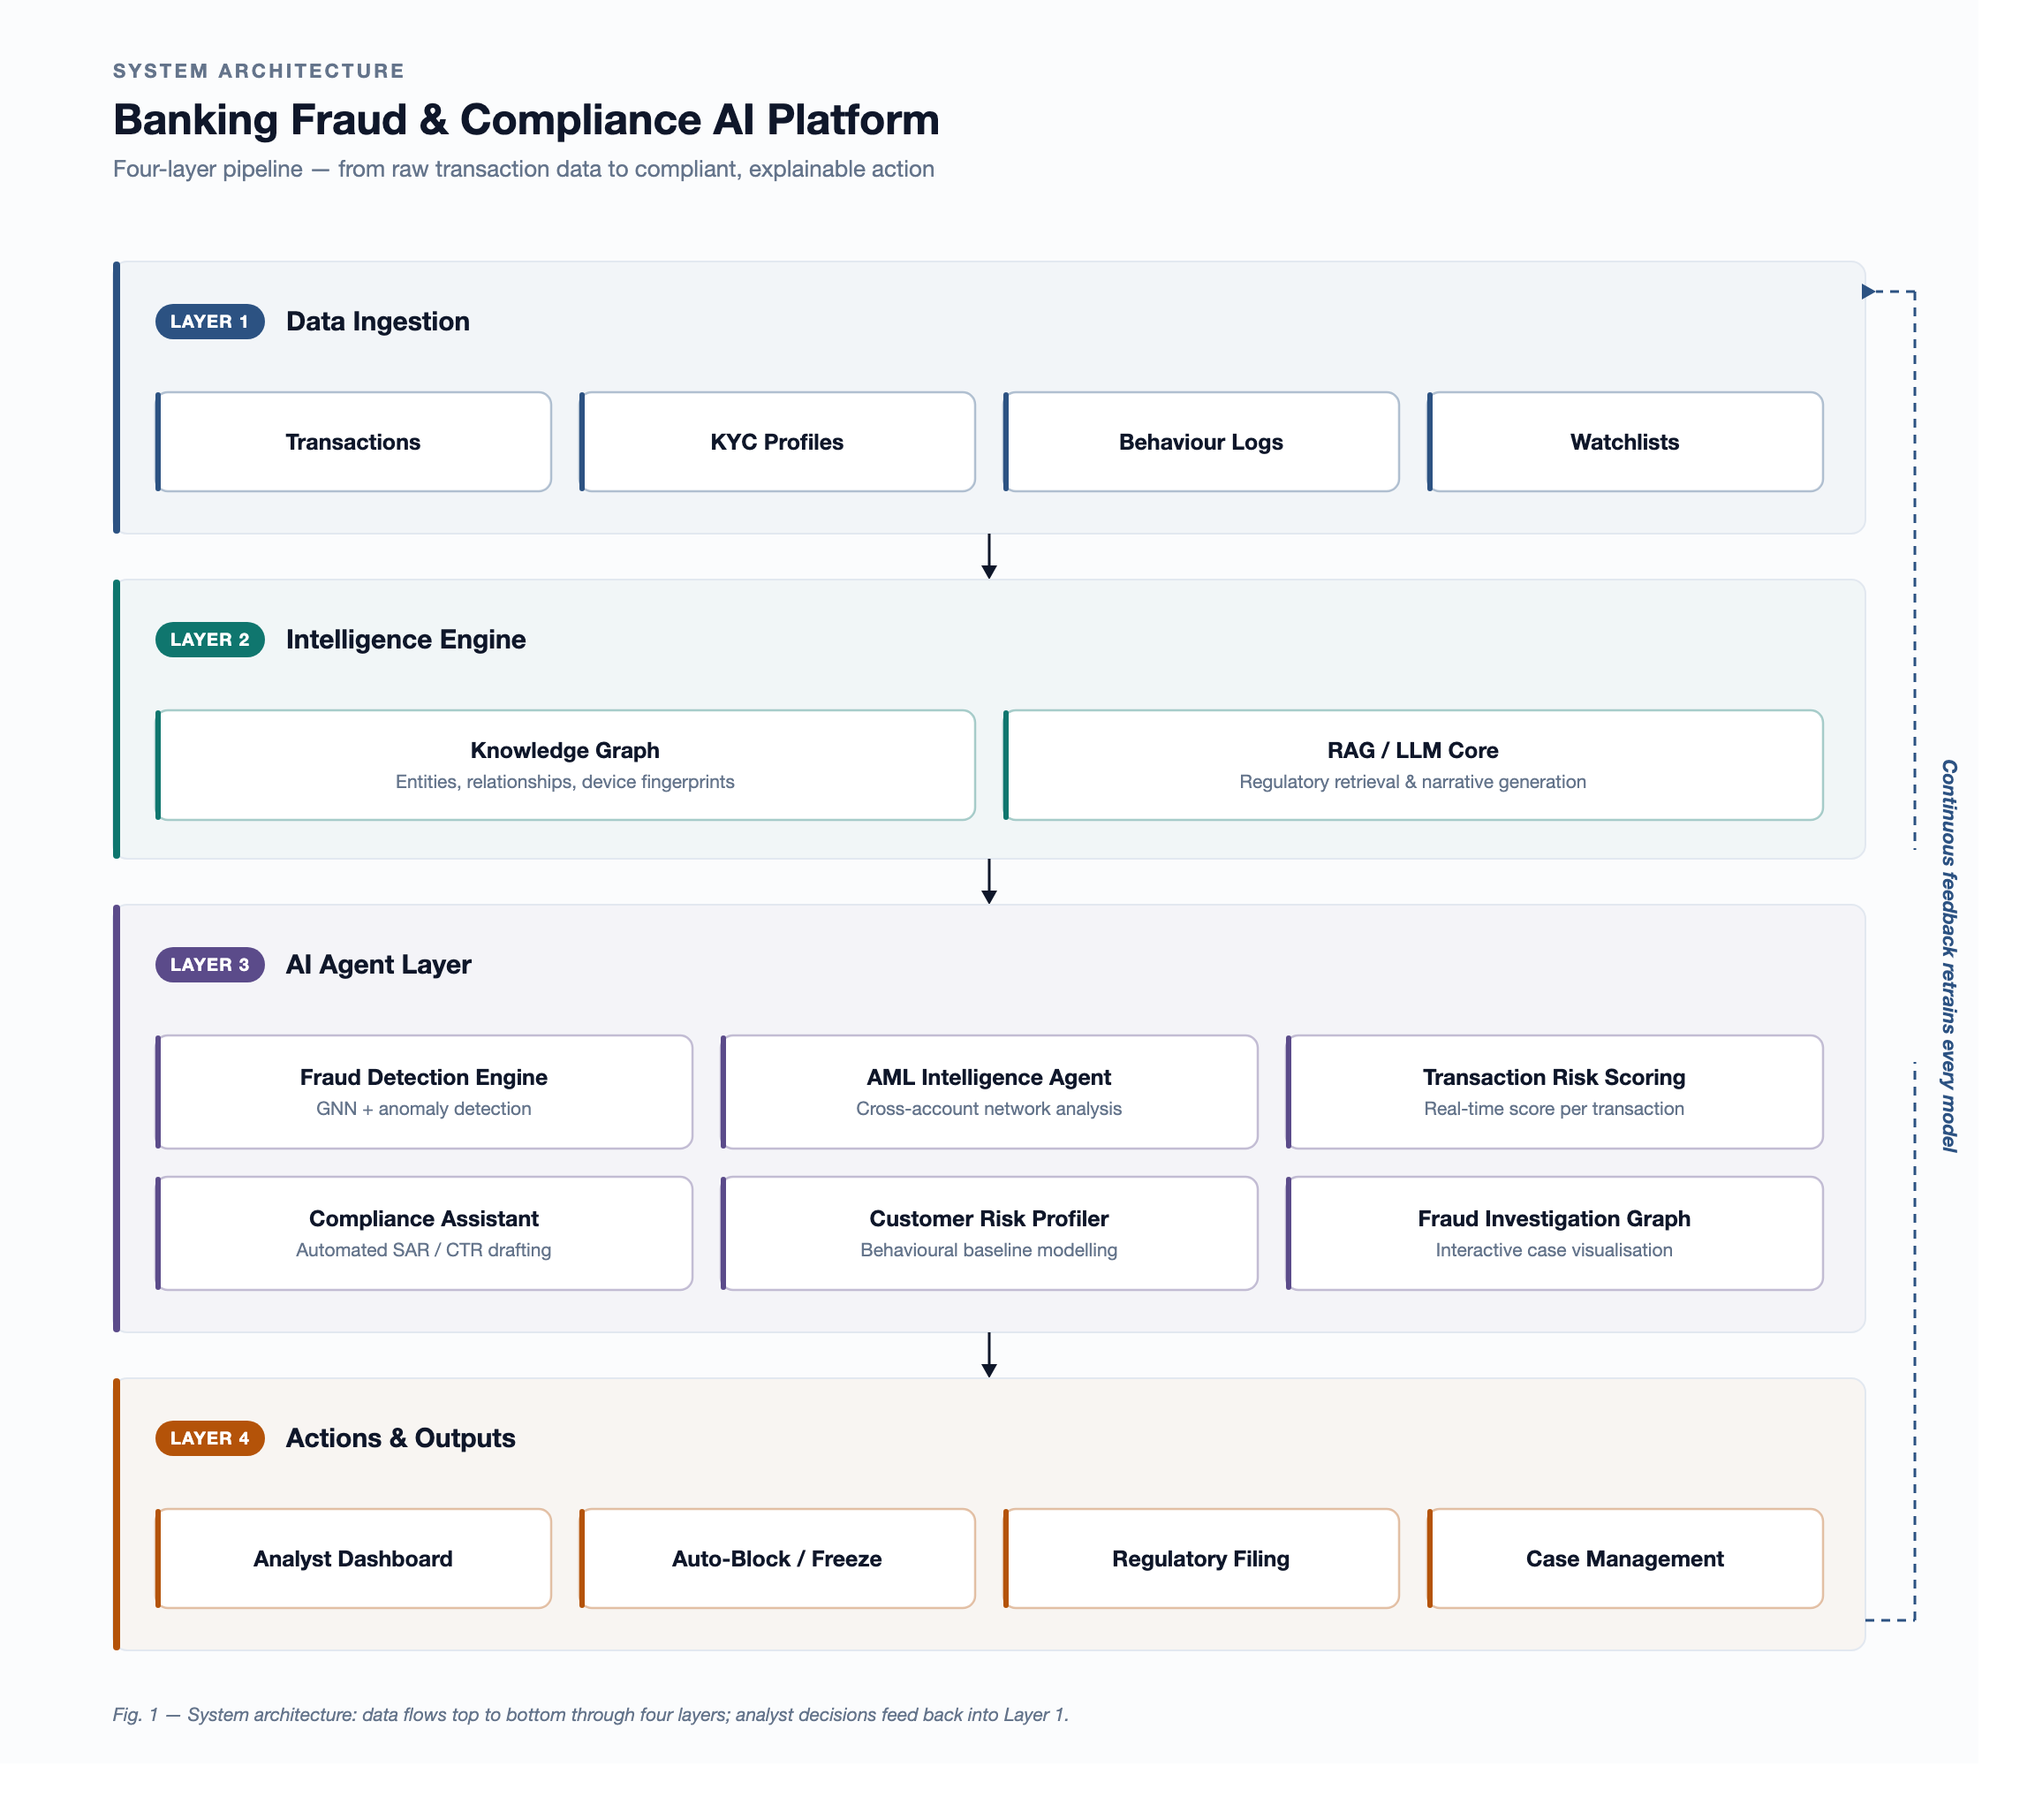
SYSTEM ARCHITECTURE
Dept. of CSE, SIT, Tumkur
8

Slide 10
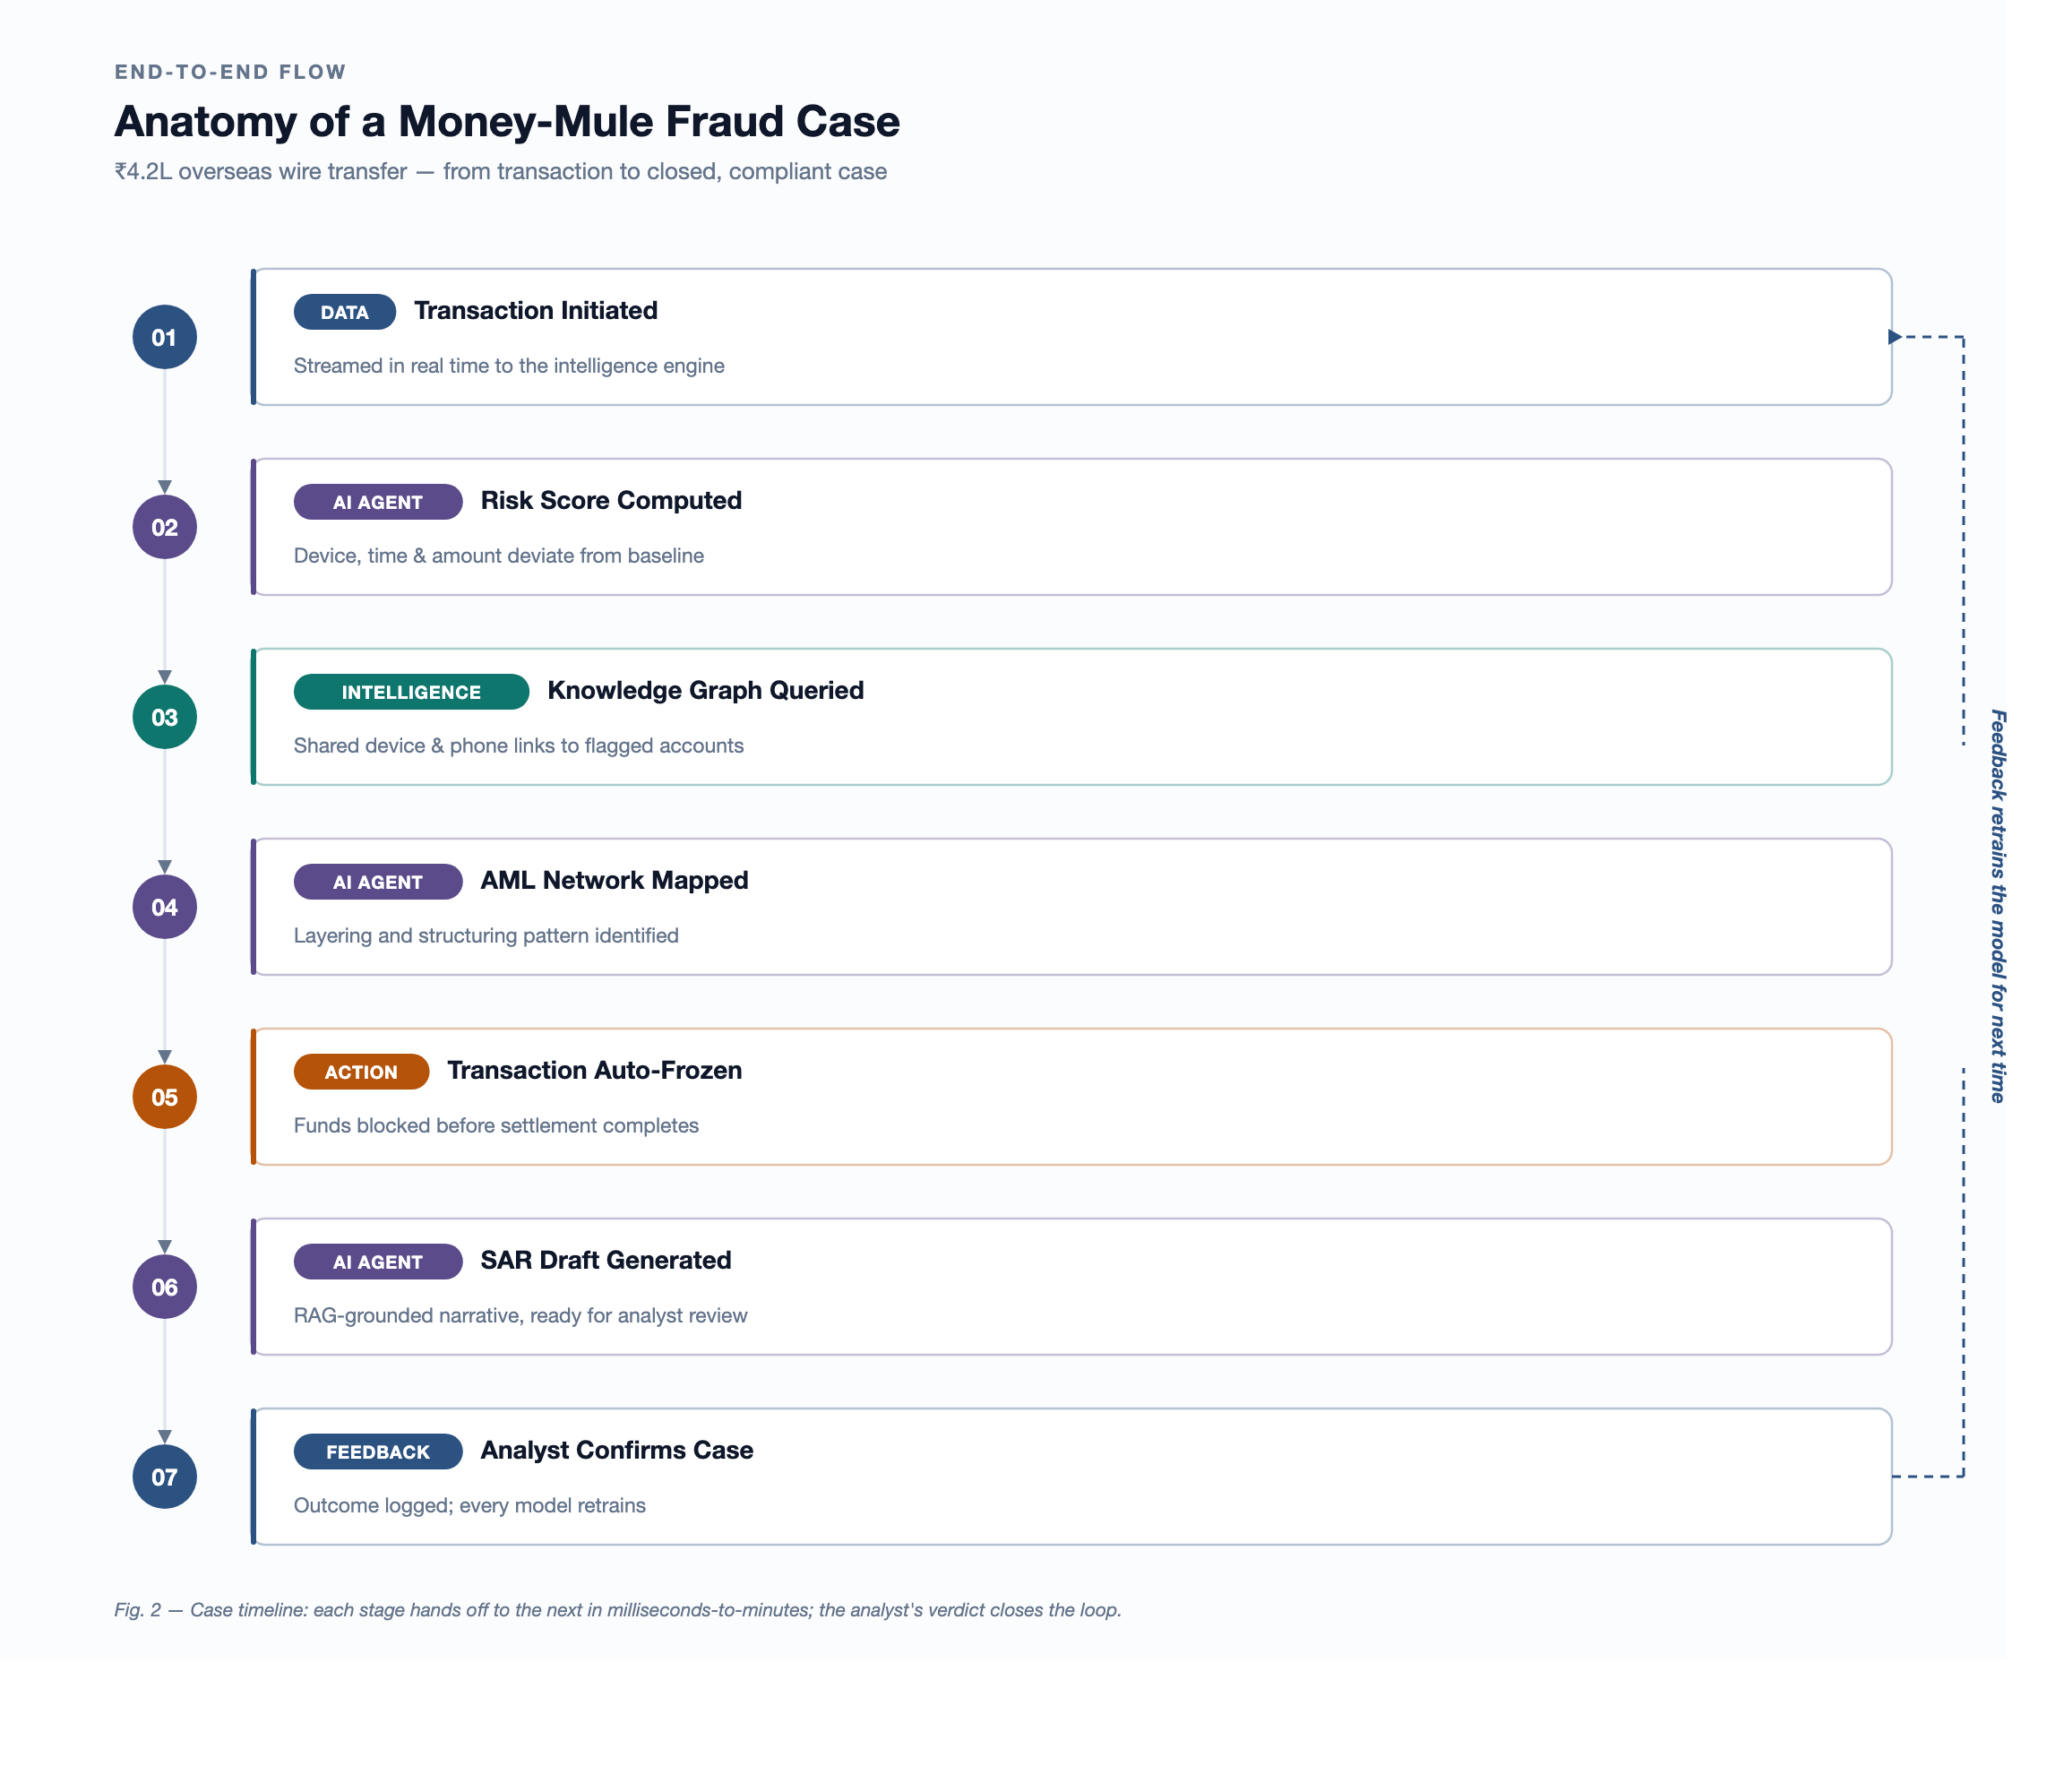
END-TO-END FLOW DIAGRAM
Dept. of CSE, SIT, Tumkur
9

Slide 11
APPLICATIONS
Real-time transaction monitoring dashboards for bank fraud/AML analyst teams.
Fraud-ring and money-mule network detection across retail banking and cross-border payments.
Automated SAR/CTR drafting to speed up regulatory compliance teams' reporting workload.
Customer-facing risk protection — reducing wrongful card blocks/false declines for genuine customers.
Extensible to corporate/trade finance and card-network fraud wherever transaction + identity data exists.
Dept. of CSE, SIT, Tumkur
10

Slide 12
REQUIREMENTS
Hardware Requirements
Software Requirements
• Development workstation: min. 16 GB RAM, quad-core CPU, 256 GB SSD
• Cloud GPU instance (e.g. NVIDIA T4/A100) for GNN model training
• Multi-core server for real-time transaction stream processing
• Reliable high-bandwidth network for streaming transaction data
• Neo4j / Amazon Neptune — knowledge graph database
• PyTorch Geometric / DGL — GNN model development
• Apache Kafka — real-time transaction streaming
• LangChain + Pinecone/Weaviate — RAG pipeline
• Claude (Anthropic API) — LLM core for SAR generation
• LightGBM / XGBoost — fast risk-scoring models
• Python (FastAPI) backend, React + D3.js frontend
• Docker + Kubernetes — containerised deployment
Dept. of CSE, SIT, Tumkur
11

Slide 13
PROJECT EXECUTION PLAN — TIMELINE
Phase | Weeks | Activities
1. Requirement Analysis | Week 1–2 | Literature review, dataset identification, requirement finalisation
2. Data Pipeline & Graph Design | Week 3–4 | Knowledge graph schema design; data ingestion pipeline setup
3. Model Development | Week 5–6 | Build fraud detection (GNN) & transaction risk-scoring models
4. AML & Profiling Agents | Week 7 | Build AML intelligence agent and customer risk profiler
5. Compliance Assistant | Week 8 | Build RAG + LLM pipeline for automated SAR drafting
6. Dashboard & Integration | Week 9 | Build dashboard, integrate agents, end-to-end testing
7. Final Testing & Demo | Week 10 | Validation, documentation, and demo preparation
Dept. of CSE, SIT, Tumkur
12

Slide 14
CONCLUSION
Rule-based fraud/AML systems are reactive, siloed and drown analysts in false positives (95%+ of alerts, $3.5B/year wasted).
This project proposes a platform that unifies bank data into one knowledge graph, analysed by collaborating, explainable AI agents.
Expected outcome: proactive fraud detection, fewer false positives, automated SAR drafting, and decisions regulators & analysts can understand.
The literature survey confirms no existing work combines graph AI, multi-agent collaboration, RAG-based compliance and explainability in one system — this is the project's contribution.
Next steps: build and validate the three core objectives (knowledge graph, risk-scoring model, SAR automation) on simulated fraud scenarios.
Dept. of CSE, SIT, Tumkur
13

Slide 15
REFERENCES
[1] Graph Neural Networks for Financial Fraud Detection: A Review, arXiv 2411.05815, 2024.
[2] CaT-GNN: Causal Temporal GNNs for Credit Card Fraud Detection, arXiv 2402.14708, 2024.
[3] Detecting Credit Card Fraud via Heterogeneous GNNs with Graph Attention, arXiv 2504.08183, 2025.
[4] Harnessing GNNs for Enhanced Fraud Detection, arXiv 2503.22681, 2025.
[5] TMR-GGNN: Time-Aware Multi-Relational Guided GNN for Card Fraud, arXiv 2606.18444, 2026.
[6] Enhancing AML Protocols: ML to Minimise False Positives, ACM ICAAI, 2024.
[7] Machine Learning Models for Money Laundering Detection (Review), LACCEI, 2024.
[8] Comparative Analysis of ML Algorithms for Money Laundering Detection, Discover AI (Springer), 2025.
[9] Leveraging AI for Enhanced Anti-Money Laundering in Financial Institutions, Discover Computing, 2026.
[10] DPxFin: Adaptive Differential Privacy for AML via Federated Learning, arXiv 2603.19314, 2026.
[11] Secure & Transparent Banking: XAI-Driven Federated Learning for Fraud Detection, MDPI 18(4):179, 2025.
[12] Financial Fraud Detection Using Explainable AI and Stacking Ensembles, arXiv 2505.10050, 2025.
[13] A User-Centered Explainable AI Approach for Financial Fraud Detection, ScienceDirect, 2024.
[14] FinGuard: Detecting Financial Regulatory Non-Compliance in LLM Interactions, arXiv 2605.29427, 2026.
Dept. of CSE, SIT, Tumkur
14

Slide 16
Thank You!
15

