Slide 1

Language Evolution in Multi Agent Systems
R181 – Computing for Collective Intelligence
Amogh Singh

Slide 2
Introduction
Language allows for communication and cooperation in completion of tasks.
Human language may not be the appropriate choice for communication between agents.
Agents can be allowed to create a language to communication by requiring coordination for task completion.
The evolved language is analyzed to compare its characteristics with a few of the characteristics of real-world languages.

Slide 3
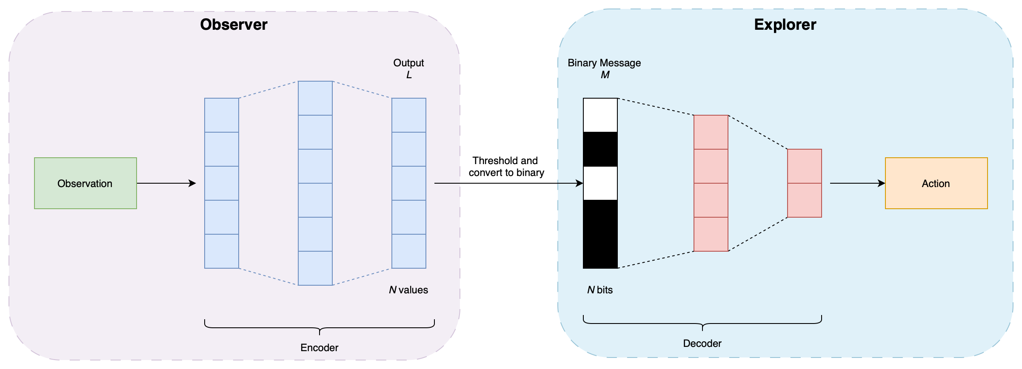
Architecture
Simple and SimpleTag environments
Encoder-Decoder
Binary Messages
Notes:
Encoder-Decoder Architecture – Two agents – Observer and Explorer
Messages are binarized – Introduces an information loss that prevents Observer from passing real valued vectors which would have higher information
Losses are calculated on the binary messages and passed to the observer so that the feedback/loss is computed on the message and not on what the observer knows

Slide 4
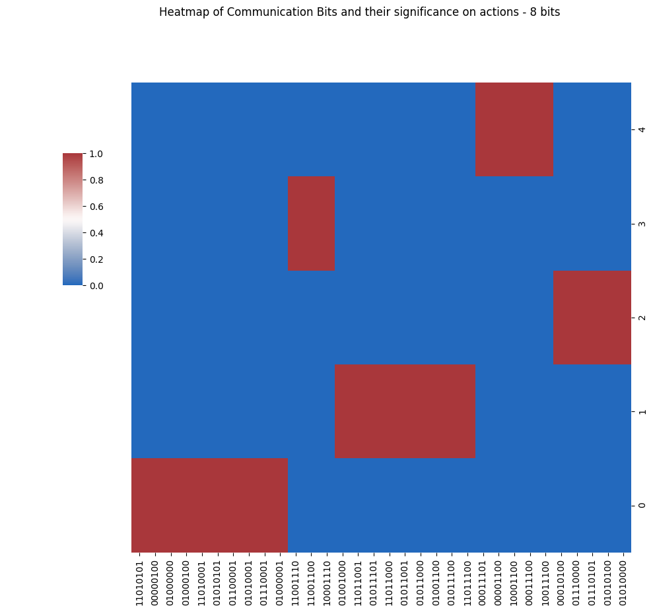
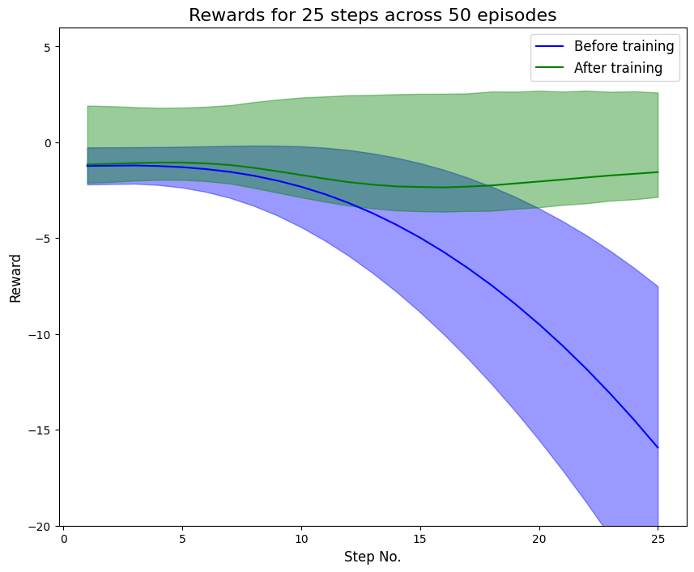
Experiments and Results
Communication
Notes:
Achieve convergence to a communication while being able to solve an environment – Bit sequences analysed to check the actions they are associated with

Slide 5
Experiments and Results
Stability of communication
After reaching a stable communication pattern, the model is trained further with varying learning rates to check if language evolves or remains constant
A higher learning rate in the second training leads to a larger change in the communication, significant shift from original communication. Using a lower learning rate retains a large part of the original language. Training further in all cases leads to expansion of language with new sequences being added.

Slide 6
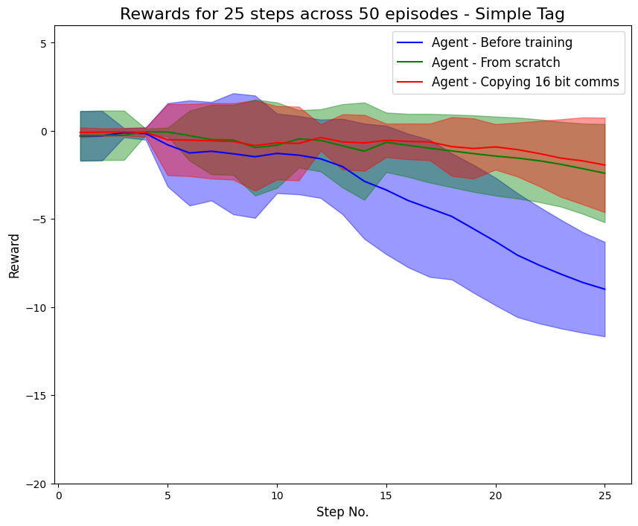
Experiments and Results
Generalizability of communication
A language would be expected to be generalizable to multiple environments if the action space remains the same, i.e., the Observer uses the same sequence for communicating an action even if environment is different.
16 bit communication model trained on Simple is used in Simple Tag.
Only ~18% of sequences remain.
60% of common sequences encode different action.
Notes:
Low percentage of sequences from base model are present in the new communication model.
Different action – While the sequence is retained, the meaning of the sequence is changed.

Slide 7
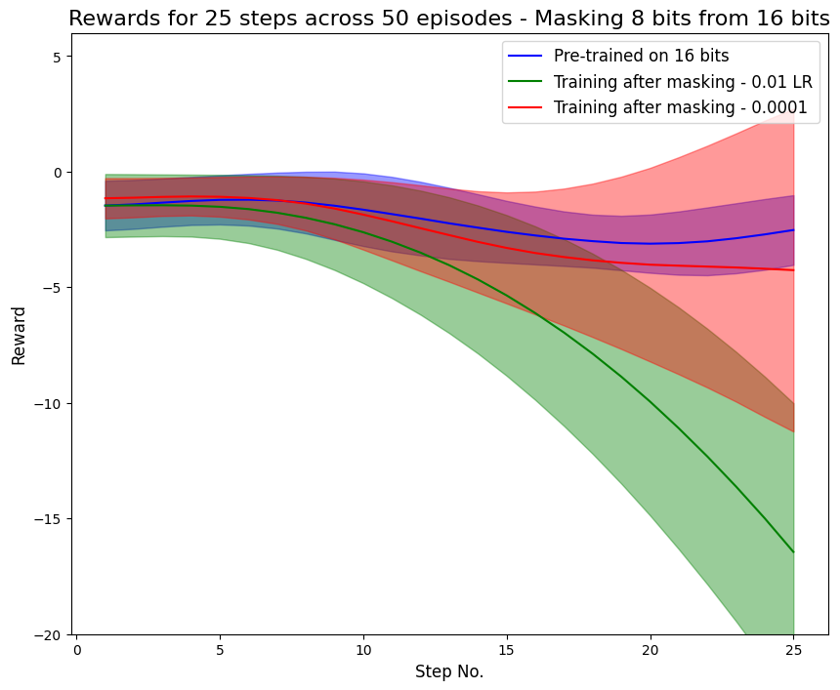
Experiments and Results
Communication breakdown
Half of the messages are masked to check adaptability
While average reward is majorly recovered, there is still high variance in the model.
Further training does not reduce the variance
Notes:
Further training does not reduce the variance in the average reward per episode indicating that the method does not fully recover communications

Slide 8
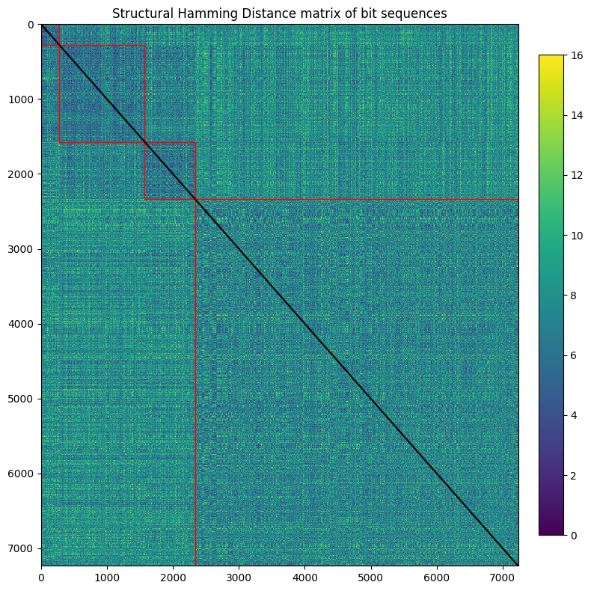
Experiments and Results
Analysis of sequences
The sequences are analyzed based on the actions they encode to check for a significant difference.
Notes:
SHD is used as metric to compute differences between the binary sequences
Regions inside the red lines indicate the intra-action SHDs and outside indicates inter-action SHDs. Intra-action regions are slightly darker, having a lower SHD compared to inter-action regions
Using a t-test to confirm this hypothesis, there is a significant difference between the two groups with a p-value of 0.016.
These were some of the interesting findings from the project and more information is available in the report. Thank you.

