Slide 1
Design and Analysis of Algorithms Lab
Dr. Sujata Joshi

Slide 2
Part B
11
Bangalore Water supply Board responsibility is to distribute water evenly among all the areas in Bangalore city. A new layout has been developed by Maxworth real estate developers. BWSB should connect the water lines to the new layout with minimum cost. The objective is to connect the water pipes so that it reaches all the houses in new layout with minimum cost. Write an algorithm by applying Kruskal’s method to find the minimum spanning tree for the given scenario.

Slide 3
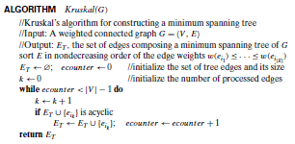
Algorithm

Slide 4

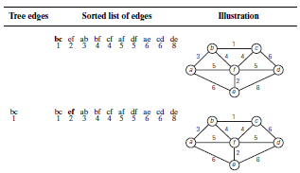
Example

Slide 5
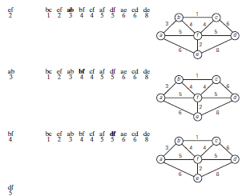

Slide 6
Cost of spanning tree =
ab+bc+bf+df+ef=3+1+4+5+2=15
1
3
b
c
4
a
f
5
d
2
e

