Slide 1
Design and Analysis of Algorithms Lab
Dr. Sujata Joshi

Slide 2
Part A
2. An island is surrounded by water and is formed by connecting adjacent lands horizontally or vertically. You may assume all four edges of the grid are all surrounded by water. Given an m x n 2D binary grid which represents a map of '1's (land) and '0's (water), return the number of islands using DFS algorithm. Design and develop a program in C to print all the lands reachable from a given starting land in a digraph by using DFS method. Repeat the experiment for different values of n and plot a graph of the time taken versus n(n=no of nodes)

Slide 3
Depth first search
Depth-first search starts a graph’s traversal at an arbitrary vertex by marking it as visited.
On each iteration, the algorithm proceeds to an unvisited vertex that is adjacent to the one it is currently in.
This process continues until a dead end—a vertex with no adjacent unvisited vertices— is encountered. At a dead end, the algorithm backs up one edge to the vertex it came from and tries to continue visiting unvisited vertices from there.
The algorithm eventually halts after backing up to the starting vertex, with the latter being a dead end. By then, all the vertices in the same connected component as the starting vertex have been visited.

Slide 4
If unvisited vertices still remain, the depth-first search must be restarted at any one of them.
It is convenient to use a stack to trace the operation of depth-first search.
We push a vertex onto the stack when the vertex is reached for the first time (i.e., the visit of the vertex starts), and we pop a vertex off the stack when it becomes a dead end (i.e., the visit of the vertex ends).

Slide 5
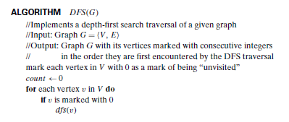
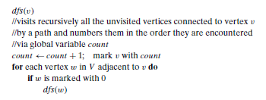
Depth First Search

Slide 6
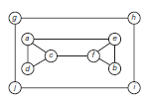
DFS traversal
Nodes : a,c,d,f,b,e g.h,i,j
Edges : ac, cd, cf, fb, be gh, hi, ij

Slide 7
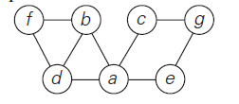
DFS Traversal -
Nodes visited: a,b,d,f,c,g,e
Path traversed :ab, bf,fd,ac,cg,ge

Slide 8
DFS
Program
DFS.docx

