Slide 1
Design and Analysis of Algorithms Lab
Dr. Sujata Joshi

Slide 2
Part A
6. Assume that NMIT college needs to maintain the student details like USN, name, and contact details in a record. USN should be generated randomly. Design and develop a program in C to sort the records based on USN by using quick sort algorithm, Determine the time required to sort the roll numbers. Repeat the experiment for different values of n and plot a graph of the time taken versus n. (n=no of elements).

Slide 3

Quicksort
Quicksort is the other important sorting algorithm that is based on the divide-and conquer approach. Unlike mergesort, which divides its input elements according to their position in the array, quicksort divides them according to their value.
A partition is an arrangement of the array’s elements so that all the elements to the left of some element A[s] are less than or equal to A[s], and all the elements to the right of A[s] are greater than or equal to it:
After a partition is achieved, A[s] will be in its final position in the sorted array, and we can continue sorting the two subarrays to the left and to the right of A[s] independently.

Slide 4
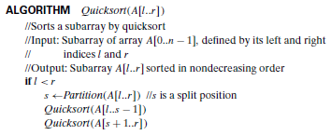
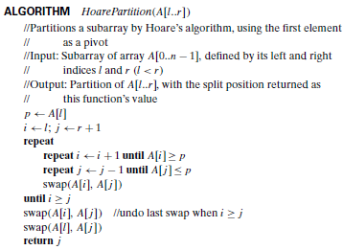

Slide 5
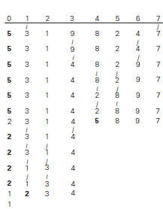


Example

