Slide 1

A Safety Device for Fall Detection
GROUP 21 : ExpressSwift
Amogha A Halhalli (2021101007)
Ashutosh Srivastava (2021101056)
Manohar Naga (2021101128)
Harshvardhan (2021111017)

Slide 2
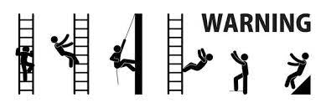
Motivation
We see many industrial workers perform maintenance works on tall chimneys and always are at risk of falling down.
So we develop an user-friendly and effective fall detection device which is reliable and cost efficient.
The safety device is worn by the worker and when he falls from great height this device detects and sends the fall information to a central monitoring system for medical aid.

Slide 3
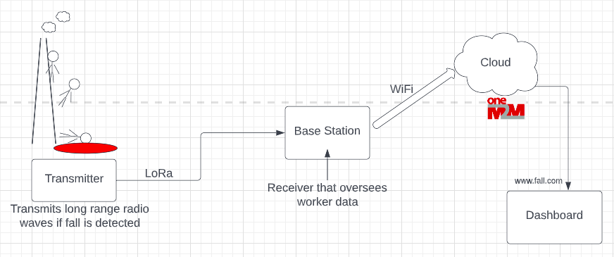
Flow Chart

Slide 4
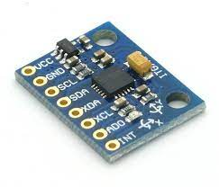

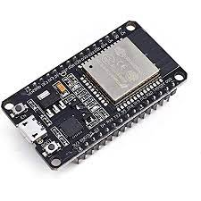

Implementation
The four parts of the project are :
Transmitter : device worn by the industrial worker.
Receiver (Base Station) : the station that receives the information.
OneM2M : stores all the information.
Dashboard : presents the status and update the information.
The components of the project are :
ESP32
MPU6050
GPS system
LoRa communication
SD card Reader

Slide 5
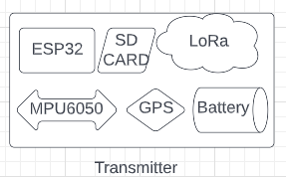
Implementation
The industrial worker is provided with transmitter device.
This transmitter device consists of ESP32, MPU6050 accelerometer sensor, SD card, LoRa transmitter along with GPS system for location access.
We will find the Fall Detection threshold values from the SD reader data, then store it in Receiver so that we can detect the values received from Transmitter.
Once the worker falls, the accelerometer sensor detects it and sends the fall information to the base station using LoRa communication modules on ESP32.
We use LoRa communication as it is more reliable in remote places and efficient in long range places.

Slide 6
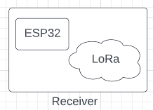
Implementation
We have receiver device at the base station.
The receiver device consists of ESP32 and LoRa receiver.
The fall information received at the base station consists of the location where the fall has occurred.
Accordingly, we can send the rescue team for medical aid at that location.
We also send the information collected to oneM2M platform using WiFi.
We then present the all the information on a dashboard.
All the components in transmitter and receiver device are soldered to form a PCB and placed in a 3D enclosure.

Slide 7

Data Analysis Plan
We conduct the Experiment for different possible Heights, Accelerations etc.,
Then we collect the raw data values from MPU6050 and GPS data etc., from Transmitter and Store it in SD reader.
Then apply the Algorithm on the Raw data Collected to get a Threshold Value for the Status of the Worker as:
1. Fall
2. No Fall

Slide 8
Data Analysis Plan
From the Receiver(Base Station) we send the data to OneM2M server- WIFI communication
From the data received from OneM2M we update the data in the website
We update the location, status, height etc., values of each worker in the website through OneM2M.
We will display the GPS location of each worker that is collected using GPS system in Transmitter.
We also display the Status of each worker - Fall, NO Fall, Height etc.,

Slide 9
Timeline
Week-1 : Building the Hardware Component for both the Rx and Tx ends.
Week-2 : Setting up the communication protocols.
Week-3 : 3D-Printing the final Box and the PCB.
Week-4 : Making the Dashboard for displaying the status of the nodes.
Week-5 : i) Testing and Deploying the final project for Data Collection.
ii) Demo Experiment.

Slide 10
Deliverables
Summary
We will be using the following sensors in our project:-
Transmitter device
Receiving Station
Dashboard website
Our project will improve worker safety and working conditions. Medical aid can be provided swiftly and conveniently, thereby increasing the chances of survival in industrial accidents.

