Slide 1

IOT Project
TEAM BUFFERING...

Slide 2

Our Project : SMART HOME SECURITY DEVICE
Team Members:
1. SWAYAM AGRAWAL (2021101068)
2. MADHAV TANK (2021101108)
3. YASH ADIVAREKAR (2021101008)
4. AMOGHA HALHALLI (2021101007)

Slide 3
OUR MAIN MOTTO
A Smart IOT Device that monitors the surrounding environment.
Any human motion detected in the range of the device will be recorded and immediately notified to the user.
Thus, acting as a security device for smart homes.
Additionally, the device also records the temperature and humidity.
If the temperature crosses a particular threshold,servo motor starts rotating.
It also stores the data by sending it to the cloud platforms, which can be later used for analysis.

Slide 4
List of components used:
● ESP-32
● HC-SR04 Ultrasonic Sensor
● HC-SR501 PIR Motion Sensor
● DHT11 Sensor
● Servo motor
● Breadboard
● Jumper Wires and Resistors
● Arduino Cable
● D830D Multimeter

Slide 5
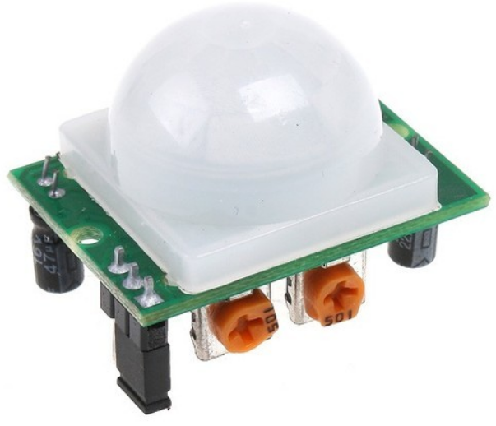
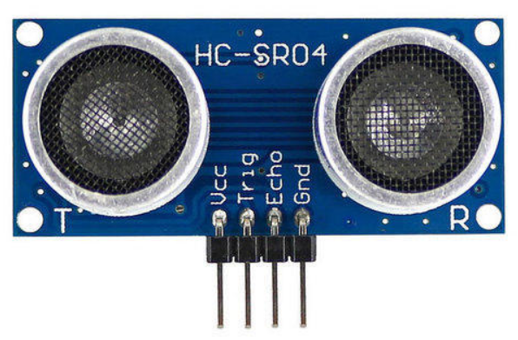
A close look at our project
The PIR Motion Sensor detects the IR radiation emitted by the person entering the environment.
We have two Ultrasonic Sensors separated by some distance.
Each Ultrasonic Sensor uses ultrasonic waves to find the distance between the device and the person.
A smaller distance recorded at the first ultrasonic sensor indicates that the person is entering the environment.
While a smaller distance recorded at the second sensor indicates that the person is leaving the environment.
Thus, at any particular time, we have the count of the number of people present in the environment.

Slide 6
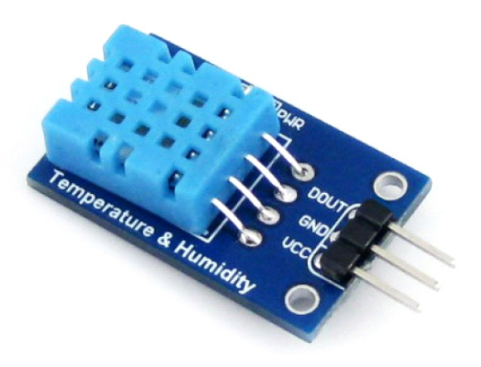
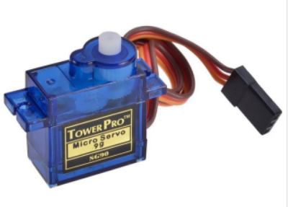
The other part of the project
The DHT11 Sensor records the temperature and humidity of the environment.
When the temperature crosses a fixed threshold, the Servo motor rotates thus, switching on the switch.
It stores the temperature, humidity, number of people in the environment and upload on the cloud platforms, oneM2M and ThingSpeak.
Over the course of data collected, we can analyze the data and derive conclusions based on the information.
We also have a website which shows the live updates of the number of people in the environment.

Slide 7
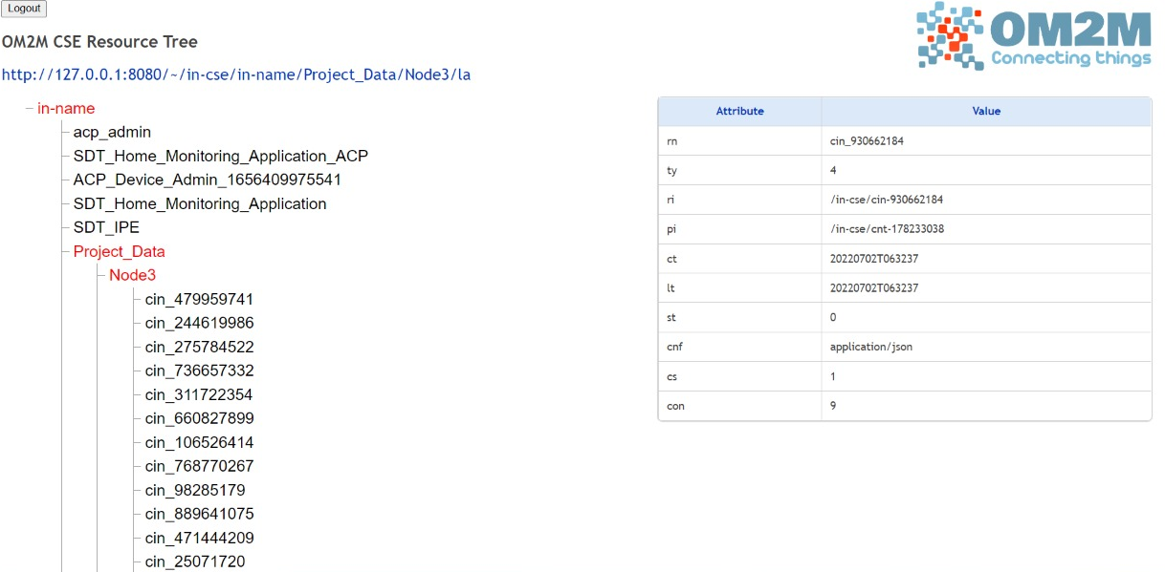
Data Analysis --- oneM2M
Data was sent to onem2m server using Arduino code that kept the track of count of people in the environment.

Slide 8
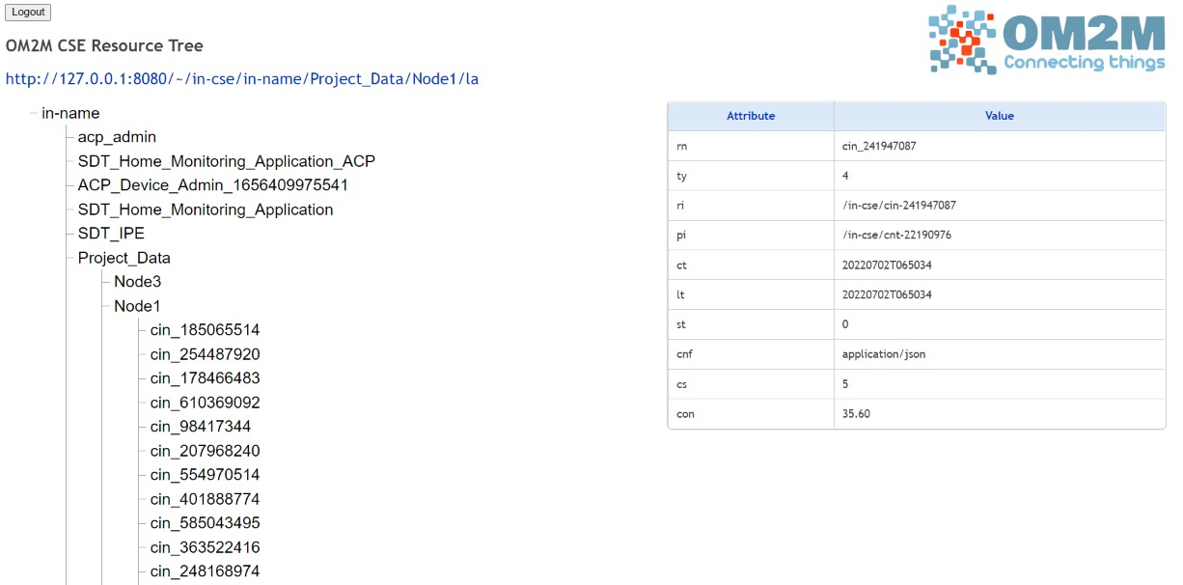
Data Analysis --- oneM2M
Data was sent to onem2m server using Arduino code that kept the track of temperature of the surrounding.

Slide 9
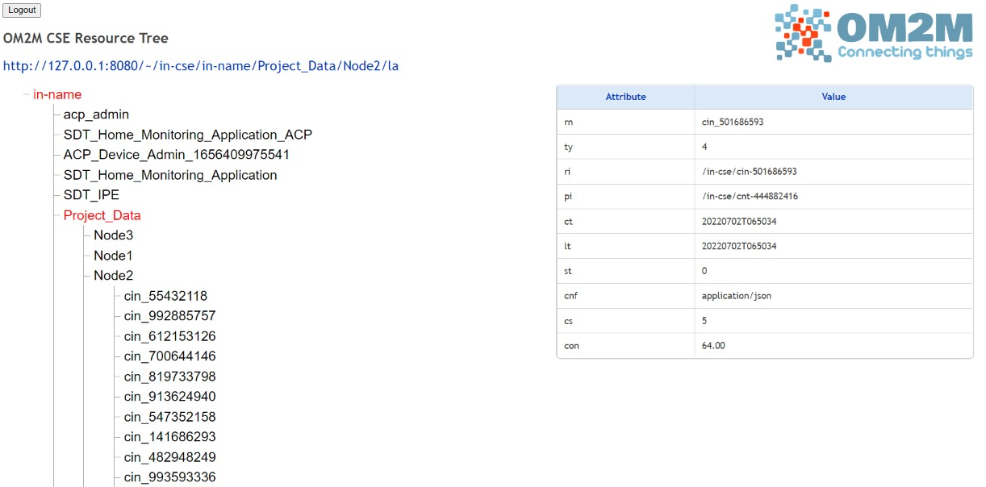
Data Analysis --- oneM2M
Data was sent to onem2m server using Arduino code that kept the track of humidity of the environment.

Slide 10
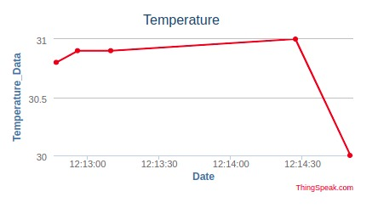
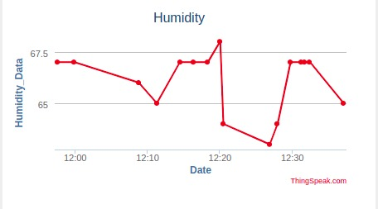
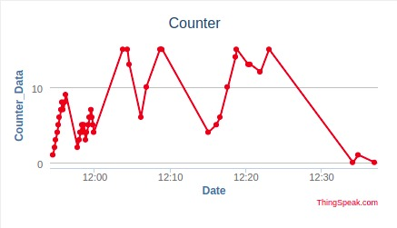
Temperature , Humidity and the count of people inside the room was also sent to Thingspeak.

Slide 11
Challenges We Faced and how we countered them ?
Problems while connecting sensors due to lose connections
Fixed the connections with the help of insulating tapes so that the connection is not disturbed.
Data transmission from onem2m to personal website using flask required learning some special syntax.
ONEM2M data had to extrapolated properly and multiple data transmission required precision.
Overall , all the challenges were properly fixed and the project was completed successfully meeting all its objectives.

Slide 12




Tech Stack:

Slide 13

Thank You!

