Slide 1
ANALYSIS OF CHANGE OF MEDICATION WITH DIABETES PATIENTS Submitted by Amogha Bheemanakolli Gurumallappa - 10400051 Sandesh Tumkur Jagadish-10394950 Sidharth Sudhakara Arabaghatte-10398292

Slide 2
GOAL OF THE PROJECT
Analyzing the effect of change of drugs with the diabetes patients based on the diabetes database from hospitals.

Slide 3
SOURCE OF THE DATASET
The dataset has been taken from UCI repository
https://archive.ics.uci.edu/ml/datasets/Diabetes+130-US+hospitals+for+years+1999-2008
Dataset Information
The dataset represents 10 years (1999-2008) of clinical care at 130 US hospitals
100,000 records over 50 attributes
The data contains various attributes as
Number of Medication and Diabetic Medications
A1c test Result and Glucose Serum Test

Slide 4
ALGORITHMS USED
Classification
Naïve Bayes
Clustering
Kmeans Clustering
K-Nearest Neighbors

Slide 5
Naïve Bayes

Slide 6


NAÏVE BAYES - Introduction
The Naïve Bayes Algorithm is a classification algorithm that is very similar to k-NN algorithm.
The difference is that Naïve Bayes works on Probability instead of distance function.
A1C Result Probability
>7 | >8 | None | Normal
3.74% | 8.07% | 83.27% | 4.90%

Slide 7
NAÏVE BAYES – Results cont…
A1C Result vs Metformin
A1C Result | Down | No | Steady | Up
>7 | 0.73% | 76.52% | 21.14% | 1.60%
>8 | 0.88% | 74.62% | 21.36% | 3.12%
None | 0.52% | 81.09% | 17.56% | 0.82%
Normal | 0.64% | 80.26% | 18.07% | 1.02%
A1C Result vs Insulin
A1C Result | Down | No | Steady | Up
>7 | 11.62% | 44.07% | 31.74% | 12.56%
>8 | 19.44% | 26.74% | 33.31% | 20.49%
None | 11.29% | 48.61% | 29.90% | 10.18%
Normal | 12.08% | 46.27% | 31.22% | 10.42%

Slide 8
NAÏVE BAYES – Results
A1C Result vs Change of Medications
A1c Result | Change | No Change
>7 | 50.76% | 49.23%
>8 | 65.10% | 34.89%
None | 44.27% | 55.72%
Normal | 44.20% | 55.79%
A1C Result vs Diabetes Medications
A1c Result | No | Yes
>7 | 19.41% | 80.58%
>8 | 9.77% | 90.22%
None | 24.31% | 75.68%
Normal | 25.19% | 74.80%

Slide 9
K-Nearest Neighbors

Slide 10
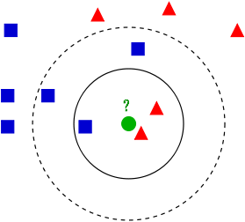
K-NN ALGORITHM – INTRO
K-NN uses distance function to calculate the distance between points from the center
The comparisons used to classify this are as follows
A1CResult vs. Metformin
A1CResult vs. Insulin
A1CResult vs. Change of medicines
A1CResult vs. Diabetic Meds

Slide 11
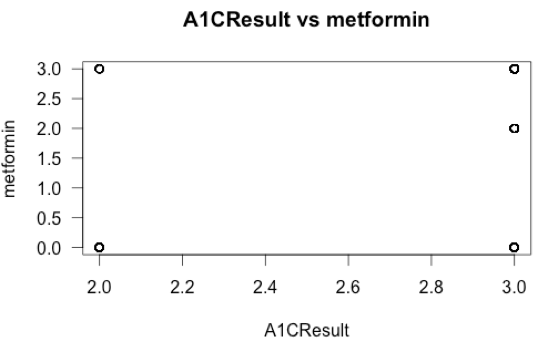
K-NN ALGORITHM – Results
A1CResult Vs. Metformin
A1C Result | No | Yes
>7 | 0 | 1
>8 | 0 | 118
None | 6998 | 23411
Normal | 0 | 2
A1CResult VS Diabetic Meds

Slide 12
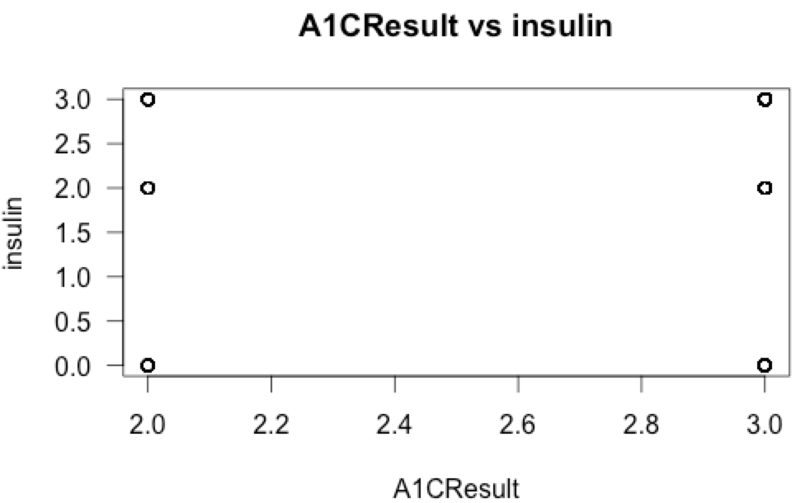
K-NN
A1cResult Vs Insulin
A1c | No Change | Change
>7 | 0 | 0
>8 | 56 | 69
None | 16397 | 14007
Normal | 0 | 1
A1cResult Vs Change of medicines

Slide 13
K-means Clustering

Slide 14
KMEANS CLUSTERING – Intro
k-means clustering is a method of vector quantization, originally from signal processing, that is popular for cluster analysis in data mining.
k-means clustering aims to partition n observations into k clusters in which each observation belongs to the cluster with the nearest mean, serving as a prototype of the cluster.
You can say this is “unsupervised classification”
Intuitively, if you would want to assign same label to a data points that are “close” to each other

Slide 15
KMEANS CLUSTERING – Algorithm
For a given cluster assignment C of the data points, compute the cluster means m_{k}:
For a current set of cluster means, assign each observation as:

Slide 16
Steps
Place K points into the space represented by the objects that are being clustered. These points represent initial group centroids.
Assign each object to the group that has the closest centroid.
When all objects have been assigned, recalculate the positions of the K centroids.
Repeat Steps 2 and 3 until the centroids no longer move. This produces a separation of the objects into groups from which the metric to be minimized can be calculated.

Slide 17
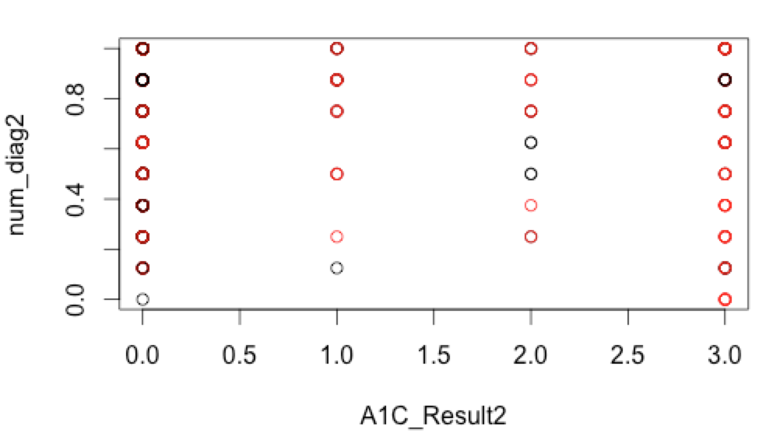
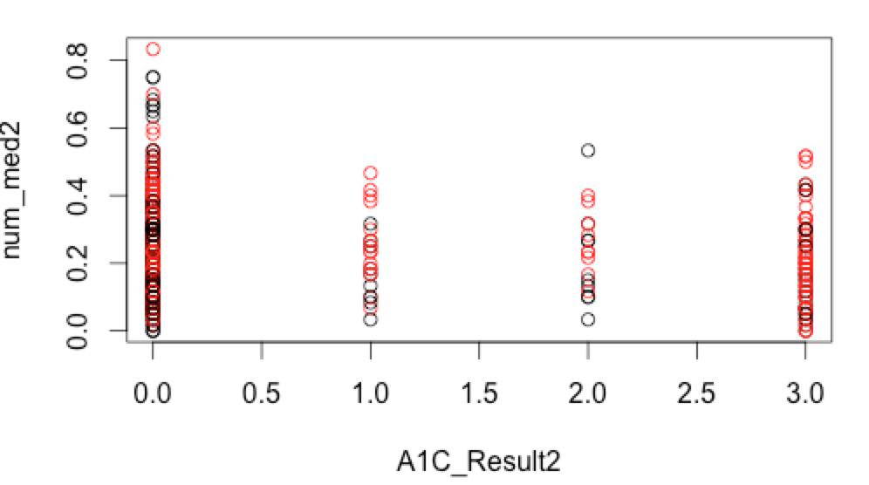
KMEANS CLUSTERING – Plots

Slide 18
COMPARING THE ACCUARACY OF KNN WITH DIFFERENT VALUES OF K

Slide 19
THANK YOU

