Slide 1
IE6600 - Computation and Visualisation
Amogha Shettar
Amoolya Shettar

Slide 2
San Francisco Crime Dataset
San Francisco has one of the highest crime rates in America. The overall crime rate in San Francisco is 151% higher than the national average.
About the dataset-
This dataset consists information about the crime in San Francisco.
The size of the file is 150500*13, that is, 150500 rows and 13 columns.

Slide 3
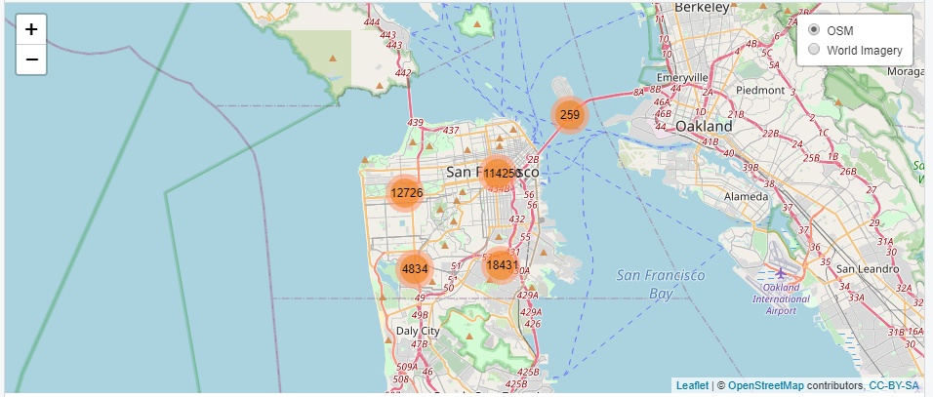
Data Visualization

Slide 4
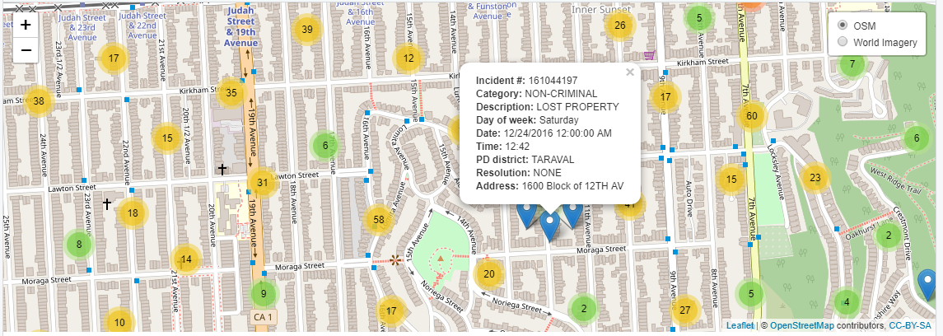

Slide 5
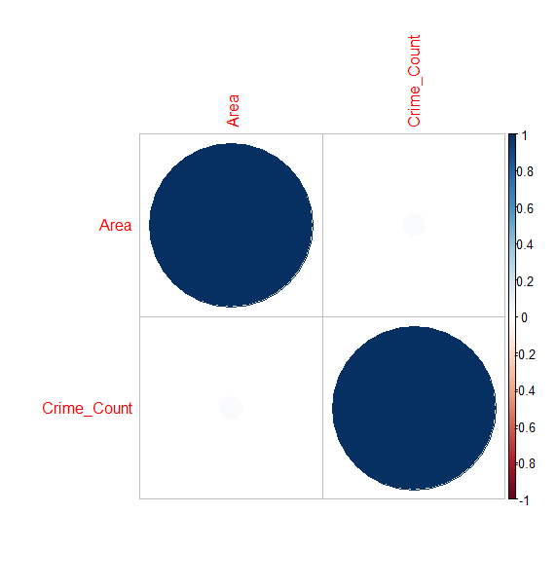
Correlation between the crimes and area in San Francisco

Slide 6
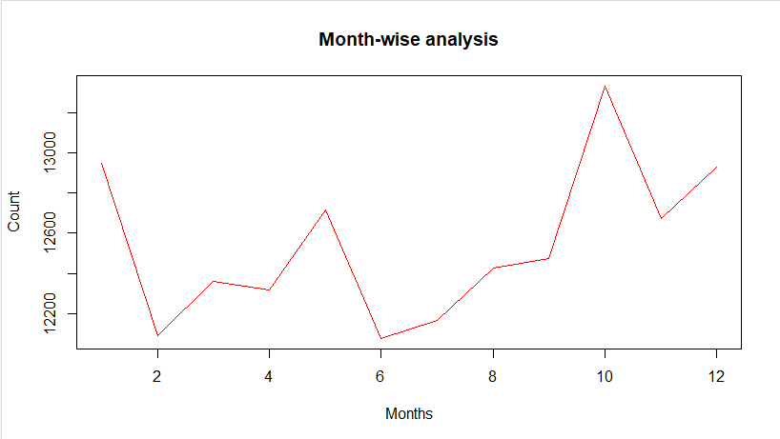
Month-wise analysis
Making use of line graph to analyse the trend in crime, monthly.

Slide 7
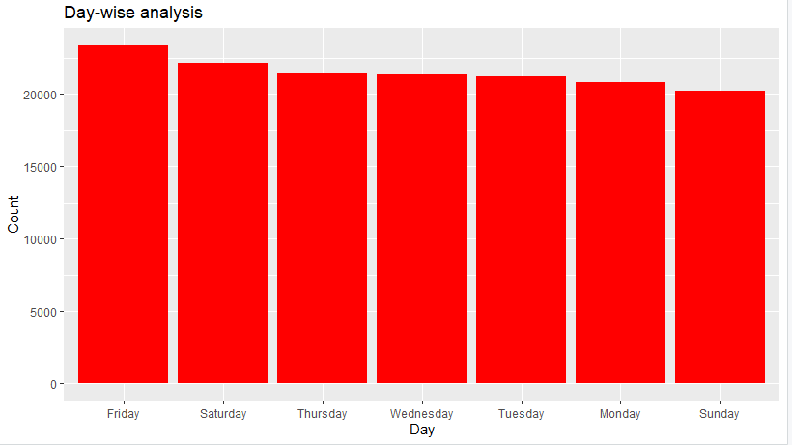
Making use of bar graph to analyse the trend in crime, day-wise in San Francisco.

Slide 8
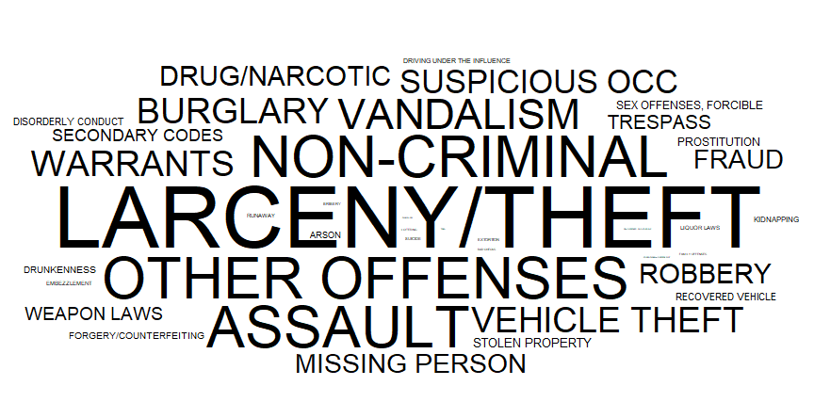
Crimes in San Francisco

Slide 9
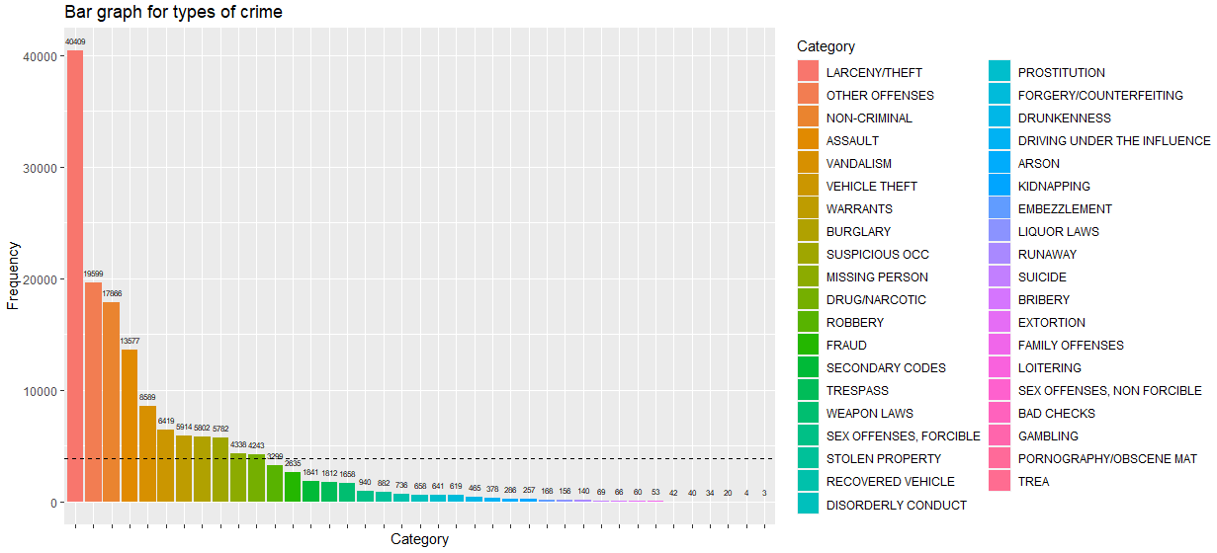
Bar graph to view the crime rate

Slide 10
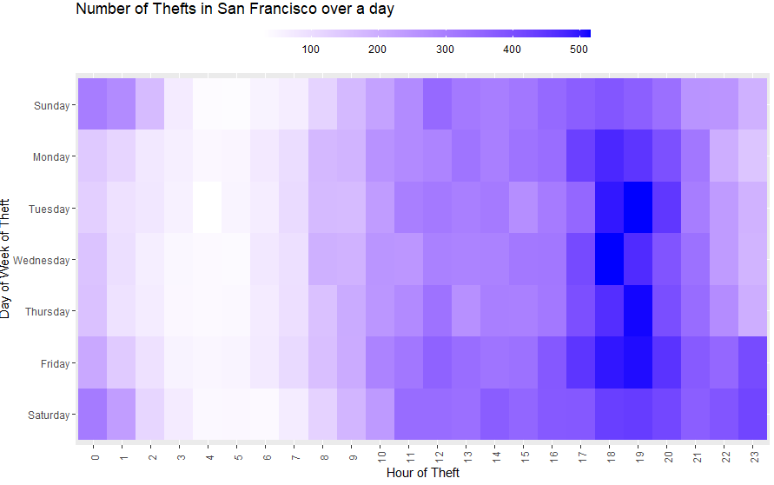
Heat Map showing the spread of Theft crime over a day.

Slide 11
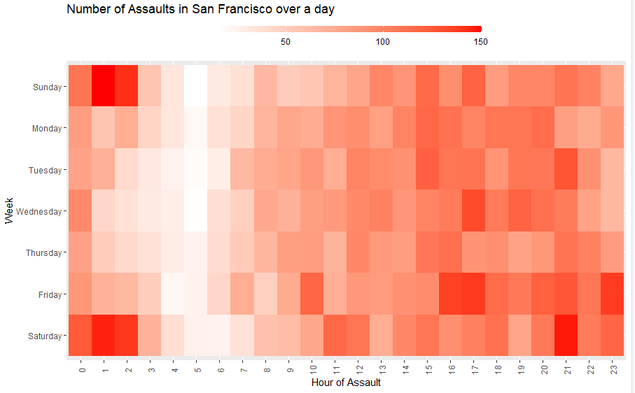
Heat Map showing the spread of Assault crime over a day.

Slide 12
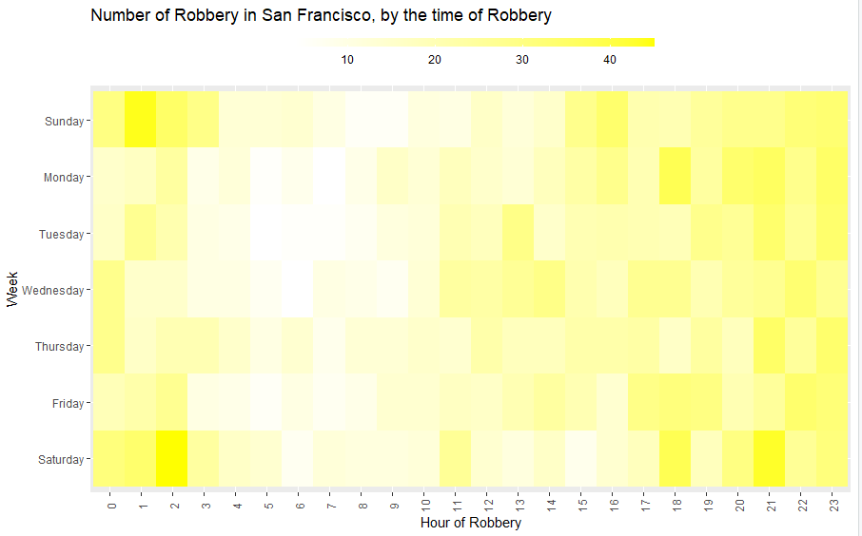
Heat Map showing the spread of Robbery crime over a day.

Slide 13
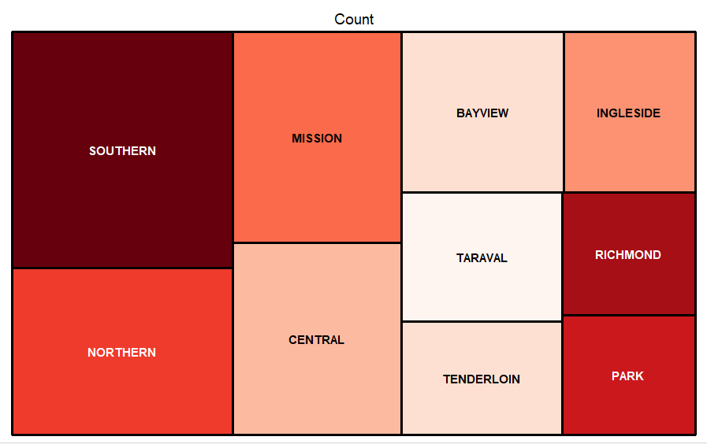
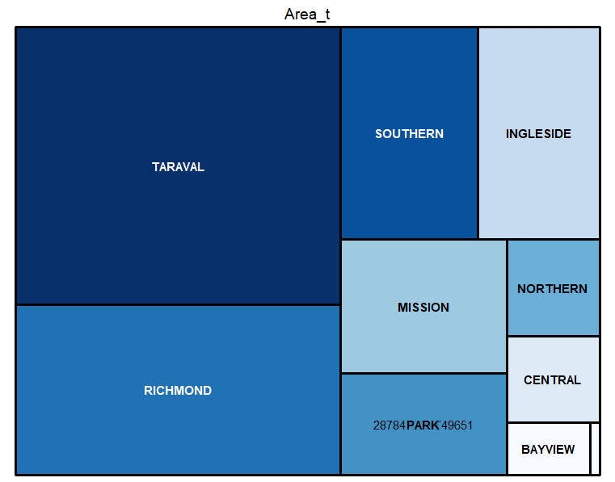
District based on crime.
District based on area.

Slide 14
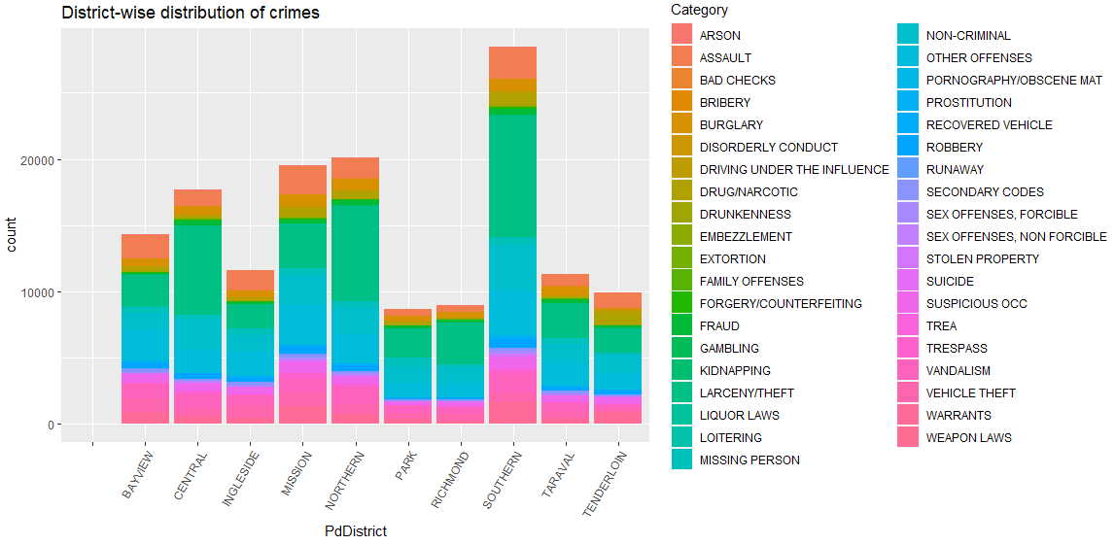
Bar graph showing the distribution of a specific crime for each district.

Slide 15
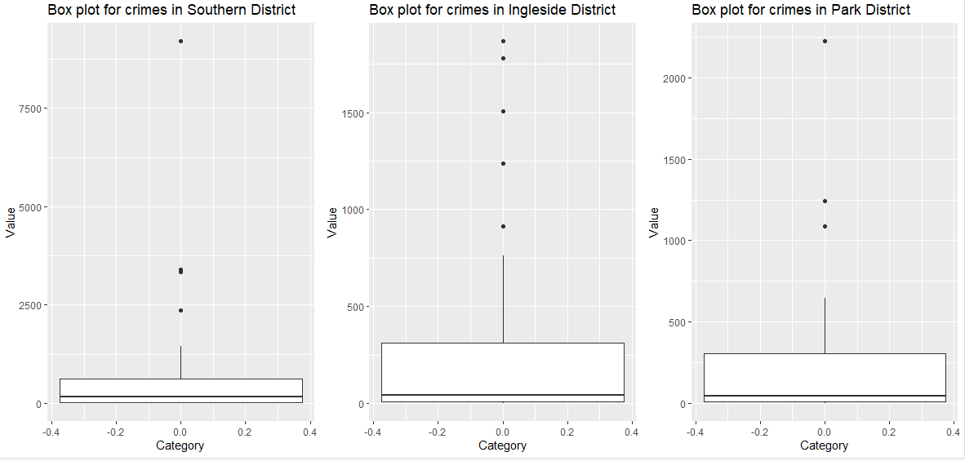

Slide 16
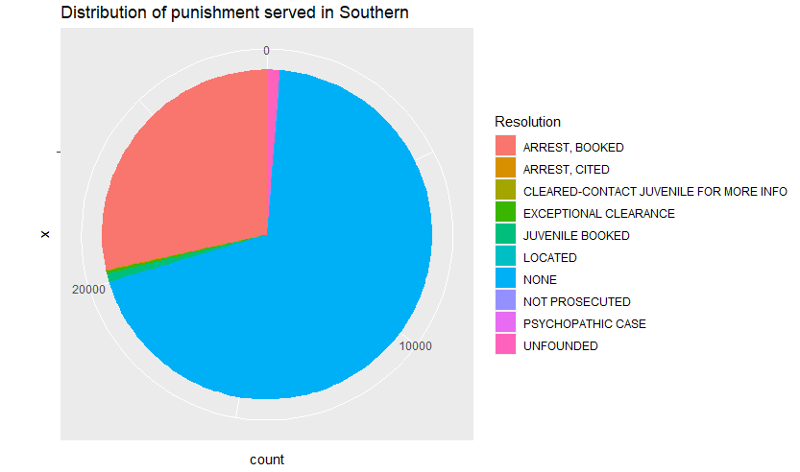
Pie chart displaying the distribution of punishment served in SOUTHERN district.

Slide 17
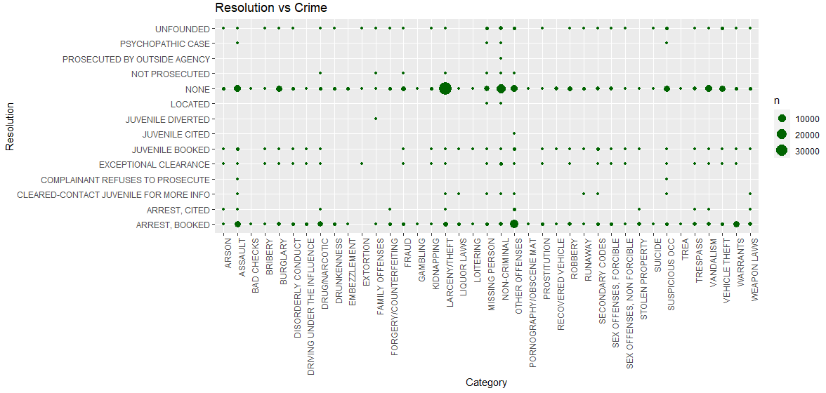

Slide 18
Thank you

