Slide 1
Aircraft Accidents Analysis
Exploring Trends, Risks & Recommendations
Amoit Winnie| 28/04/2025 | Phase 1 Project

Slide 2
Introduction
- Aviation is among the safest transportation modes, yet accidents persist.
- Objective: Identify trends, high-risk factors, and improvement areas and recommend the best aircraft to purchase.
- Method: Data wrangling + EDA + Visualizations

Slide 3
Dataset Overview
- Source: Public aviation accident dataset
- Total records: 8,889 rows with 31 columns
- Key columns in my analysis: Event date, Phase of flight, Aircraft make/model, Fatal injuries and weather condition.
- Period covered: 1982 - 2007

Slide 4
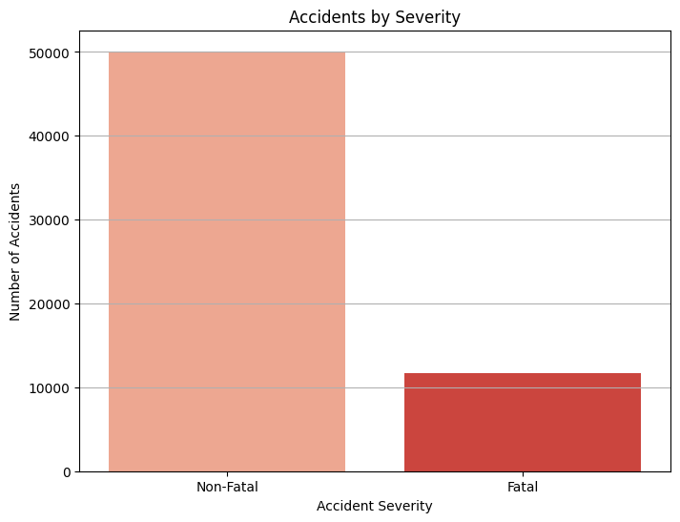
Fatal vs Non-Fatal Accidents
- Majority are non-fatal
- Fatal accidents carry high consequences
- 1 fatal accident is one too many.

Slide 5
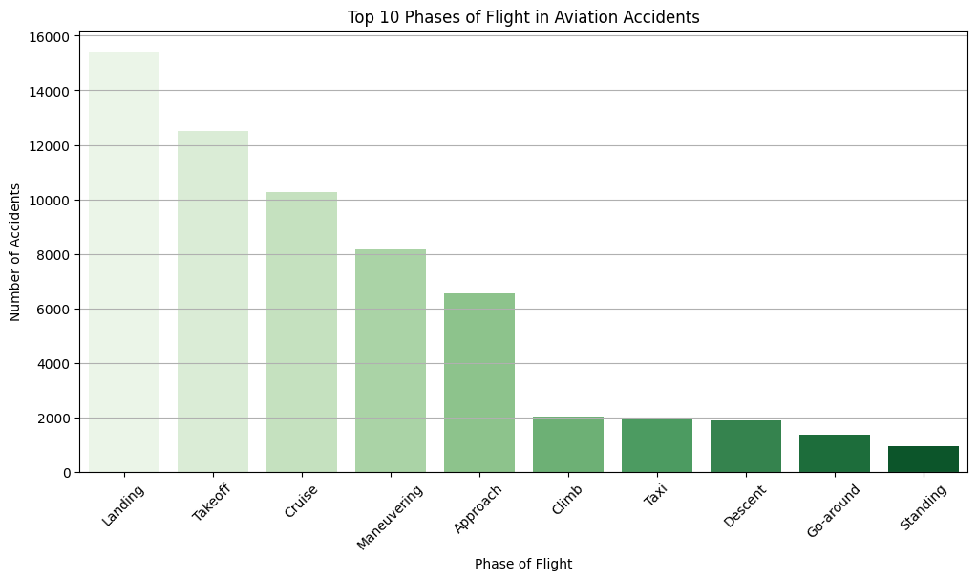
Common Phases During Accidents
- Highest risk phases: Landing, Takeoff, and
- I recommend focused training and safety measures to reduce accidents during these phases.

Slide 6
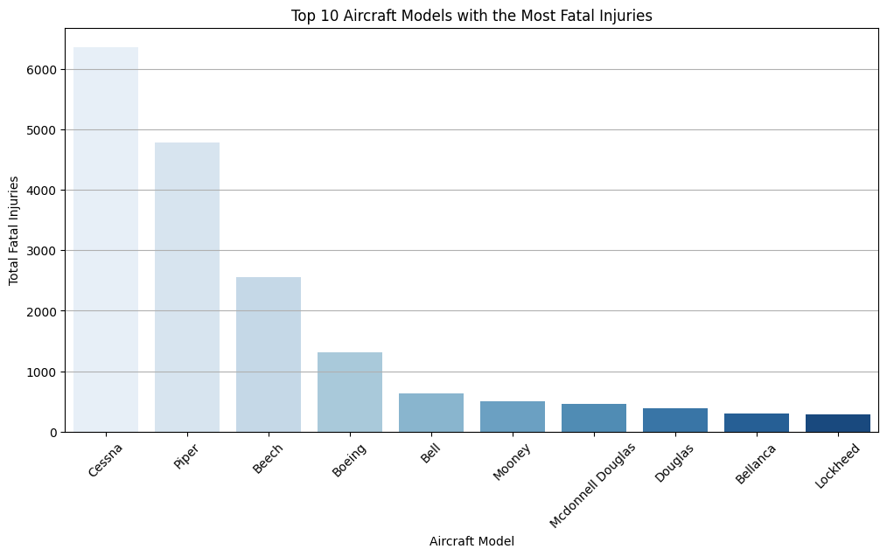
Aircraft Models with Most Fatal Injuries
- The Cessna aircraft models show higher fatality totals and no. of accidents. Thus not a good aircraft to purchase.
- Indicates potential safety/design issues

Slide 7
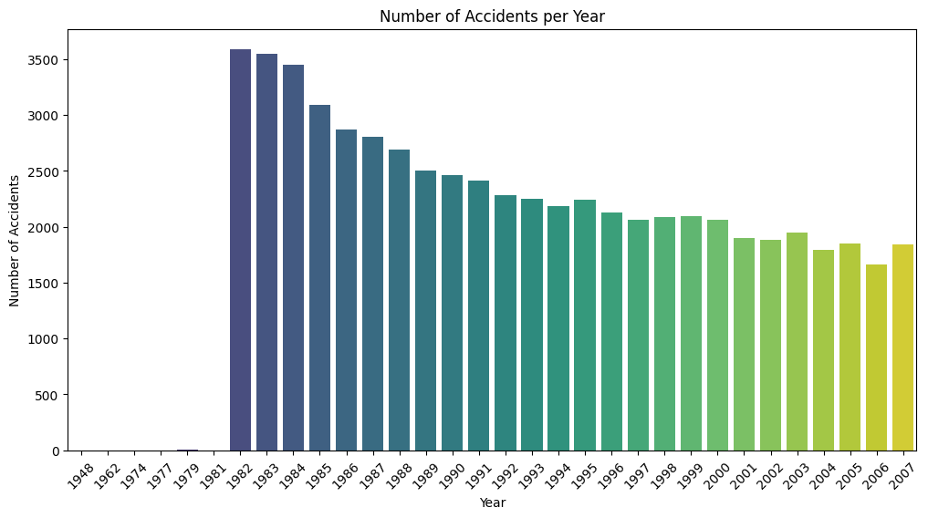
Trends Over Time
- Accident counts fluctuate by year with the 3500 as the highest.
- Reflects regulation and technology shifts thus fewer accidents.

Slide 8
Key Recommendations
- Enhance pilot training for high-risk phases
- Target inspections on high-risk aircraft models
- Integrate real-time weather and decision tools
- Promote adoption of Safety Management Systems (SMS)

Slide 9
Tools Used
- Python (Pandas, NumPy)
- Seaborn & Matplotlib for static charts
- Plotly for interactive visualization
- Jupyter Notebook for analysis
- Tableau Desktop Dashboard

Slide 10
Q&A / Thank You
- Questions?
- GitHub / Notebook link : https://github.com/Amoitw/Aircraft_Accidents_Analysis_Project

