Slide 1
Cloud Computing: Concepts, Technologies and Business Implications

Slide 2
Agenda
Introduction to cloud context
  Technology context: multi-core, virtualization, 64-bit processors, parallel computing models, big-data storages…
  Cloud models: IaaS (Amazon AWS), PaaS (Microsoft Azure), SaaS (Google App Engine)
Demonstration of cloud capabilities
  Cloud models
  Data and Computing models: MapReduce
  Graph processing using amazon elastic mapreduce

Slide 3
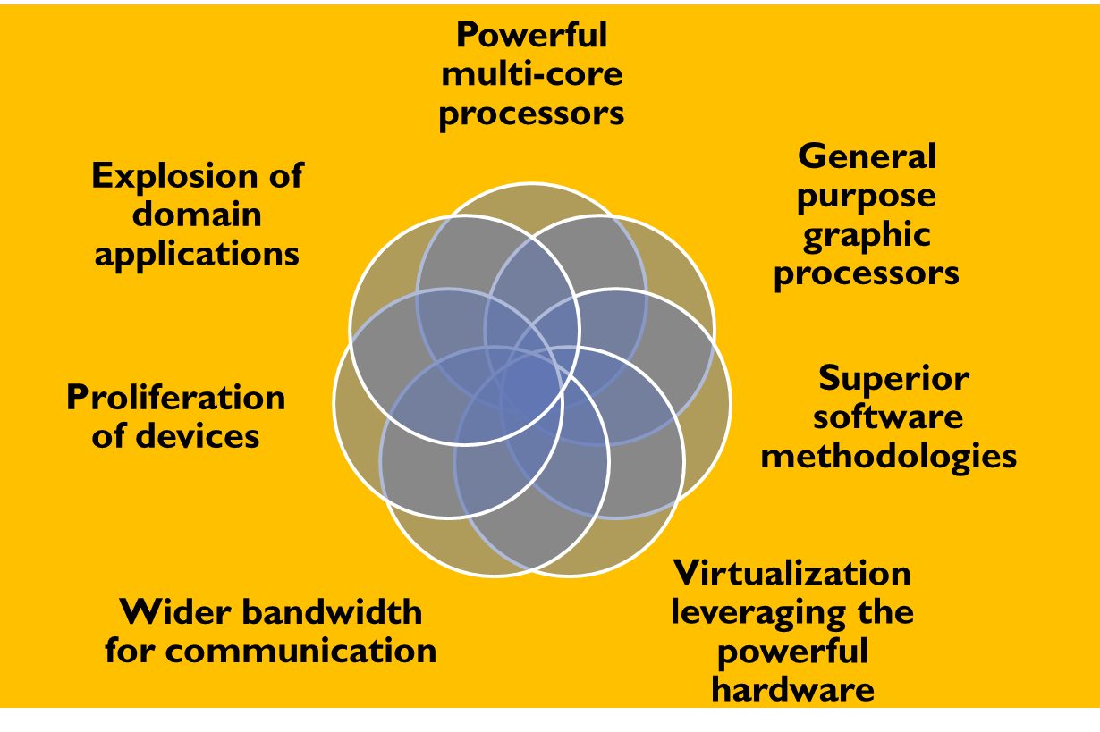
Introduction: A Golden Era in Computing

Slide 4

Evolution of Internet Computing
scale
web
Data-intensive
HPC, cloud
deep web
Semantic
discovery
Data marketplace and analytics
Social media and networking
Automate (discovery)
Discover (intelligence)
Transact
Integrate
Interact
Inform
Publish
time

Slide 5
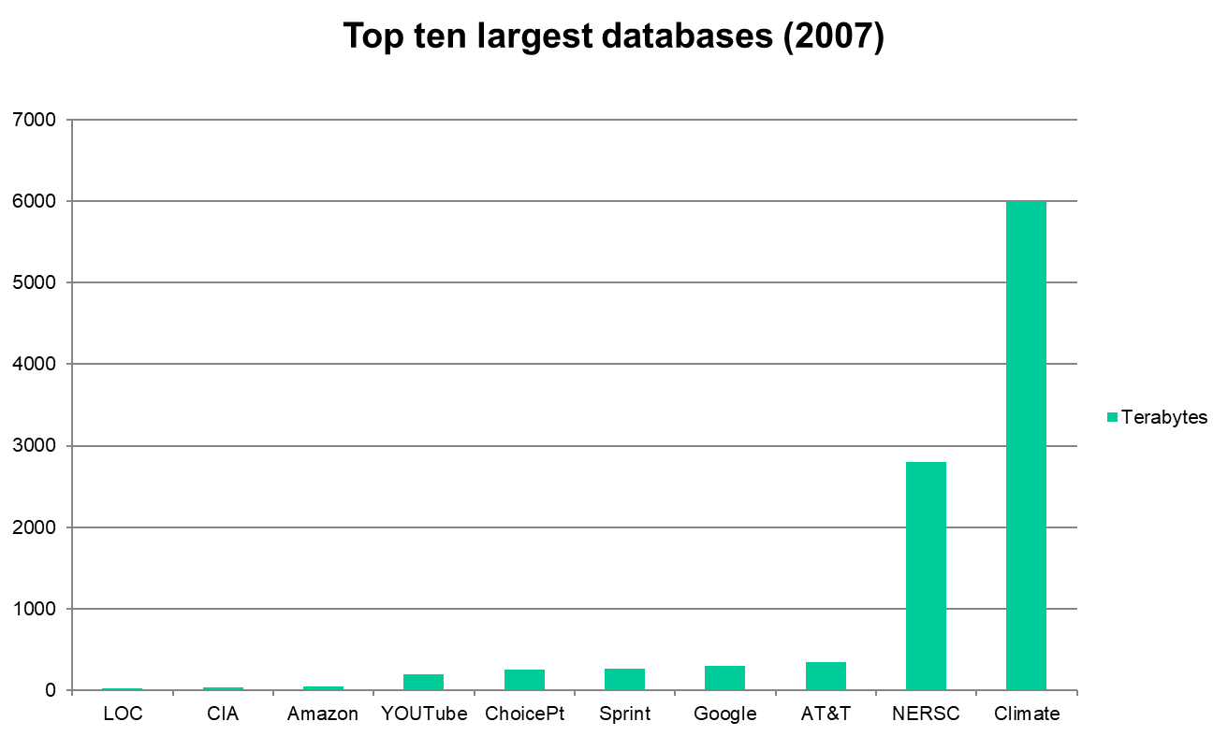
Top Ten Largest Databases
Ref: http://www.focus.com/fyi/operations/10-largest-databases-in-the-world/

Slide 6
Challenges
Alignment with the needs of the business / user / non-computer specialists / community and society
Need to address the scalability issue: large scale data, high performance computing, automation, response time, rapid prototyping, and rapid time to production
Need to effectively address (i) ever shortening cycle of obsolescence, (ii) heterogeneity and (iii) rapid changes in requirements
Transform data from diverse sources into intelligence and deliver intelligence to right people/user/systems

Slide 7
Enter the cloud
Cloud computing is Internet-based computing, whereby shared resources, software and information are provided to computers and other devices on-demand, like the electricity grid.
The cloud computing is a culmination of numerous attempts at large scale computing with seamless access to virtually limitless resources.

Slide 8
“Grid Technology”
Emerging enabling technology.
Natural evolution of distributed systems and the Internet.
Middleware supporting network of systems to facilitate sharing, standardization and openness.
Infrastructure and application model dealing with sharing of compute cycles, data, storage and other resources.
Publicized by prominent industries as on-demand computing, utility computing, etc.

Slide 9
It is a changed world now…
Explosive growth in applications: biomedical informatics, space exploration, business analytics, web 2.0 social networking: YouTube, Facebook
Extreme scale content generation: e-science and e-business data deluge
Extraordinary rate of digital content consumption: digital gluttony: Apple iPhone, iPad, Amazon Kindle

Slide 10
Answer: The Cloud Computing?
Typical requirements and models:
  platform (PaaS),
  software (SaaS),
  infrastructure (IaaS),
  Services-based application programming interface (API)
A cloud computing environment can provide one or more of these requirements for a cost
When using a public cloud the model is similar to renting a property than owning one.
An organization could also maintain a private cloud and/or use both.

Slide 11






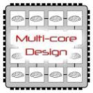
Enabling Technologies
Cloud applications: data-intensive, compute-intensive, storage-intensive
Bandwidth
WS
Services interface
Web-services, SOA, WS standards
VM0
VM1
VMn
Storage Models: S3, BigTable, BlobStore, ...
Virtualization: bare metal, hypervisor. …
Multi-core architectures
64-bit processor

Slide 12
Summary
We illustrated cloud concepts and demonstrated the cloud capabilities through simple applications
We discussed the features of the Hadoop File System, and mapreduce to handle big-data sets.
We also explored some real business issues in adoption of cloud.
Cloud is indeed an impactful technology that is sure to transform computing in business.

Slide 13
Thank
You

