Slide 1
S.O.L.I.D Principles
By:
Amol Chaudhari

Slide 2
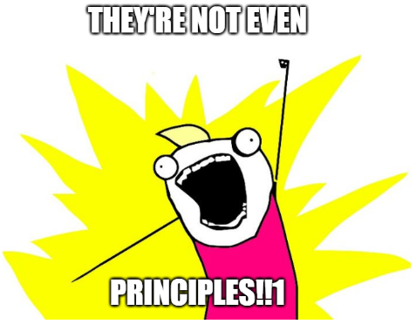
Disclaimer

Slide 3
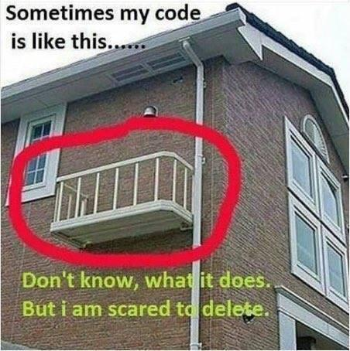
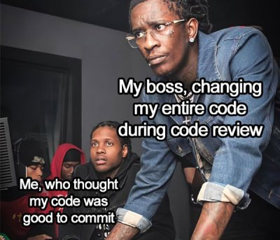
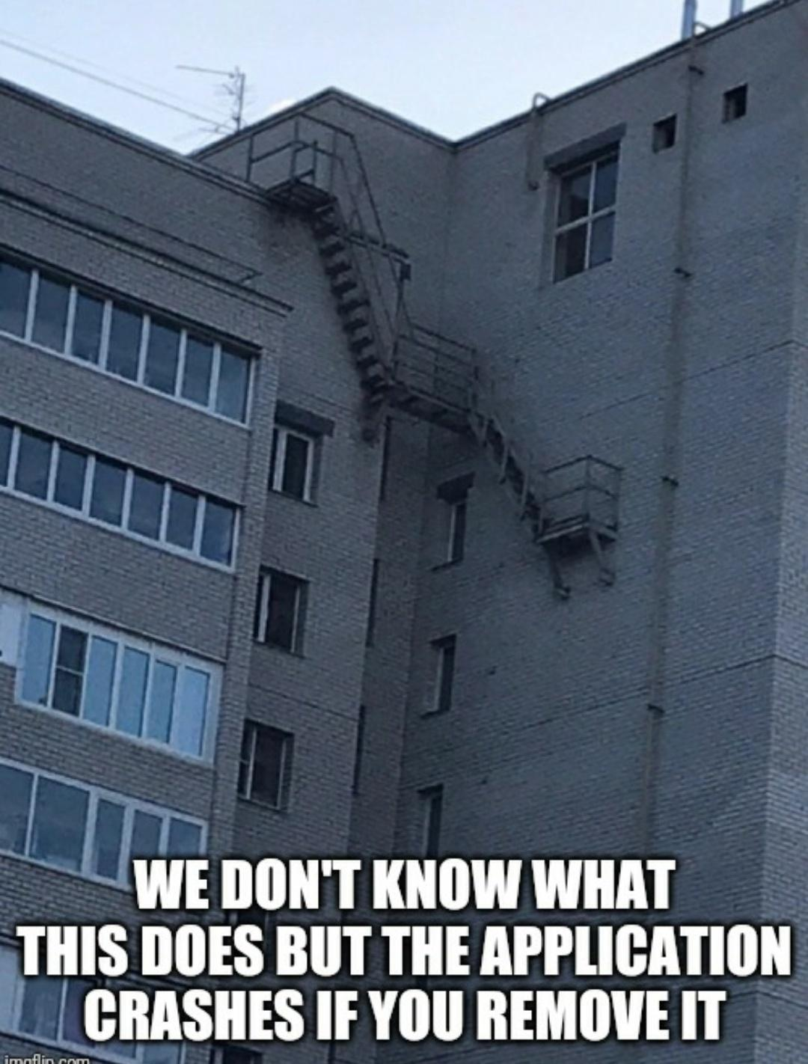
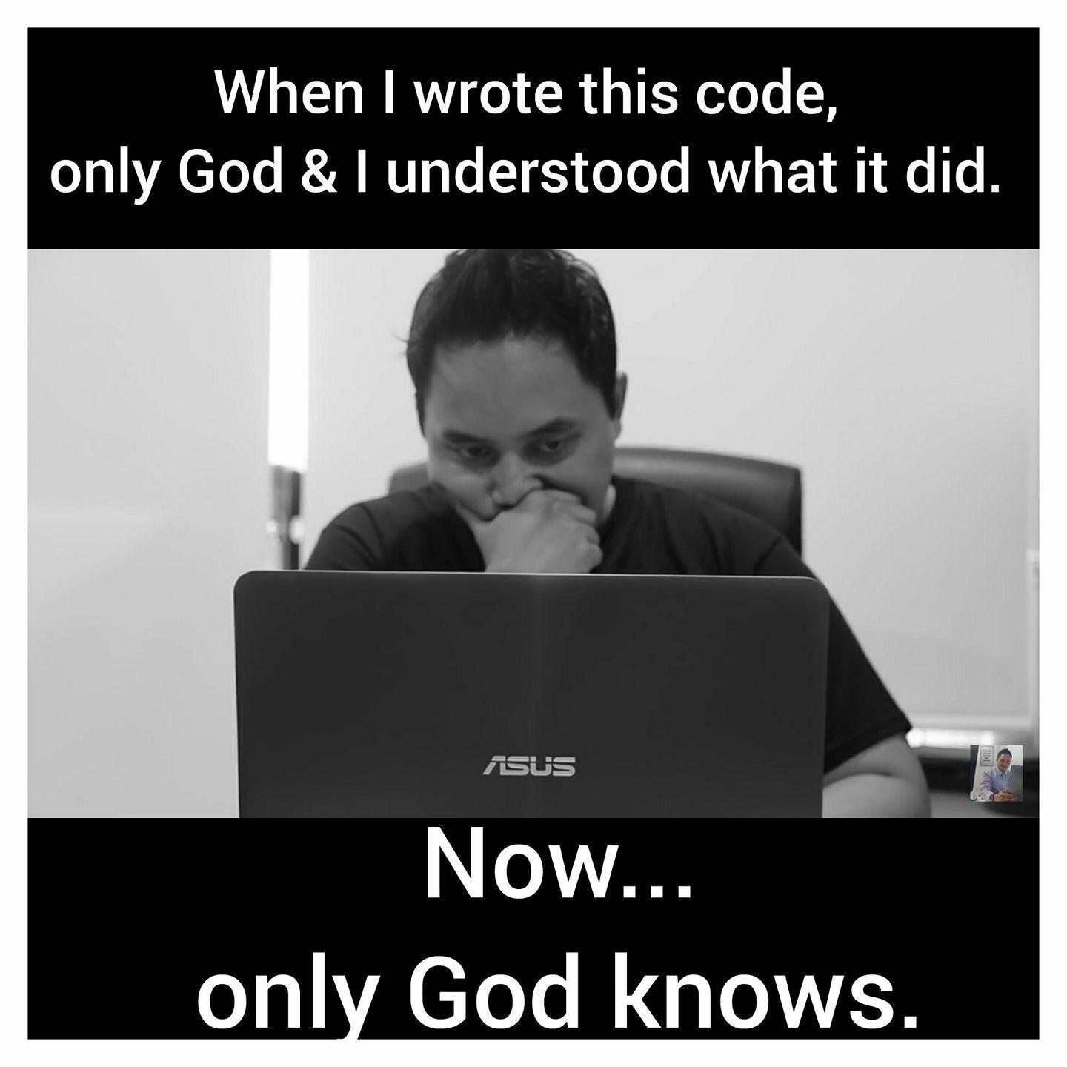
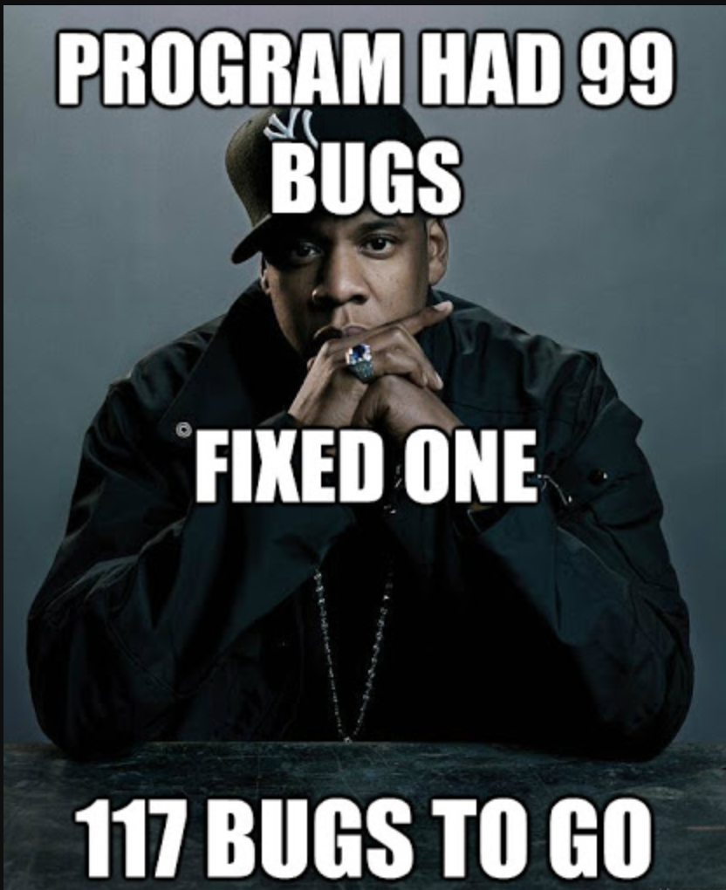
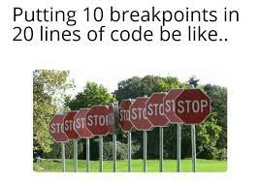

Slide 4
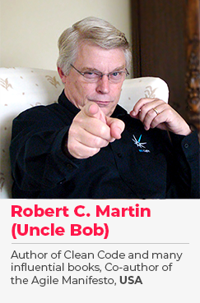
KISS - Keep It Super Simple
DRY - Don’t Repeat Yourself
SOLID Principle
Best Developer

Slide 5
Single Responsibility Principle (SRP)
“A Class/function Should have one and only one reason To Change”.

Slide 6
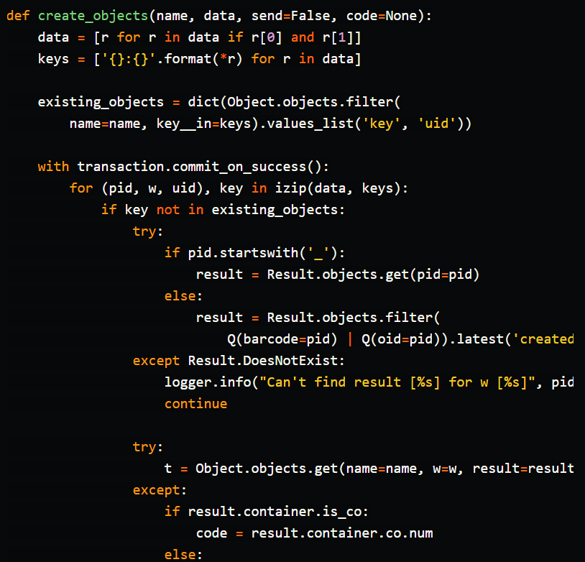
…….Its still increasing

Slide 7
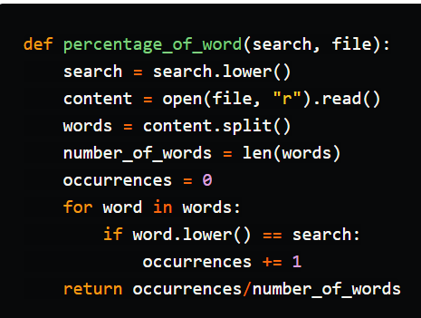
1.Reads File
2.Calculate Number of total Words.
3.Calculate Number of Word occurrences.

Slide 8
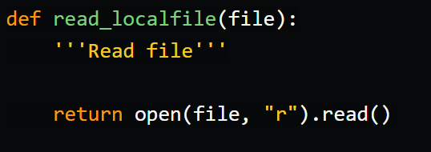
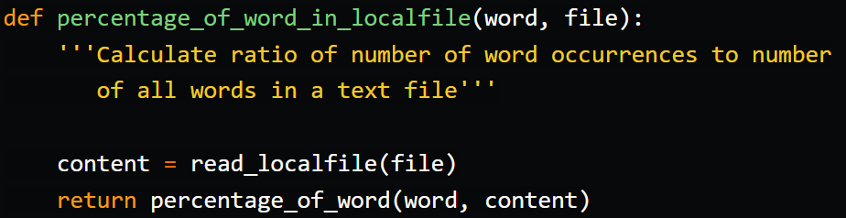
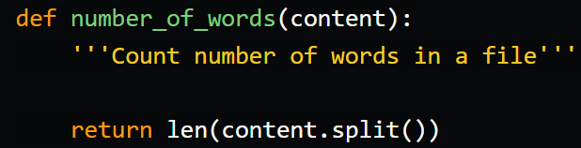
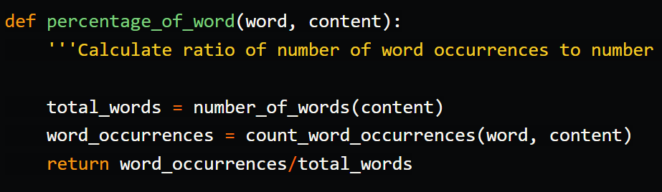
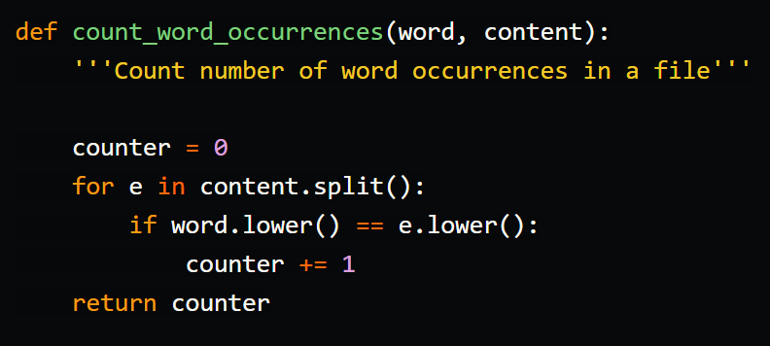

Slide 9
Benefits:
The code is DRY. No code is repeated, so if we need to make a modification in one of the functions, we would only need to do it in one place.
The code is clean, organized and very easy to read and understand.
We can write tests for each function separately, so it is easier to debug the code.

Slide 10
Another wording for SRP
“Gather Together the things that change for same reason. Separate those things that change for different reasons”.

Slide 11
Open Closed Principle (OCP)
“Software Entities (class) should be open for Extension but closed for modifications”.

Slide 12
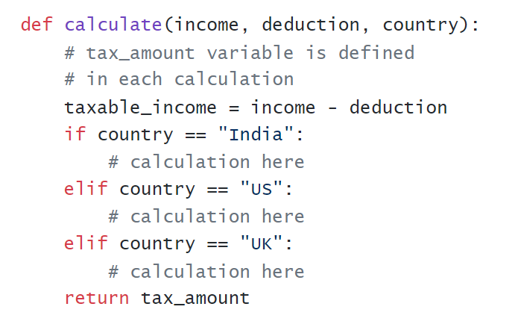
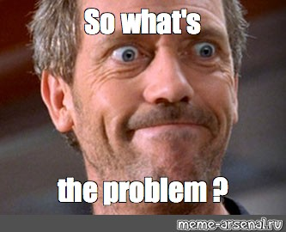

Slide 13
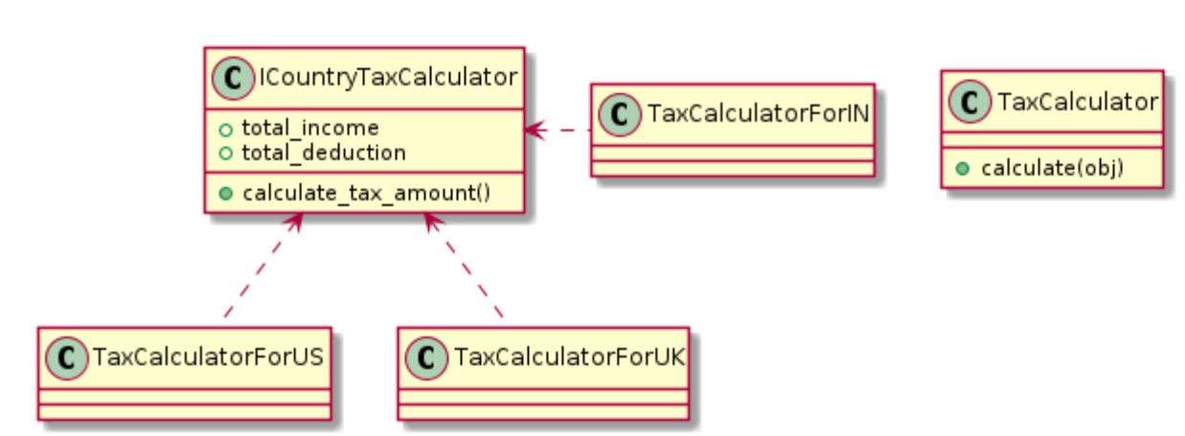

Slide 14
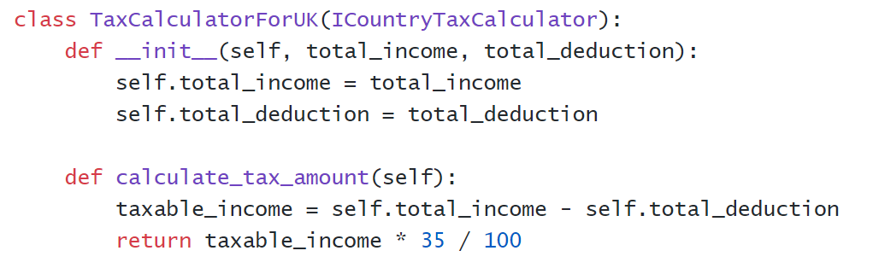
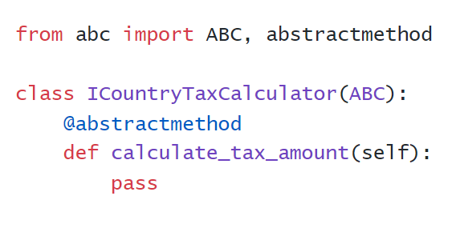
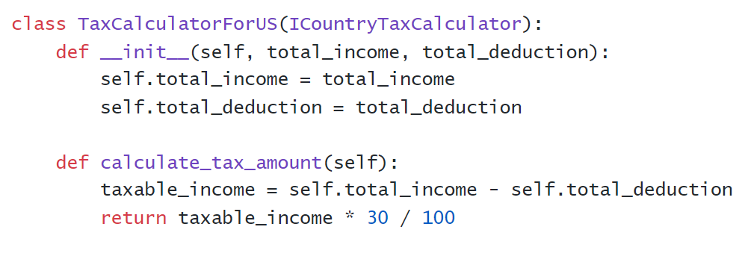
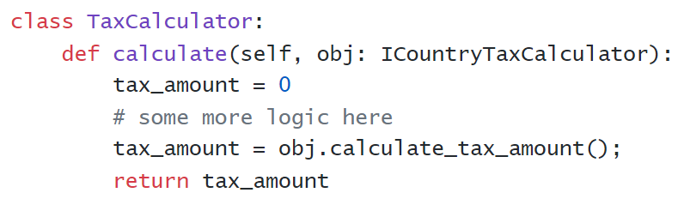

Slide 15
Final Thoughts
“New requirements must constantly be satisfied, and existing requirements must be changed according to customer/ business needs”.
“Applying open-closed principle is a good way of maintain any extension required for your codebase”.

Slide 16
Liskov Substitution Principle (LSP)
“Child class should not give different meaning to parent class”.
“Child Class should behave in such a way that it will not cause problems when use instead of superclass”.
OR
“Object of parent class can be replaceable by child class without any code changes in code base”.

Slide 17
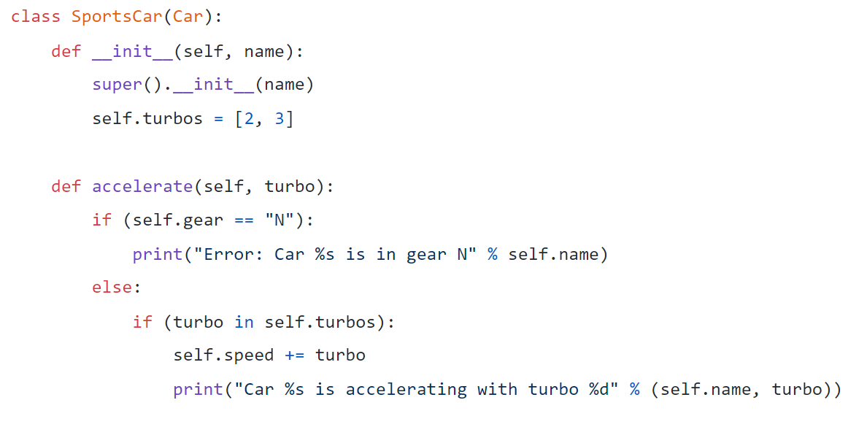
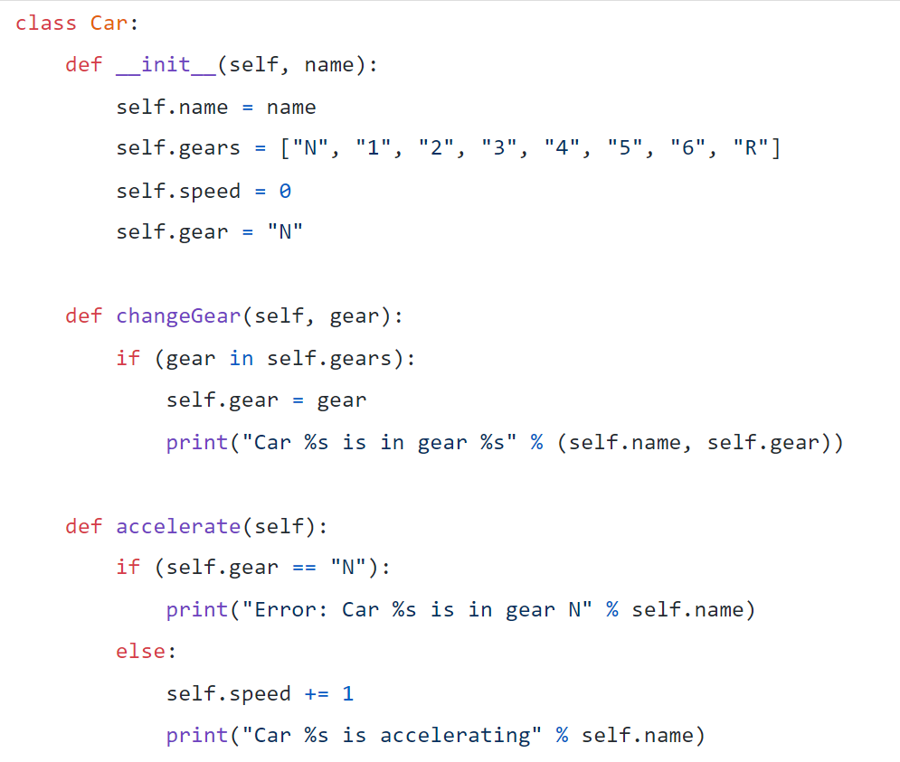
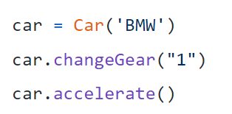
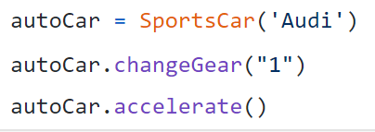
Simple Example

Slide 18
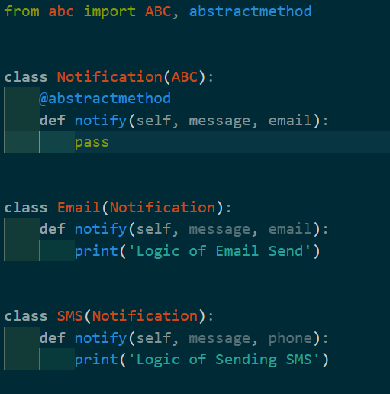
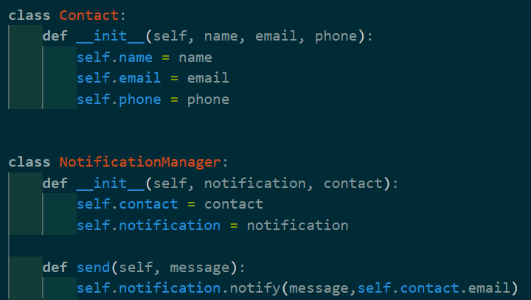
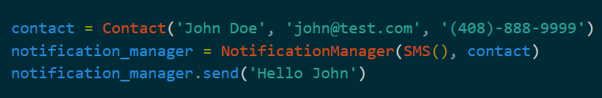

Slide 19
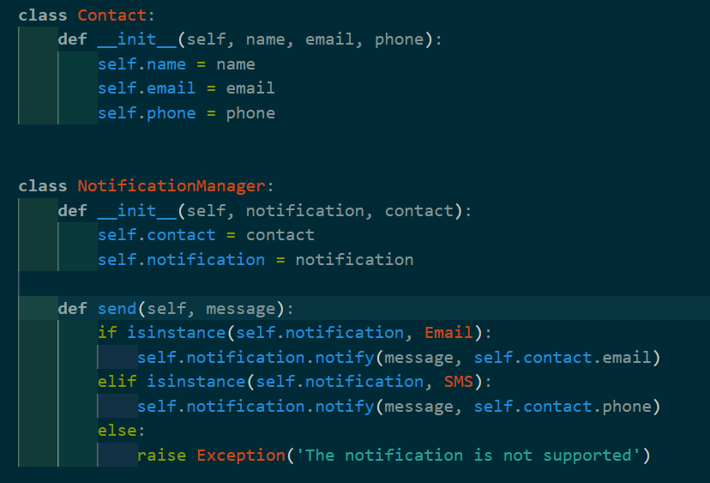

Slide 20
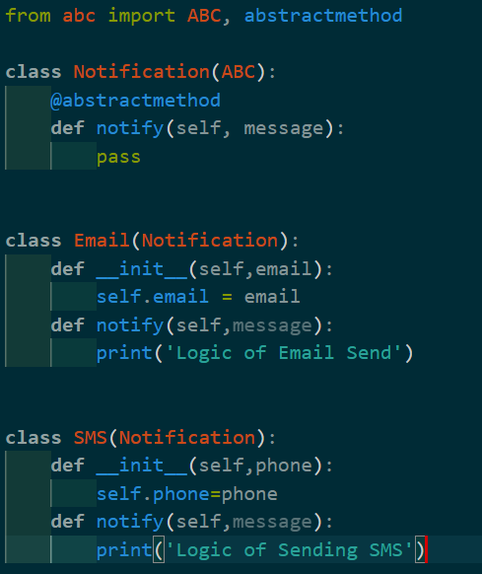
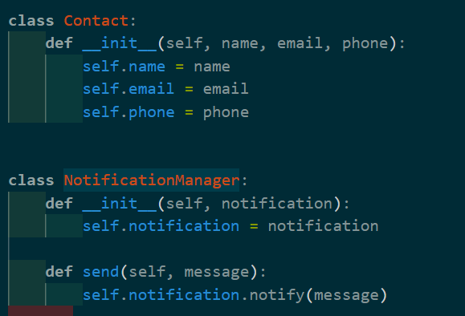
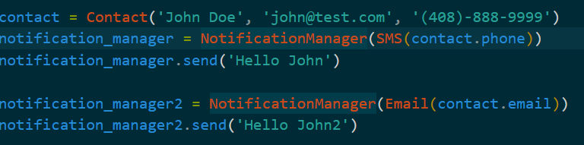

Slide 21
Interface Segregation Principle (ISP)
“Clients should not be forced to depend upon interfaces that they don’t use ”.

Slide 22
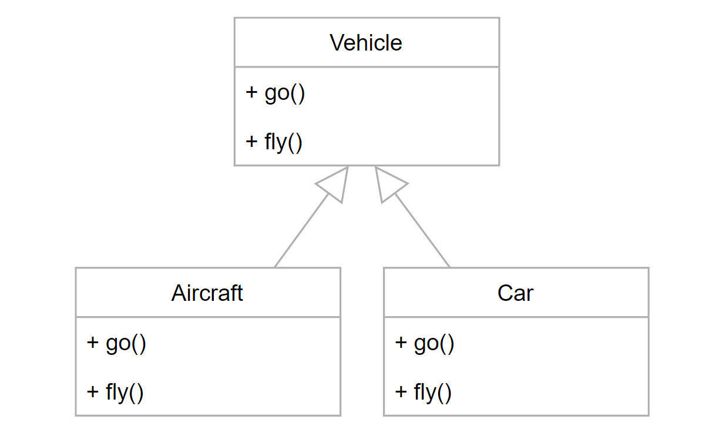

Slide 23
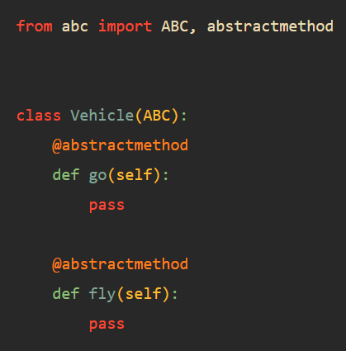
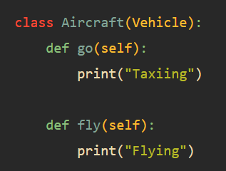
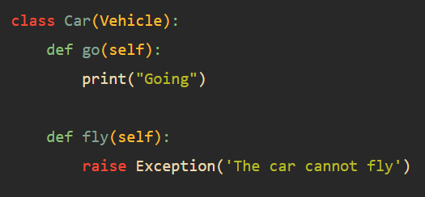

Slide 24
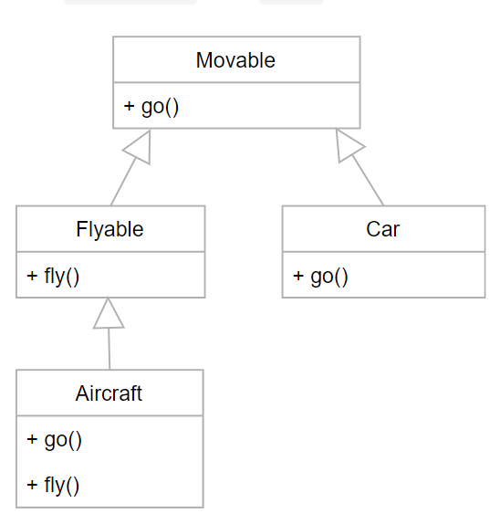

Slide 25
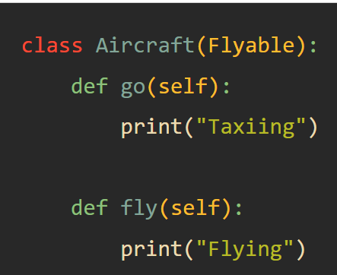
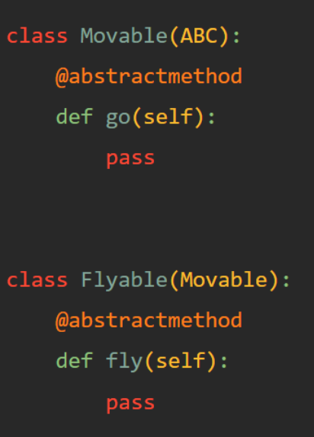
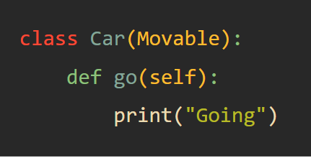

Slide 26
Dependency Inversion Principle (DIP)
“High level module should not depend on Low level module. Both Should depend on Abstraction”.

Slide 27
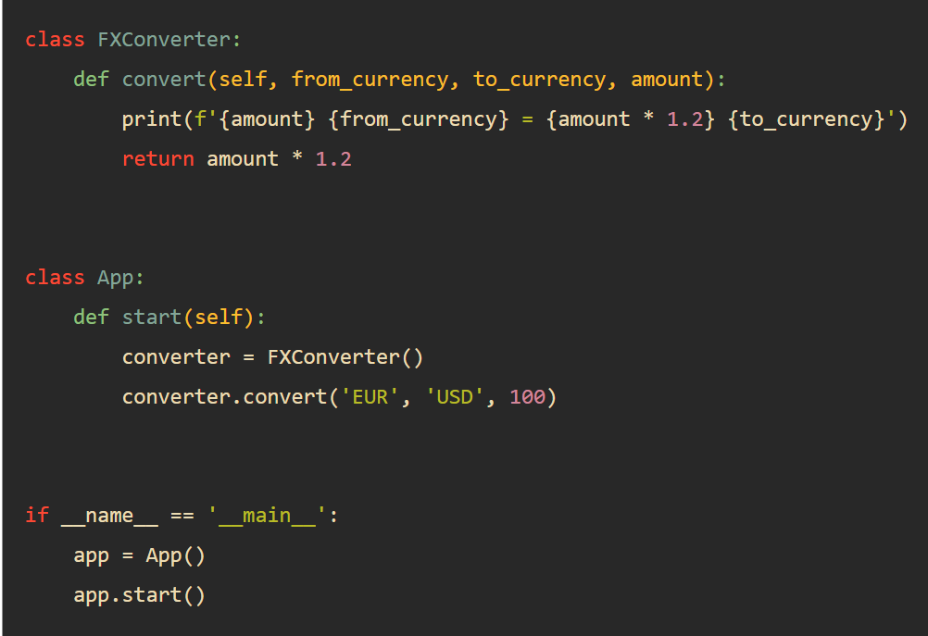

Slide 28
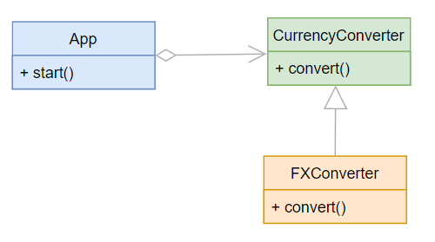
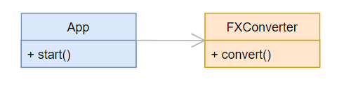
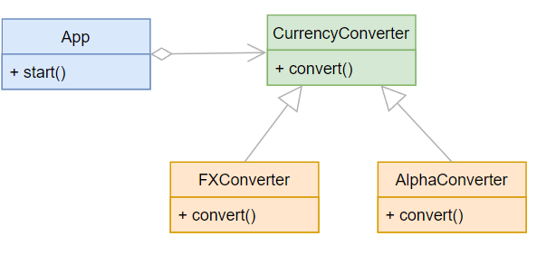

Slide 29
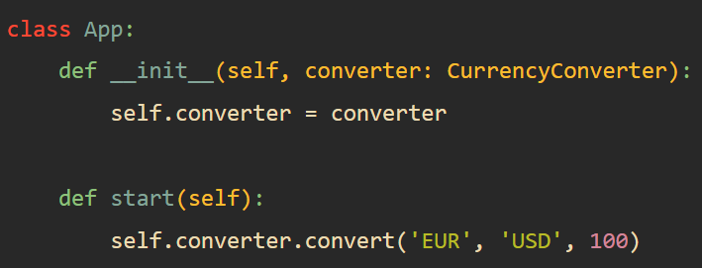
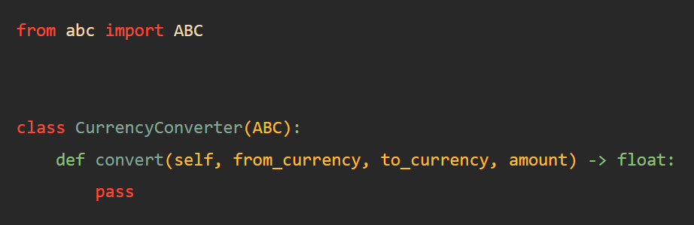
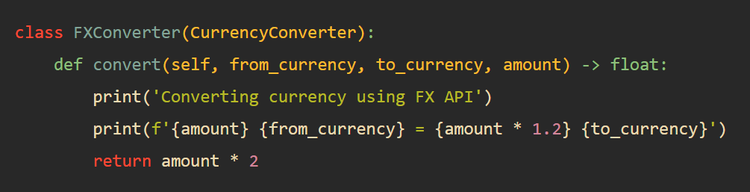
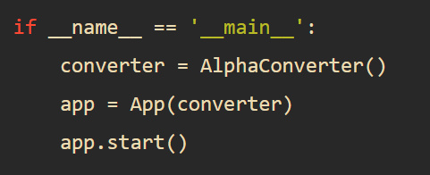
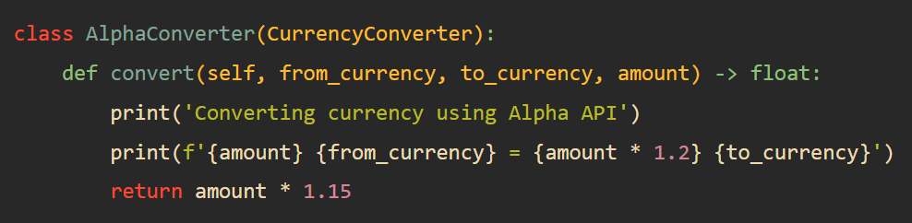

Slide 30

Conclusion

Slide 31


Slide 32
“Happy Coding”.

