Slide 1
Topic Modeling with Top2Vec
Amol Mavuduru, Applied AI ML Engineer at JPMorgan Chase

Slide 2
What is topic modeling?
Topic modeling is an unsupervised learning task in natural language processing that involves discovering topics in text.
Generally topics are represented as probability distributions of words. Some words such as “goal” and “penalty” are more likely to occur in a topic such as “football” or “soccer”.
Topic: football
word | goal | kick | run | penalty
probability | 0.23 | 0.32 | 0.2 | 0.4

Slide 3
What is Top2Vec?
Top2Vec is an algorithm that detects topics present in the text and generates jointly embedded topic, document, and word vectors. At a high level, the algorithm performs the following steps to discover topics in a list of documents:
Generate embedding vectors for documents and words.
Perform dimensionality reduction on the vectors using an algorithm such as UMAP.
Cluster the vectors using a clustering algorithm such as HDBSCAN.
Assign topics to each cluster.

Slide 4
Step 1: Generating Embedding Vectors

Slide 5
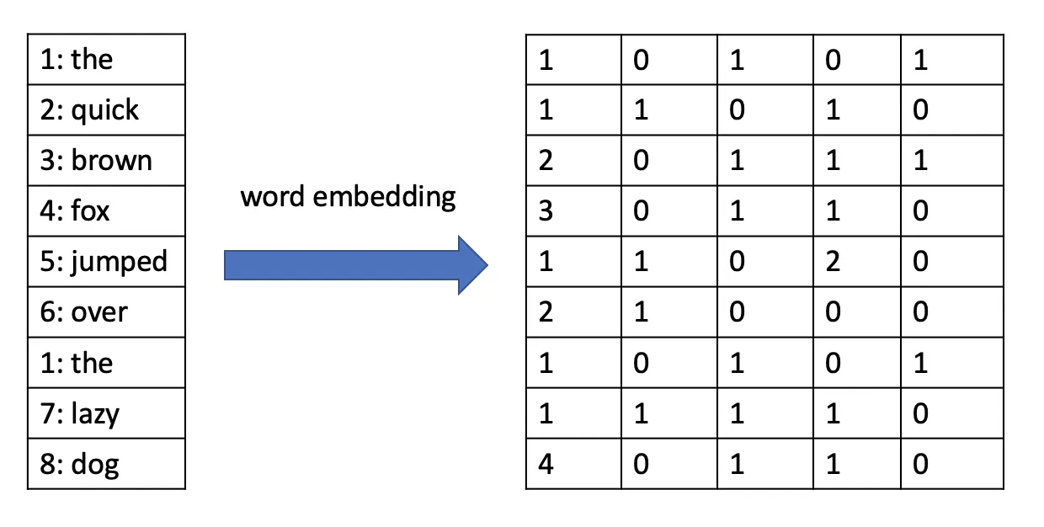
What are embedding vectors?
An embedding vector is a vector that allows us to represent a word or text document in multi-dimensional space. The idea behind embedding vectors is that similar words or text documents will have similar vectors.

Slide 6
Word2Vec – Skip-gram version
Word2Vec is an embedding algorithm that allows us to learn word embedding vectors from a corpus of text. In the skip-gram version we take a target word and try to predict the surrounding context words within n-words (skip-grams) of that word.
The words are represented in a dataset with one-hot vectors as shown below and a neural network with a single hidden layer is used to predict the context words. The weights of the hidden layer then form the embedding vectors for each word.
the | quick | brown | fox | jumps | over | lazy | dog
0 | 0 | 0 | 1 | 0 | 0 | 0 | 0
the | quick | brown | fox | jumps | over | lazy | dog
0.01 | 0.3 | 0.2 | 0.1 | 0.2 | 0.1 | 0.08 | 0.01
context words
context words
The quick brown fox jumps over the lazy dog.
8 x 8 weight matrix = 8 embedding vectors

Slide 7
Word2Vec – Continuous Bag of Words
The continuous bag of words version of Word2Vec we take surrounding context words and use them to predict a target word. We may have multiple context words and use them to predict a single target word.
quick, brown, jumps, over
fox
context words
context words
target

Slide 8
Other Embedding Algorithms
Doc2Vec
Transformer-based approaches, which are available through the Python sentence-transformers library.

Slide 9
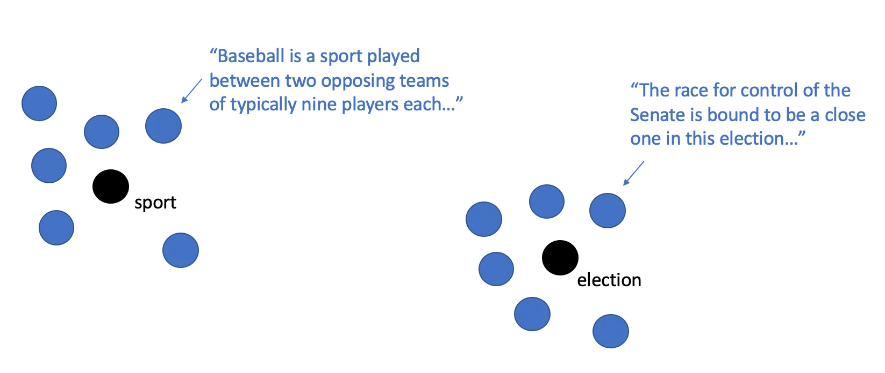
Intuition behind embeddings and topics
Creating embedding vectors for each document allows us to treat each document as a point in multi-dimensional space. Top2Vec also creates jointly embedded word vectors, which allows us to determine topic keywords later.

Slide 10
Step 2: Dimensionality Reduction with UMAP

Slide 11
What is dimensionality reduction?
Dimensionality reduction is the process of taking higher-dimensional data and reducing it to data with less dimensions.
Dimensionality reduction is important because embedding algorithms generally produce word vectors with many dimensions so it makes sense to reduce the number of dimensions in our embedding data before moving on to the clustering step.

Slide 12
UMAP Explained
UMAP (Uniform Manifold Approximation and Projection) is a dimensionality reduction algorithm that is based on topological analysis.
This algorithm works by building a neighbor graph in higher dimensional space and then mapping that graph to a lower dimension.
The graph is constructed using parameters such as the k-nearest neighbors (a constant, k), which are used to draw connections between points and construct topological objects known as simplices.

Slide 13
Step 3: Clustering with HDBSCAN

Slide 14
What is clustering?
Clustering is an unsupervised technique that allows us to group similar data points together, usually based on distance-based measures.
Top2Vec uses a clustering algorithm called HDBSCAN to cluster documents and words.

Slide 15
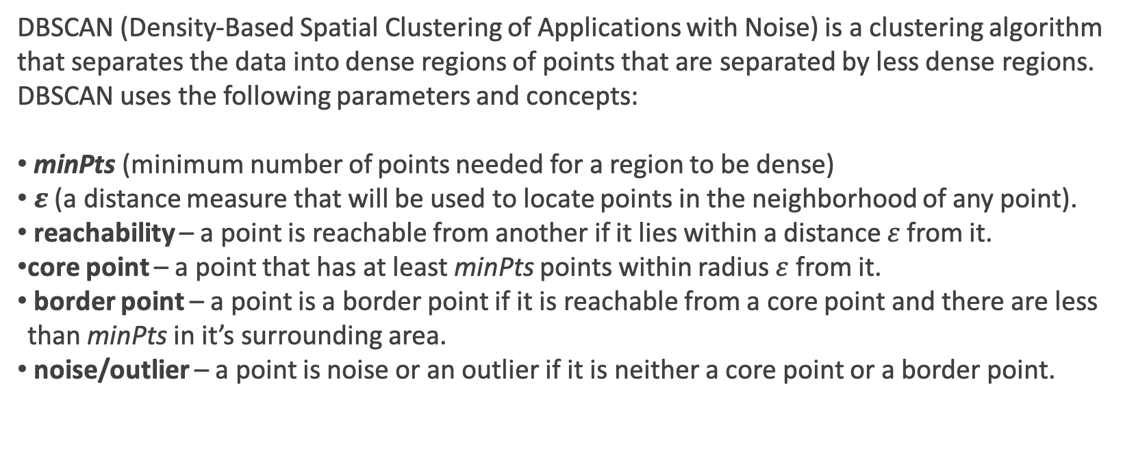
DBSCAN Explained
DBSCAN (Density-Based Spatial Clustering of Applications with Noise) is a clustering algorithm that separates the data into dense regions of points that are separated by less dense regions. DBSCAN uses the following parameters and concepts:
minPts (minimum number of points needed for a region to be dense)
$ε$(a distance measure that will be used to locate points in the neighborhood of any point).
reachability – a point is reachable from another if it lies within a distance $ε$ from it.
core point – a point that has at least minPts points within radius $ε$ from it.
border point – a point is a border point if it is reachable from a core point and there are less than minPts in it’s surrounding area.
noise/outlier – a point is noise or an outlier if it is neither a core point or a border point.

Slide 16

DBSCAN Steps
Select a point at random and determine it’s neighborhood using the radius $ε$
If there at least minPts number of points in the neighborhood, label it as a core point and start forming a cluster with the points in the neighborhood, otherwise mark it as noise.
Repeat steps 1-2 among the points that have not been visited until all of the points have been visited.
neighborhood
noise
core point

Slide 17
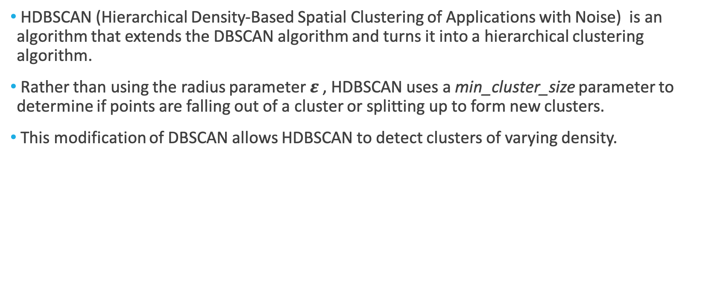
HDBSCAN Explained
HDBSCAN (Hierarchical Density-Based Spatial Clustering of Applications with Noise) is an algorithm that extends the DBSCAN algorithm and turns it into a hierarchical clustering algorithm.
Rather than using the radius parameter $ε$ , HDBSCAN uses a min_cluster_size parameter to determine if points are falling out of a cluster or splitting up to form new clusters.
This modification of DBSCAN allows HDBSCAN to detect clusters of varying density.

Slide 18
Step 4: Assigning Topics to Clusters

Slide 19
Interpreting Topics
Once we have clusters, we can use our own human interpretation to give names to each of the topics, represented as sets of keywords that are most likely to occur.
“We are now in the World Cup finals…
kick
penalty
soccer
team
goal
speed

Slide 20
Practical Example in Python

Slide 21
Installing Top2Vec and Setup
We can use a library called Top2Vec to actually use the Top2Vec algorithm in Python. To install this library make sure you have pip and run the following command:
pip install top2vec[sentence_encoders]
This command will install Top2Vec with the pre-trained universal sentence encoders required to follow along with the the practical tutorial in this talk.
You can find the code for this practical tutorial at https://github.com/AmolMavuduru/Top2Vec-Tutorial

Slide 22
Closing Notes
Feel free to connect with me on LinkedIn or read my blog on Medium!
LinkedIn: https://www.linkedin.com/in/amol-mavuduru-815736129/
Medium: https://medium.com/@amolmavuduru

