Slide 1
Stock Market Dashboard
Here is where your presentation begins

Slide 2
Problem Statement
Investors, traders, and financial analysts often struggle to efficiently track and analyze stock market data from various sources. They need a centralized platform that provides real-time updates, historical data analysis, and customizable features to suit their investment strategies.

Slide 3
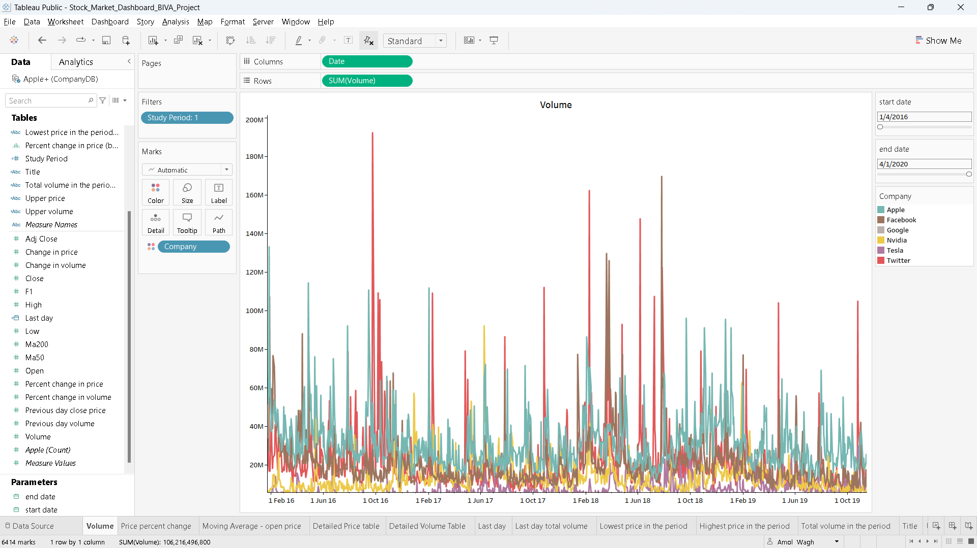
Volume with dates

Slide 4
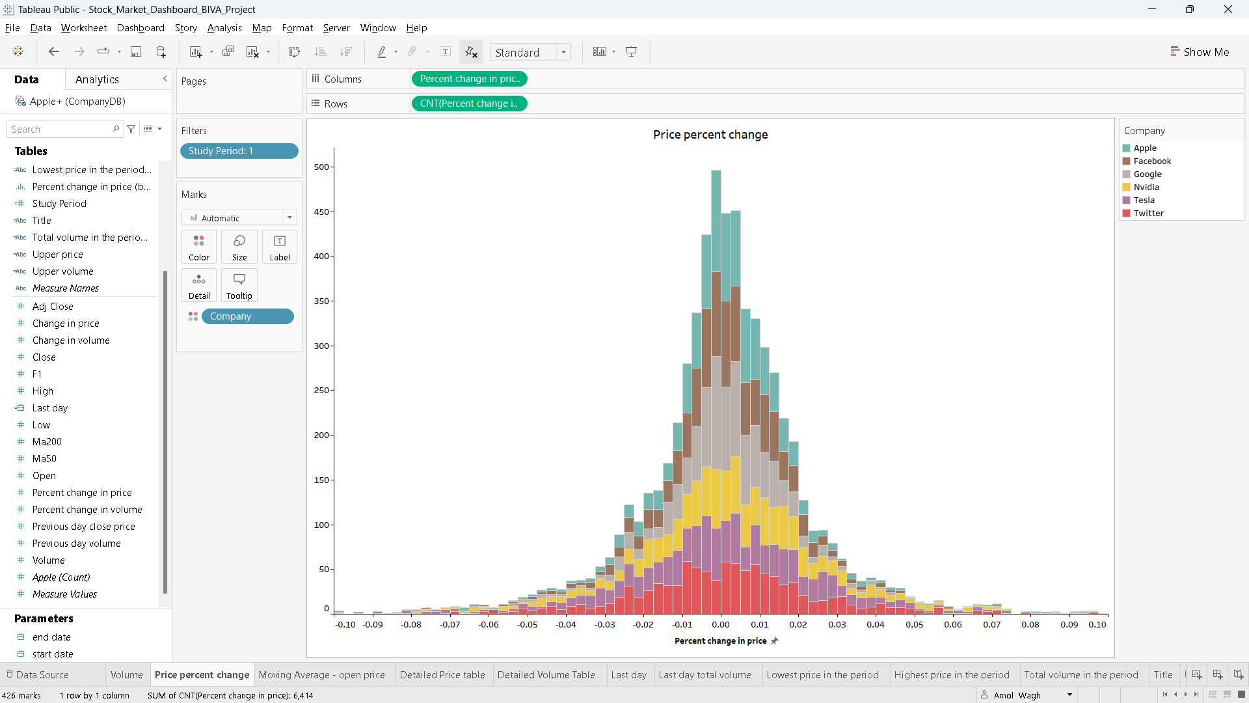
Price percent change

Slide 5
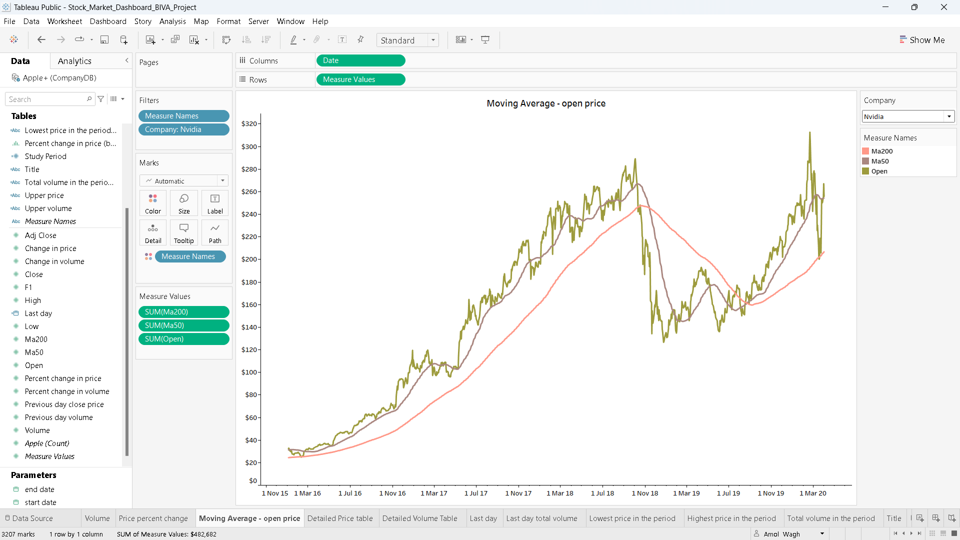
Moving Average – open price

Slide 6
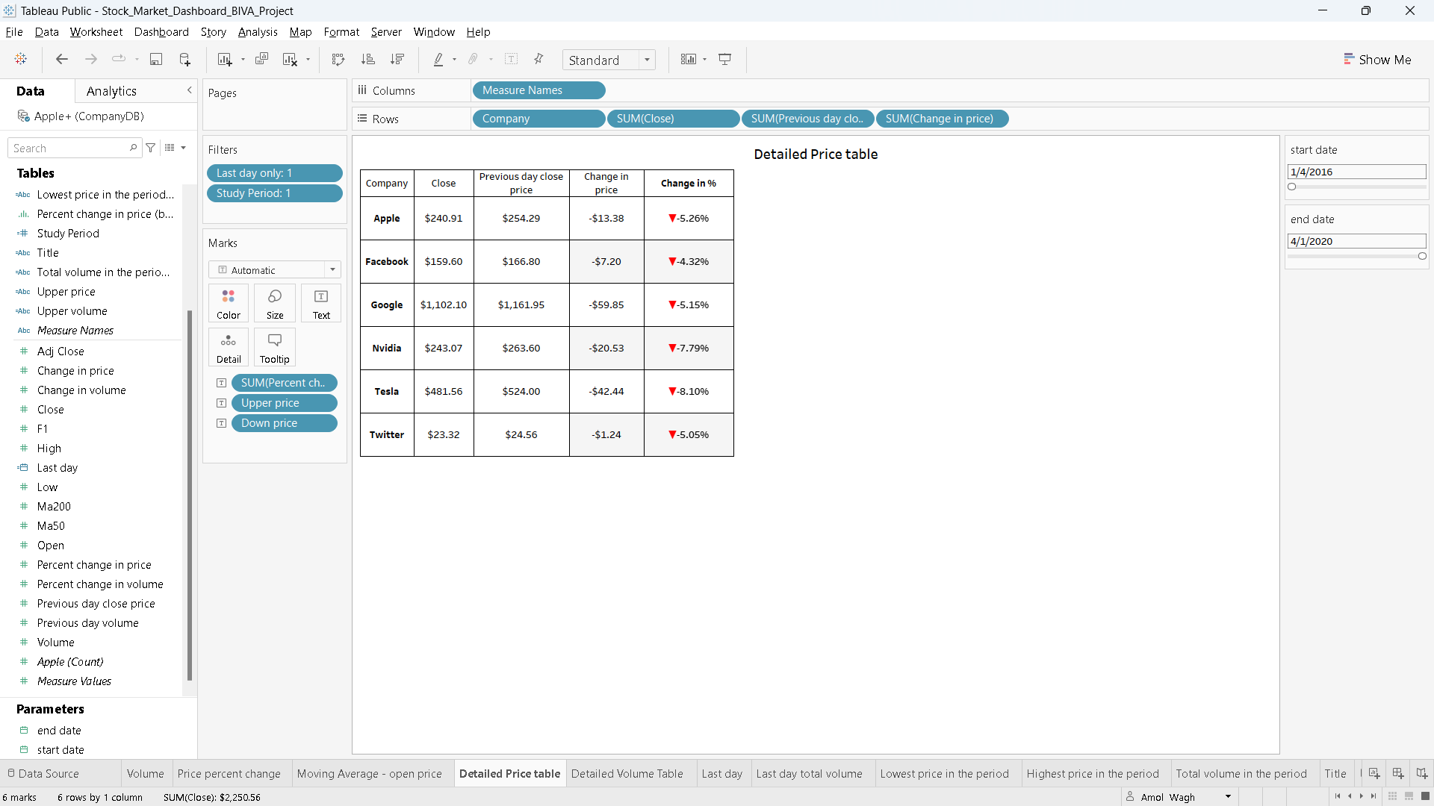
Detailed price table

Slide 7
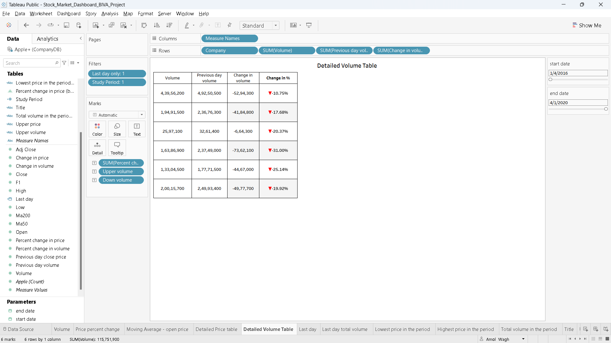
Detailed volume table

Slide 8
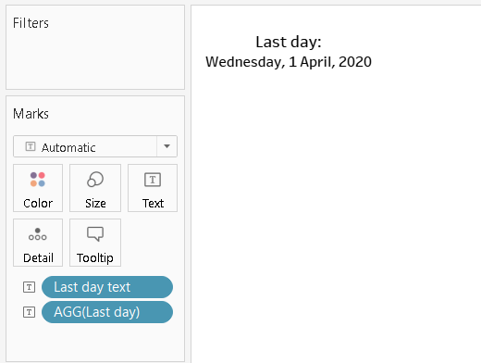
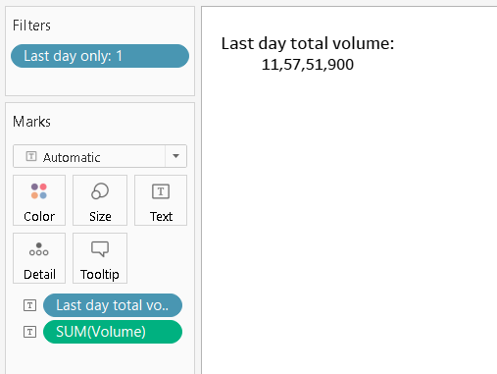
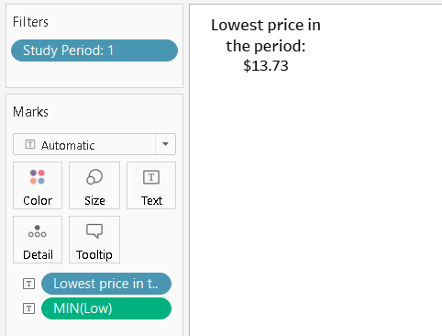
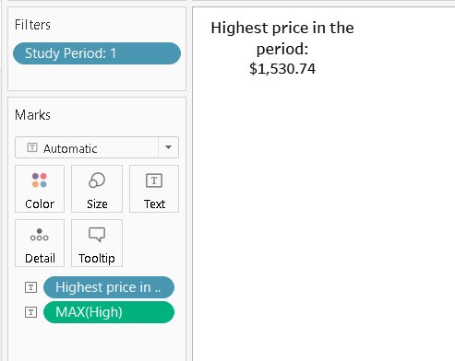
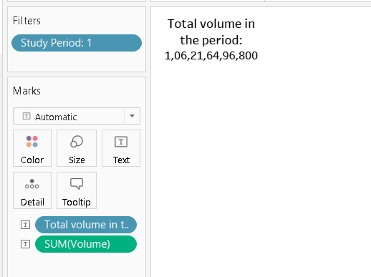
Other highlights of data

Slide 9
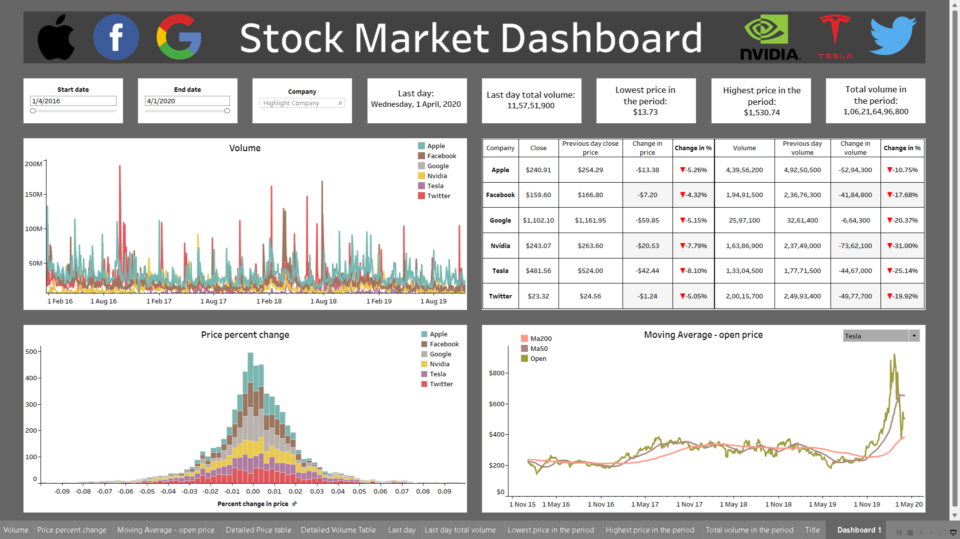
Dashboard

Slide 10
Conclusions
the Market Insights Dashboard offers a comprehensive solution for investors, traders, and financial professionals to efficiently track and analyze stock market data. With real-time updates, historical analysis tools, customizable features, and revenue streams from subscriptions, advertising, data licensing, and consulting services, the dashboard provides value and convenience to users while positioning itself for sustained growth in the financial technology sector.

Slide 11
Thanks!

