Slide 1
Feature importance

Slide 2
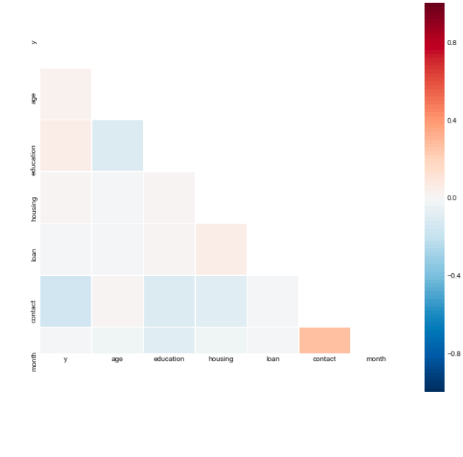
Relation between different features
The lighter the color, the less relevant the feature is.
The correlation between the selected features should be as low as possible

Slide 3
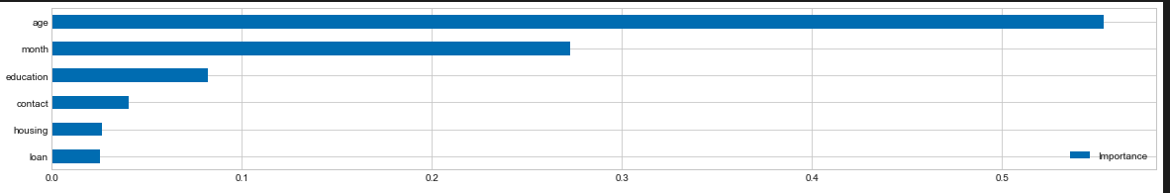
Random forest to choose features
For each tree, compute the OOB error
Add noise ,computer the OOB error again.
the importance for feature X = ∑ (errOOB2-errOOB1) / Ntree

