Slide 1
Strings

Slide 2
Introduction
Strings are array of characters i.e. they are characters arranged one after another in memory. Thus, a character array is called string.
Each character within the string is stored within one element of the array successively.
A string is always terminated by a null character (i.e. slash zero \0).

Slide 3
Arrays and Strings…
Operations performed on character strings include:
Reading and writing strings
Copying one string to another
Combining strings together
Comparing strings for equality
Extracting a portion of a string

Slide 4
A string variable is declared as an array of characters.
Syntax:
char string_name[size];
E.g. char name[20];
When the compiler assigns a character string to a character array, it automatically supplies a null character (‘\0’) at the end of the string

Slide 5
Initializing String Variables
Strings are initialized in either of the following two forms:
char name[4]={‘R’,‘A’,‘M’, ‘\0’};
char name[]={‘R’,‘A’,‘M’, ‘\0’};
char name[4]=“RAM”;
char name[]=“RAM”;
When we initialize a character array by listing its elements, the null terminator or the size of the array must be provided explicitly.
R | A | M | \0
name[0] | name[1] | name[2] | name[3]

Slide 6
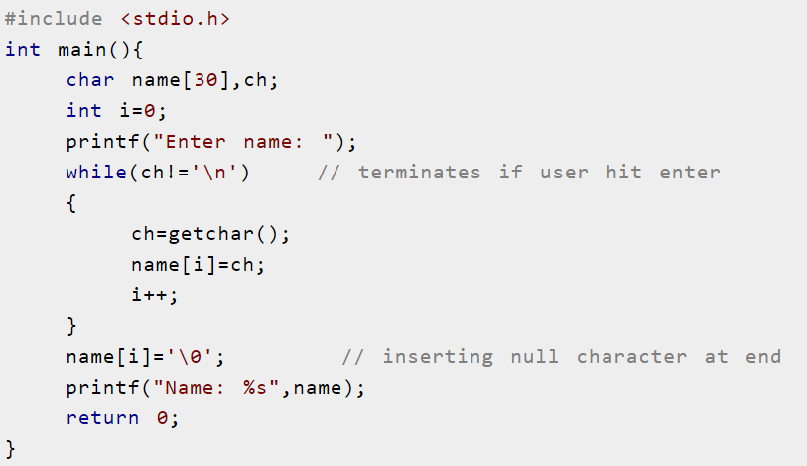
Reading and displaying Strings
It can be done manually.

Slide 7
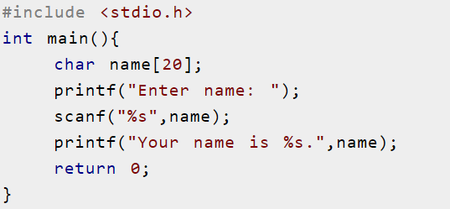
Using printf() and scanf()

Slide 8
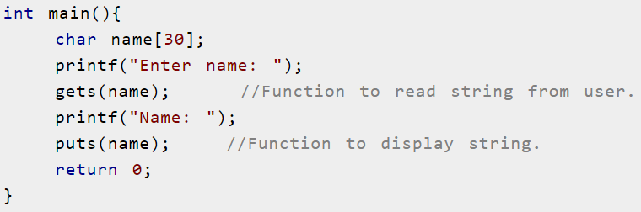
Using gets() and puts()

Slide 9
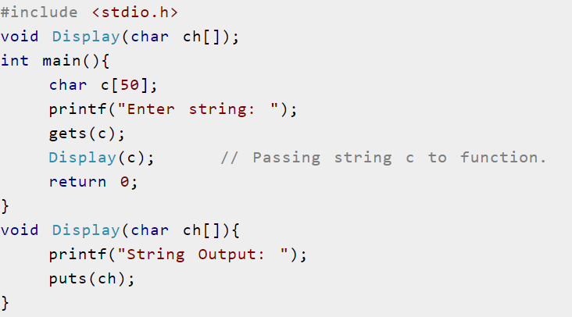
Passing String to function

Slide 10
String handling functions
Strings need to be manipulated by programmer.
It can be done manually but is time consuming.

Slide 11
Counting length of the string
#include <stdio.h>
#include <conio.h>
void main()
{
char input_string[50];
int i=0, length=0;
clrscr();
printf("\nEnter your text:\t");
gets(input_string);
while(input_string[i]!='\0')
{
length++;
i++;
}
printf("\nThe length of your text is: %d character(s)", length);
getch();
}

Slide 12
Copying one string to another
#include <stdio.h>
#include <conio.h>
void main()
{
char copy[50], paste[50];
int i;
clrscr();
printf("\nEnter your name (to copy):\t");
gets(copy);
for(i=0;copy[i]!='\0';i++)
{
paste[i]=copy[i];
}
paste[i]='\0';
printf("\nThe name is (pasted as):\t");
puts(paste);
getch();
}

Slide 13
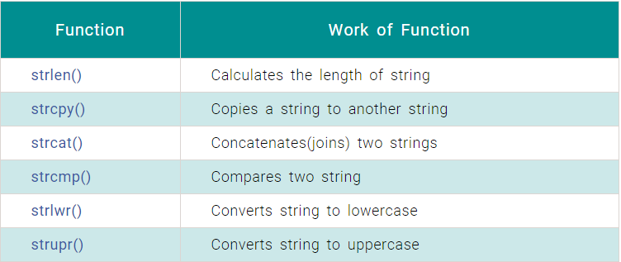
There are various string handling functions define in string.h some of them are:

Slide 14
void main()
{
char input_string[50];
int length;
clrscr();
printf("\nEnter your text:\t");
gets(input_string);
length=strlen(input_string);
printf("\nThe length of your text is: %d character(s)", length);
getch();
}

Slide 15
void main()
{
char copy[50], paste[50];
int i;
clrscr();
printf("\nEnter your name (to copy):\t");
gets(copy);
strcpy(paste, copy);
printf("\nThe name is (pasted as):\t");
puts(paste);
getch();
}

Slide 16
void main()
{
char first_name[30]=“College " ;
char middle_name[]=" of Applied";
char last_name[]=" Business";
clrscr();
strcat(first_name,middle_name);
puts(first_name);
strcat(first_name,last_name);
puts(first_name);
getch();
}

Slide 17
void main()
{
char str1[30],str2[40];
int diff;
clrscr();
printf("Enter first string:\t");
gets(str1);
printf("\nEnter second string:\t");
gets(str2);
diff=strcmp(str1, str2);
if(diff>0)
printf("\n%s is greater than %s by ASCII value difference %d", str1, str2, diff);
else if(diff<0)
printf("\n%s is smaller than %s by ASCII value difference %d", str1, str2, diff);
else
printf("\n%s is same as %s", str1, str2);
getch();
}

Slide 18
void main()
{
char string[25];
clrscr();
printf("\nInput string to be reversed:");
gets(string);
strrev(string);
printf("\nThe reversed string is: %s", string);
getch();
}

Slide 19
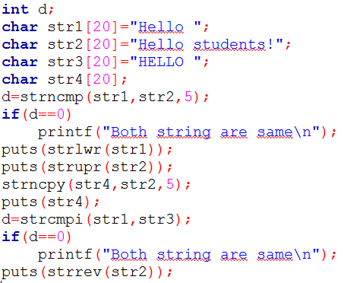
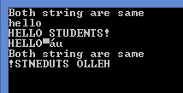
Output:

Slide 20
Arrays of Strings
String is array of characters.
Thus an array of string is 2-D array of characters.
E.g.
char names[5][10];
Here, names[5][10] means 5 names having 10 characters each.

Slide 21
Classwork
WAP to read name of 5 persons using array of strings and display them
WAP to sort name of 5 persons in alphabetical order

Slide 22
void main()
{
char names[5][10];
int i;
clrscr();
printf("\nEnter name of 5 persons:");
for(i=0;i<5;i++)
scanf("%s", names[i]);
printf("\nThe names are:");
for(i=0;i<5;i++)
printf("\n%s", names[i]);
getch();
}

Slide 23
void main()
{
char names[5][10],temp[10];
int i, j;
clrscr();
printf("\nEnter name of 5 persons:");
for(i=0;i<5;i++)
gets(names[i]);
for(i=0;i<5;i++)
{
for(j=i+1;j<5;j++)
{
if(strcmp(names[i], names[j])>0)
{
strcpy(temp, names[i]);
strcpy(names[i], names[j]);
strcpy(names[j], temp);
}
}
}
printf("\nNames in ascending order:\n");
for(i=0;i<5;i++)
puts(names[i]);
getch();
}

