Slide 1
JavaScript hoisting

Slide 2
What is HOISTING ?
In JavaScript, Hoisting is the default behavior of moving all the declarations at the top of the scope before code execution.
Hoisting is a JavaScript mechanism where variables and function declarations are moved to the top of their scope before code execution.

Slide 3
Variable hoisting
Variable declarations will be hoisted/moved at the top of the scope before code execution. Assignments will not be moved, they will be left in place.
Example: Using Var
console.log(num); //undefined
var num = 10; //declaration and assignment

Slide 4
Example: Using Let & Const
console.log(num);
//Uncaught ReferenceError: Cannot access 'num' before initialization
let num = 10; //declaration and assignment
In case of let and const, hoisting is not valid.

Slide 5
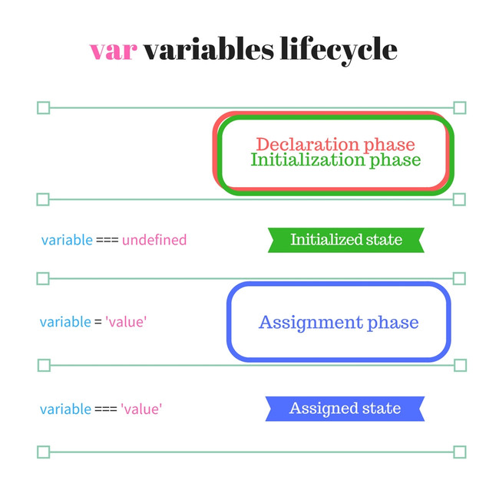
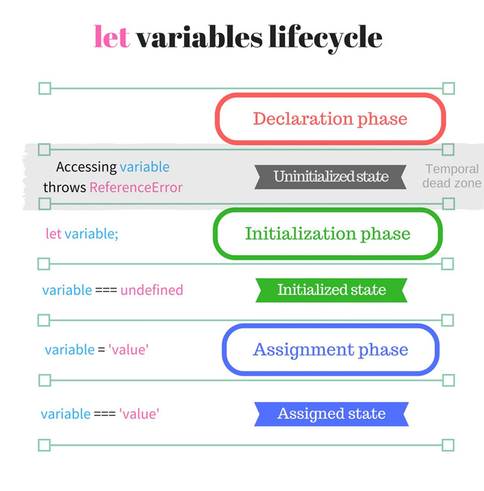

Slide 6
Function Hoisting
Function declarations will be hoisted, but not function expressions.
JavaScript functions can be classified as the following:
Function declarations
Function expressions

Slide 7
Function Declaration
hoisted(); // Output: "This function has been hoisted."
function hoisted() {
console.log('This function has been hoisted.');
};

Slide 8
Function Expressions
hoisted();
// Output: Uncaught TypeError: hoisted is not a function
var hoisted = function () {
console.log('This function has been hoisted.');
};

Slide 9
Thank You

