Slide 1


STCL
Amazon Web Services
Domain –Cloud computing
Presented by
Amol Dhawale
Under guidaance of
Prof.A.A.Bhise

Slide 2

Contents:
Introduction
Motivation
Literature survey
cloud computing and its Feature
cloud computing models
Cloud services provider
What is AWS
Benifits of uses AWS
AWS region and avability zone
AWS core Services

Slide 3
Contents:
Load elastic services
Storage services
AWS Security services
AWS Database services
AWS networking services
AWS Career
Diadvantages of AWS
conclusion
references

Slide 4

INTRODUCTION:
Generally cloud computing is fasted growing technology in world . There are diffrent cloud povider like Amazon web services,Microsoft Azure,IBM cloud services,Google cloud platform. AWS is one of most popular service .AWS provide the platform where user can get requirement whatever he want. It provide different services like compute,storage,security,database,networking,DevOpstetc.

Slide 5
Motivation:
According to linkdien 600000+ job appochunity available in cloud computing
increase the flexibility of storage
Easily recover the data
Easy access to the data
secure and protected
no maintaince required

Slide 6
Literature survey:
Sr.no | Name | Description | Problem Found
1 | Toward Cloud Computing Reference Architecture | In this paper they have foced on architecure of cloud computing. how cloud computing work exactly | only basic information given | .
2. | Evaluation of Highly Reliable Cloud Computing | In this paper they have foced on Evaluation of cloud. it describe the history of the cloud computing.when it come in market and people use it | No prediction of future result.

Slide 7
Sr.no | Name | Description | Problem Found
3. | Utilising Amazon Web Services to provide an on demand urgent computing facility for climateprediction.net | In this paper they have focused on urgent depmand computing facility for climatepredicion.net climateprediction.net volunteer computing project to investigate and reduce uncertainties in climate modelling | No deep analysis of result | .
4. | Evaluating Caching and Storage Options on the Amazon Web Services Cloud | In this paper they have focued on Evaluation of AWS it describe the Evaluation of AWS and different services provide by AWs | No prediction of future result
5. | Comparison of the IoT Platform Vendors, Microsoft Azure, Amazon Web Services, and Google Cloud, from Users’ Perspectives | In this paper they have focuse on the diffrent cloud platform and comparision of this platform mostly focus on the users prespective how easily can use it and provide better enviroment | only collection of all topic provided | .

Slide 8

Cloud Computing
Cloud computing enables on demand services like computation,storage ,networking etc. Which can access through internet user not requied to manage this services.
e.g AWS,ServerSpace ,IBM Cloud etc.

Slide 9




Feature of cloud computing
Scalable
Pay as you go
Flexible
Secure and Disaster Recovery

Slide 10
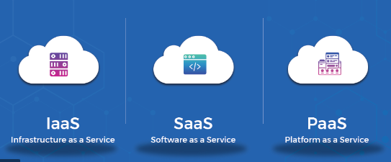
Cloud computing model
Cloud providing the services in diffrent form they are following
IaaS
PaaS
SaaS

Slide 11
Cloud Service provider
Amazon Web services
IBM Cloud
Google Cloud Platform
Microsoft

Slide 12
Amazon Web Service
AWS first start in 2004 with few services
AWS is cloud service provider which provide services like storage,security,netwoking etc.
AWS services are smooth and finised
It provide 200+ services
It uses the share security model
AWS enables you to select the operating system, programming language, web application platform, database, and other services you need

Slide 13
Benifits of uses AWS
It help Everyday life activities such as Banking, Email, Media Streaming, and Ecommerce all use the Cloud.
cost effective
security
Avaibility and disaster recovery
Easy to use
Flexible

Slide 14
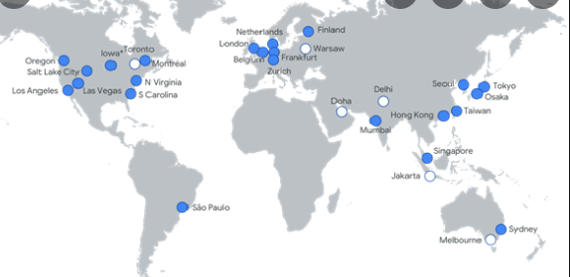
AWS REgions and availability zone

Slide 15
AWS REgions and availability zone
The AWS Cloud spans 87 Availability Zones within 27 geographic regions around the world, with announced plans for 21 more Availability Zones and 7 more AWS Regions in Australia, Canada, India, Israel, New Zealand, Spain, and Switzerland.

Slide 16
AWS Core services
AWS provide some core services they are following
Elastic load balance
Networking
Management
tool
security
storage
Database
migration
Analysis

Slide 17
Elastic load balance
It is a load balancing service which distribute the incoming traffic accross several target such as Amazon EC2 instances,Lambda function container and range of IP address in multiple availability zone
It automatically scale the incoming traffic
improve overall performace of application
increase the availability
There are diffrent types of load balances
classic load balances
network load balances
Application load balances

Slide 18
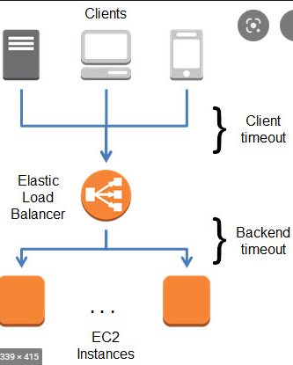
Elastic load balance

Slide 19
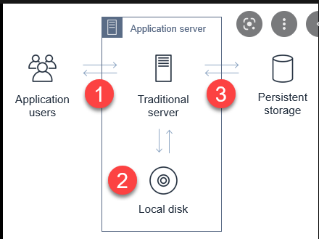
AWS Storage services
AWS cloud storage is an online storage available as a network and is provider to consumer over a network as storage as a service
Data backup
Application data
messaging data
multi-media
e.g facebook,instagram,gmail
etc

Slide 20
AWS Security services
AWS offers shared security model to consumer.That means AWS control the some security aspects and some are controlled by you as consumer .
As consumer you get to control identify access management asepts of security
Lets us take look at some of security services out of there
AWS IAM
AWS shield
AWS trusted advisor

Slide 21
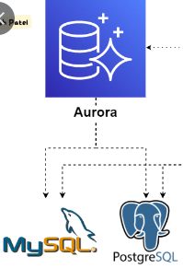
AWS DATABASE services
Amazon Aurora
It is compatible with mysql and postgreSQL database
high performance and
high avaibality just like enterprise database
very cost effective
simple in nature open source database

Slide 22
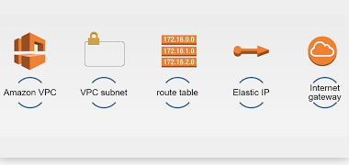
AWS Networking services
We know cloud connect the data and application around the world that is way it is very improtant put this data in this application and these application these network. AWS provide series of Services that provide better network feature , security and connetivity

Slide 23



AWS career
Cloud Architect
Cloud Developer
Cloud Administor

Slide 24
Aws disadvantages
Internet connectivity
Variation of cost
Affect of speed
Aggrements
Lower bandwidth
sometimes Laks of supports

Slide 25
Conclusion
This presentation concluded various aspets that are realted Amazon web services
This presentation describe the benefits of the cloud amazon web services
it describe the diffrent services provided by the AWS

Slide 26
References:
V. Josyula, M. Orr, and G. Page, Cloud Computing: Automating the Virtualized Data Center, Cisco Systems, Inc., Indianapolis,
USA, 2011.
2. https://www.ieee.org/
3. CCRA Team and M. Buzetti, “Cloud Computing Reference
Architecture 2.0: Overview”, IBM Corporation, 2011.
4. D.C. Plummer and L.F. Kennedy, “Three types of cloud
brokerages will enhance cloud service,” Gartner Special Report
on Cloud Computing, November 2009

Slide 27
thank you…

