Slide 1

Manufacturing Company
Presented By Group No.1 1. Apurva Salunkhe 2. Rachana Ketkar 3. Amol Patil 4. Aarthi Vikraman 5.Maitri Kulkarni 6. Jayesh Gurav 7. Naveen H

Slide 2

Introduction about Manufacturing company
The manufacturing industries convert raw materials into finished goods. This industry makes use of machinery or labor to manufacture finished goods. The economic strength of a nation is measured by the development of manufacturing industries.
About 75 % for industry are in loss due to not analyzing of data properly , However analysis and use of Data in manufacturing has enabled manufacturers to make data-driven decisions that can drive growth and profitability.
A study by McKinsey found that companies proficient in using data analytics are 23% more likely to achieve above-average profitability.

Slide 3

List of KPI’s
Manufacture Qty
Rejected Qty
Processed Qty
Wastage Qty
Employee Wise Rejected Qty
Machine Wise Rejected Qty
Production Comparison trend
Manufacture Vs Rejected
Department Wise Manufacture Vs Rejected
Delivery Period wise Qty
Operation Wise manufactured VS Total Qty
Day Wise Avg Balance

Slide 4
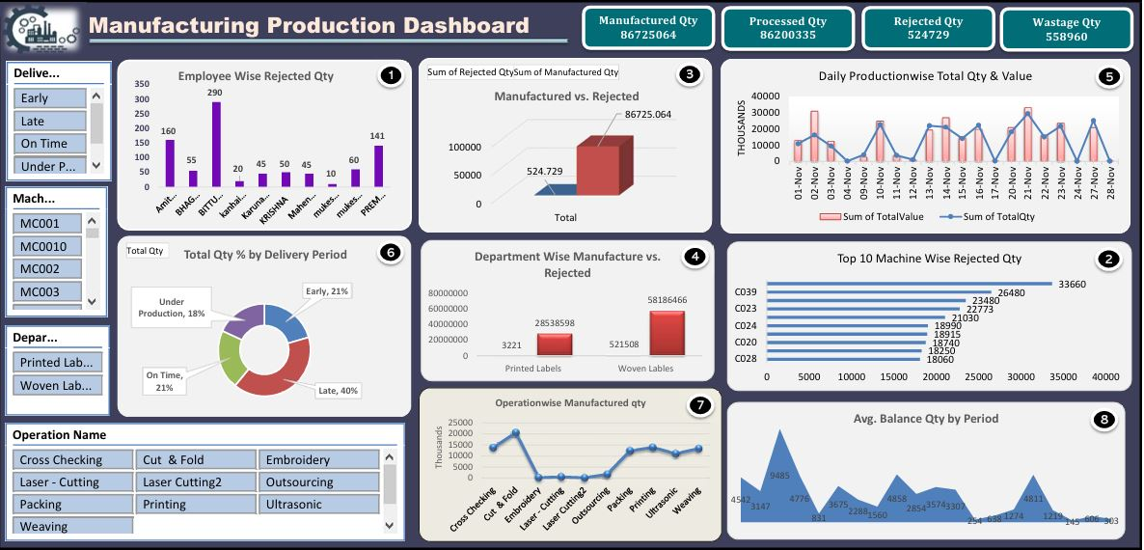
Dashboard- Excel

Slide 5
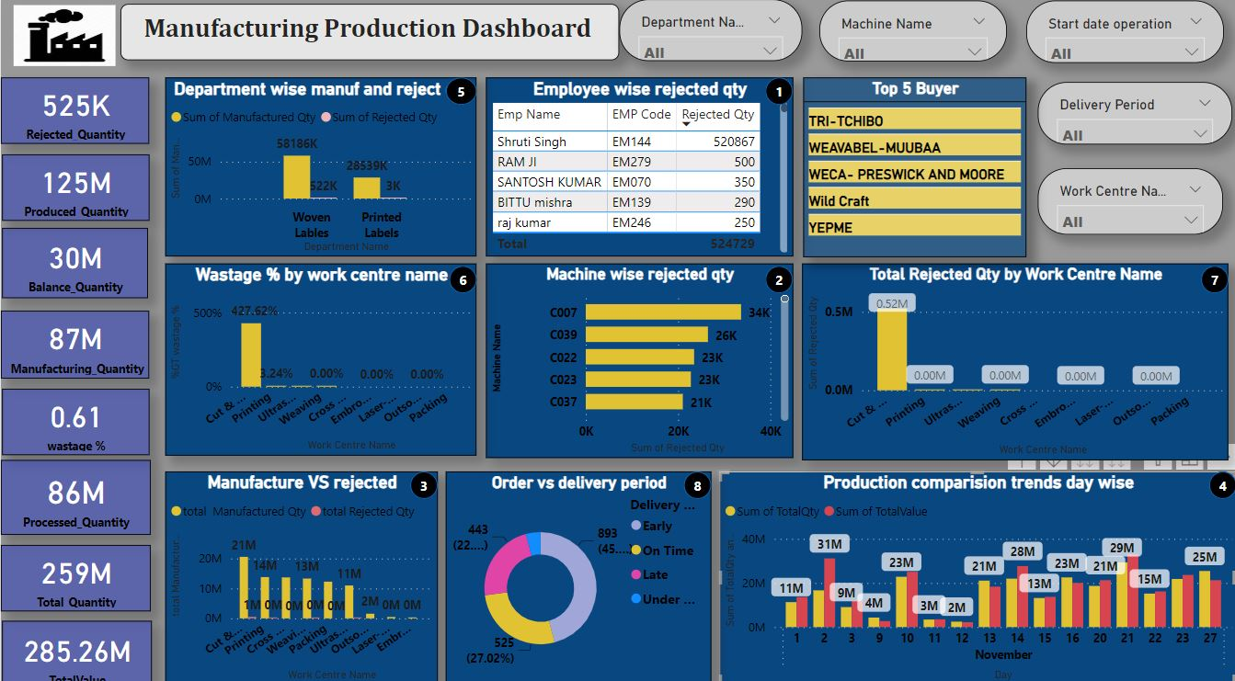
Dashboard- Power Bi

Slide 6
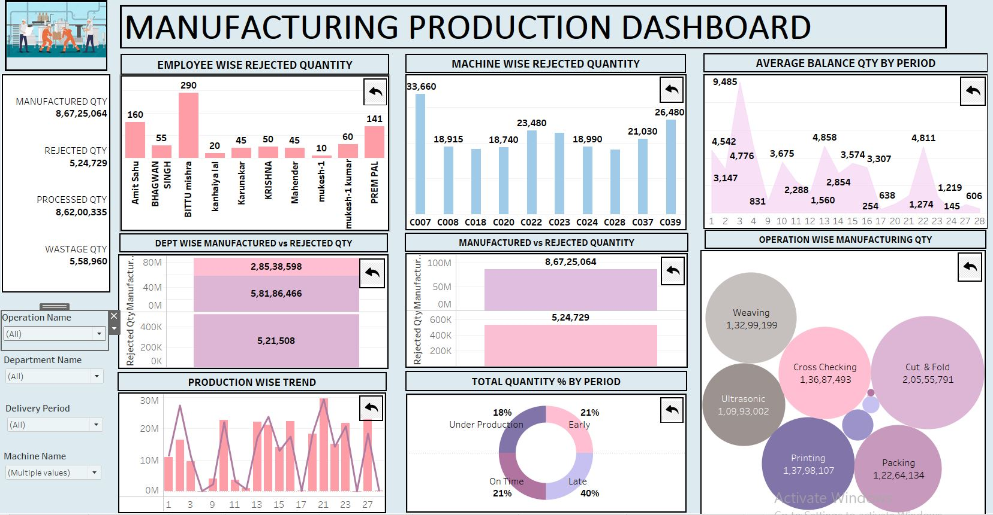
Dashboard- Tableau

Slide 7
Challenges
Null Value
Duplicate values
Merging Datasets of different formats
Column Formatting

Slide 8
KPI Outcome
Manufacturing production analysis KPIs showed 86,725,064 units manufactured, 8,620,335 processed, with 524,729 rejected and 558,960 wasted.
Net production yield = 86725064-524729
(86200335)
Rejection quantity is lower than Manufacturing qty hence good product quality was maintained which ensure optimise process and minimum wastage .
In the production comparison trend, the highest value of 31 million units was recorded on November 2nd, while the lowest value of 2 million units was observed on November 12th.
The total quantity distribution by period reveals that 21% were delivered early, 40% were delivered late, 21% were delivered on time, and 18% remained under production.
With maximum of 20555791 manufactured quantity, we could see count of 13798107 of manufactured quantity in printing , 13687493 of manufactured quantity in cross checking, 13299199 of manufactured quantity in weaving, 12264134 of manufactured quantity in packing, 10993002 of manufactured quantity of Ultrasonic operation .
In the comparison between manufactured and rejected quantities, the Department of Printed Labels produced 28,538,598 units, with only 3,221 units rejected. Meanwhile, the Department of Woven Labels manufactured 58,186,466 units, experiencing a rejected quantity of 521,508 units.
In the manufacturing process, Employee Bittu Mishra recorded the highest rejected quantity of 290 units, while Mukesh-1 had the lowest at just 10 units. Where as Machine C007 recorded the highest rejected quantity of 33660 units, while C028 had the lowest at just 18060 units

Slide 9
Project Conclusion
Running an efficient plant is crucial to stay competitive in today's fast-paced manufacturing world. This overview of innovative manufacturing dashboard highlights the importance of utilizing data to achieve operational excellence. Every KPI provides valuable insights that enhance performance by improving equipment effectiveness, production efficiency, quality control, and supply chain operations. Employing powerful analytics tools can assist manufacturing companies in boosting production efficiency and product quality. By leveraging manufacturing data analytics, businesses can determine the required production volume to meet market demand, resulting in overall performance optimization.

