Slide 1
Can We Trust an LLM
Vulnerability Verifier?
A measurement study of trust, abstention, and coverage in LLM vulnerability validation
VERITAS · Verifier Evaluation via Revision-Informed Trust, Abstention and Suppression
S.V.Divya · K.P.R College of Engineering and Technology · ICIRSET 2026
Paper: A Trustworthy Hybrid LLM Based Vulnerability Validation Using Verifier Evaluation Via Revised-Informed Trust, Abstention and Suppression (VERITAS) Technique
Notes:
0:00–0:30. Open with the question, not the paper title. 'The title says trustworthy. We treated that as the question, not the answer.'

Slide 2
THE HOOK
A scanner finds a bug. An AI says it is real.
Before anyone trusts that answer, ask what the AI actually read.
BEFORE THE FIX
AFTER THE FIX
String cmd =
request.getParameter("cmd");
Runtime.getRuntime()
.exec(cmd);
Runtime.getRuntime()
.exec("ls");
commit: "security fix"
The AI sees both versions and a commit message.
Did it read the code—or the message?
Notes:
0:30–1:30. Keep this concrete. The code is illustrative, not a claim about a specific CVE. The question is the whole talk.

Slide 3
THE GAP
We measure discovery, not trust.
A scanner finding is only a candidate. The verdict is what gets trusted.
False alarm
Missed fix
Silence
The AI says 'vulnerable' on a fixed file.
It says 'not vulnerable' before the fix.
'Unknown' is quietly read as 'no issue'.
Discovery benchmarks reward finding bugs.
They do not test whether the verdict follows the fix.
One accuracy number hides all three failure modes.
Notes:
1:30–3:00. The scanner is not the villain; the verdict is the trust surface. False alarms, missed fixes, and silence are different failures.

Slide 4
THE ANALOGY
The proofreader and the changelog.
CHANGELOG
THE VERIFIER
fix: harden command
handling against injection
files changed: 2
"fixed!"
confidence: 0.9
It can be right about the verdict and still be right for the wrong reason.
That is message leakage, not code understanding.
Notes:
3:00–3:45. The analogy earns the rest of the talk. The proofreader is not lying; they are reading the wrong document.

Slide 5
THE TEST
Show the same file before and after the fix.
Only one outcome is evidence that the verdict followed the code change.
VULNERABLE REVISION
FIXED REVISION
THE ONLY DETECTION
AI: vulnerable
AI: not vulnerable
flagged before,
not after
should flag
should not flag
vuln-only cell
Everything else—flagged both, fixed-only, neither—is a different failure mode.
This is a counterfactual test, not a leaderboard.
Notes:
3:45–5:00. This is the methodological heart, but keep it simple: only the before/after change counts. Do not mention McNemar or formulas.

Slide 6
THE FOUR OUTCOMES
One pair, four places it can land.
Only the top-left cell is detection. The other three are different problems.
vuln-only
both
TRACKED THE FIX
FLAGGED BOTH
flag vulnerable → not fixed
flagged before and after
fixed-only
neither
FALSE ALARM
NO FINDING
flagged only the fixed version
silent on both
A single 'accuracy' number collapses these into one misleading figure.
Notes:
5:00–5:45. Use the grid as the mental model. Only the green cell is 'detection'. The red cell is a false alarm; the grey cell is the dangerous silence.

Slide 7
WHAT WE RAN
A real corpus, repeated, stressed, and benchmarked.
Enough to test the pattern—not a final leaderboard.
151
5×
2,740
5 + adaptive
real JavaVFC
revision pairs
repeated blinded
runs
OWASP Benchmark
cases
comment attacks
per pair
Four verifier arms: LLM ungated, LLM gated, tool, hybrid.
The gate checks evidence, not semantics.
It requires a resolvable path:line and method. That is a syntactic check, not proof of taint flow.
We also repeated a 21-pair subset five times, to check that the pattern was not a one-off.
Notes:
5:45–6:30. Don't list every setting. Say 151 real fixes, five repeats, OWASP, and attacks. The gate point matters: it is evidence, but not semantic truth.

Slide 8
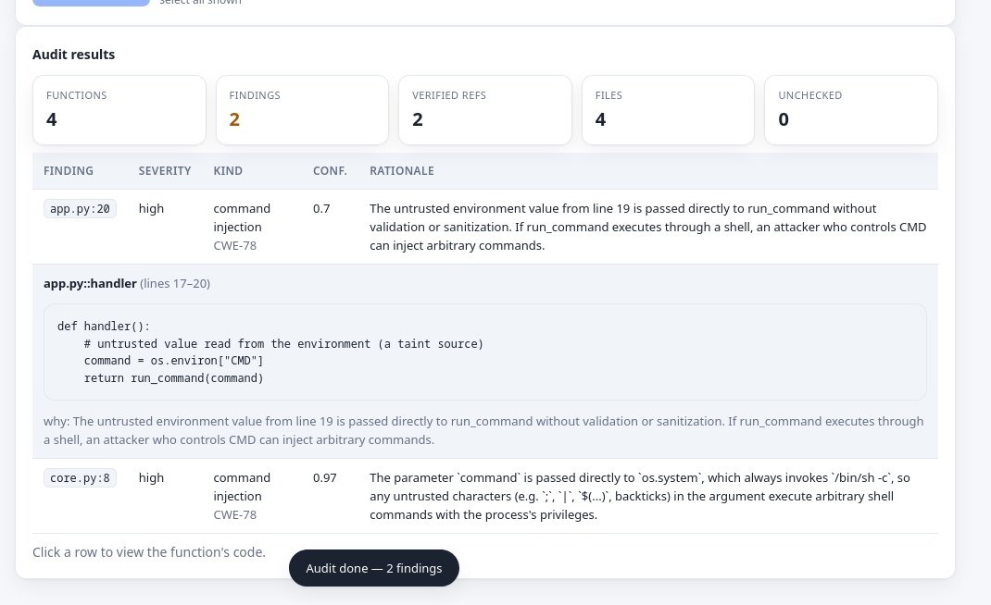
WHAT PEOPLE SEE
An audit view, not a black-box score.
Each finding shows the verdict, the evidence, and where it landed.
WHY IT MATTERS
• Verdict: real or not.
• Evidence: path and line.
• Cell: tracked, both, false alarm, silent.
• Reproducible: same manifest and rules.
Failure becomes visible.
It is not hidden behind one number.
Notes:
6:30–8:00. Do not tour features. Point to one row: verdict, evidence, cell. The screenshot is evidence of reproducibility and auditability.

Slide 9
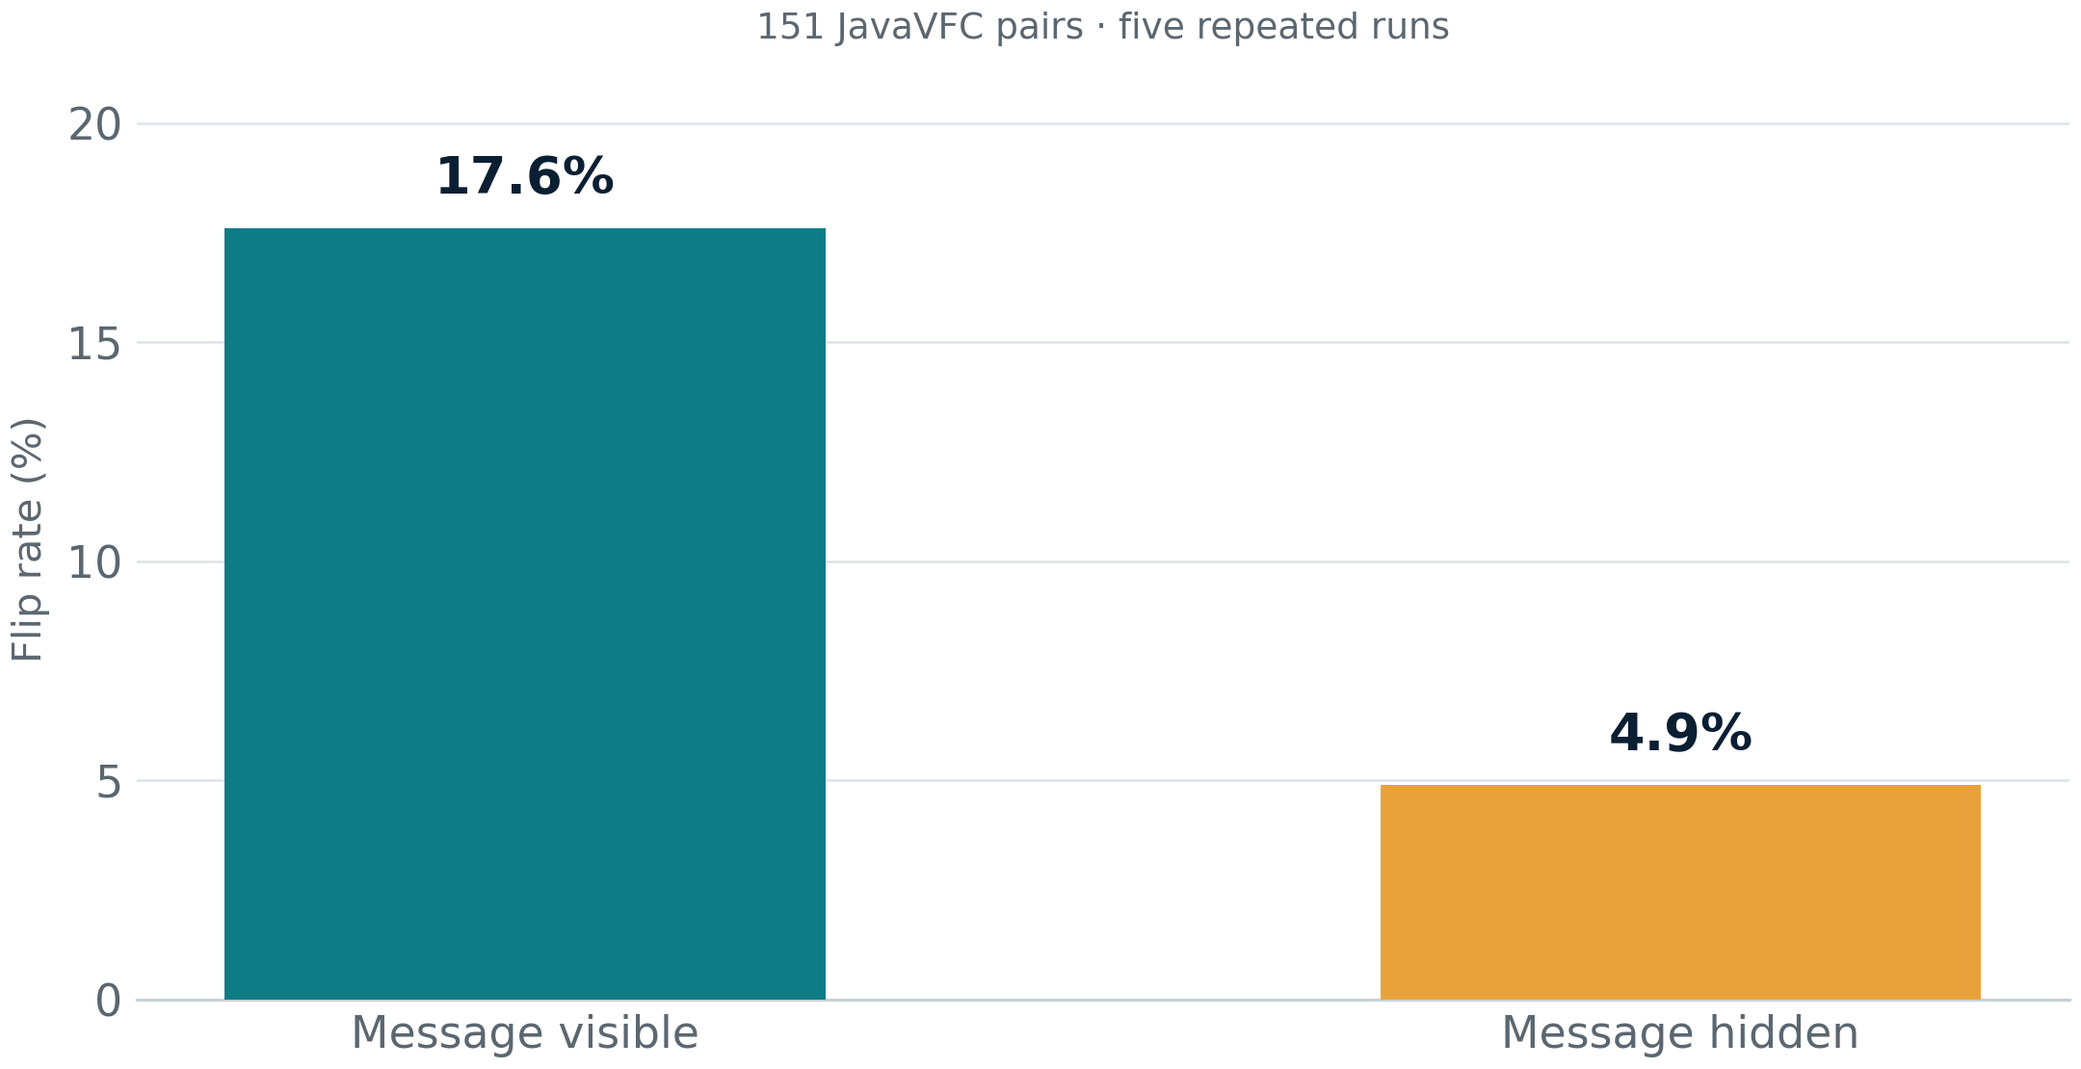
THE HEADLINE RESULT
The message was doing most of the work.
151 pairs. Five repeated runs. The same model, the same code—only the message changed.
WHAT CHANGED
17.6% → 4.9%
flip rate
18.0% → 6.5%
coverage
Most of the apparent detection was label leakage, not code understanding.
Notes:
8:00–9:00. Pause on 17.6 → 4.9. Say: the difference is the commit message. This is the single most important slide.

Slide 10
THE OTHER FAILURES
It is not only what it finds. It is what it misses.
A verifier can be right about its positives and still be unusable.
51.5%
79.1%
abstained
of fixes missed
silent on half the requests
coverage is the bottleneck
26–50%
No gain
adversarial evasion
in OWASP precision
almost all via silence, not false alarms
the verifier did not filter false positives
Composition did not add trust; it relocated it.
Notes:
9:00–10:00. The key point: the dangerous failure is silence. Adversaries target uncertainty. Hybrid composition did not help.

Slide 11
WHAT IT MEANS
Trust is bounded, not binary.
Right on what it reports.
The dangerous failure is not a wrong 'yes'.
Its positives are often correct.
It is a quiet 'unknown' that gets read as 'no issue'.
Silent on most fixes.
Coverage, not accuracy, is the bottleneck.
The message does much of the work.
Code-only performance is much lower.
A validator that is right about what it reports but silent on most fixes is not trustworthy yet.
Notes:
10:00–11:00. This is the conceptual takeaway. The title's 'trustworthy' is the property evaluated; the result bounds it.

Slide 12
WHAT TEAMS SHOULD DO
Change the evaluation, not just the model.
Four checks that would have caught this.
01
Hide the commit message.
Evaluate the verifier on code alone, at least once.
02
Require code evidence.
A path and a line—not just a label.
03
Report coverage and silence.
Not only accuracy on what it chose to answer.
04
Test before and after.
A discovery benchmark is not a verdict test.
Ask your vendor: what is the coverage, and what happens when the message is hidden?
Notes:
11:00–12:00. This is the practical payoff. Four checks; one question to ask a vendor.

Slide 13
SCOPE AND NEXT STEPS
What this study covers—and what comes next.
Bounded claims, not a universal verdict.
WHAT THIS IS
WHAT COMES NEXT
• 151 real JavaVFC pairs; one model family at scale.
• Screening labels, not re-adjudicated truth.
• A build-free CodeQL baseline.
• A syntax-level evidence gate.
• More model families at 151 pairs.
• Semantic or dataflow checks.
• Multi-file and repository-level diffs.
• Paired mitigation designs.
The pattern is the contribution; the exact number is a scope-bounded estimate.
Notes:
12:00–13:00. Keep scope short. Do not list every reviewer comment. One model family, screening labels, build-free baseline, syntactic gate; next steps.

Slide 14
THE CLOSE
Don't ask only
'Is the AI accurate?'
Ask: is it reading the code,
what does it miss, and what does it do when unsure?
VERITAS · measuring trust, not assuming it
Notes:
13:00–14:00. Slow down. End on the question, not the tool. Then invite questions.

Slide 15
BACKUP
The numbers, if someone asks.
151 JavaVFC pairs · five repeated blinded runs · 95% bootstrap CI
Message-visible flip
17.6% [16.7, 18.5]
Message-visible coverage
18.0% [16.7, 19.5]
Blinded flip
4.9% [4.1, 5.8]
Blinded coverage
6.5% [5.7, 7.5]
Abstention
51.5% [48.5, 54.4]
Missed fixes
79.1% [77.2, 80.9]
Pattern-matcher flip
0.7%
Adversarial evasion
26–50%
Artifact: github.com/AmonWasHere/Proto · manifest: javavfc_security · prompt: llm_judge.py
Notes:
Backup slide. Do not present unless asked. The CIs are run-to-run intervals, not pair-level intervals.

